Slide 1
Payroll Load Rates Calculation and 2019 Projections
FEBRUARY 23rd, 2018

Slide 2
UW Benefit Costs for 2016
Notes:
Numbers and Percentages to be updated……

Slide 3
UW Benefit Costs for 2017
Notes:
Numbers and Percentages to be updated……

Slide 4
UW Benefit Costs (2014 - 2017)
Notes:
Numbers and Percentages to be updated……

Slide 5
Payroll Load Rate High Level Description
Description:
The payroll load rate is the rate applied to all salary dollars in FAS which is intended to charge departments for the cost of employee benefits earned by their employees during that period.
The Formula:
The formula for calculating the payroll load rate is dictated by the Cost Allocation Services (CAS) of the Department of Health and Human Services.
The rate is calculated separately for eight different salary classes, in order to recognize the differing basket of benefits which are earned by various employee groups.
The payroll load rate is comprised of two components:
"Core" Rate Intended to charge out the estimated cost of employee benefits earned during a given pay period
"Prior Year Over/Under“
The add/subtract from the "core" rate that is intended to adjust for prior year over/under recoveries

Slide 6
PAYROLL LOAD RATE "CORE" COMPONENT OF THE RATE
Actual salaries and benefit costs from two years prior (and any other available information) are used to forecast salaries and benefit costs to be incurred during the payroll load period.
Forecast Benefits / Forecast Salaries = Payroll Load Rate
For example (Professional Staff):
Type of Benefit | Basis | 2017 Actual Dollars |  | 2019 Forecast Dollars
Healthcare | Contribution per FTE | $110,535,000 |  | $124,696,000
Social Security | Percent of Salary | 49,415,000 |  | 54,080,000
UWRP Retirement | Percent of Salary | 52,082,000 |  | 56,999,000
UWRP Supplemental | Annual required funding | 29,816,000 |  | 29,816,000
PERS Retirement | Percent of Salary | 19,752,000 |  | 24,208,000
Medicare | Percent of Salary | 12,242,000 |  | 13,397,000
Unemployment, Workers’ Compensation, etc. | Percent of Salary | 14,483,000 |  | 15,850,000
Total Benefit Dollars |  | 288,325,000 |  | 319,046,000
Total Salaries |  | 886,012,000 |  | 969,654,000
 |  | Professional “Core” Rate= |  | 32.9%

Slide 7
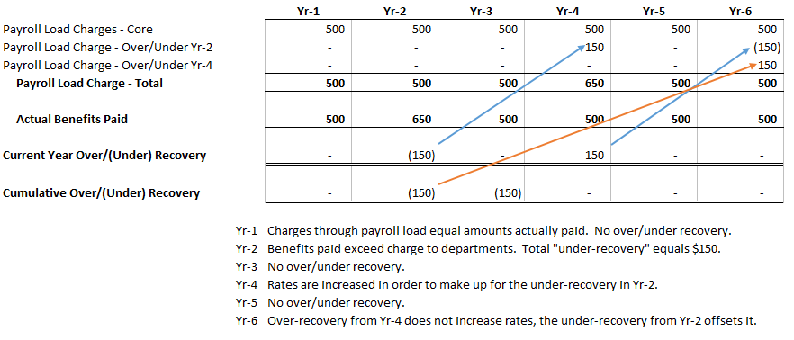
PAYROLL LOAD RATE "PRIOR YEAR OVER/UNDER" COMPONENT OF THE RATE
The purpose of the prior year over/under is to adjust current period rates for over/under recoveries experienced TWO years prior. To the extent that the prior year difference relates to an adjustment to the rates intended to recover a prior year difference, the impact is eliminated by bringing in the over/under from FOUR years prior.
Total "prior year over/under" impact on payroll load rates is the combination of these two items. For example:

Slide 8
Payroll Load Rate Impact on 2019 Estimated Rates
 |  |  | Change in Assumptions
Total Load Rate | 2019 (estimate) |  | Healthcare 2019 | Healthcare 2019 | PERS 2019 | PERS 2019 | Salary 2019
Classified | 40.3% |  | 39.8 | 41.8 | 39.6 | 40.6 | 40.8
Professional | 33.5% |  | 33.1 | 34.4 | 33.4 | 33.4 | 33.9
Faculty | 26.4% |  | 26.2 | 27.0 | 26.4 | 26.4 | 26.7
Cost Drivers | 2019 (estimate) |  | 2019 | 2019 | 2019 | 2019 | 2019
Health Care – Premium/FTE | $ 926 |  | 900 | 1000 | 926 | 926 | 926
PERS Retirement - % of Salary | 12.70% |  | 12.70% | 12.70% | 12.0% | 13.0% | 12.70%
Salary Assumption | Average 3% |  | 3.0% | 3.0% | 3.0% | 3.0% | Flat

