Slide 1
GCA UPDATE
MRAM
April 11, 2024
Juan Lepez, Director
Grant & Contract Accounting

Slide 2
AGENDA
Process Changes
Updates on Known Issues
New Grant Reports
Web Updates
Reminders
MRAM - Juan Lepez- Grant & Contract Accounting

Slide 3
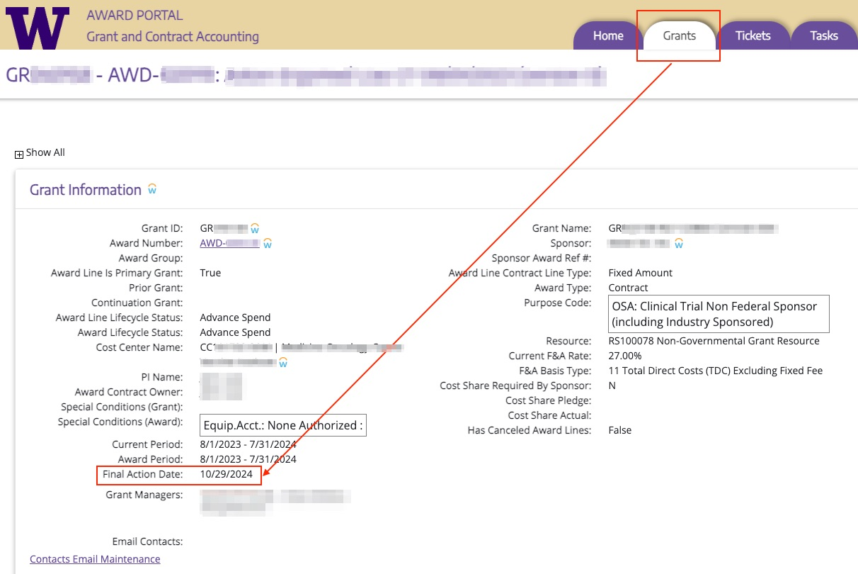
PROCESS CHANGES
New automated Workday lifecycle status change
Expired to Closeout in Progress
Started Monday April 8, 2024
Occurs Mondays
after Final Action Date
Reduces manual entry
for GCA and likelihood of
unallowable charges
posting
MRAM - Juan Lepez- Grant & Contract Accounting

Slide 4
PROCESS CHANGES
New Pending Adjustment Workday lifecycle status
Will exclude award line from automated status change from Expired to Closeout in Progress
Campus will need to send Award Portal ticket to request new status
Include reason to keep award line open
May need to include sponsor approval
Information about the automated status change and new status are available on GCA Closing Your Award webpage
MRAM - Juan Lepez- Grant & Contract Accounting

Slide 5
PROCESS CHANGES
Requesting changes to Workday Awards
SAGE GCA Only MOD with SAGE Budget
If request includes new award line
SAGE GCA Only MOD with no SAGE Budget
May require attaching new forms (e.g. rebudgeting)
Allows campus to include approvers if needed
Better workflow for requests to be sent directly to GCA Award Setup Team
Provides more accurate workload picture for GCA
MRAM - Juan Lepez- Grant & Contract Accounting

Slide 6
PROCESS CHANGES
Requesting Changes to Workday Awards
New forms include:
Rebudgeting within one award line
Rebudgeting between multiple award lines
Changes to a non-primary award line (e.g. Cost Center)
Forms and additional guidance will be available on GCA Modifications webpage by April 30
MRAM - Juan Lepez- Grant & Contract Accounting

Slide 7
KNOWN ISSUES UPDATES
Company issues in Workday
Issues can happen when GCA changes Award Line Cost Center from UW1861 to/from SOM. Examples of issues we’ve come across include:
Posting expenses
Letter of credit drawdowns and cash application
Generating sponsor invoices
MRAM - Juan Lepez- Grant & Contract Accounting

Slide 8
KNOWN ISSUES UPDATES
Company issues in Workday
Award line cost center, grant cost center, and award line company must all match
Critical that these are set up correctly from the beginning
Cost centers should likely not be listed under the two companies (UW1861 & SOM)
GCA still researching and working with Financial Application Management team to document impacts and create process documentation
MRAM - Juan Lepez- Grant & Contract Accounting

Slide 9
KNOWN ISSUES UPDATES
Issue - PAAs were posting in Closeout in Progress
Update - This has been corrected in Workday. PAAs can no longer post to an award line in Closeout in Progress status
Visit the GCA Known Issues webpage for updates on other issues
MRAM - Juan Lepez- Grant & Contract Accounting

Slide 10
NEW REPORTS
Award Reconciliation Plan Workday Report (R1536)
Compares plan amounts to award line amounts
Useful for carryover, rebudgeting funds between award lines
Job aid is currently in progress
Actual vs. Calculated F&A Report (BI Portal)
Purpose: compares actual F&A expenses to calculated F&A
Usage: during monthly grant reconciliation, during closeout
Using the Calculate vs. Actual Indirect Cost Report (UW Connect job aid)
MRAM - Juan Lepez- Grant & Contract Accounting

Slide 11
WEB UPDATES
Refreshed Final Action Date webpage
Updated to Workday terminology
Added a Roles and Responsibilities section
Added examples of FAD calculations
No change to how the FAD is calculated
MRAM - Juan Lepez- Grant & Contract Accounting

Slide 12
REMINDERS
Recent increase in direct communications with GCA staff
Please contact GCA through Award Portal or gcahelp@uw.edu
Helps our teams focus on completing workload
MRAM - Juan Lepez- Grant & Contract Accounting
Notes:
.

Slide 13
RESOURCES
Closing Your Award
Workday Award Line Lifecycle Statuses
MRAM - Juan Lepez- Grant & Contract Accounting

Slide 14
QUESTIONS
Questions can be sent to gcahelp@uw.edu
MRAM - Juan Lepez- Grant & Contract Accounting

