Slide 1
 | MRAM Monthly Research Administration Meeting
 | MAY 11, 2017 - UW TOWER AUDITORIUM
 | TOPIC | PRESENTER | CONTACT | MIN
 | Welcome | Ted Mordhorst Research Compliance & Operations | 206 616-8678 tedm2@uw.edu | 2
 | Research Website | Joe Giffels Office of Research | 206-616-0804 jgiffels@uw.edu | 15
 | Transpasu: Bug Fixes & Next Scheduled Enhancements | Kristen Bendixsen Research Compliance & Operations | 206 616-9890 krisbend@uw.edu | 5
 | SAGE & HRP Modernization | Carey Acker Office of Research Information Services | 206 221-0612 ackerc1@uw.edu | 10
 | When do you need to use an eGC1? | Carol Rhodes Office of Sponsored Programs | 206 543-2139 carhodes@uw.edu | 10
 | Final RPPR & Interim RPPR | Adelia Yee Office of Sponsored Programs | 206 685-4249 ayee@uw.edu | 5
 | NIH: Single IRB Policy | Karen Moe Human Subjects Division | 206 543-7246 kemoe@uw.edu | 10
 | Research Terms & Conditions: What are they; which agencies have adopted them? | Jasmine Campbell Office of Sponsored Programs Andra Sawyer Post Award Financial Compliance | 206 685-8540 jlnc@uw.edu 206 685-8902 andra2@uw.edu | 10
JOIN US FOR OUR NEXT MEETING - JUNE 8, 2017 - UW TOWER AUDITORIUM

Slide 2
New
RESEARCH WEBSITE
MRAM
May 11, 2017
Joe Giffels
Office of Research

Slide 3
THESE WERE ARE OUR GOALS
Hub for UW research community
Enhance the UW research enterprise
User focused, activity based
Sustainable
MRAM - Joe – Office of Research

Slide 4
THESE WERE ARE OUR PARTNERS
Office of Research
Office of Research Information Systems
Office of Sponsored Programs
Human Subjects Division
Grant and Contract Accounting
Post Award Financial Compliance
Management Accounting and Analysis
Environmental Health and Safety
Office of Animal Welfare
UW Researchers
UW Research Administrators
University Marketing and Communications
MRAM - Joe – Office of Research

Slide 5
research@uw.edu
MRAM
May 11, 2017
Joe Giffels
Office of Research

Slide 6
What we’ve done—will be in production this Friday (May 12)
Fixed Bugs
Typos in emails and minor wordsmithing in Help document
The “Signed on” date was missing on a signatory in PDF GrantTracker request
Able to EDIT a TPU request after it was already Approved
Made Enhancements
Added view of signatory responses to the MyTRANSPASUs grid
Automatically send reminder emails to signatories who don’t sign; Requestor is also CC’d
GCAHelp given the ability to view anyone’s MyTRANSPASUs grid and requests so they can trouble shoot problems and better support campus with online TPU questions

Slide 7
View of signatories within MyTRANSPASUs…
PI’s for both new subs have been notified. Only one has signed.
Other signatories have not yet been notified per the Approval Order.

Slide 8
What we are working on next…
Override F&A rate or F&A amount by Object Code and New Sub; You change the Rate or the Amount and the other will automatically be calculated for you
Handle multiple TPUs in the TPU-to-FIN pipeline; will allow you to add as many new subs you want in a day; this needs to be done before Re-budgeting can be done
Re-budgeting; this needs to be done so you will be able to allocate from 38-99 to another Object Code (by first Re-budgeting and then Adding New Subs)

Slide 9
Questions?
Especially if we aren’t working on something you need.
Feel free to email me
Kristen Bendixsen krisbend@uw.edu

Slide 10
SAGE and HR/P MODERNIZATION
MRAM
May 2017
Carey Acker, Project Manager
Office of Research Information Services

Slide 11
HR/PAYROLL MODERNIZATION PROGRAM
The HR/Payroll Modernization Program (HRPM) is a major UW initiative to standardize human resources and payroll processes with the implementation of Workday

Slide 12
SAGE HRPM PROJECT GOALS
Make it work!
Update SAGE to utilize new Workday data model and terminology
Make select targeted improvements in key areas
Collaborate closely with HRP-Integrations and HRPM Program staff

Slide 13
COORDINATED RELEASE TIMELINE
June 19
June 27
July 5
July 6
July 7 - 31
HEPPS freeze
Workday Go Live!
NIH Deadline!!
SAGE Go Live!
Stabilization & Support
SAGE personnel & pay data is static/stale

Slide 14
COMMUNICATIONS & TRAINING
User testing May
MRAM presentations May, June, July
Announcements & guidance via website, mailing lists
eLearning & SAGE budget class updates
SAGE system documentation updates

Slide 15
PRIMARY WORKDAY IMPACTS TO SAGE
Throughout SAGE
Person Lookup
eGC1
Approval graph generation based on personnel/jobs & their org codes
Additional reviewers selection
SAGE Budget
Personnel entry
Pay and Benefits

Slide 16
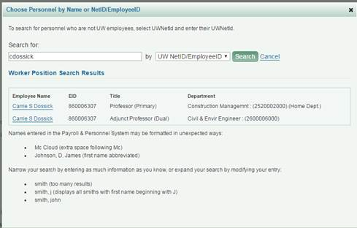
PERSON LOOKUP (throughout SAGE Suite)
Future State
Changes:
Updated data source
No more duplicates
Bonus!
Academic Appointment Type
Primary Department

Slide 17
eGC1- ADDITIONAL REVIEWERS
Bonus!
Compliance question: Additional Organizational Units (FG-9) will now be located on the renamed PI, Personnel, & Organizations page

Slide 18
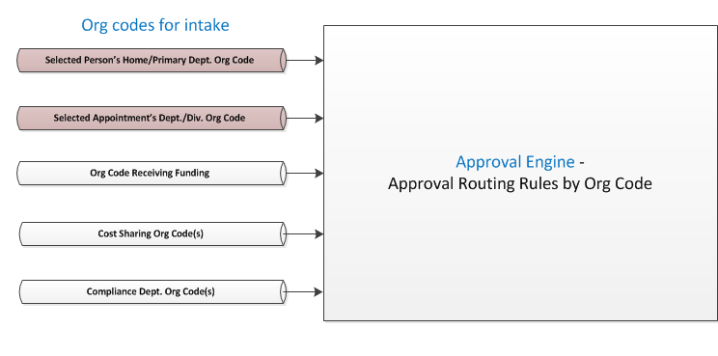
eGC1 - APPROVALS
Changes:
Updated data source with new data model

Slide 19
APPROVALS - Selected Job Org Code
(Primary Org)
(Sup Org)
Changes:
Primary position’s Org Code replaces Home Department Org Code
Primary Org will be part of Approval Graph automatically (current state)
If an academic appointment is selected, and has no related position, the Supervisory Org for the Academic Unit will be added to Approval Graph
Still working with HRPM Program and units where Sup Orgs don’t match current approval orgs

Slide 20
SAGE BUDGET
Changes:
New data source and data concepts
Object Codes less granular for 01, 07, and 08
Earn Types to Earning Codes (not a direct translation)
IBS Earnings Indicator - logic update
Salary Amounts - logic updates
Benefit Exemption Status cannot be identified for Professional staff, so users will be prompted to verify benefit exemptions
Adding TBD or non-Workday personnel
Highlighted today:
Changes:
Personnel source data
Convert/Update Salary
Bonus!
Apply salary and wages to multiple periods on the same screen

Slide 21
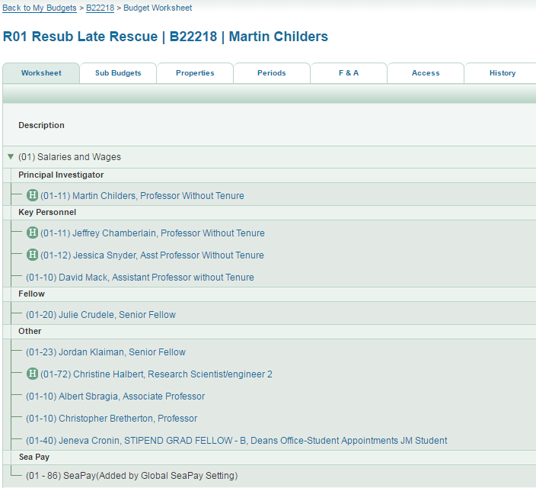
SAGE BUDGET - Personnel Source Data
Changes:
An ‘H’ will display for personnel added using HEPPS data, an indicator displays next to each record
Personnel added/converted using Workday data will not have an ‘H’ displayed

Slide 22
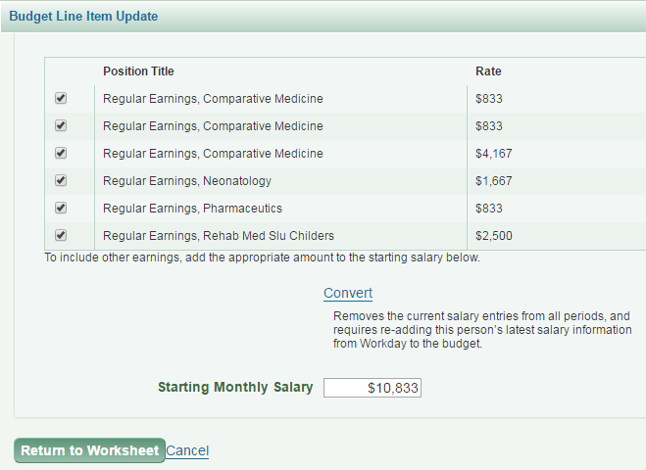
SAGE BUDGET - Convert/Update Salary
HEPPS record
Changes:
Opening HEPPS line items will give you the option to Convert Salary (convert/update salary using Workday data)
Opening Workday line items will give you the option to Update Salary (current state)
WORKDAY record

Slide 23
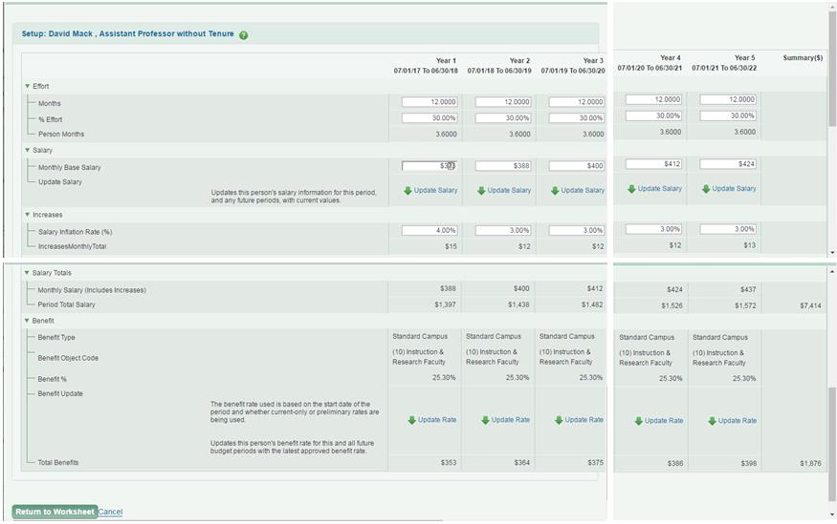
SAGE BUDGET - Apply Salary and Wages to Periods
Bonus!
Apply salary and wages to multiple periods in one place!
Update Salary for personnel records using Workday data (the Update Salary link will not display records with HEPPS data)

Slide 24
THANK YOU!
See you at next MRAM
Keep an eye out for additional communications and training

Slide 25
When do you need to use an eGC1?
MRAM May 2017
Carol Rhodes, Director
Office of Sponsored Programs
carhodes@uw.edu

Slide 26
When to use an eGC1
Pre-Applications:
when authorized official submission/sign off or budget details are needed
Proposals for Research, Instruction or other Sponsored Activity
Noncompeting Renewals (Progress Reports)
Revised Applications
After-the-Fact (ATF) Awards
Non-Award Agreements

Slide 27
Changes in Scope
Even if there is an eGC1 on file...
Cumulative amount of award exceeds 25% or more of cumulative amount of eGC1(s) on file
PI or sponsor determines significant change in scope:
Change in direction, aims, objectives, purposes, types
of research
New compliance requirements not on earlier eGC1 (animals, human subjects, cost share etc..)
OSP may determine unique situations requiring an eGC1

Slide 28
What is an NAA?
Non-Award Agreements are
An agreement between UW and another party that:
Is related to research
Obligates UW resources or makes legal obligations on behalf of the UW
and
Does not include external funding
Requires institutional sign-off
More information on Agreement Types
Notes:
an award agreement between the UW and another party, related to research that obligates UW resources or otherwise makes legal obligations on behalf of the University and does not include external funding, requiring institutional sign-off.

Slide 29
Examples: Non-Award Agreements (NAA)
Data Use Agreements (DUA)
Confidentiality Agreements (CDA)
Master Agreements
Material Transfer Agreements (MTA)
Unfunded Research Agreements
More information on Agreement Types
Notes:
an award agreement between the UW and another party, related to research that obligates UW resources or otherwise makes legal obligations on behalf of the University and does not include external funding, requiring institutional sign-off.

Slide 30
Exceptions: Non-Award Agreement
eGC1s are NOT required for:
Pre-Clinical Trial Confidentiality Agreements (CDAs)
Email these directly to osp@uw.edu
When the UW is running a registry and a high volume of Data Use Agreements (DUA) are needed for incoming data from multiple sites.
Contact OSP to arrange process on handling.

Slide 31
Resources Proposal Routing: https://www.washington.edu/research/myresearch-lifecycle/plan-and-propose/submit-proposal/#proposal-routing Agreement Types: https://www.washington.edu/research/myresearch-lifecycle/setup/collaborations/agreement-types/ GIM 01: Review & Submission Requirements for Proposals https://www.washington.edu/research/policies/gim-1 Sponsored program Activity Types https://www.washington.edu/research/policies/gim-13-facilities-and-administrative-fa-rates/#activity-types

Slide 32
NIH: Research Performance Progress Reports (RPPR) Final & Interim
MRAM May 2017
Adelia Yee
Office of Sponsored Programs
ayee@uw.edu

Slide 33
RPPR Resources
How Do I Fill Out the RPPR Forms? https://era.nih.gov/erahelp/commons/Commons/rppr/rppr_fields.htm Submitting Your Final Research Performance Progress Report https://era.nih.gov/erahelp/commons/Commons/status/closeout/Final_RPPR.htm Overview of the Interim RPPR https://era.nih.gov/erahelp/commons/Commons/rppr/Interim_RPPR/interim_RPPR_overview.htm Submitting Your Interim RPPR https://era.nih.gov/erahelp/commons/#Commons/rppr/Interim_RPPR/intermin_RPPR_steps.htm GIM 39: Closeout of Sponsored Programs http://www.washington.edu/research/policies/gim-39-closeout-of-sponsored-programs/

Slide 34
The Single IRB Policy d
Karen Moe, PhD
Director, Human Subjects Division
MRAM Meeting; May 11, 2017
kemoe@uw.edu
hsdinfo@uw.edu

Slide 35
What is the Single IRB Policy?
Two complementary federal policies
Require the institutions participating in certain kinds of studies to rely on the same (single) IRB

Slide 36
IRB review for current clinical trials

Slide 37
Single IRB policy

Slide 38
Why
Faster overall startup time
More efficient
More consistent

Slide 39
Single IRB policy
 | NIH | Common Rule
Implementation date | New grants on or after Sept 25, 2017 | Jan 20, 2020
Applies to | NIH-funded multi-site clinical trials
Exceptions | Not international Not VA Not tribal involvement
Affects current studies? | No

Slide 40
Why are we talking about this now?
The grants submitted to NIH this fall
for multi-site clinical trials must include
specific single IRB information
including budget information.

Slide 41
UW IRB as the single IRB?
UW IRB will not be the single IRB
For the first 2 years of the single IRB policy
Collect data re workload & cost, then decide
HSD will work with the PI to select a large independent IRB (e.g., WIRB)

Slide 42
Why?
Advantages of large independent IRBs
Expertise (number & type of IRB members)
Can quickly “scale up” for large studies
Faster turnaround time
Our peer institutions taking the same approach
HSD staff will still be available to help

Slide 43
Preparing a NIH grant application
for a multi-site clinical trial

Slide 44
Basic steps: UW PI is Lead PI
Grant preparation
Post-award
Choose the IRB (with HSD)
HSD Letter of Support
Letter of Support for single IRB from participating sites
Personnel: IRB liaison
Budget: IRB fees
Budget: IRB liaison
IRB liaison: identify/hire
Zipline: request to use external IRB
Reliance agreement between IRB & sites
Generic protocol: IRB review
Each site: IRB review

Slide 45
Cost of the single IRB review
It costs money
The grant (lead site) must pay
The cost is not included in indirect costs (F&A)
Must be included in grant budget
See two NIH guidance documents
(links on HSD Single IRB webpage)

Slide 46
HSD Single IRB webpage
Template Letter of Support for participating sites
IRB Liaison description & cost
IRB review fees: How to budget
Links to NIH guidance about review fees

Slide 48
Research Terms & Conditions (RTCs)
MRAM
May 2017
Andra Sawyer & Jasmine Campbell
Research Accounting and Analysis/Office of Sponsored Programs
Notes:
Andra

Slide 49
Research Terms & Conditions (RTCs)
Requirements for research awards; intent is to reduce administrative burden
Practical Application: Prior Approval Waiver
Not all federal agencies use the RTCs
Participating agencies have different implementation dates; review the Award for notification
Applicable to all NIH awards
Notes:
Andra: Define what it is – started with initiative from the FDP to streamline and reduce admin burden for research institutes; has some information about other topics but really the only thing it adds from an implementation perspective is the Prior Approval Matrix. Not all federal agencies use this- need to review the award to see if it is referenced. NIH says will be applicable with all awards; other agencies have various implementation dates.

Slide 50
RTC Prior Approval Matrix - Sample
Notes:
Jasmine: Show a sample from the PAFC formatted prior approval matrix - explain that the column to the left is the item and on the right are the individual federal agencies with an R if it is Required/Restricted and a W if it has been waived.

Slide 51
RTC Information Location
RTCs are issued by NSF, info on the NSF website:
https://www.nsf.gov/awards/managing/rtc.jsp
UW information:
PAFC: description, re-formatted prior approval matrix:
http://f2.washington.edu/fm/pafc/research-terms-and-conditions-rtcs
Notes:
Jasmine: Where to find the RTCs themselves; UW information can be found on the PAFC website and the OSP website (provide summary info and links)

Slide 52
RTC Information Location (con’t)
OSP: linked in the sponsors that have implemented (currently NSF, NIH, and DoE):
https://www.washington.edu/research/myresearch-lifecycle/plan-and-propose/sponsor-requirements/federal/
Notes:
Jasmine: Where to find the RTCs themselves; UW information can be found on the PAFC website and the OSP website (provide summary info and links)

Slide 53
RTCs in the Federal Regulation Hierarchy
Notes:
Andra: RTCs are after the Sponsor T&C but before Program Announcements

Slide 54
RTC Example: NIH & Carry Forward
Notes:
Andra: An example of a real requirement and a real agency – upshot is that the RTCs don’t really add anything new – don’t anything that is new in comparison to agency requirements. Advise, as always, to review the Award

Slide 55
UPCOMING COURSES IN
RESEARCH ADMINISTRATION
 | ONLINE | GCA 201 | Salary and Cost Transfers Online Class
 | ONLINE | RAA 201 | Post Award Food Purchases and Compliance
 | ONLINE | GCA 202 | Direct Billing of F&A Type Costs Online Class
 | ONLINE | RAA 202 | Timing of Expenditures & Benefit to Award
 | May 17 | MAA 102 | Electronic Faculty Effort Certification (eFECS) for FEC Coordinators
 | May 18 | ORIS 102 | SAGE: Creating NIH Proposals in Grant Runner
 | May 24 | MAA 225 | Using the Tools: Calculators, Worksheets and Reports
 | June 7 | MAA 231 | Salary Limitations - Salary Cap
 | June 14 | MAA 230 | Salary Limitations - K Awards
 | June 15 | GCA 203 | Preparing for an Audit
 | Introduction to Export Controls coming this summer!
To see a full list of courses and to register, visit: https://uwresearch.gosignmeup.com/public/course/browse
For information on CORE, visit our homepage:
https://www.washington.edu/research/learning/

