Slide 1
Research Terms & Conditions (RTCs)
MRAM
May 2017
Andra Sawyer & Jasmine Campbell
Research Accounting and Analysis/Office of Sponsored Programs
Notes:
Andra

Slide 2
Research Terms & Conditions (RTCs)
Requirements for research awards; intent is to reduce administrative burden
Practical Application: Prior Approval Waiver
Not all federal agencies use the RTCs
Participating agencies have different implementation dates; review the Award for notification
Applicable to all NIH awards
Notes:
Andra: Define what it is – started with initiative from the FDP to streamline and reduce admin burden for research institutes; has some information about other topics but really the only thing it adds from an implementation perspective is the Prior Approval Matrix. Not all federal agencies use this- need to review the award to see if it is referenced. NIH says will be applicable with all awards; other agencies have various implementation dates.

Slide 3
RTC Prior Approval Matrix - Sample
Notes:
Jasmine: Show a sample from the PAFC formatted prior approval matrix - explain that the column to the left is the item and on the right are the individual federal agencies with an R if it is Required/Restricted and a W if it has been waived.

Slide 4
RTC Information Location
RTCs are issued by NSF, info on the NSF website:
https://www.nsf.gov/awards/managing/rtc.jsp
UW information:
PAFC: description, re-formatted prior approval matrix:
http://f2.washington.edu/fm/pafc/research-terms-and-conditions-rtcs
Notes:
Jasmine: Where to find the RTCs themselves; UW information can be found on the PAFC website and the OSP website (provide summary info and links)

Slide 5
RTC Information Location (con’t)
OSP: linked in the sponsors that have implemented (currently NSF, NIH, and DoE):
https://www.washington.edu/research/myresearch-lifecycle/plan-and-propose/sponsor-requirements/federal/
Notes:
Jasmine: Where to find the RTCs themselves; UW information can be found on the PAFC website and the OSP website (provide summary info and links)

Slide 6
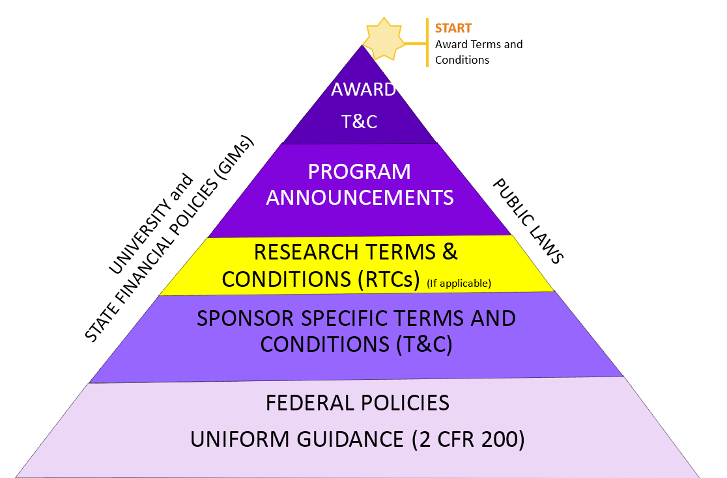
RTCs in the Federal Regulation Hierarchy
Notes:
Andra: RTCs are after the Sponsor T&C but before Program Announcements

Slide 7
RTC Example: NIH & Carry Forward
Notes:
Andra: An example of a real requirement and a real agency – upshot is that the RTCs don’t really add anything new – don’t anything that is new in comparison to agency requirements. Advise, as always, to review the Award

