Slide 1
SAGE Updates:
Grant Runner plus
SAGE & HR/Payroll Modernization
MRAM
June 2017
Amanda Snyder, Associate Director, Office of Sponsored Programs
Carey Acker, Project Manager, Office of Research Information Services

Slide 2
SAGE Grant Runner Update
What is Grant Runner again?
Allows NIH proposals to be completed and submitted directly from SAGE
Sponsor forms are pre-populated with institutional and eGC1 data, saving time and improving accuracy
Available for select NIH opportunities at this time

Slide 3
2017-18 Grant Runner Goals
Expand to cover more NIH Opportunity Types
Career Development
Fellowships
Training Grants
Update to Forms-E
More pre-population of forms
Deliver high value features (we hear you!)

Slide 4
New Features Just Released - June 6!!
Single PDF
Print or Download all sponsor forms and attachments in a single PDF
Expanded Validations
All NIH validations are now covered in “Check for Errors”

Slide 5
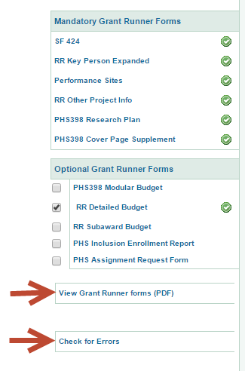
Both Features Accessed from Left Navigation
Check for Errors also available on Certify and Route Page

Slide 6
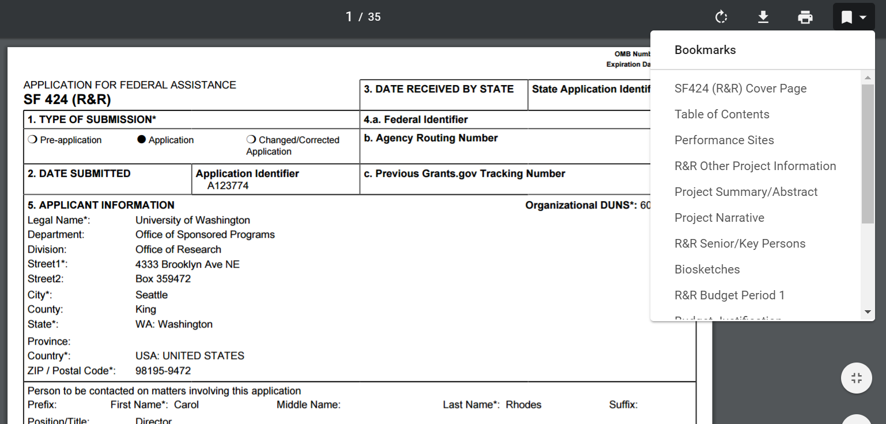
Single PDF Features
Same format that NIH reviewers will see
“Bookmarks” take you quickly to a section
Easy print or download
Notes:
Also generates table of contents, helpful headers and footers

Slide 7
Expanded Validations Highlights
eGC1, Grants.Gov and NIH error checks all included
Allows pro-active application validation (check for errors early and often!)
Errors must be cleared before “completion” of eGC1
NIH Warnings also shown, but won’t prevent eGC1 completion or submission

Slide 8
More coming soon….
Next Release (Summer) :
Forms-E changes
Inclusion of Career Development opportunities
If you haven’t used Grant Runner recently, give it a try and share your feedback!
sagehelp@uw.edu

Slide 9
SAGE Integration with Workday
Timeline Reminder
June 19
June 27
July 5
July 6
July 7 - 31
HEPPS freeze
Workday Go Live!
NIH Deadline!!
SAGE Go Live!
Stabilization & Support
SAGE personnel & pay data is static/stale

Slide 10
Primary Workday Impacts to SAGE
Personnel Chooser
Approval Graph
SAGE Budget

Slide 11
SAGE Personnel Chooser
Enhancement: Search by Employee Identification (EID) number.
Future: In the Personnel Chooser, notice the following results changes:

Slide 12
SAGE Approval Graph
Enhancement: Add organizations via the PI, Personnel, and Organizations page.
Future: Approval Graph may have different results from what had previously displayed. We are still working with HRPM Program and Schools/ Colleges where Supervisory Org Codes don’t match current approval Org Codes.

Slide 13
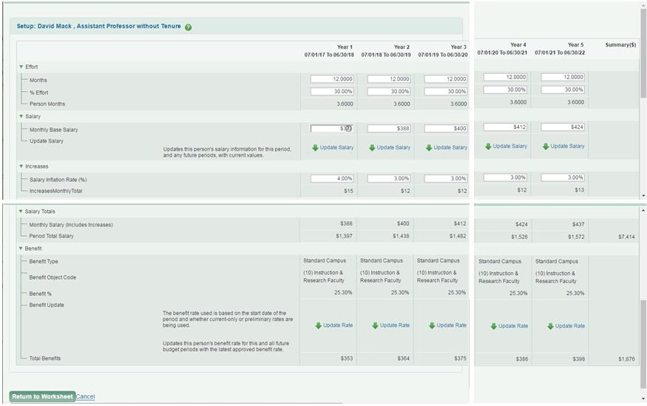
SAGE Budget
Enhancement: Enter data for a given line item across all Budget periods on a single page.

Slide 14
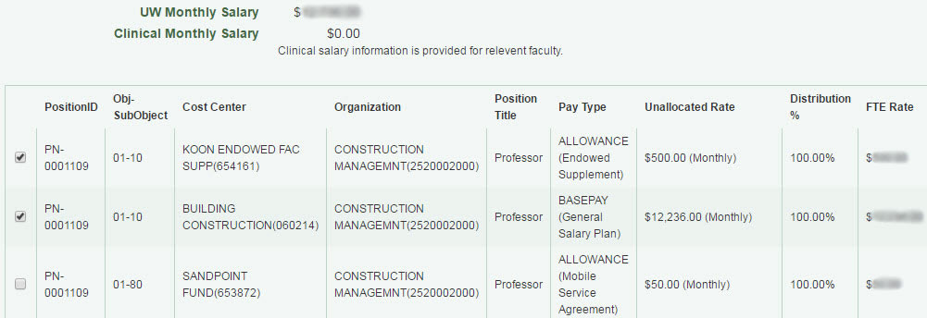
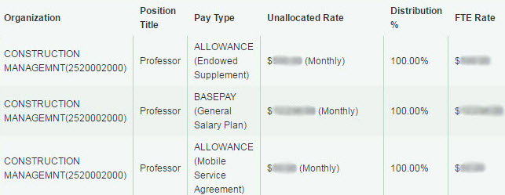
SAGE Budget
Future: Salary information displays differently.
Before:

Slide 15
User Testing & Feedback
Focus group
RAPIT
User testing
SAGE Budget
Approvals

Slide 16
Communications
MRAM presentations:
May, June, July
Research Website:
Announcements, email lists

Slide 17
SAGE Training
eLearning Videos
Workday & SAGE: Changes to Person Chooser
Workday & SAGE: Changes to the Approval Graph
Workday & SAGE: SAGE Budget
Job Aid
Modifying the SAGE Approval Graph
Updates to SAGE Budget class
Next class: September 26

Slide 18
Additional Resources
SAGE system documentation updates
SAGE Help Desk
206.685.8335
oris@uw.edu

Slide 19
Questions?

