Slide 1
 | MRAM Monthly Research Administration Meeting
 | JULY 13, 2017 UW TOWER AUDITORIUM
 | TOPIC | PRESENTER | EMAIL | MIN
 | Welcome | Ted Mordhorst Research Compliance & Operations | tedm2@uw.edu | 02
 | WA State Records Law: How It Applies to Research Records | Eliza Saunders Office of Public Records and Open Meetings | esaunder@uw.edu | 25
 | SAGE & HRP Modernization | Carey Acker Office of Research Information Services | ackerc1@uw.edu | 10
 | HRP Modernization: GIM Updates | Carol Rhodes Office of Sponsored Programs Mike Anthony Management Accounting & Analysis | carhodes@uw.edu mda1213#@uw.edu | 10
 | Research Website Highlights | Carol Rhodes Office of Sponsored Programs | carhodes@uw.edu | 5
 | Compliance Corner | Andra Sawyer Post Award Financial Compliance | andra2@uw.edu | 10
JOIN US FOR OUR NEXT MEETING: AUGUST 10, 2017 UW TOWER AUDITORIUM

Slide 2
WA State Records Law:
How it Applies to Research Records
MRAM
July 2017
Eliza Saunders
Office of Public Records and Open Meetings

Slide 3
SAGE and HRP Modernization
MRAM
July 2017
Carey Acker
Office of Research and Information Services

Slide 4
SAGE HR/P Release Complete 7/6/2017!
SAGE is now using Workday employee, job, and salary data
Key enhancements to make using SAGE easier
Complete details on all release items can be viewed in the July 6, 2017 SAGE Release Notes.

Slide 5
Primary Workday Impacts to SAGE
Personnel Chooser
Approval Graph
SAGE Budget

Slide 6
SAGE Personnel Chooser - Workday Change
“Title (Academic Appointment Type)” replaces Job Class Title
"Primary Position” replaces Home Department

Slide 7
SAGE Personnel Chooser - Enhancement
Primary organizational unit and the selected organizational unit display
No duplicate rows - linked Positions and Academic Appointments are displayed in one row, with more descriptive Academic Appointment Title
Search by Employee ID

Slide 8
SAGE Approval Graph - Workday Change
With the transitions to Positions, Academic Appointments and Primary Organizations, you may see differences in how this information is displayed in the approval graph

Slide 9
SAGE Approval Graph - Enhancement
Can add additional organizations to the approval graph from the “PI, Personnel, & Organizations” page (former compliance question FG-9)
The “View Approval Graph” link will now show on two eGC1 pages -- on “Certify and Route” (as always) and also on “PI, Personnel, & Organizations”

Slide 10
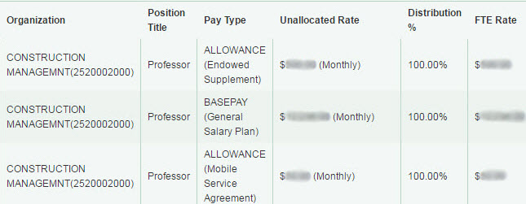
SAGE Budget - Workday Change
Salary information displays in an easy-to-read table format with more detail and new Workday terminology and data
Object Codes are less granular and will display only one digit of the sub-object code (Example: ‘07-06’ is now ‘07-00’, ‘08-02’ is now ‘08-00’)

Slide 11
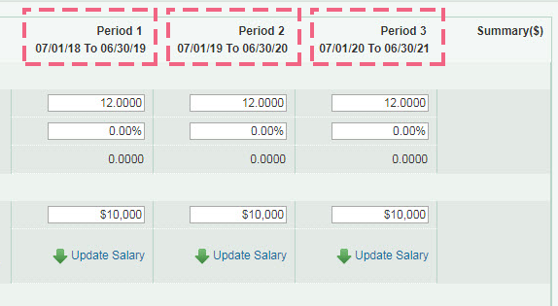
SAGE Budget - Enhancement
Line items can be entered across all Budget periods on a single page
Salary and wages data from HEPPS displays an “H” icon. When editing any of these lines, you can select “Convert Salary” to replace the HEPPS data with the person’s latest salary data from Workday.

Slide 12
Resources
[Video] Workday & SAGE: Changes to Person Chooser
[Video] Workday & SAGE: Changes to the Approval Graph
[Job Aid] Workday & SAGE: SAGE Budget
[Job Aid] Workday & SAGE: Approval Graph Troubleshooting
Go to sage.washington.edu and select “videos” or “job aids” in the right-hand menu

Slide 13
SAGE Training
Updates to SAGE Budget class
Next class: September 26

Slide 14
Additional Resources
SAGE system documentation updates
SAGE Help Desk
206.685.8335
oris@uw.edu

Slide 15
Thank You!
ORIS HR/P project team
ORIS Communications and Training team
UW Workday team
HRP-I team
Campus partners including OSP, GCA, MAA, SoM
Campus members:
Focus group participants
RAPIT
User session participants
SAGE Budget
Approvals

Slide 16
Questions?

Slide 17
HRP Modernization:
GIM Updates
MRAM
July 2017
Carol Rhodes – Office of Sponsored Programs
Mike Anthony – Management Accounting & Analysis

Slide 18
Research Website Highlights
MRAM
July 2017
Carol Rhodes
Office of Sponsored Programs

Slide 19
Research Website Highlights from OSP
Updated at least quarterly this quick reference will help you see what’s changing on the research website.
https://www.washington.edu/research/announcements/web-highlights-osp/

Slide 20
Compliance Corner
MRAM
July 2017
Andra Sawyer
Post Award Financial Compliance

Slide 21
Publication Costs & Close Out
Federal Regulation (CFR 200.461) states that “page charges for professional journal publications” can be incurred after the end date of the award but before “closeout.”
This means that any “page charges” have to be posted by the Final Action (FAD).
This does not mean that any cost related to the final report or its publishing can be incurred after the FAD.

Slide 22
Publication Costs & Close Out
Request a No Cost Extension (NCE) if:
it is anticipated that any expenses, including report finalization, will be incurred after the Award end date; and
there are sufficient funds remaining in the Award to cover the anticipated expenditures.
For more information – PAFC FAQ:
https://finance.uw.edu/pafc/faq?term_node_tid_depth=Publication%20Costs

Slide 23
Revised GIM 2 – Signature Delegation
GIM 2 is being revised to clarify the following:
PI must be involved in the transaction.
PI’s may delegate this authority but:
designee must have direct knowledge of the award and how the expense benefits the award; and
the delegation must be written.
Written delegation is not required for “Senior/Key personnel” (as defined in GIM 10).

Slide 24
Revised GIM 2 – Signature Delegation
Specific costs itemized in the proposal and funded by the sponsor do not require additional approval (by the PI, Senior/Key/designated personnel) during the procurement process.
Subaward invoices must be approved (per GIM 8).

Slide 25
GIM 10 - Senior/Key Personnel
“Senior/Key Personnel” means the Principal Investigator and any other person identified as senior or key personnel by the University in a grant application, award, or contract or in any progress report, or any other report submitted to the PHS or other funding source.

Slide 26
GIM 2 Clarification – Responsibility for Aged Receivables
GCA
Facilitates collection procedures
Notifies departments of past due invoices
Department
Accountable for all deficits, including non-payment by the sponsor

Slide 27
UPCOMING COURSES IN
RESEARCH ADMINISTRATION
 | Aug 1 | OSP 175 | Introduction to Export Compliance at the UW
 | Aug 2 | MAA 100 | Introduction to Grant and Contract Certification (GCCR)
 | Aug 16 | MAA 101 | Introduction to Faculty Effort Certification
 | Aug 30 | MAA 102 | Electronic Faculty Effort Certification (eFECS) for FEC Coordinators
 | Sep 13 | MAA 205 | Modifying an FEC Using Comments and Adjusting Cost Sharing
 | Sep 14 | OSP 101 | Introduction to Research Administration
 | Sep 19 | ORIS 101 | SAGE: Creating and Submitting eGC1s
 | ONLINE | GCA 201 | Salary and Cost Transfers Online Class
 | ONLINE | RAA 201 | Post Award Food Purchases and Compliance
 | ONLINE | GCA 202 | Direct Billing of F&A Type Costs Online Class
 | ONLINE | RAA 202 | Timing of Expenditures & Benefit to Award
Full list of courses and registration: https://uwresearch.gosignmeup.com/public/course/browse
About CORE :
https://www.washington.edu/research/training/about-core/

