Slide 1
Animal Use Verification
& eGC1
Carol Rhodes
Director, Office of Sponsored Programs

Slide 2
eGC1 Types
OAW not automatically added as Approver
Competing: Pre-app, New, Competing Renewal, Competing Supplement, Resubmission
As of August 2017
Noncompeting Renewal: Research Performance Progress Reports (RPPRS), progress report requiring SO sign-off or submission
Noncompeting Supplement: Additional funding being requested or awarded for ongoing project e.g. administrative supplement
Noncompeting Revision

Slide 3
When Animal Use Answered Yes
OAW Automatically added as Approver
To these eGC1 Types
Transfer to UW
After-the-Fact Award (no proposal stage)
Supplement/extension

Slide 4
When OAW is Approver
OSP relies on approval & protocol in eGC1.

Slide 5
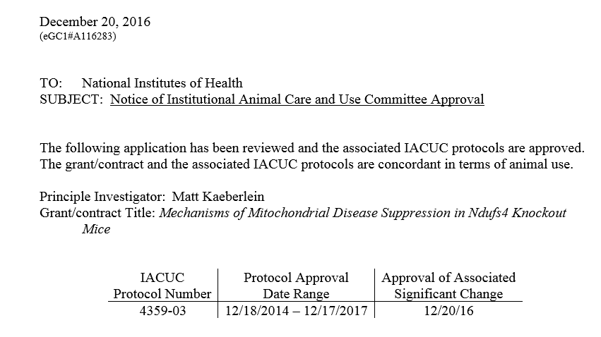
When OAW is NOT Approver
OSP Verification of Animal Protocol Approval
OSP needs congruence letter issued for the project.

Slide 6
Funding & HOLDS
Whenever animal use research will be carried out, an approved protocol must be in place for the work.
OSP will not release funding until verified.
Funding HOLD examples:
Protocol approval date expired on congruence letter
No IACUC approval on record
In all cases, if animal use scope of work changes, it is the PI’s responsibility to provide updated information/materials to OAW.

Slide 7
Related Future Changes...
Updates to GIM 27: Animal Use policy
eGC1:
IACUC approval details pulled into eGC1 from Hoverboard
At JIT or later, campus users will be able to update an eGC1 with current version of compliance information after OSP approval

