Slide 1
SAGE Updates:
Grant Runner
MRAM
August 2017
Judy Chung, Program Manager, Office of Research Information Services

Slide 2
2017-18 Grant Runner Expansion Project
Mission:
Expand SAGE Grant Runner capabilities to allow more federal opportunities to be supported, saving researcher teams time and effort through:
Reduced duplicate entry
Fewer systems to interact with
Reduced training and support requirements for non-UW Systems

Slide 3
Approach
Deliver more value more frequently (every 2-3 months)
Target NIH forms expansion (first)
Add key features requested to create a more streamlined experience
Expand to more sponsors (future)

Slide 4
What’s New!!
Career Development (K) grants
More NIH required fields on form entry
Reminder: We now show ALL NIH errors and warnings through the “check for errors” feature

Slide 5
Career Development (K) Support
Temporary Issue:
Grant Runner does not yet support applications where the UW PI differs from the application PI.
Temporary Work-around:
Use another submission method OR
Wait for mid-September SAGE update when that capability will be supported

Slide 6
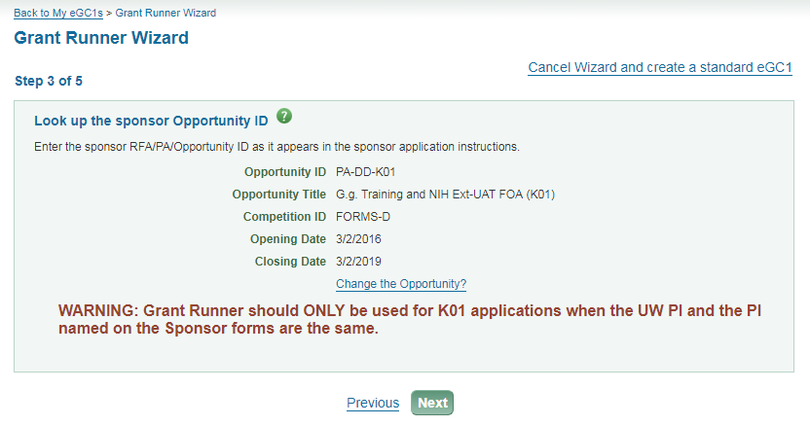
Career Development (K) Support
Temporary Message: (Only until mid-September)

Slide 7
More coming soon….
September Release:
Allow application PI to differ from UW PI (K apps)
Related approval graph changes
October Release:
New Human Subjects and Clinical Trials form
All Forms-E changes available
Fellowship grants
sagehelp@uw.edu

Slide 8
Conclusion
If you haven’t used Grant Runner yet, or for awhile
GIVE IT A TRY
THEN GIVE US FEEDBACK!
sagehelp@uw.edu

