Slide 1
Export Controls and Sponsored Research

Slide 2
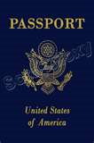
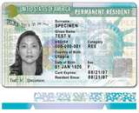

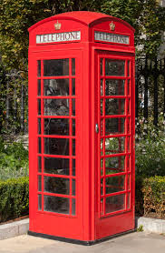

What is an Export?
“’Export’ means an actual shipment or transmission of items … out of the United States, or release of technology or software, … to a foreign national in the United States”
        Export Administration Regulations (EAR)
Not Foreign Nationals
Slide 2

Slide 3
Why Export Controls at a University?
Exports do not have to be shipments of goods
  Providing goods, technology, or software to a foreign national in the United States is still considered to be an export – a.k.a. “deemed export”
  E-mailing technical data or a software program
Foreign nationals coming to the United States for education and research (increasing numbers from more countries)
Technology has enabled education to become increasingly global and “hands-on”
Export Controls does not cover FISMA, Personal Identifiable Information, or Confidential Unclassified Information
Slide 3

Slide 4
Exporting Basics
Categorization (What?)
  Determines Jurisdiction (State, Commerce, NRC, etc)
  Almost everything has a control number
Destination (Where?)
  Sanctioned countries may have additional prohibitions on financial or travel transactions
End-User (Who?)
  Debarred Parties Screening
End Use (Why?)
  Certain End Uses are prohibited (e.g., nuclear proliferation)
Slide 4

Slide 5
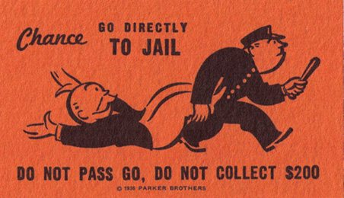
Why?
Prohibited End Uses
Certain nuclear activities
Rocket Systems and UAVs (drones)
Chemical and Biological Weapons
Others but very specific – luckily not the type of activities UW performs
Slide 5

Slide 6
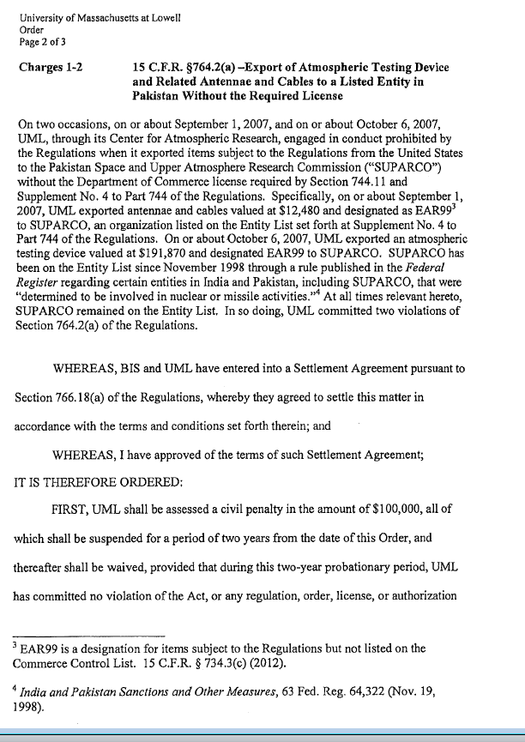
Who?
KNOW YOUR RECIPIENT!
Debarred Parties, include universities, hospitals, research institutes, etc.
  Beihang University
  Sichuan University
  Ben Gurion University
  Space and Upper Atmosphere Research Commission (SUPARCO)
Slide 6

Slide 7
Debarred Parties
When dealing with an unknown entity, we can screen all of these, and many more, for you
Denied Persons List (Commerce)
Entity List (Commerce)
Specially Designated National List (Treasury)
Debarred List (State)
Nonproliferation Sanctions (State)

Slide 8

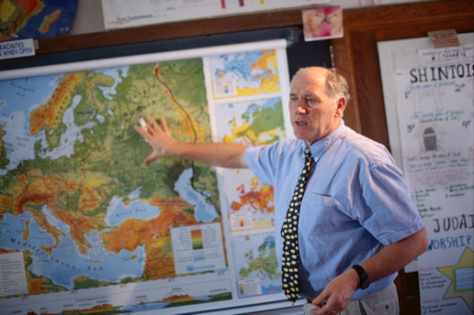
What is generally not subject to export controls?
Public Domain Information
  Information that is generally accessible to the public through: periodicals, books, print, or electronic media.
  Includes information that is readily available at libraries, in patents, or through an “open” conference.
Academic Catalog Courses
Slide 8

Slide 9
What is excluded from Export Controls?
Fundamental Research Results
  Basic and applied research in science or engineering; and
  Intention is to publish the research results and there are no restrictions or approvals required on the publishing of the research results; and
  No restrictions on the access to the research results (including foreign national restrictions or approvals)
Slide 9

Slide 10
How do I know if UW’s research is covered under the fundamental research exclusion?
Contracts
  Read clause carefully. UW may notify the sponsor of any publications or foreign nationals working on a research project but it must be clear that it is not an approval process (or it appears to be an approval process.) Generally, any clause which requires PRIOR notification of a foreign national on a project is not acceptable.
  DFARS 252.204-7000 is an obvious example of a publication restriction
Slide 10

Slide 11
Sample Clauses
Unacceptable
DFARS 252.204-7000
(a) The Contractor shall not release to anyone outside the Contractor's organization any unclassified information, regardless of medium (e.g., film, tape, document), pertaining to any part of this contract or any program related to this contract, unless—
(1) The Contracting Officer has given prior written approval; or
(2) The information is otherwise in the public domain before the date of release.
(b) Requests for approval shall identify the specific information to be released, the medium to be used, and the purpose for the release. The Contractor shall submit its request to the Contracting Officer at least 45 days before the proposed date for release.
(c) The Contractor agrees to include a similar requirement in each subcontract under this contract. Subcontractors shall submit requests for authorization to release through the prime contractor to the Contracting Officer.
Acceptable
To comply with DFARS 252.204-7000, Disclosure of Information, the contractor shall be free to publish, permit to be published, or distribute for public consumption, any information, oral or written, concerning the results of conclusions made pursuant to performance of the contract; provided, however, that it shall provide copies of any such publication or notification of release of information to the Contracting Administrator 15 days prior to release.
Slide 11

Slide 12
Hidden Contractual Restriction
On publication
Slide 12

Slide 13
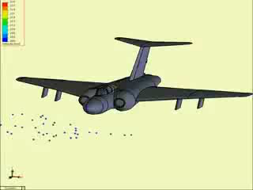
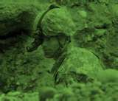
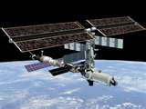
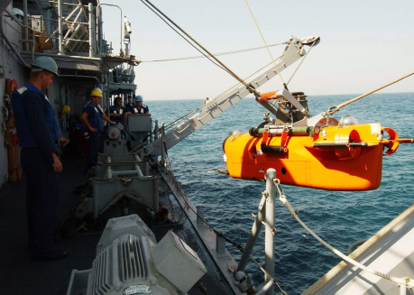
What is controlled?
International Traffic in Arms Regulations ITAR -
  State Department
  Anything specifically designed or modified for military or space application
    DARPA, AFRL, ONR, ARO technology and/or goods
    Includes mock-ups and models
    Does not include general system descriptions
  License required for all countries (limited exceptions)
Slide 13
Notes:
Guns, Arms, and Ammunition (story about Australian DoD)
Rockets (microrocket)
Explosives (Hallinga)
List of Propellants, Oxidizers, Additives, and Precursors (provide lists)
Military equipment (Bass’ Helmet story)
2nd & 3rd generation night vision equipment (Cummer)
List of Toxilogical Agents (provide list)

Slide 14
Defense Service
The only export that can be done with public domain information, courses, or fundamental research results
Furnishing assistance (including training) on defense articles to foreign persons
  Includes design, development, engineering, manufacture, production, assembly, testing, repair, maintenance, modification, operation, demilitarization, destruction, processing or use of defense articles
Training of foreign units/forces, including through the use of educational or informational publications
What does this mean?
Any activity with a foreign government’s military or space programs should be brought to the Office of Research’s attention
Slide 14

Slide 15
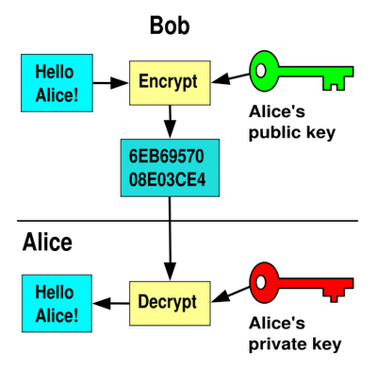

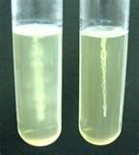
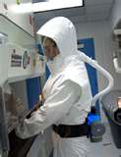
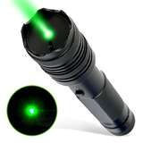
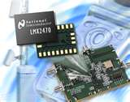
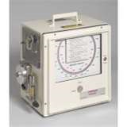
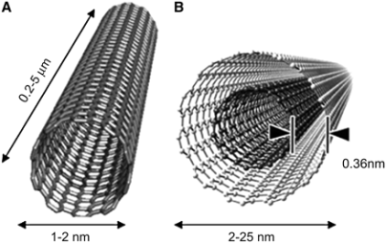
Examples of Export Controlled
Goods And Technology
Department of Commerce
  Export Administration Regulations (EAR)
Slide 15

Slide 16
Export Administration Regulations (EAR)
Categories
0. Nuclear Materials, Facilities and Equipment
1. Chemicals, Microorganisms, Toxins
2. Material Processing
3. Electronics
4. Computers
5. Telecommunications and Information Security
6. Sensors and Lasers
7. Navigation and Avionics
8. Marine
9. Propulsion Systems, Space Vehicles, and other
Product Groups (Subcategories)
Equipment, Assemblies and Components
Test, Inspection, and Production Equipment
Materials
Software
Technology
Slide 16

Slide 17
When might an export license be needed?
Slide 17

Slide 18
When the Fundamental Research Exclusion Doesn’t Apply
Confidential or Proprietary data being shared with a foreign national
Foreign national use of ITAR items
Research results that are withheld from publication due to national security or ethical issues
Shipments of physical items
Encryption software
Providing a “Defense Service”
Foreign nationals who are working on a controlled project (e.g., sensitive APL project)
Slide 18

Slide 19
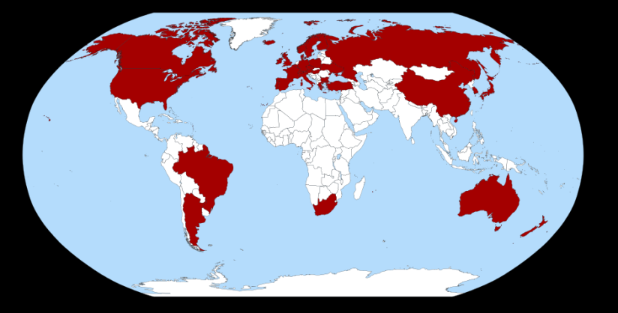
Where?
Export Controls vary based on the country
  Canada
  NATO
  Countries/Regions that are US-friendly and stable
  Countries suspected of nuclear weapon/missile development
  Sanctioned countries
Missile Technology Export Control Regime Membership Map
Slide 19

Slide 20
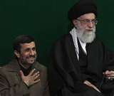

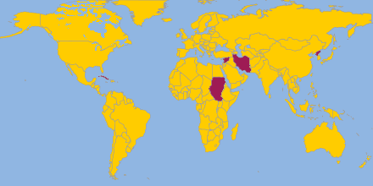
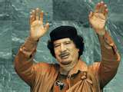


Sanctions and Embargos
Office of Foreign Assets Controls (OFAC)
CUBA
IRAN
NORTH KOREA
SUDAN
SYRIA
Belarus
Cote d’Ivoire (Ivory Coast)
Congo
Liberia
Lebanon
Libya
Somalia
Zimbabwe
Slide 20

Slide 21

The Sanctioned Countries
Often prohibited:
  Exports/Imports of any kind
  Collaboration on research projects or publications
  Financial transactions
  “Participation” in conferences
  Technical data
Public domain information may be shared without restrictions
Slide 21

Slide 22
Anti-Boycott
It is illegal for a US person or a person in the US to accept terms which support an international boycott in which the US does not participate – (Israel)
The law also requires US persons to report any such language to the US government
May be found on any type of document (contract, P.O., Letter of Credit, Waybill, certification, etc.) – Do not sign and contact export controls
Slide 22

Slide 23
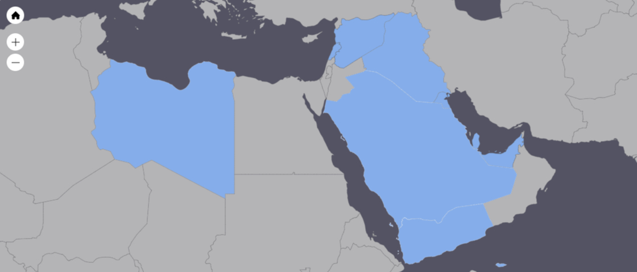
Anti-Boycott Countries
Countries currently* cooperating with Arab Boycott of Israel:
  Iraq
  Kuwait
  Lebanon
  Libya
  Qatar
  Saudi Arabia
  Syria
  United Arab Emirates
  Yemen, Republic of
* As of 2017
Slide 23

Slide 24
Other Export Licensing Regimes
Department of Energy – Nuclear Regulatory Commission
  Regulate the import and export of radioactive materials and certain research activities with radioactive materials
Fish and Wildlife Service – CITES
  Regulates the trade of animals (primates, marine mammals, migratory birds, etc.) as well as specimens of endangered species
Department of Health and Human Services – Food and Drug Administration
  Regulates export of certain drugs, devices, and biological products
Department of Commerce –
  Patent and Trademark Office - regulates the international filings of patents and trademarks
  Bureau of Census – collects data on all exports
Slide 24

Slide 25
Incoming Foreign Nationals
UW has a system of reviewing any foreign nationals coming to UW under a sponsored visa
If UW is not sponsoring an H1-B Visa but the foreign national is coming to UW, ask:
  Will we be exposing export controlled equipment/technology to the foreign national?
  Will we provide them something to take out of the country?
  Could they be considered a foreign government official?
  Where are they from (both citizenship and residency?)
  Should they be screened against debarred lists?
  Is the purpose of their visit allowable?

Slide 26
Key Points
Fundamental Research Exclusion
  No publication of foreign national approvals or restrictions
  Physical shipments of goods overseas and proprietary data is never considered to be fundamental research
Screen unknown foreign entities
Military and Space research requires extra thought
Sanctioned country interaction should be thoroughly reviewed
Ask the question – resources are available

Slide 27

Real Cases
Dr. J. Reese Roth of the University of Tennessee – Knoxville was convicted of export control violations
He shared DARPA research with a Chinese national and went on a lecture tour in China
He was sentenced to 4 years in prison followed by 2 years of supervised release
Began serving sentence in February 2012
“I could hardly believe it,” Roth said. “This whole imbroglio has such heavy police state overtures.”

Slide 28
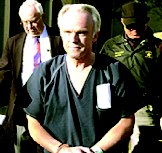
Real Cases
In March 2004, Dr. Tom Butler of Texas Tech University was sentenced to 2 years imprisonment, 3 years supervised release, and a $50,000 fine
Sent vials of bubonic plague bacteria to Tanzania
Claimed the vials were either lost or stolen
September 2010 - “Officials shut down most of the airport (Miami) overnight, roused hotel guests from their beds and detained Thomas Butler, 70, until Friday morning, when he was released without charges, the official said.”

Slide 29
Questions?
Mark Stomski: 206-616-8741
stomski@uw.edu
Slide 29

