Slide 1
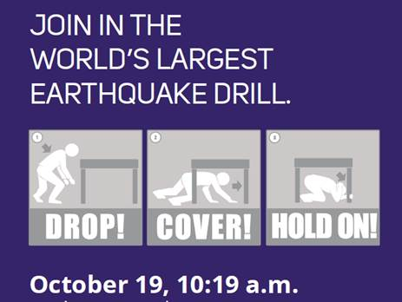
Great Shake Out 10.19 at 10:19 Earthquake Drill - That’s Today!
All floors of the Tower will receive a live announcement with drill instructions.

