Slide 1
OCTOBER IS NATIONAL BIOSAFETY MONTH
MRAM
October 2017
Zara Llewellyn, PhD.
Biological Safety Manager
206-221-2676, zaral@uw.edu
Environmental Health & Safety Department

Slide 2
WHAT IS BIOSAFETY?
The containment of potentially harmful biological agents
Requires use of safe practices, training, facilities, and equipment for managing biohazardous materials
Provides protection of people, animals, and the environment

Slide 3
UW BIOLOGICAL SAFETY PROGRAM
1,813 of 4,100 total (44%) of lab spaces are biohazard labs
539 of 970 total (56%) lab Principal Investigators (PI) are registered with Institutional Biosafety Committee (IBC)
681 projects are registered with the IBC
387 IBC applications reviewed in 2016
40% of IBC applications involve animals
5.6 Biological Safety Officers
IBC/Research Coordinator

Slide 4
OCTOBER IS NATIONAL BIOSAFETY MONTH
Led by the National Institutes of Health (NIH)
Office of Science Policy
Started in 2014 as a result of biosafety lapses at government laboratories

Slide 5
NATIONAL BIOSAFETY MONTH
Time to focus attention to biosafety policies, practices, and procedures
We encourage labs to raise biosafety awareness, discuss safety, and seek ways to strengthen biosafety in their labs
Last year we focused on biological inventories

Slide 6
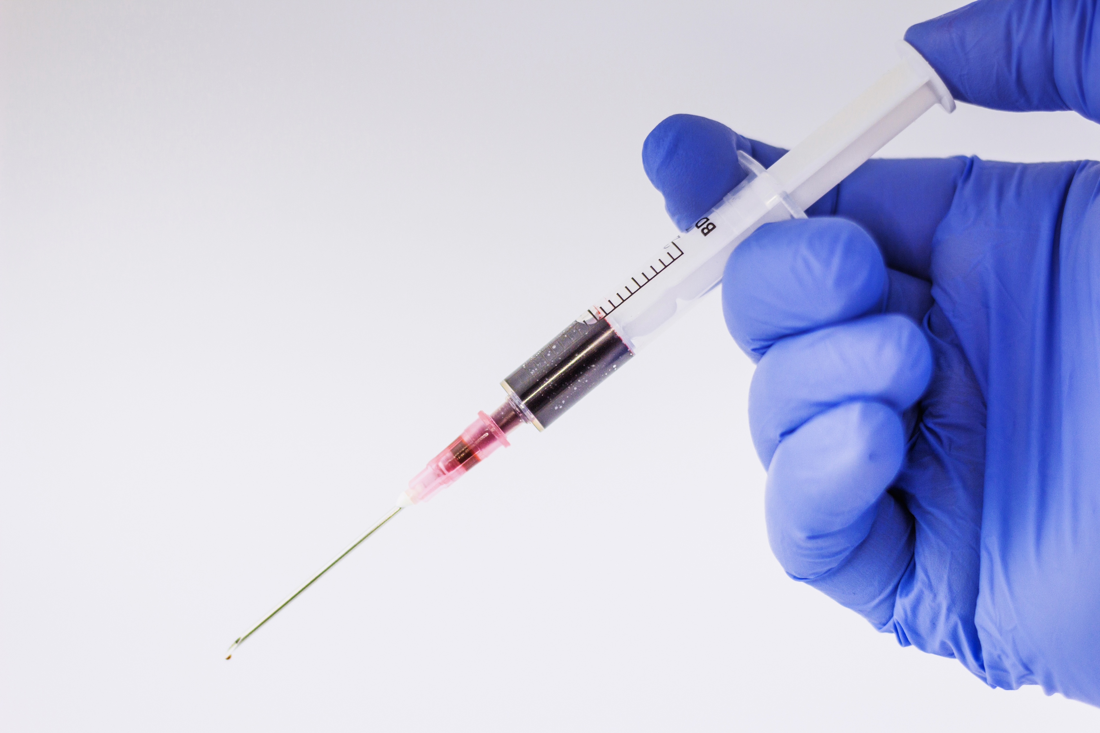
2017 UW BIOSAFETY MONTH
SHARPS SAFETY
Sharps Safety
Raise awareness about working safely with needles and other sharp items
Prevent needlesticks, injuries, and accidents
Exposure Response Procedures
Clarify and simplify response procedures
Raise awareness about the Exposure Response Poster

Slide 7
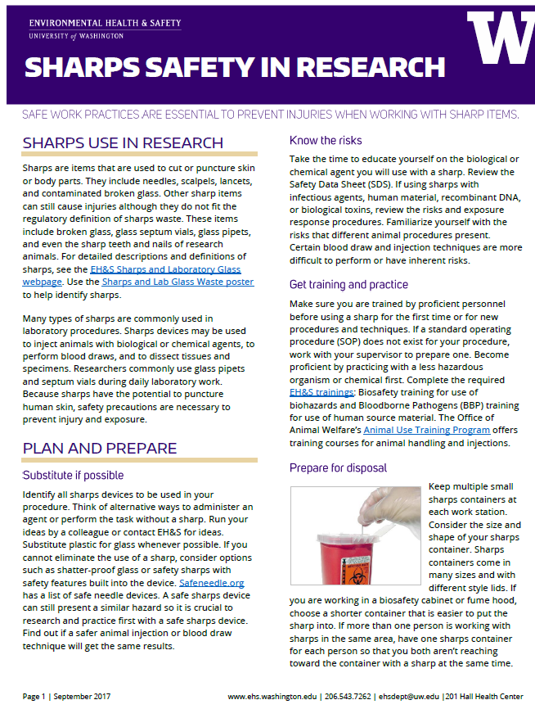
SHARPS SAFETY IN RESEARCH
http://www.ehs.washington.edu/manuals/focus/sharps_safety.pdf

Slide 8
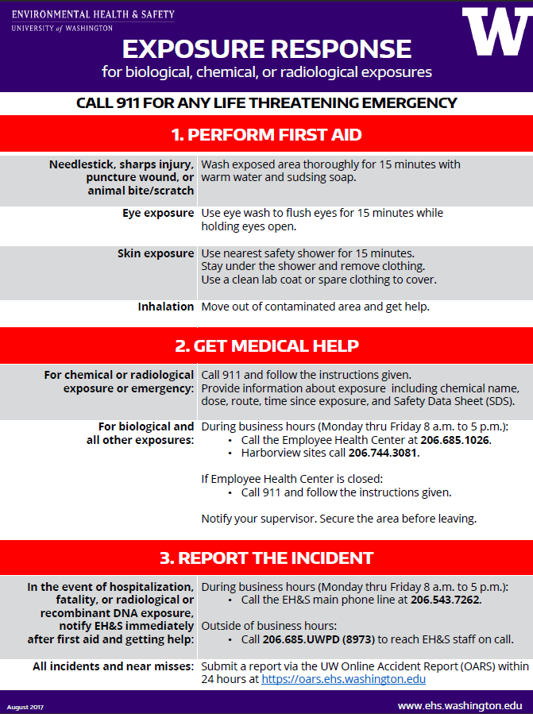
NEW EXPOSURE
RESPONSE POSTER
https://www.ehs.washington.edu/manuals/posters/exposureresponseposter.pdf

Slide 9
HELP US GET THE MESSAGE OUT
National Biosafety Month
Sharps safety in research
New exposure response poster

Slide 10
RESOURCES
EH&S web: www.ehs.washington.edu
Biological safety: https://www.ehs.washington.edu/rbsbiosafe/index.shtm
UW Biological Safety Stewardship: http://www.ehs.washington.edu/rbsbiosafe/steward.shtm
Sharps Safety in Research: http://www.ehs.washington.edu/manuals/focus/sharps_safety.pdf
Exposure Response Poster: https://www.ehs.washington.edu/manuals/posters/exposureresponseposter.pdf
Institutional Biosafety Committee: https://www.ehs.washington.edu/rbsresplan/ibc.shtm
NIH Biosafety Month:
https://osp.od.nih.gov/2017/09/13/national-biosafety-month-new-fall-classic/
EH&S Biosafety:
206.221.7770 or ehsbio@uw.edu

