Slide 1
SAGE Compliance Improvements R1 MRAM Overview 10.19.17
System to Administer Grants Electronically
(SAGE)

Slide 2
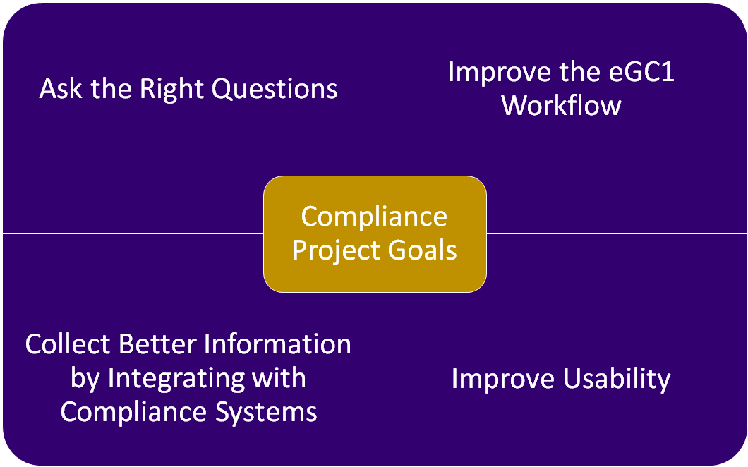

Slide 3
Two Phased Feature Delivery
Release 1 (Released on 10/17!!) | Release 2 (Win2018)
Goal: Ask the Right Questions
Eliminate unnecessary questions Reword fiscal and admin questions to better clarify purpose/intent | Revise Compliance page questions
Goal: Improve Workflow
Move fiscal & administrative questions off Compliance page Add new Activity Locations page with space planning & international involvement
Goal: Integrate with other Systems
Use GeoSIMS for location lookups | Use Hoverboard and Zipline lookups for protocol status, start and end dates
Goal: Improve Usability
Updated design on Activity Locations Feedback will inform future rollout across all of SAGE | New Compliance page design Provide PIs direct access to Compliance page via URL

Slide 4
Release 1 Feature Overview
Compliance pages get slimmer….
Question | Change
FG-1 Cost Share | Relocated to Budget & Fiscal Compliance page
FG-2 Conducted off campus | Removed (Replaced by Activity Locations)
FG-3 F&A at less than federally negotiated rate | Relocated to Budget & Fiscal Compliance page
FG-4 New, rental or renovation | Relocated to Activity Locations page
FG-5 Compensation for overtime | Removed
FG-6 Deliverables | Removed
FG-7 Administrative support | Relocated to Budget and Fiscal Compliance page
FG-8 Interdisciplinary facilities | Relocated to the PI, Personnel & Organizations page
FG-9 Review by other organization | Relocated to the PI, Personnel & Organizations page
NG-1 Advancement assistance | Removed
NG-3 Originating sponsor | Relocated to the Details page

Slide 5
Release 1 Feature Overview
Budget & Fiscal Compliance page

Slide 6
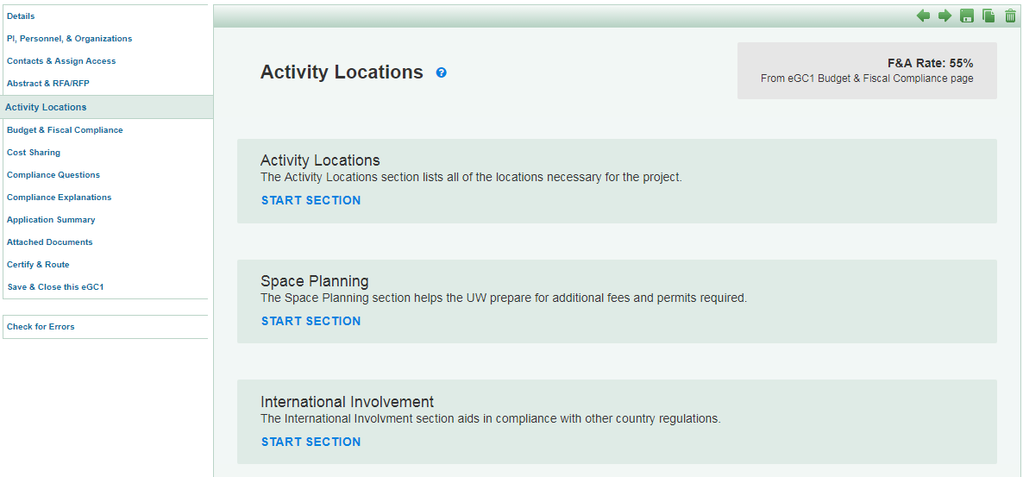
Release 1 Feature Overview
New Activity Locations page (New Design)

Slide 7
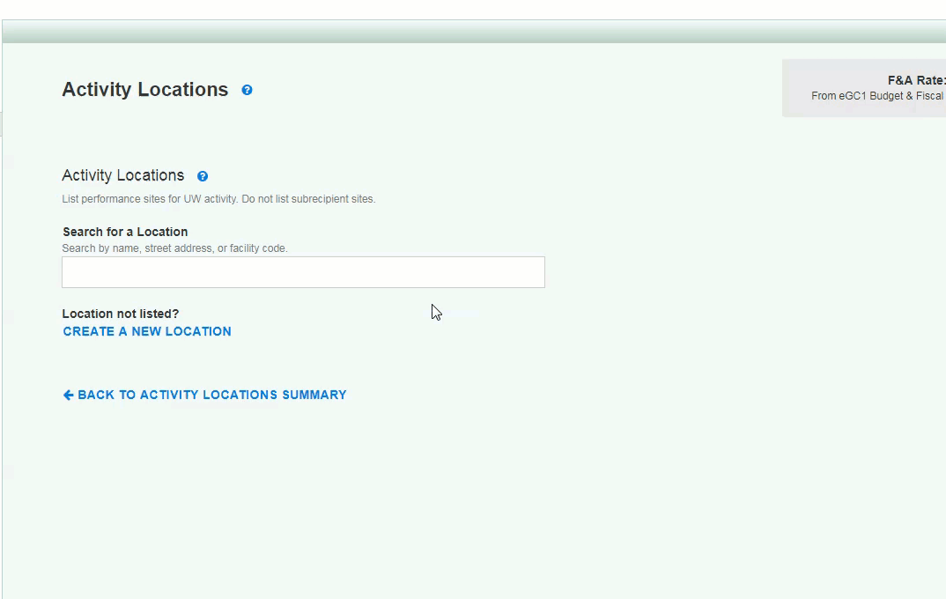
Release 1 Feature Overview
New Activity Locations page (Adding Locations)
Notes:
touch on new design and address/owned&leased coming as available in GeoSIMS

Slide 8
Release 1 Benefits

Slide 9
Resources and Feedback
Useful resources
SAGE Help Documentation
GIM 13: Facilities & Administrative (F&A) Rates
Stay tuned for updates to GIM 13: Locations section
Determining the Correct F&A Rates
Have questions or suggestions?
Contact sagehelp@uw.edu

Slide 10
SAGE Budget Update -- Pending
Resources and Training Opportunities
Coming October 26:
Fixes to cascading behavior
New setting to turn salary cascading ON/OFF (defaults to ON)
Fixes to APL rates
Decimal handling updates

Slide 11
Grant Runner Update -- Pending
Resources and Training Opportunities
Coming in Late November…
FORMS-E changes
Human Subjects & Clinical Trials Form

