Slide 1
MRAM | Monthly Research Administration Meeting
NOVEMBER 16, 2017 9:00 – 10:00 AM UW TOWER AUDITORIUM
TOPIC | PRESENTER | EMAIL | MIN
Welcome | Kirsten DeFries Research Compliance & Operations | kirsten5@uw.edu | 2
Audit Requirements in Foreign Sponsor Agreements | Richard Cordova Internal Audit | rcordova@uw.edu | 15
GIM 27 Updated | Grant Lyon & Carol Rhodes Office of Animal Welfare & Office of Sponsored Programs | carhodes@uw.edu glyon@uw.edu | 5
Compliance Corner | Matt Gardner Post Award Fiscal Compliance | mgard4@uw.edu | 10
IRB News: Non-UW IRB Review | Karen Moe Human Subjects Division | kemoe@uw.edu | 5
Certificates of Confidentiality | Carol Rhodes Office of Sponsored Programs | carhodes@uw.edu | 5
NIH: FORMS-E | Amanda Snyder Office of Sponsored Programs | acs229@uw.edu | 3
NIH: Clinical Trial Stewardship | Amanda Snyder, Carol Rhodes & Karen Moe Office of Sponsored Programs & Human Subjects Division | acs229@uw.edu carhodes@uw.edu kemoe@uw.edu | 15
NEXT MEETING DECEMBER 14, 2017 UW TOWER AUDITORIUM

Slide 2
Audit Requirements in Foreign Sponsor Agreements
MRAM - November 16, 2017
Richard Cordova, Executive Director
Internal Audit
University of Washington

Slide 3
Audit Requirements in Foreign Sponsor Agreements
Foreign Sponsor Agreement - Background:
Over the last 4 years Internal Audit has completed 5 audits for units across UW campus related to requirements coming out of the European Union.
Awards were flow thrus from EU to a European University
All required 20-25% cost sharing
Initially the audits were fairly straight forward

Slide 4
Audit Requirements in Foreign Sponsor Agreements
Foreign Sponsor Agreement – Background (cont):
Required approximately 100 hours of Internal Audit time
Required grant administration time over a period of a few weeks
Recent developments creating challenges and extending time to complete work.

Slide 5
Audit Requirements in Foreign Sponsor Agreements
Basic Audit Requirements:
Audit required when costs exceed $375,000 EUR if projects period exceeds two years.
Audit the costs claimed in the financial report provided to the sponsor.
Verify and test a certain quantity of transactions
Note they set a standard scope – much more specific than US Federal requirements.

Slide 6
Audit Requirements in Foreign Sponsor Agreements
Basic Audit Requirements (cont.):
Recalculate totals and verify Total Cost of Project including cost sharing.
Verify accuracy for foreign exchange rates used.
Require a Certified Public Accountant to “Certify” the accounts.
Allow up to 2,500 EUR for audit costs.

Slide 7
Audit Requirements in Foreign Sponsor Agreements
Recent Challenges:
EU terms and conditions require that ALL personnel costs be supported by time sheets.
They have refused to accept our certification reports.
Required the University to set productive hours/yr.
Units had to create timesheets that matches effort reported.

Slide 8
Audit Requirements in Foreign Sponsor Agreements
Recent Challenges (cont.):
Units needing the audits did not realize awards had audit clauses until near completion of budget/project period.
Internal Audit requested to complete the work within a very short time frame and without much notice.
Without audit report, EU sponsor will not release final payment on grant and could request return of funds previously paid.

Slide 9
Audit Requirements in Foreign Sponsor Agreements
Next steps:
OSP
Identify awards with audit requirements
Alert PI/depts. of the requirement
Ask department to include 2,500 EUR in their budget for audit costs.
Alert Internal Audit of the audit requirement

Slide 10
Audit Requirements in Foreign Sponsor Agreements
Next steps (cont.):
Internal Audit
Provide units with checklist on expectations for the audit so they can prepare records and reduce audit time at the end of the project.
Units
Notify Internal Audit at the start of the grant of the audit requirement
Plan, Plan, Plan – please keep OSP/IA informed of progress and give IA plenty of notice before end of the budget/project period.

Slide 11
Audit Requirements in Foreign Sponsor Agreements
Contacts:
Peter Harris, Senior Auditor, Internal Audit
ph3@uw.edu 206.543.4028
Zenaida Shattuck, Associate Director, Internal Audit
zshatt@uw.edu 206.543.4028
Carol Rhodes, Director, Office of Sponsored Programs
carhodes@uw.edu 206.543.2139

Slide 12
Update to GIM 27 - Use of Vertebrate Animals in Sponsored Programs
MRAM
November, 2017
Grant Lyon (glyon@uw.edu) Carol Rhodes (carhodes@uw.edu)
Office of Animal Welfare Office of Sponsored Programs

Slide 13
GIM 27
The Office of Animal Welfare (OAW) recently worked with the Office of Sponsored Programs (OSP) to revise GIM 27, a revised copy was published on 10/20/2017 and can be found on OSP’s website here.
GIM 27 had not been updated in over a decade and had information that was severely outdated, especially given the recent changes to grant/protocol congruence review.

Slide 14
Updates
Additional context to explain why and when OAW reviews proposals involving the use of vertebrate animals.
Clarification on roles and responsibilities (PI, OAW, OSP).
Terms commonly used are now defined.
A link to OAW’s Grant and Contract Review Process page was added.

Slide 15
Questions?
Office of Animal Welfare (OAW) Contact:
Grant Lyon
Program Operations Analyst
glyon@uw.edu, (206) 685-7027
Office of Sponsored Programs (OSP):
osp@uw.edu (206) 543-4043

Slide 16
COMPLIANCE CORNER:
UPDATES TO FEDERAL AGENCY REGULATIONS
MRAM
November 2017
Matt Gardner
Post Award Fiscal Compliance

Slide 17
WHAT’S NEW: NIH & NSF UPDATES
Updated guidance from NIH and NSF
No major changes from prior notices and announcements
Changes are outlined in documents linked on the PAFC website
MRAM – PAFC
Notes:
1-2 minutes

Slide 18
PAFC WEBSITE UPDATES
Goal: Make it easier for campus to access regulations, guidance and updates related to UW’s major federal sponsors
How to access: https://finance.uw.edu/pafc/regulations
Click on “Table of Select Federal Agency Regulations”
MRAM – PAFC
Notes:
If NIH and NSF released updated GPS/PAPPG, you don’t want to have to read through the whole thing to see what’s changed. PAFC website will provide users with a high-level overview of changes, along with links to current and relevant sponsor guidance.
Describe the landing page and text explaining federal hierarchy, etc.

Slide 19
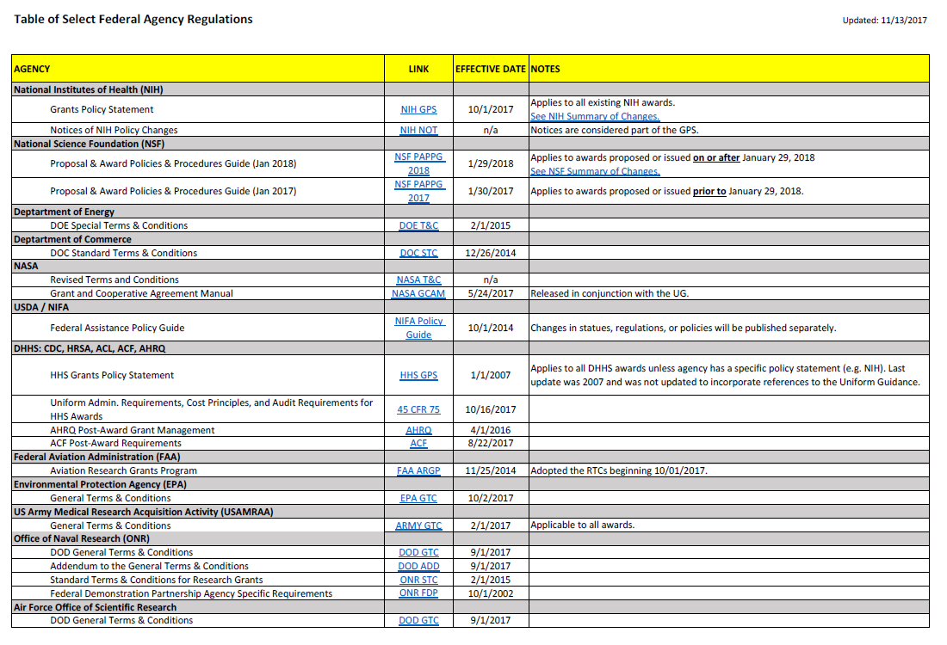
MRAM – PAFC
Notes:
Discuss links to the current policy and guidance.
Highlight “Effective Date” and any descriptive notes.
Highlight links in the Notes for both NIH and NSF leading to the Summary of Changes documents for each agency.

Slide 20
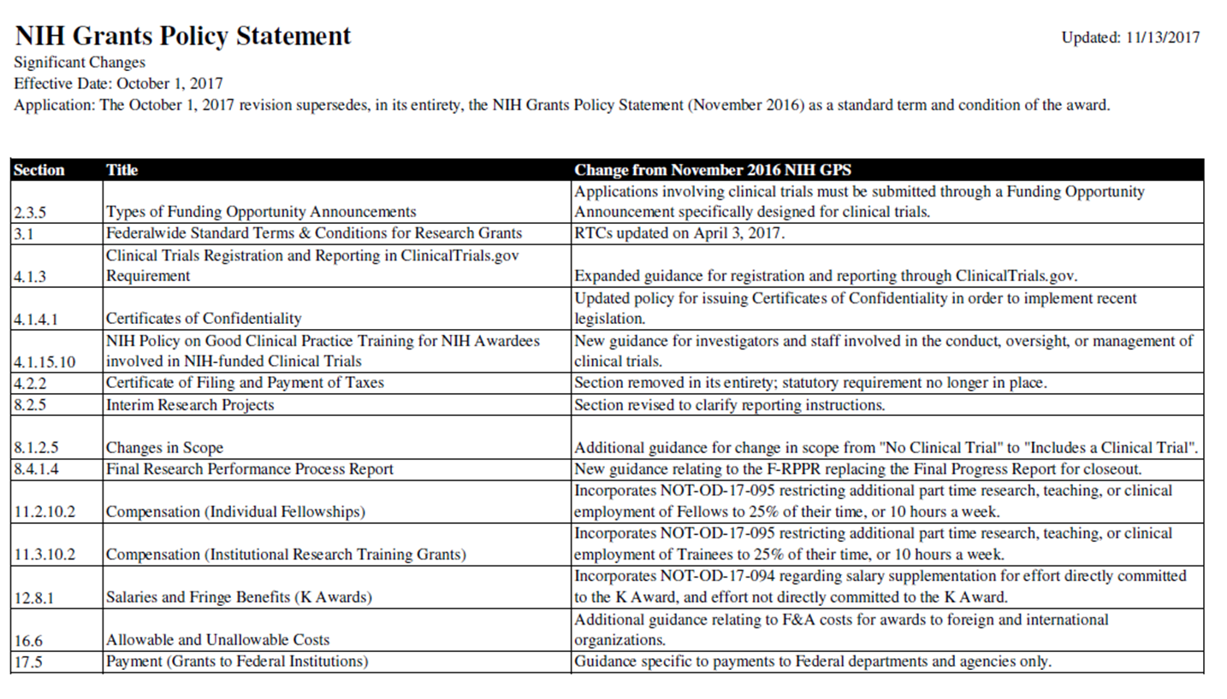
Notes:
Notes that PAFC will provide a summary of changes for NIH and NSF going forward for easy access by Campus.

Slide 21
QUESTIONS?
Please send us an email at: gcafco@uw.edu
Or give us a call:
Andra Sawyer: 685-8902
Matt Gardner: 543-2610
Thank you!
MRAM – PAFC

Slide 22
Using an External (non-UW) IRB Changes on January 12, 2018 d
Karen Moe, Director, UW Human Subjects Division kemoe@uw.edu
MRAM November 16, 2017

Slide 23
Some UW human subjects studies are reviewed by an external IRB instead of UW IRB
Why?
Expertise
Industry clinical trials go to an independent IRB (WIRB)
Oncology trials go to the Hutch IRB
Collaborative studies: Eliminate duplicate IRB review
Example: generic cooperative agreements with Seattle Childrens for studies that involve investigators at both institutions
Example: study-specific agreement to rely on another IRB
Single IRB requirement
NIH requirement for a single IRB to review all sites in a multi-site clinical trial
hsdinfo@uw.edu
www. washington.edu/research/hsd/

Slide 24
Problems with current process
Existing cooperative agreements
Which IRB should do the review? Not clear
Leads to significant delays while IRB offices work this out
No clear process or single point of contact
For requesting the use of an external IRB & establishing the agreement between the IRBs
Inefficient process
Not prepared to handle the pending increased workload due to NIH Single IRB policy
Changing federal expectations & compliance requirements
Documentation and tracking of review arrangements
hsdinfo@uw.edu
www. washington.edu/research/hsd/

Slide 25
Changes beginning January 12, 2018
Use Zipline for all requests to use an external IRB
Already doing this for reviews by WIRB and Hutch IRB
A single process for all external IRBs
Includes reviews under cooperative agreements (Seattle Childrens, Kaiser/Group Health, Benaroya)
Single point of contact and larger HSD team
HSD reliance team hsdrely@uw.edu
Adrienne Meyer, Assistant Director for Researcher Support
Elizabeth Falsberg, Bailey Bodell, Johanna Salmonson
Must provide external IRB with HSD authorization for review
Already doing this for WIRB and Hutch IRB
Obtain it through the Zipline request
Cooperative agreements: Guidance about which IRB to use
hsdinfo@uw.edu
www. washington.edu/research/hsd/

Slide 26
Timeline and Resources
Now
HSD Reliance Team available for help and problem-solving hsdrely@uw.edu
Mid-December
INSTRUCTION document
Short online tutorial
External IRB request form that is uploaded with Zipline request
a revision of current Request to use WIRB and Hutch
January 12, 2018
Zipline software revision
All changes are implemented
Guidance re cooperative agreements
External IRB webpage on the HSD site
hsdinfo@uw.edu
www. washington.edu/research/hsd/

Slide 27
NIH
Certificate of Confidentiality
November MRAM
Carol Rhodes
Office of Sponsored Programs

Slide 28
New NIH Certificate of Confidentiality Policy
Effective October 1, 2017:
CoCs issued automatically for active NIH-funded project using identifiable, sensitive information (applies to all active research as of 12.13.16)
An institution/PI/entity cannot opt out of the protections and resulting requirements applied under a CoC.

Slide 29
Certificate of Confidentiality - Purpose
A Certificate of Confidentiality (CoC) protects the privacy of individuals whose information is used as part of a project.
It prevents the disclosure of identifiable, sensitive information:
As part of a Federal, State, local civil, criminal, administrative, legislative or other proceeding, or
To any other person not connected with the research.

Slide 30
What Does NIH Consider
Identifiable, Sensitive Information?
Information about an individual that is gathered or used during the course of biomedical, behavioral, clinical, or other research, where:
An individual is identified; or
Collection or use of biospecimens that are identifiable to an individual or when there is at least a very small risk, that some combination of the information, a request for the information, and other available data sources could be used to deduce the identity of an individual; or
Generation of individual level human genomic data from biospecimens or the use of such data.

Slide 31
CoC: Exceptions
Disclosure allowed even with a CoC in place
There are SOME Exceptions that allow disclosure of CoC protected information
Required by Federal, State, or local laws
Made with the consent of individual
Made for purposes of other scientific research that is in compliance with applicable Federal regulations governing the protection of human subjects in research.

Slide 32
Length of Time Protected
Sensitive, identifiable research information collected when a Certificate is in effect, is protected permanently.
PIs must apply for a CoC for continuity of protections If they are or will continue to collect data after NIH funding has ended.
No extension is necessary if no more data will be collected and NIH funding has ended.

Slide 33
Principal Investigator (PI) CoC Responsibilities
Treat ALL information about individuals involved in NIH funded research as if a CoC applies.
Modify CoC, if the study is modified
If the collection of data continues after the award, apply to extend the CoC protection
Review & follow guidance for Sharing/Disclosing Information under a CoC
Use UW CoC decision tree for step by step determination
PI keeps a record of decision tree analysis in local project file.
Notes:
Includes NIH flow-through funding or projects partially funded by NIH

Slide 34
Sharing Protected Information with
Eligible Recipients
Make recipients aware that information being shared is protected by CoC.
Use this recommended language in emails, within systems housing the information, or in any Data Use Agreements used for the protected information.
Obtain patient consent when required.
Resources
Sharing/Disclosing CoC Protected Information
CoC Decision Tree: Is my NIH research subject to a CoC?
Notes:
OSP Subawards Team is using similar language in outgoing subawards, when it applies.

Slide 35
How HSD is helping
If you have a protocol in place, HSD helps you determine if the CoC applies.
HSD will let you know if you need to consent or re-consent as necessary.

Slide 36
CoC Resources
21st Century Cures Act
Is your project considered research?
Does your research involve Human Subjects?
Suggested Language to use when sharing
Guidance: Certificate of Confidentiality
Apply, Extend, Modify a Certificate of Confidentiality
NIH: NOT-OD-17-109
NIH: CoC Kiosk
NIH: CoC FAQs

Slide 37
NIH FORMS-E
Choose the Right Form!
November MRAM
Amanda Snyder
Office of Sponsored Programs

Slide 38
NIH FORMS E: Changes
Mostly changes to human subjects and clinical trials data collection (more on that later)
Consolidates Clinical Trials & Human Subjects info
NEW PHS / CT Form Mandatory in MOST Application Packages
MAKE SURE you are using the correct application forms for your due date!!
SAGE Grant Runner updates in December
Due Dates on or after
01.25.2018
FORMS-E Application Packages REQUIRED
NOT-OD-17-062
Notes:
Amanda

Slide 39
NIH FORMS - E: Choose the Right FOA
FOAs with STANDARD Due Dates: available for download 60 days before due dates.
MUST use FORMS-E for all standard due dates on or after Jan 25, 2018
Pay attention to Related Notices of FOAs for unique considerations.
Check your FOA at least 30 days before due date for updates
Notes:
Parent announcements for administrative supplements and post award administrative actions (successor-in-interest and change of institution applications) do not have set due dates and, consequently, will follow a different timeline than other parent announcements.
There are some less common FOAs being reissued ON January 25th such as PA-16-285 Change of Grantee Organization (Type 7 Parent).
Applications started on or after 1.25.18 MUST use the new FOAs and FORMS-E application. Current FOAs for the above, expire on 2.25.18.

Slide 40
Selecting the Right Form
Use FORMS-D for applications... | Use FORMS E for applications...
With due dates on or before 1.24.18 Submitted under NIH Late Policy 2-week window of consideration for due dates on or before 01.24.18 Submitted by 02.07.18 under NIH Continuous Submission Policy for the 1.7.18 AIDS due date | With due dates on or after 1.25.18, including: Those submitted early for due dates on or after 01.25.18 All application types (New, Resubmission, Renewal, Revision)
Notes:
Late Policy = Extenuating Circumstances, rarely applies; Continuous Submission = PIs who are especially active Peer Reviewers

Slide 41
FORMS-E Resources
Annotated Form Sets
High-level Summary of Form Changes in FORMS-E Application Packages
Preview of FORMS-E Grant Application Form Changes

Slide 42
NIH Clinical Trial Stewardship
November MRAM
Carol Rhodes, Amanda Snyder & Karen Moe
Office of Sponsored Programs &
Human Subject Division

Slide 43
All Research Involving Human Participants
Certificates of Confidentiality for all NIH research that uses “identifiable, sensitive information”
Use of a single Institutional Review Board (IRB) for multi-site studies
New forms to collect human subjects & clinical trials information
Notes:
Amanda : NIH Reforms & Initiatives to Enhance Stewardship of Research Involving Human Subjects, issued a notice fall of last year and have been implementing changes for about a year now.

Slide 44
Research That Meets the
NIH Definition of a Clinical Trial
Respond to Clinical trial-specific Funding Opportunity Announcements (FOAs)
Registration and results reporting in ClinicalTrials.gov
Training in Good Clinical Practice (GCP)
Notes:
Amanda

Slide 45
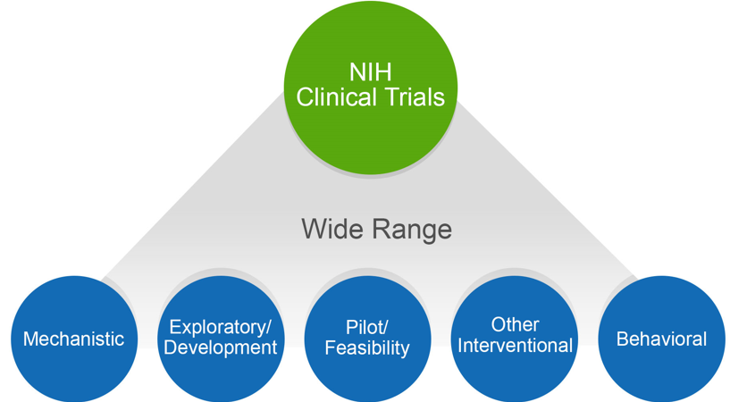
NIH Might Consider Your Human Subjects Research a Clinical Trial
Does your study…
Involve one or more human subjects?
Prospectively assign human subject(s) to intervention(s)?
Evaluate the effect of intervention(s) on the human subject(s)?
Have a health-related biomedical or behavioral outcome?
If “yes” to ALL of these questions, your study is considered a clinical trial
Use the NIH Decision Tree to help: https://grants.nih.gov/ct-decision/
Notes:
Amanda

Slide 46
Why This Is Important
If NIH considers your research a clinical trial (CT) the PI needs to:
Respond to a clinical trial-specific FOA
FORMS E - additional required fields
Indicate where single IRB is (Not UW... )
Register and report the clinical trial in ClinicalTrials.gov
Good Clinical Practice (GCP) Training Requirements
Notes:
Amanda

Slide 47
Identifying the Right Funding Opportunity Announcement (FOA) is Key
All FOAs will be designated as one of the following in Section II of the FOA:
Clinical Trial Required
Clinical Trial Not Allowed
Clinical Trial Optional
No Independent Clinical Trials: *only for Career Development (K) & Fellowship (F)
CT applications MUST be submitted to an FOA that allows clinical trials
Check your FOA at least 30 days before due date for updates
Notes:
Amanda - certain types of FOAs will not include the PHS/CT form

Slide 48
Confirming FOA
It is the PI’s responsibility to decide if the project is a clinical trial as defined by NIH and to choose the appropriate FOA.
NIH validations are specific enough to check for required fields based on FOA selected and other responses within the proposal.

Slide 49
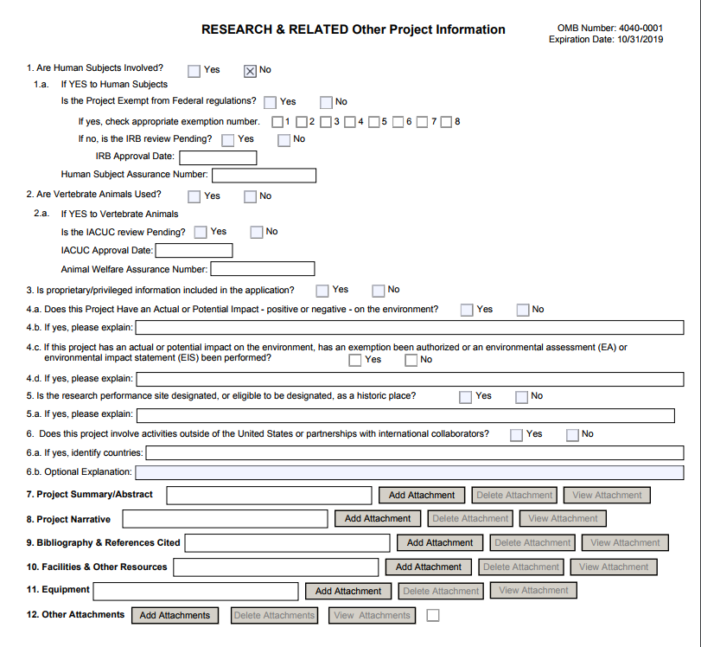
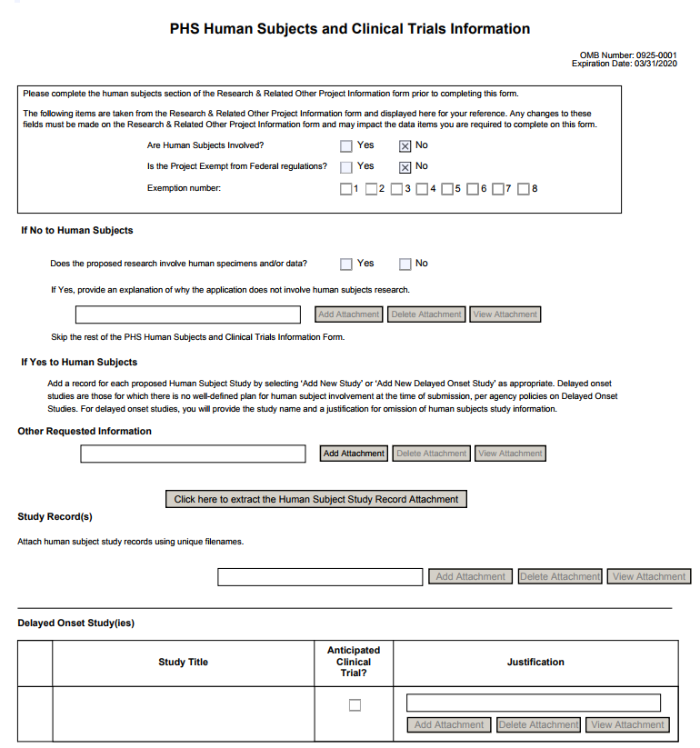
PHS HS & CT Form
When HS=NO
Notes:
Amanda

Slide 50
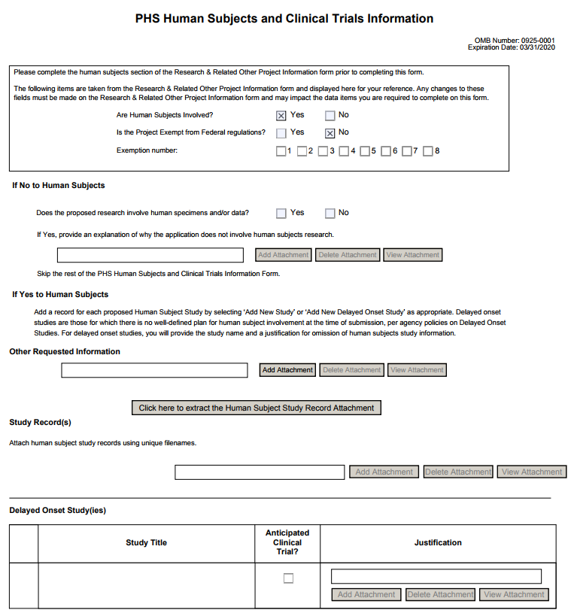
PHS HS & CT
Form
WHEN HS=YES
…must include at least one full or delayed onset study record
Full Study Record
Delayed Onset Study
Notes:
Amanda - HS - Yes & CT - even more fields to fill out.

Slide 51
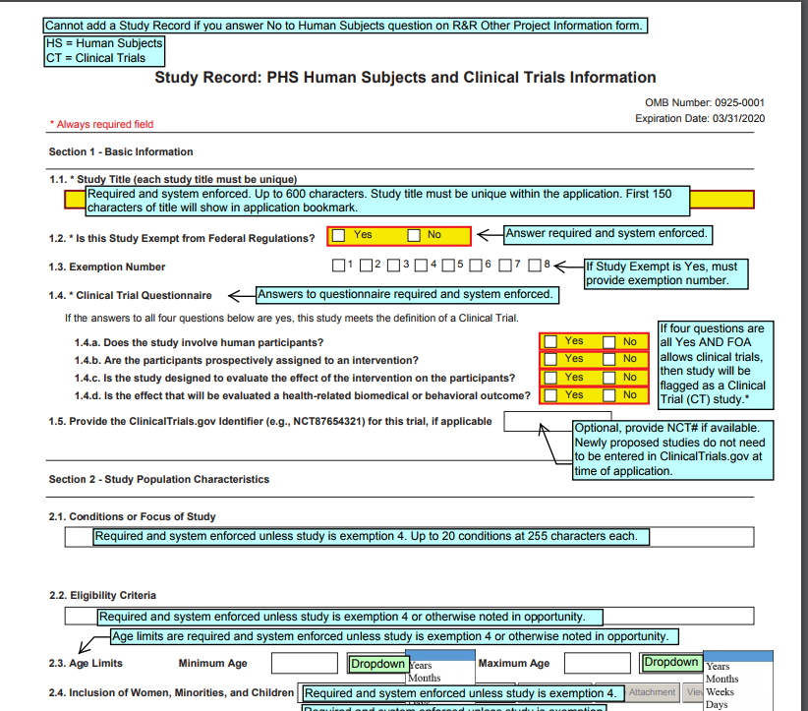
Annotated Forms
Notes:
Amanda - HS - Yes & CT - even more fields to fill out. Study Level Forms - speak to how much more work maybe do this on the web if we have it 5 pages - 1) Basic Study Info, 2) Study Population Characteristics (with Inclusion Enrollment), 3) Protection & Monitoring Plan, 4) Protocol Synopsis, 5) Other CT attachments. NIH is moving towards having a link between ASSIST and CT.gov to pull in info from CT.gov (using a valid NCT number).

Slide 52
Another consideration at time of proposal...
In addition to selecting the appropriate FOA & filling out required fields, the PI needs to be aware whether a single IRB is required.
Notes:
Amanda

Slide 53
NIH Single IRB Policy for Multi-site Clinical Trials d
Karen Moe, Director, UW Human Subjects Division kemoe@uw.edu
MRAM November 16, 2017

Slide 54
Current practice Each site obtains its own IRB review
hsdinfo@uw.edu
www. washington.edu/research/hsd/

Slide 55
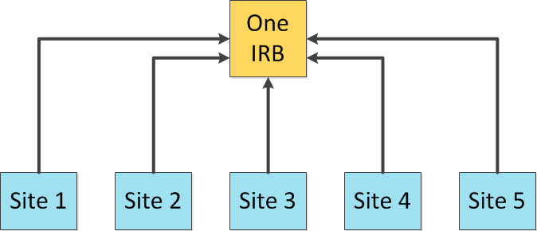
NIH Single IRB Policy
Beginning January 25, 2018
All competing NIH grants for multi-site research must include a plan for using a Single IRB to review all domestic sites.
https://grants.nih.gov/policy/clinical-trials/single-irb-policy-multi-site-research.htm
More efficient overall study start-up
Consistency of IRB review across sites
hsdinfo@uw.edu
www. washington.edu/research/hsd/

Slide 56
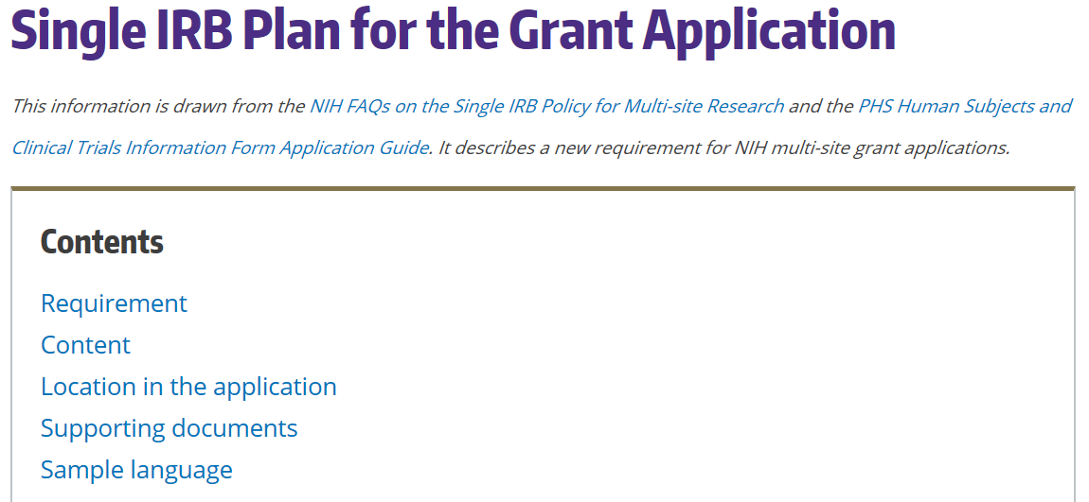
HSD Single IRB Website https://www.washington.edu/research/hsd/single-irb/single-irb-plan-grant-applic ation/
hsdinfo@uw.edu
www. washington.edu/research/hsd/

Slide 57
Selecting the Single IRB
Essential points to know
The UW IRB will not be able to serve as the single IRB for the next two years. (capacity issues)
If you are the lead or coordinating site: HSD will help you identify an appropriate single IRB (e.g., another academic IRB or an independent IRB)
If you are a participating site: HSD must approve the single IRB being proposed by the lead site (letter of support)
hsdinfo@uw.edu
www. washington.edu/research/hsd/

Slide 58
The Cost of a the Single IRB
Grants for the lead site or coordinating center
Essential points to know
Most IRBs (even at academic institutions) will charge fees for serving as a single IRB.
The fees are the responsibility of the lead or coordinating site, and must be included in your grant budget.
hsdinfo@uw.edu
www. washington.edu/research/hsd/

Slide 59
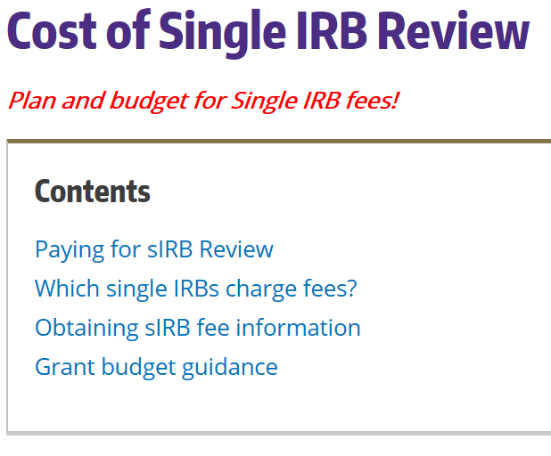
HSD Single IRB Website https://www.washington.edu/research/hsd/single-irb/cost-single-irb-review/
hsdinfo@uw.edu
www. washington.edu/research/hsd/

Slide 60
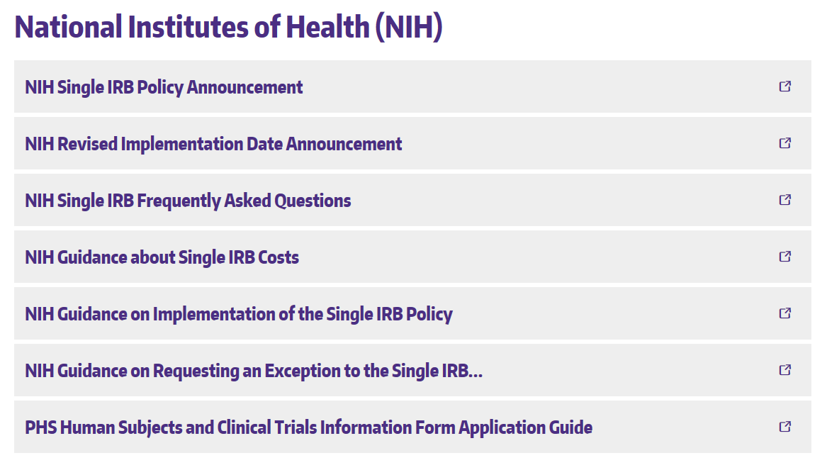
Resources & Help from NIH Links at the bottom of the HSD Single IRB webpage https://www.washington.edu/research/hsd/single-irb/
hsdinfo@uw.edu
www. washington.edu/research/hsd/

Slide 61
Clinical Trial Registration and Results Reporting d
Karen Moe, Director, UW Human Subjects Division kemoe@uw.edu
MRAM November 16, 2017

Slide 62
NIH Policy All clinical trials must:
Register trials at ClinicalTrials.gov by 3 weeks after the first subject is enrolled
Inform subjects about the registration (required paragraph in consent form)
Report study results at ClinicalTrials.gov within 1 year after study completion
Which clinical trials?
Clinical trials supported by NIH grants submitted on or after January 18, 2017
Why?
Promote broad, transparent, timely dissemination of trial results
Avoid needlessly duplicating previously conducted trials
Stewardship of precious public resources, through robust database about trials
Respect ethical obligations to participants who give their time and sometimes put themselves at risk for the sake of advancing science
hsdinfo@uw.edu
www. washington.edu/research/hsd/

Slide 63
How do you register a trial?
Essential points to know
You must register through the UW’s organizational account at ClinicalTrials.gov.
HSD manages the UW account.
The HSD Clinical Trials webpage has all the instructions, information, and tools you need for registration and results reporting.
hsdinfo@uw.edu
www. washington.edu/research/hsd/

Slide 64
HSD Clinical Trials webpage https://www.washington.edu/research/hsd/clinical-trials/clinical-trials-registration-and-reporting/
hsdinfo@uw.edu
www. washington.edu/research/hsd/

Slide 65
How HSD is helping with this requirement
Required wording in the standard consent template
Assess each new IRB application: Is it a clinical trial?
Before IRB review occurs
Upload assessment into Zipline (CT.gov Checklist)
Email to PI
Make sure consent form is correct
Guidance and problem-solving re registration
hsdreprt@uw.edu
hsdinfo@uw.edu
www. washington.edu/research/hsd/

Slide 66
Resources
HSD
HSD staff: hsdreprt@uw.edu
HSD Clinical Trials webpage
https://www.washington.edu/research/hsd/clinical-trials/clinical-trials-registration-and-reporting/
NIH
Webpage about the requirements and how to fulfill them
https://grants.nih.gov/policy/clinical-trials/reporting/index.htm
ClinicalTrials.gov website and its Protocol Reporting System (PRS)
https://clinicaltrials.gov/ct2/manage-recs
hsdinfo@uw.edu
www. washington.edu/research/hsd/

Slide 67
NIH GCP Training Policy
NIH-funded investigators and staff involved in clinical trials must be trained in Good Clinical Practice (GCP).
Review NIH GCP Training Information
Must demonstrate completion & retain training documentation.
GCP training should be refreshed at least every three years.
NOT-OD-16-148
Notes:
Carol

Slide 68
PI/Department Responsibilities
Keep email receipt of training certification in department files.
In Just-in-Time (JIT) materials, PI confirms training completion for personnel.
RPPR stage: NIH indicated annual assurance will be made. OSP will rely on eGC1 routing/approval that info. in RPPR is up to date.
Be prepared to respond to NIH GMS request for training confirmation
Resources:
Request training completion report: contact CITI
HSD Required Training
Notes:
Carol

Slide 69
Resources
NIH Clinical Trials:
Definition of a CT
CT Decision Tree
CT Training
Case Studies
Take a 10 min. tour of new Human Subjects /CT form
NOT-OD-17-043
sIRB
NIH sIRB
UW HSD: sIRB Guidance
CT.gov Registration & Reporting
UW HSD: Clinical Trial Registration & Reporting
Good Clinical Practice (GCP)
Review NIH GCP Training Information
HSD Required Training

