Slide 1
COMPLIANCE CORNER:
UPDATES TO FEDERAL AGENCY REGULATIONS
MRAM
November 2017
Matt Gardner
Post Award Fiscal Compliance

Slide 2
WHAT’S NEW: NIH & NSF UPDATES
Updated guidance from NIH and NSF
No major changes from prior notices and announcements
Changes are outlined in documents linked on the PAFC website
MRAM – PAFC
Notes:
1-2 minutes

Slide 3
PAFC WEBSITE UPDATES
Goal: Make it easier for campus to access regulations, guidance and updates related to UW’s major federal sponsors
How to access: https://finance.uw.edu/pafc/regulations
Click on “Table of Select Federal Agency Regulations”
MRAM – PAFC
Notes:
If NIH and NSF released updated GPS/PAPPG, you don’t want to have to read through the whole thing to see what’s changed. PAFC website will provide users with a high-level overview of changes, along with links to current and relevant sponsor guidance.
Describe the landing page and text explaining federal hierarchy, etc.

Slide 4
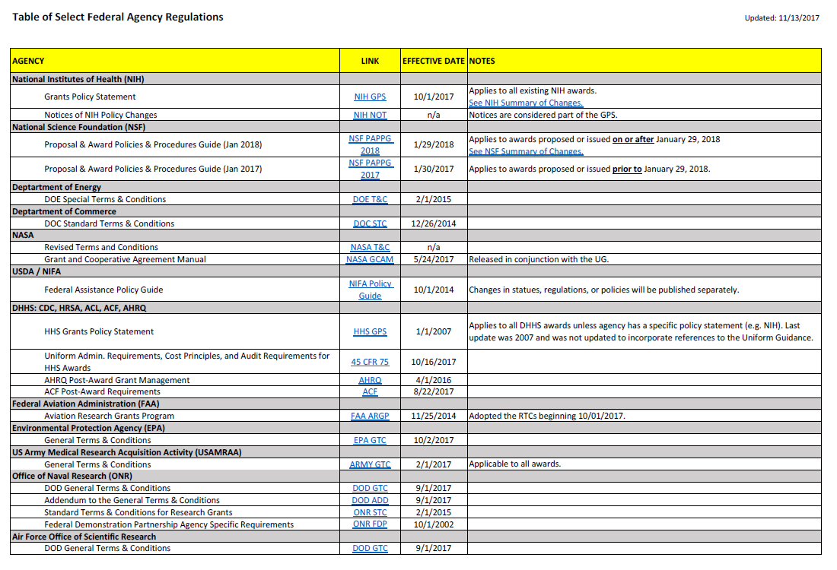
MRAM – PAFC
Notes:
Discuss links to the current policy and guidance.
Highlight “Effective Date” and any descriptive notes.
Highlight links in the Notes for both NIH and NSF leading to the Summary of Changes documents for each agency.

Slide 5
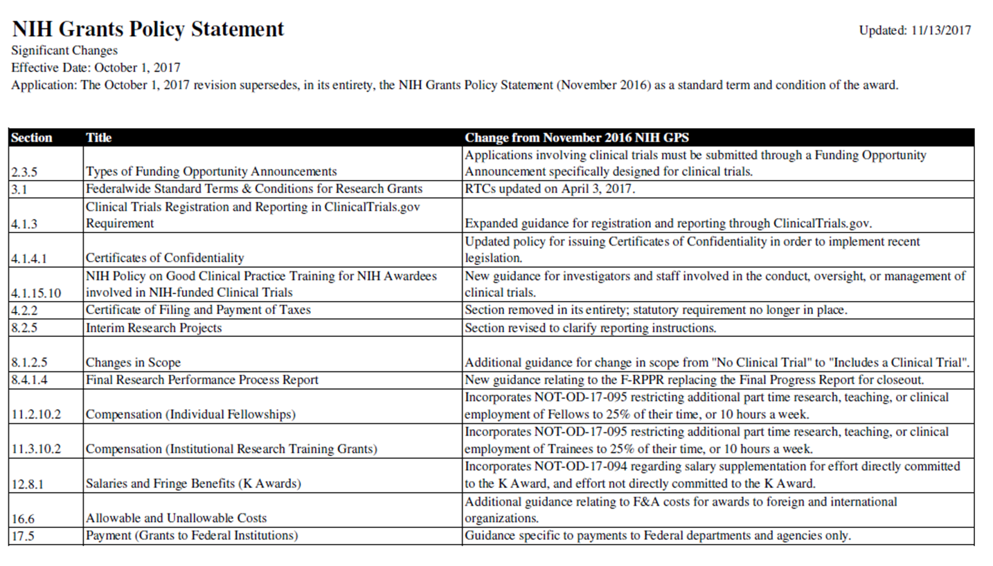
Notes:
Notes that PAFC will provide a summary of changes for NIH and NSF going forward for easy access by Campus.

Slide 6
QUESTIONS?
Please send us an email at: gcafco@uw.edu
Or give us a call:
Andra Sawyer: 685-8902
Matt Gardner: 543-2610
Thank you!
MRAM – PAFC

