Slide 1
NIH Clinical Trial Stewardship
November MRAM
Carol Rhodes, Amanda Snyder & Karen Moe
Office of Sponsored Programs &
Human Subject Division

Slide 2
All Research Involving Human Participants
Certificates of Confidentiality for all NIH research that uses “identifiable, sensitive information”
Use of a single Institutional Review Board (IRB) for multi-site studies
New forms to collect human subjects & clinical trials information
Notes:
Amanda : NIH Reforms & Initiatives to Enhance Stewardship of Research Involving Human Subjects, issued a notice fall of last year and have been implementing changes for about a year now.

Slide 3
Research That Meets the
NIH Definition of a Clinical Trial
Respond to Clinical trial-specific Funding Opportunity Announcements (FOAs)
Registration and results reporting in ClinicalTrials.gov
Training in Good Clinical Practice (GCP)
Notes:
Amanda

Slide 4
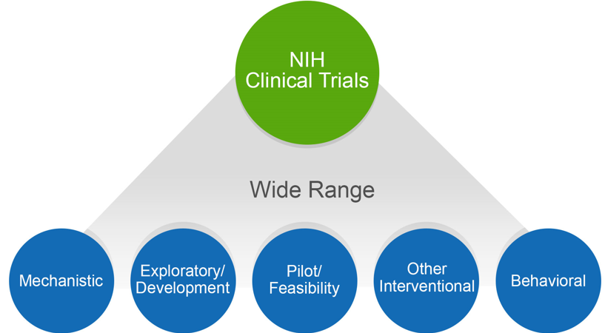
NIH Might Consider Your Human Subjects Research a Clinical Trial
Does your study…
Involve one or more human subjects?
Prospectively assign human subject(s) to intervention(s)?
Evaluate the effect of intervention(s) on the human subject(s)?
Have a health-related biomedical or behavioral outcome?
If “yes” to ALL of these questions, your study is considered a clinical trial
Use the NIH Decision Tree to help: https://grants.nih.gov/ct-decision/
Notes:
Amanda

Slide 5
Why This Is Important
If NIH considers your research a clinical trial (CT) the PI needs to:
Respond to a clinical trial-specific FOA
FORMS E - additional required fields
Indicate where single IRB is (Not UW... )
Register and report the clinical trial in ClinicalTrials.gov
Good Clinical Practice (GCP) Training Requirements
Notes:
Amanda

Slide 6
Identifying the Right Funding Opportunity Announcement (FOA) is Key
All FOAs will be designated as one of the following in Section II of the FOA:
Clinical Trial Required
Clinical Trial Not Allowed
Clinical Trial Optional
No Independent Clinical Trials: *only for Career Development (K) & Fellowship (F)
CT applications MUST be submitted to an FOA that allows clinical trials
Check your FOA at least 30 days before due date for updates
Notes:
Amanda - certain types of FOAs will not include the PHS/CT form

Slide 7
Confirming FOA
It is the PI’s responsibility to decide if the project is a clinical trial as defined by NIH and to choose the appropriate FOA.
NIH validations are specific enough to check for required fields based on FOA selected and other responses within the proposal.

Slide 8
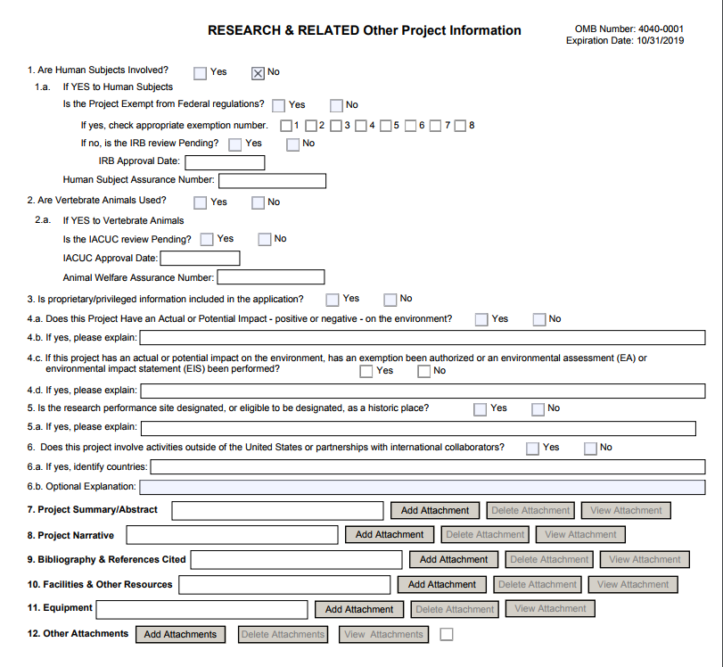
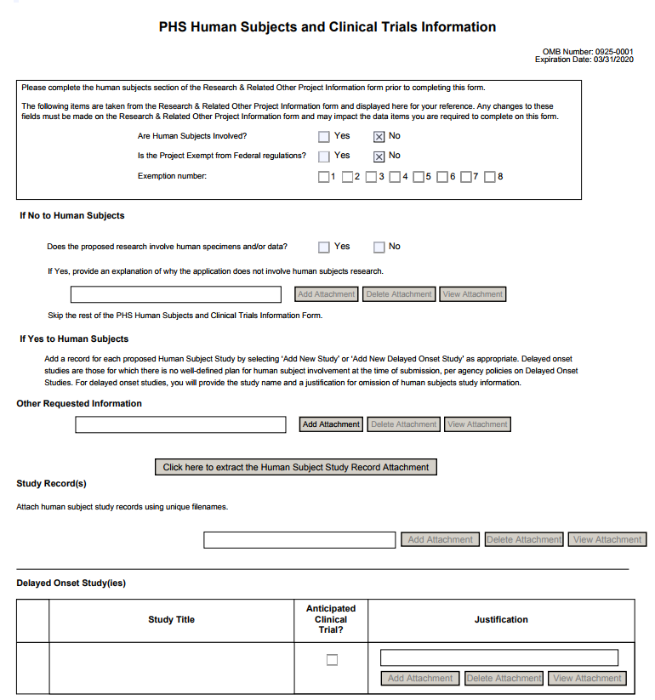
PHS HS & CT Form
When HS=NO
Notes:
Amanda

Slide 9
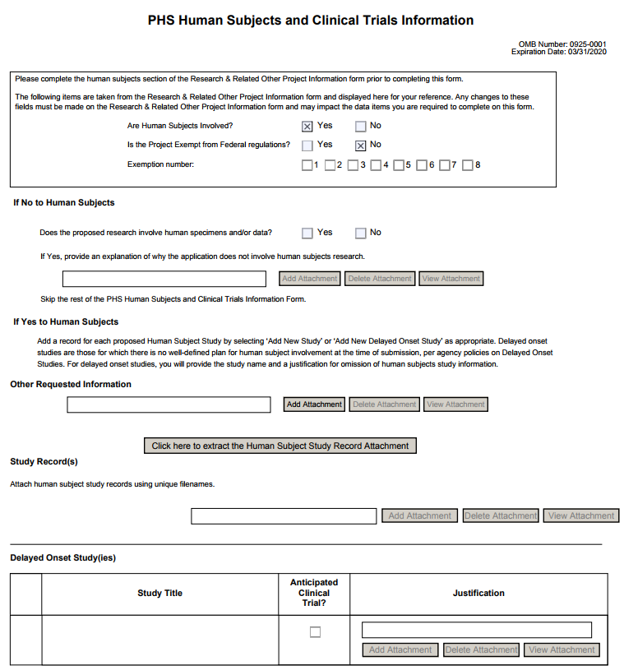
PHS HS & CT
Form
WHEN HS=YES
…must include at least one full or delayed onset study record
Full Study Record
Delayed Onset Study
Notes:
Amanda - HS - Yes & CT - even more fields to fill out.

Slide 10
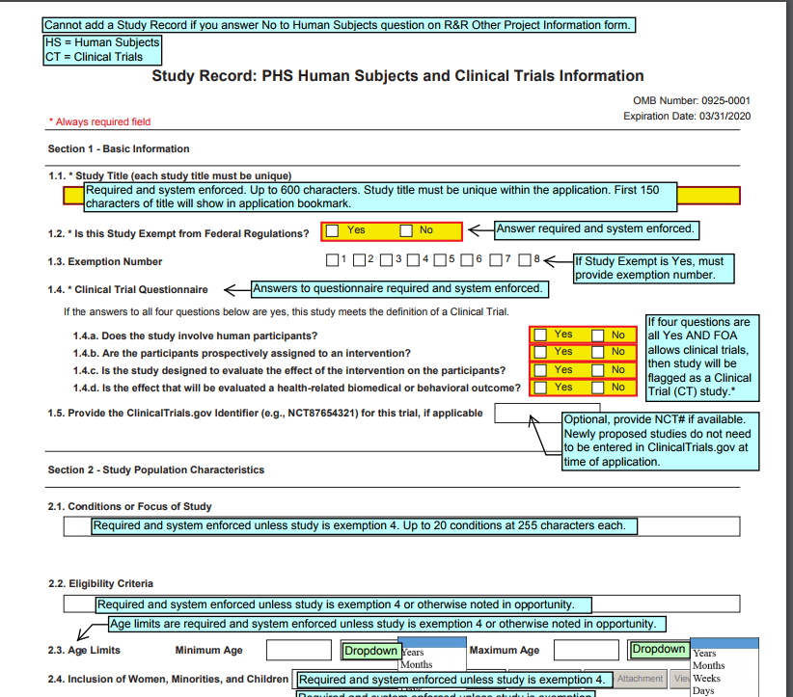
Annotated Forms
Notes:
Amanda - HS - Yes & CT - even more fields to fill out. Study Level Forms - speak to how much more work maybe do this on the web if we have it 5 pages - 1) Basic Study Info, 2) Study Population Characteristics (with Inclusion Enrollment), 3) Protection & Monitoring Plan, 4) Protocol Synopsis, 5) Other CT attachments. NIH is moving towards having a link between ASSIST and CT.gov to pull in info from CT.gov (using a valid NCT number).

Slide 11
Another consideration at time of proposal...
In addition to selecting the appropriate FOA & filling out required fields, the PI needs to be aware whether a single IRB is required.
Notes:
Amanda

Slide 12
NIH Single IRB Policy for Multi-site Clinical Trials d
Karen Moe, Director, UW Human Subjects Division kemoe@uw.edu
MRAM November 16, 2017

Slide 13
Current practice Each site obtains its own IRB review
hsdinfo@uw.edu
www. washington.edu/research/hsd/

Slide 14
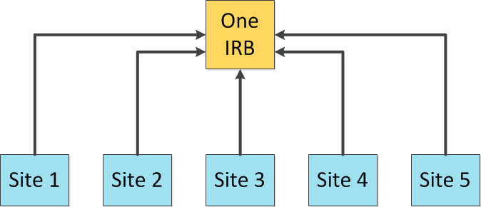
NIH Single IRB Policy
Beginning January 25, 2018
All competing NIH grants for multi-site research must include a plan for using a Single IRB to review all domestic sites.
https://grants.nih.gov/policy/clinical-trials/single-irb-policy-multi-site-research.htm
More efficient overall study start-up
Consistency of IRB review across sites
hsdinfo@uw.edu
www. washington.edu/research/hsd/

Slide 15
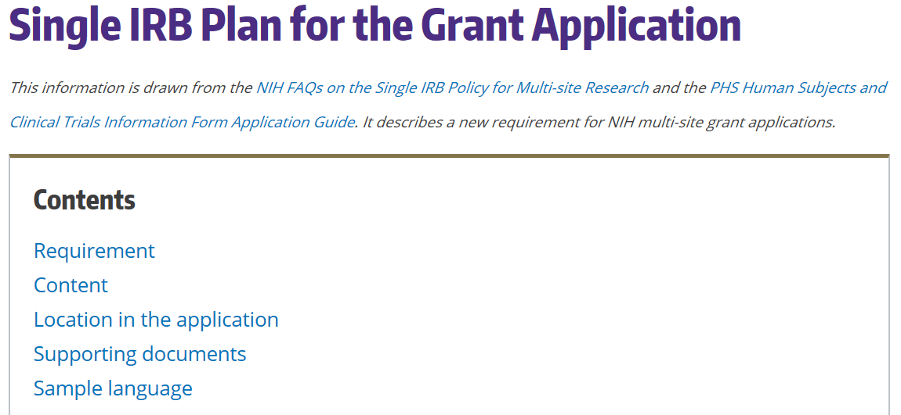
HSD Single IRB Website https://www.washington.edu/research/hsd/single-irb/single-irb-plan-grant-applic ation/
hsdinfo@uw.edu
www. washington.edu/research/hsd/

Slide 16
Selecting the Single IRB
Essential points to know
The UW IRB will not be able to serve as the single IRB for the next two years. (capacity issues)
If you are the lead or coordinating site: HSD will help you identify an appropriate single IRB (e.g., another academic IRB or an independent IRB)
If you are a participating site: HSD must approve the single IRB being proposed by the lead site (letter of support)
hsdinfo@uw.edu
www. washington.edu/research/hsd/

Slide 17
The Cost of a the Single IRB
Grants for the lead site or coordinating center
Essential points to know
Most IRBs (even at academic institutions) will charge fees for serving as a single IRB.
The fees are the responsibility of the lead or coordinating site, and must be included in your grant budget.
hsdinfo@uw.edu
www. washington.edu/research/hsd/

Slide 18
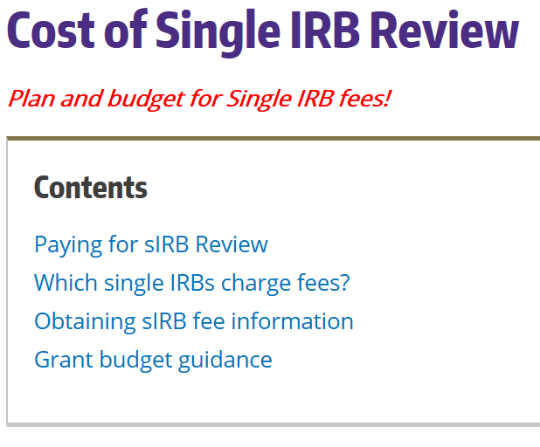
HSD Single IRB Website https://www.washington.edu/research/hsd/single-irb/cost-single-irb-review/
hsdinfo@uw.edu
www. washington.edu/research/hsd/

Slide 19
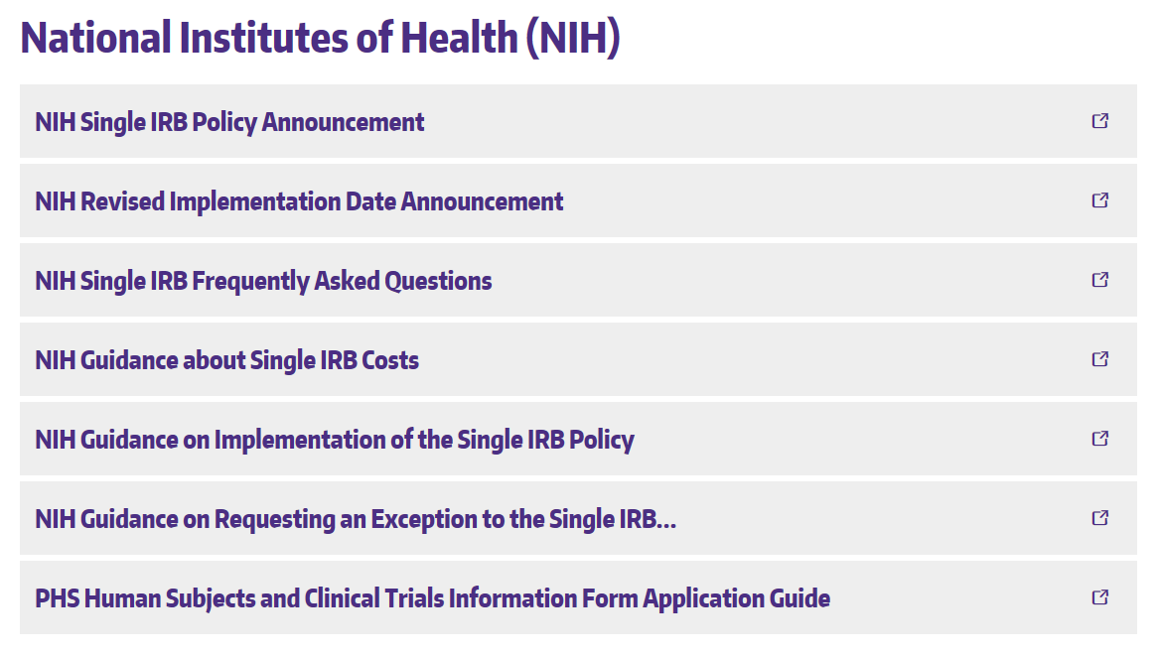
Resources & Help from NIH Links at the bottom of the HSD Single IRB webpage https://www.washington.edu/research/hsd/single-irb/
hsdinfo@uw.edu
www. washington.edu/research/hsd/

Slide 20
Clinical Trial Registration and Results Reporting d
Karen Moe, Director, UW Human Subjects Division kemoe@uw.edu
MRAM November 16, 2017

Slide 21
NIH Policy All clinical trials must:
Register trials at ClinicalTrials.gov by 3 weeks after the first subject is enrolled
Inform subjects about the registration (required paragraph in consent form)
Report study results at ClinicalTrials.gov within 1 year after study completion
Which clinical trials?
Clinical trials supported by NIH grants submitted on or after January 18, 2017
Why?
Promote broad, transparent, timely dissemination of trial results
Avoid needlessly duplicating previously conducted trials
Stewardship of precious public resources, through robust database about trials
Respect ethical obligations to participants who give their time and sometimes put themselves at risk for the sake of advancing science
hsdinfo@uw.edu
www. washington.edu/research/hsd/

Slide 22
How do you register a trial?
Essential points to know
You must register through the UW’s organizational account at ClinicalTrials.gov.
HSD manages the UW account.
The HSD Clinical Trials webpage has all the instructions, information, and tools you need for registration and results reporting.
hsdinfo@uw.edu
www. washington.edu/research/hsd/

Slide 23
HSD Clinical Trials webpage https://www.washington.edu/research/hsd/clinical-trials/clinical-trials-registration-and-reporting/
hsdinfo@uw.edu
www. washington.edu/research/hsd/

Slide 24
How HSD is helping with this requirement
Required wording in the standard consent template
Assess each new IRB application: Is it a clinical trial?
Before IRB review occurs
Upload assessment into Zipline (CT.gov Checklist)
Email to PI
Make sure consent form is correct
Guidance and problem-solving re registration
hsdreprt@uw.edu
hsdinfo@uw.edu
www. washington.edu/research/hsd/

Slide 25
Resources
HSD
HSD staff: hsdreprt@uw.edu
HSD Clinical Trials webpage
https://www.washington.edu/research/hsd/clinical-trials/clinical-trials-registration-and-reporting/
NIH
Webpage about the requirements and how to fulfill them
https://grants.nih.gov/policy/clinical-trials/reporting/index.htm
ClinicalTrials.gov website and its Protocol Reporting System (PRS)
https://clinicaltrials.gov/ct2/manage-recs
hsdinfo@uw.edu
www. washington.edu/research/hsd/

Slide 26
NIH GCP Training Policy
NIH-funded investigators and staff involved in clinical trials must be trained in Good Clinical Practice (GCP).
Review NIH GCP Training Information
Must demonstrate completion & retain training documentation.
GCP training should be refreshed at least every three years.
NOT-OD-16-148
Notes:
Carol

Slide 27
PI/Department Responsibilities
Keep email receipt of training certification in department files.
In Just-in-Time (JIT) materials, PI confirms training completion for personnel.
RPPR stage: NIH indicated annual assurance will be made. OSP will rely on eGC1 routing/approval that info. in RPPR is up to date.
Be prepared to respond to NIH GMS request for training confirmation
Resources:
Request training completion report: contact CITI
HSD Required Training
Notes:
Carol

Slide 28
Resources
NIH Clinical Trials:
Definition of a CT
CT Decision Tree
CT Training
Case Studies
Take a 10 min. tour of new Human Subjects /CT form
NOT-OD-17-043
sIRB
NIH sIRB
UW HSD: sIRB Guidance
CT.gov Registration & Reporting
UW HSD: Clinical Trial Registration & Reporting
Good Clinical Practice (GCP)
Review NIH GCP Training Information
HSD Required Training

