Slide 1
SAGE Updates
MRAM
December 2017
Amanda Snyder, Associate Director, OSP
Judy Chung, Program Manager, ORIS

Slide 2
SAGE: Coming Next Week!
On December 21, 2017:
Grant Runner:
FORMS-E updates
New Human Subjects and Clinical Trials form
Other SAGE:
Non-Award Agreement changes
Subaward updates

Slide 3
2017-18 Grant Runner Expansion Project
Mission:
Expand SAGE Grant Runner capabilities to support more federal opportunities, saving users time and effort through:
Fewer systems to interact with
Reduced duplicate entry
Reduced training and support requirements for non-UW Systems

Slide 4
Grant Runner FORMS-E Updates
Opportunity search:
Forms-E will be selectable after next week’s release
Notes:
Will see multiple versions for certain opportunities
Pick the correct opportunity version, based on due date

Slide 5
Human Subjects and Clinical Trials Form
New HSCT form shown in left navigation
Inclusion Enrollment no longer a separate form; embedded in HSCT
Fields from Research Plan and Career Development Supplemental transferred to new HSCT form

Slide 6
Human Subjects & CT Form Features
Features:
Download a blank fillable pdf study form
Import study data from the fillable PDF
Partial form import is OK; edit remainder in SAGE
Notes:
Teams may find it helpful to have the PI complete the study form using the PDF;
The form import is for individual studies only, not the entire HSCT form which can contain multiple studies. One study at a time gets imported.

Slide 7
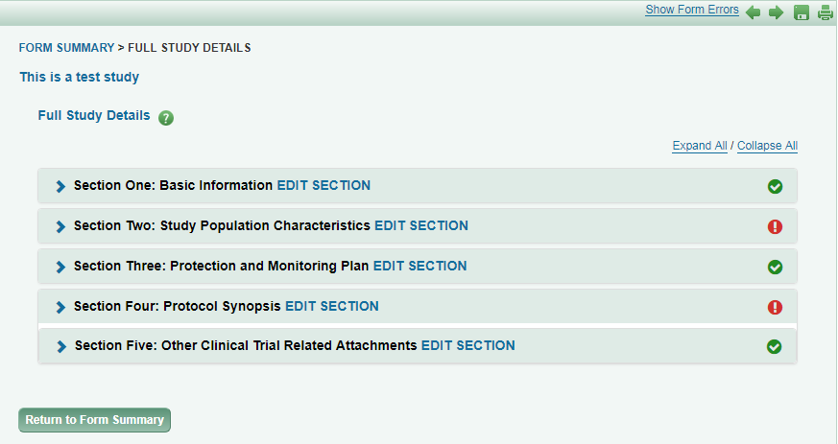
Form Features (continued):
Easy navigation and section status markers
“Expand All” for full form viewing
Notes:
Navigation includes: breadcrumbs at top, expandable sections
Sections are large, so can choose expand or not

Slide 8
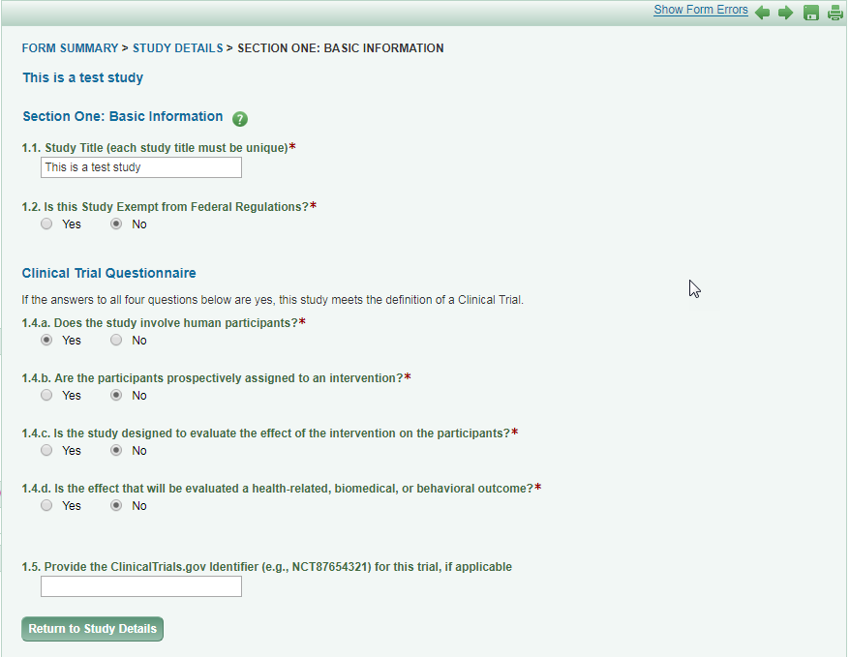
Edit Section by Section
Notes:
Easier to manage one section at a time
Will provide error checking section-by-section as well

Slide 9
Form Features (continued):
As with other Grant Runner forms, HSCT includes:
Print/preview PDF
individual form or full package, in NIH format
Error Checking
Individual form level -- Grants.gov errors only
Full package -- eGC1, Grants.gov and NIH errors

Slide 10
NIH Opportunities Currently Supported in Grant Runner
NIH Single Project, 5 year budget for:
Basic Research
Career Development
Endowment Programs
Shared Instrumentation
Director Awards
Targeted Research
Pre-Applications
Resource Awards
List by Activity Code

Slide 11
Non-Award Agreement Changes
Agreement related to research that does not include external funding but does obligate UW resources or make other legal obligations of UW, requiring institutional sign-off.
Examples include:
Data Use Agreements (DUA)
Confidentiality Agreements (CDA),
Master Agreements,
Material Transfer Agreements (MTA)
Unfunded research agreements

Slide 12
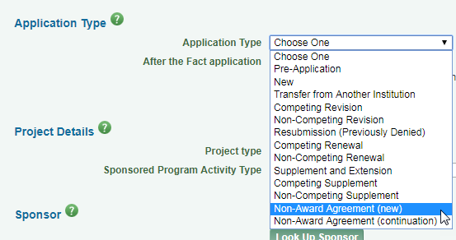
eGC1 Requirements for NAAs
eGC1s are required for an NAA.
2 new Application Types created for NAAs
Upon selection:
When is an eGC1 required? https://www.washington.edu/research/faq/need-use-egc1/
Notes:
May need explanation on when to use continuation.

Slide 13
eGC1 Requirements for NAAs (cont.)
Other changes to the eGC1 for NAAs:
“After the Fact” will always be YES
Help text that Sponsor = Other Party to the agreement
Budget locked down, fiscal questions default to “no”
Loosening of required field restrictions
Notes:
Loosening of field restrictions: sponsor deadline fields, abstracts & RFA/RFP fields

Slide 14
NAAs on eGC1: What has not changed
What is still required for NAAs:
FIDS Disclosures
Compliance question responses (non-fiscal)
Standard approval routing
Notes:
FIDS disclosures will fire when the eGC1 is in approved status AND a child admin action is created.

Slide 15
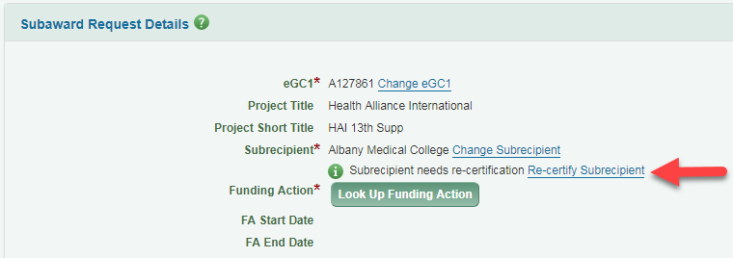
Subaward Changes
New prompt on screen when subrecipient certification is expired
It will not hold up submission
Meant to give an early heads up to take action
Send recertification form to subrecipient for completion, OR
OSP will send as part of their process

Slide 16
Locations Survey Link
Give us your feedback on the new design used in Locations page
Will help inform SAGE-wide design direction

Slide 17
Next Up in SAGE….
Winter 2018 Targets
Grant Runner:
Import from Clinical Trials.gov to pre-populate HSCT
SAGE Budget sync with RR Detailed Budget
Fellowship grants
Compliance (non-fiscal):
Question revisions
New look and feel (like locations)

