Slide 1
Federal Regulations
Some Important Dates
Office of Research

Slide 2
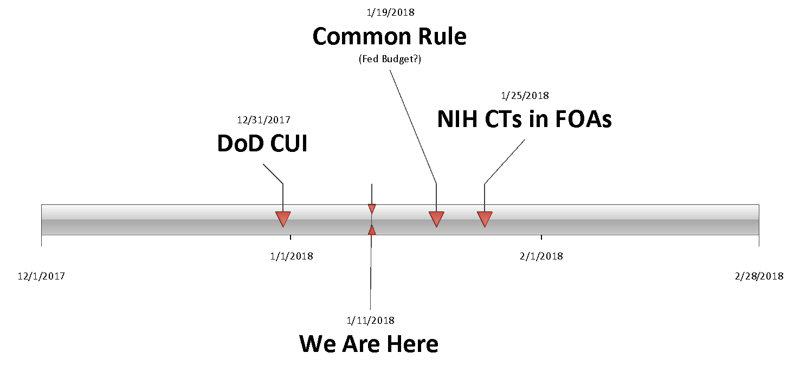
Some Important Dates

Slide 3
DoD CUI DFARS Clause
December 31 (2017)
Only applies to Dept of Defense (DoD) contracts
Only if the Controlled Unclassified Information (CUI) Defense Federal Acquisition Regulations (DFARS) clause applies
Only if “covered defense information” is involved
Special data and systems security requirements
  National Institute of Standards and Technology (NIST) 800-171 security standards
252.204.7012
Office of Research

Slide 4
NIH Clinical Trials (CTs)
January 25
Appropriate Funding Opportunity Announcement (FOA)
Expanded definition of CT
  Use the NIH
More regulations/requirements
  New sections in FORMS-E application
  Single IRB (sIRB) for multi-site CTs
  Good Clinical Practice (GCP) training
  Registering and reporting in ClinicalTrials.gov
decision tree
Office of Research

Slide 5
Some Important Dates

Slide 6
Common Rule
January 19
A delay is anticipated
Office of Research

