Slide 1
MRAM | Monthly Research Administration Meeting
FEBRUARY 8, 2018 9:00 – 10:00 AM UW TOWER AUDITORIUM
TOPIC | PRESENTER | EMAIL | MIN
Welcome | Kirsten DeFries Research Compliance & Operations | kirsten5@uw.edu | 2
Equipment Inventory Office (EIO) and Management Accounting & Analysis (MAA) Updates | Michael Anthony Management Accounting & Analysis | mda1213@uw.edu | 5
Annual Report: Grants and Contracts | Carol Rhodes Office of Sponsored Programs | carhodes@uw.edu | 10
Federal Shutdown? | Carol Rhodes Office of Sponsored Programs | carhodes@uw.edu | 2
Workspace update | Amanda Snyder Office of Sponsored Programs | acs229@uw.edu | 5
Faculty Grants Management (FGM) Course | Joe Giffels Office of Research | jgiffels@uw.edu | 10
NSF PAPPG: Changes | Tim Mhyre Office of Sponsored Programs | tmhyre@uw.ed | 10
Compliance Corner | Andra Sawyer Post Award Financial Compliance | andra2@uw.edu | 5
NEXT MEETING MARCH 15, 2018 UW TOWER AUDITORIUM

Slide 2
Management Accounting & Analysis & EIO Updates
MRAM - February 8, 2018
Michael Anthony
MAA/EIO
University of Washington

Slide 3
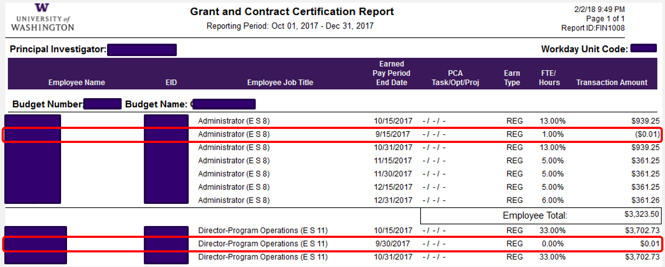
Penny Offsets on GCCRs
GCCRs might reflect 1c offset transactions with Earned Pay Period End date belonging to previous reporting period
These transactions are immaterial
No need to adjust previous cycle or treat these like OSETs
GCCR questions? E-mail efecs@uw.edu

Slide 4
EIO Update – ONR Audit
ONR Audit
ONR will be on campus in March conducting the Property Management System Analysis (PMSA)
It will include:
a sample physical inventory of all DoD or NASA acquired property regardless of title
controls testing related to the acquisition, receiving, disposal of property and asset records.
University of Washington Management Accounting & Analysis

Slide 5
EIO Update – New Goal
EIO
New goal – Improve department inventories
Will be conducting random sampling of inventory submissions throughout the year to determine accuracy
It will mirror the State audit process
A major concern was the number of assets that departments could not locate during the retagging effort yet were noted as being found on inventory submissions
Will start in March 2018
University of Washington Management Accounting & Analysis

Slide 6
Annual Report
Grants & Contracts
February 2018 MRAM
Carol Rhodes
Office of Sponsored Programs

Slide 7
Sponsored Program Administration
Proposals & Awards 2017
Proposals: 5,892 = $4.9 Billion
Federal: 3,973
Non-federal: 1,919
Awards: 5,174 = $1.6 Billion
Federal: 63.48%
Non-federal: 36.52%
Non Competing Renewals: 1,096
Outgoing Subawards: 1,852

Slide 8
Sponsored Program Administration
Administrative Actions 2017
Admin Actions: 7,697
Post Award Changes (PACs): 4,072
Pre Award Notifications (PANs): 2,086
Non Award Agreements (NAAs): 847
Closeout (CO): 638

Slide 9
Sponsored Project Administration
Complexity & Diversification
Proposals
1,543 unique sponsors 11% increase 5 years
451 unique industry sponsors 14% increase 5 years
Larger & more complex
9% increase of proposals over $1M
14% increase of proposals over $2M
Awards
1,145 unique sponsors 11% increase over 5 years
326 unique industry sponsors 14% increase over 5 years
Subawards
~500 unique subrecipients
Unique: direct funding source, not originating sponsors.

Slide 10
Resources
Research Stats & Rankings
https://www.washington.edu/research/or/research-stats-rankings/

Slide 11
Questions?

Slide 12
Federal Shutdown?
February MRAM
Carol Rhodes
Office of Sponsored Programs

Slide 13
Congress voting on a budget now
We are hopeful Congress will pass a budget before the deadline tonight.
Just in case...

Slide 14
If a Budget does not pass....
How Will OSP Share Information?
Research Homepage, MRAM email & Announcements on site
Award Specific:
Set up in SAGE as a Post Award Change (PAC). OSP Reviewer will forward to PI & eGC1 Admin Contact.
Subawards with a stop work order: OSP subawards team will coordinate actions to suspend. Do not put in a request.
General Agency information:
Agency specific information will be posted to
Research website

Slide 15
Questions?

Slide 16
Grants.gov
Workspace
February 2018 MRAM
Amanda Snyder
Office of Sponsored Programs

Slide 17
General Guidance
Questions about Workspace?
Grants.gov Adobe Application Packages Are Going Away!
Workspace: Introduction - MRAM presentation
Unless a sponsor specific system exists OR
Grant Runner is an option:
Then - use Workspace

Slide 18
Questions?

Slide 19
Redesigned:
Faculty Grants Management Course
Office of Research

Slide 20
History and Context
Past Audit Findings
Requirement – New UW PIs
Nearly 25 Years Old
Last few years
Pre-Award
Post-Award
Compliance
Audit
Office of Research

Slide 21
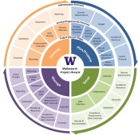
Refreshed FGM
Based on the Research Project Lifecycle
Case Study and Examples
How to develop checklists
How to find information/get help
Panels
Q&A
Guest Experts
Mix & Mingle
Refreshments
Office of Research

Slide 22
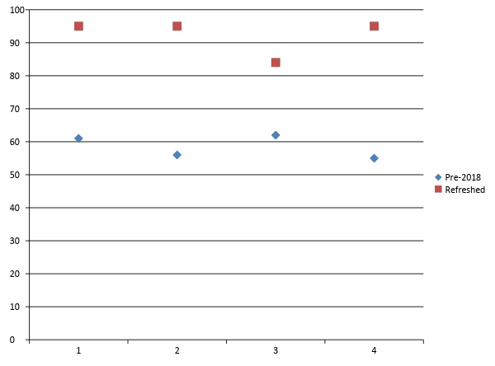
First Refreshed FGM Presentation
January 16 2018
% Strongly Agree/Agree
Applicable Content
Effective Presenters
Useful Handouts
Better Understanding
Office of Research

Slide 23
Going Forward…
FGM is (still) for F
Tweaks
Format
Content
Online version
To be refreshed, too
May 10 is next in-person session
Suggestions are welcomed!
Office of Research

Slide 24
NSF: PAPPG Changes Effective 1.29.18
February 2018 MRAM
Tim Mhyre
Office of Sponsored Programs

Slide 25
Sponsor Requirements:
NSF PAPPG - Significant Changes
Collaborators & Other Affiliations Information
Must use standard NSF COA template
Project Description
Must include a separate section specifically identified as "Intellectual Merit".
Budget and Budget Justification
Budget justification increased from 3 to 5 pages per proposal. Applies to budget justification for both proposers and subawardees.
Prior Written Approvals
Now references RTCs

Slide 26
FastLane & Research.gov Updates to Support PAPPG changes
Proposal File Updates (PFU):
Always trigger automated compliance review of ENTIRE proposal - even if previously submitted successfully
NSF Resources
COA Template FAQs
Summary of Changes to PAPPG
Webinar NSF PAPPG (NSF 18-1) webinar

Slide 27
Questions?

Slide 28
Compliance
Corner
MRAM
February 2018
Andra Sawyer
Post Award Fiscal Compliance

Slide 29
National Science Foundation (NSF) Audit
Audited expenditures in FY 2010 – 2013
Audit report released in March 2016
Questioned Costs
$1.8m in salaries in excess of the “2 month rule”
$200k other disallowed costs
UW responded to report in May 2016
Per NSF standard procedure, finalization of the audit is pending NSF management’s final decision
Notes:
Provide update on the NSF audit, tell participants that I will be defining the 2-month rule in the next slide

Slide 30
NSF’s 2 Month Rule
NSF limits the salary compensation requested in the proposal budget for “senior personnel” to no more than two months of their regular salary in any one “year.”
This limit includes salary compensation received from all NSF Awards.
Compensation for such personnel in excess of two months must be disclosed in the proposal budget, justified in the budget justification, and must be specifically approved by NSF in the award notice budget.
Notes:
Quote from PAPPG – tell participants that I will define Senior Personnel and Year next. Highlight statements in bold

Slide 31
Definition of Senior Personnel
Per GIM 10:
“…the Pl and any other person identified as senior or key personnel by the UW in a grant application, award, or contract or in any progress report, or any other report submitted to the PHS or other funding source.”
Notes:
GIM 10 has the definition of Senior Personnel

Slide 32
Definition of Year
2018 PAPPG:
“It is the organization's responsibility to define and consistently apply the term "year", and to specify this definition in the budget justification.”
Notes:
This year is the first time NSF has defined year, which is basically to leave it up to us.

Slide 33
UW Definition of Year
We want to make the definition of Year as easy as possible for:
departments to comply with the requirement; and
central offices to respond to in an audit.
If you have an opinion on the definition of year, please contact Andra, now, at andra2@uw.edu for input.
Notes:
Ask for help – should be defined within the next couple of weeks. Will need to clear with OSP, Controller’s Office and Internal Audit

Slide 34
Meanwhile, about Re-budgeting….
Previously, and during the period of the UW NSF Audit, NSF had an FAQ that said recipients (e.g., the UW) could exceed the 2-month limitation via re-budgeting; sponsor approval is not required
NSF’s Auditors (OIG) said that a NSF’s FAQ is not policy so any unapproved effort in excess of the 2-month rule is a questioned cost.
NSF management has since:
not sustained any other recipients’ “2-month rule” questioned cost
included the re-budgeting information as part of their policy (PAPPG) rather than an FAQ
Notes:
Provide an update on the rebudgeting issue

Slide 35
References
PAPPG 2-month Rule:
Part I, Chapter II, Section C.2.g.(i)(a)
https://www.nsf.gov/pubs/policydocs/pappg18_1/pappg_2.jsp#IIC2gia
GIM 10: https://www.washington.edu/research/policies/gim-10-financial-conflict-of-interest-policy/
Notes:
Info with links to the PAPPG and GIM 10

Slide 36
UPCOMING COURSES
IN RESEARCH ADMINISTRATION
 | Feb 13 | OSP 125 | Contracts Gone Bad
 | Feb 13 | ORIS 103 | SAGE Budget
 | Feb 14 | MAA 102 | Electronic Faculty Effort Certification (eFECS) for FEC Coordinators
 | Feb 27 | ORIS 102 | SAGE: Creating NIH Proposals in Grant Runner
 | Feb 28 | MAA 205 | Modifying an FEC Using Comments and Adjusting Cost Share
 | Mar 6 | RAA 100 | Grant and Contract Fiscal Administration: Compliance
 | Mar 13 | OSP 146 | Subawards in SAGE
 | Mar 14 | MAA 215 | Faculty Effort and Cost Share: Calculate It Right!
Register: https://uwresearch.gosignmeup.com/public/course/browse
CORE home: https://www.washington.edu/research/training/about-core/

