Slide 1
Management Accounting & Analysis & EIO Updates
MRAM - February 8, 2018
Michael Anthony
MAA/EIO
University of Washington

Slide 2
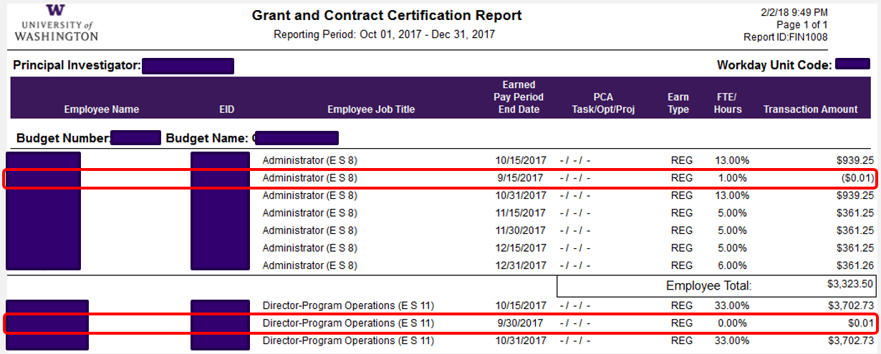
Penny Offsets on GCCRs
GCCRs might reflect 1c offset transactions with Earned Pay Period End date belonging to previous reporting period
These transactions are immaterial
No need to adjust previous cycle or treat these like OSETs
GCCR questions? E-mail efecs@uw.edu

Slide 3
EIO Update – ONR Audit
ONR Audit
ONR will be on campus in March conducting the Property Management System Analysis (PMSA)
It will include:
a sample physical inventory of all DoD or NASA acquired property regardless of title
controls testing related to the acquisition, receiving, disposal of property and asset records.
University of Washington Management Accounting & Analysis

Slide 4
EIO Update – New Goal
EIO
New goal – Improve department inventories
Will be conducting random sampling of inventory submissions throughout the year to determine accuracy
It will mirror the State audit process
A major concern was the number of assets that departments could not locate during the retagging effort yet were noted as being found on inventory submissions
Will start in March 2018
University of Washington Management Accounting & Analysis

