Slide 1
Redesigned:
Faculty Grants Management Course
Office of Research

Slide 2
History and Context
Past Audit Findings
Requirement – New UW PIs
Nearly 25 Years Old
Last few years
Pre-Award
Post-Award
Compliance
Audit
Office of Research

Slide 3
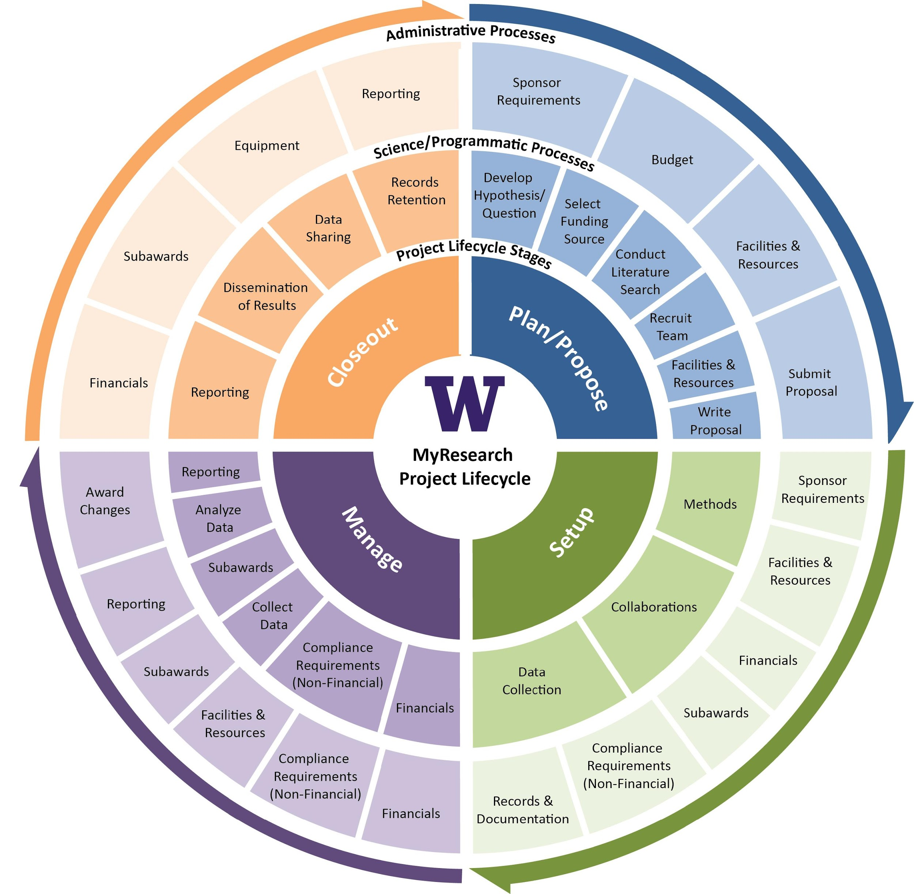
Refreshed FGM
Based on the Research Project Lifecycle
Case Study and Examples
How to develop checklists
How to find information/get help
Panels
Q&A
Guest Experts
Mix & Mingle
Refreshments
Office of Research

Slide 4
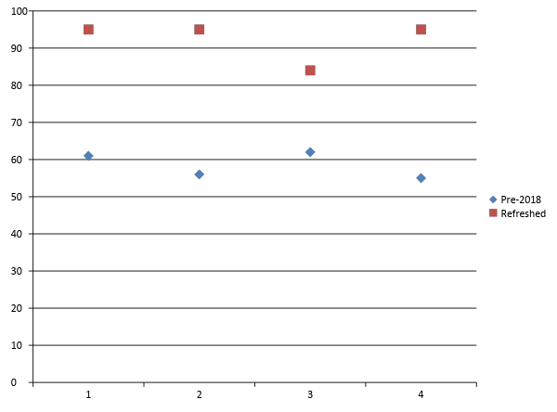
First Refreshed FGM Presentation
January 16 2018
% Strongly Agree/Agree
Applicable Content
Effective Presenters
Useful Handouts
Better Understanding
Office of Research

Slide 5
Going Forward…
FGM is (still) for F
Tweaks
Format
Content
Online version
To be refreshed, too
May 10 is next in-person session
Suggestions are welcomed!
Office of Research

