Slide 1
COMPLIANCE CORNER
MRAM
March, 2018
Andra Sawyer & Matt Gardner
Post Award Fiscal Compliance

Slide 2
New PAFC/GCA Tools
Cost Share Addendum
http://finance.uw.edu/gca/cost-share
Internal Controls – Purchasing eLearning
http://finance.uw.edu/pafc/trainings-and-outreach
Fiscal Compliance Dashboard
https://bitools.uw.edu/#/projects/228/workbooks

Slide 3
New Cost Share Addendum
What’s New?
Cost Share Calculators are linked to the Addendum
Addendum displays the benefits and/or F&A for each Cost Share item
F&A Rate only entered one time on the Addendum
Why is this better?
Reduction in the amount of information entered
Less chance for error
Easier to review the benefits and F&A costs
Easier to reconcile to eFECS Summary
MRAM – Post Award Fiscal Compliance

Slide 4
New Cost Share Addendum
Four different Excel files
Calendar Percent-based
Calendar Dollar-based
Academic Percent-based
Academic Dollar-based
Drop-down menus to prevent using the wrong form (Academic vs. Calendar)
Updated Cost Share content on the GCA webpage
http://finance.uw.edu/gca/cost-share
MRAM – Post Award Fiscal Compliance

Slide 5
New Cost Share Addendum
Want to see the New Addendum yourself?
Training for Campus!
Date: April 24th, 2018
Time: 9:30am – 11:00am
Room: Foege N130A
Sign up at CORE
https://uwresearch.gosignmeup.com/Public/Course/Browse
MRAM – Post Award Fiscal Compliance

Slide 6
New Cost Share Addendum
Questions?
Andra Sawyer
andra2@uw.edu
206-685-8902
Matt Gardner
mgard4@uw.edu
206-543-2610
Matt & Andra
gcafco@uw.edu
GCA
gcahelp@uw.edu
206-616-9995
MRAM – Post Award Fiscal Compliance

Slide 7
UPCOMING COURSES
IN RESEARCH ADMINISTRATION
 | Mar 28 | MAA 210 | Modifying an FEC, Change Outside eFECS and Recertifications
 | Apr 3 | OSP 101 | Introduction to Research Administration
 | Apr 11 | MAA 220 | Managing Faculty Effort
 | Apr 17 | GCA 203 | Preparing for Audit
New! | Apr 18 | OR Special Topics | Handling Research Administration Data
New! | Apr 24 | RAA 100 | Cost Share Essentials: Filling out the Addendum
New! | Online Class | RAA 203 | Internal Controls: Basic Concepts
Register: https://uwresearch.gosignmeup.com/public/course/browse
CORE home: https://www.washington.edu/research/training/about-core/

Slide 8
Internal Controls eLearning
Notes:
Only small part of Internal Controls, just around purchasing and purchase documentation – here is a screen shot of what the introduction looks like, you can see the content covered on the left menu bar. As with all of our eLearnings, set up so that users can either use as a reference tool and just enter the sections of interest or can take the entire course. If want credit then need to pass the Quiz at the end

Slide 9
Goals & Objectives

Slide 10
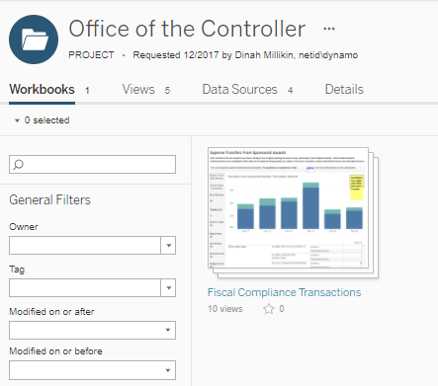
Office of the Controller Dashboard
Aged Receivables & high risk transactions on Sponsored Awards
Options for Open and Controlled Access
Program will expand
Uses Tableau which is:
Really cool
Frustrating
Notes:
When open it will see this view, click on the pic and you will see….

Slide 11
Office of the Controller Dashboard:
Aged Receivables has Open Access
Notes:
Cover what the A/R viz includes, updated daily

Slide 12
Visualizations with Controlled Access
Cost Transfers (To/From)
Equipment > 90 days Award End
Food
High risk transactions should be reviewed for:
Trends
Corrective actions
Training opportunities
Gaps in Internal Controls
Access > School/College Admin>email gcafco@uw.edu

Slide 13
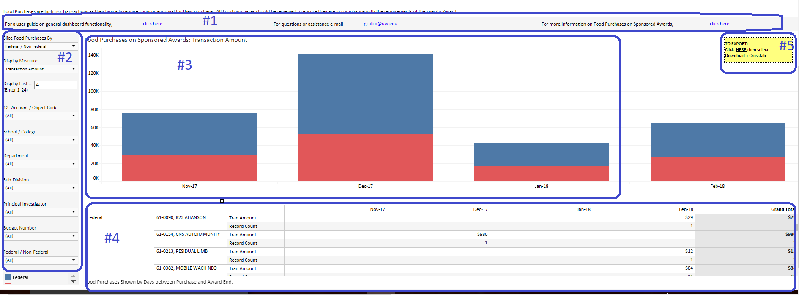
5 Parts to the Visualization
Help
Filter
Chart
Table
Export

Slide 14
Equipment Example: 1 department, Transaction Count, PI by Color

Slide 15
Food Example: 1 School, Transaction Amount, Colors by Department
Notes:
Highlight hover functionality; and Export

Slide 16
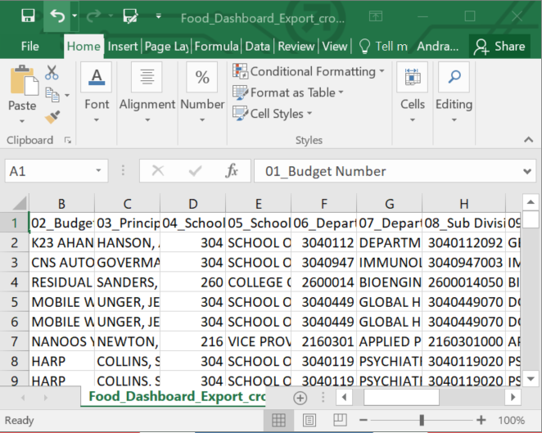
Filtered Data Exported into Excel
Budget Number & Name
Org Code (broken down into 3 segments)
PI Name
Revenue Class (Sponsor)
Federal/Non-Federal
Account Code
Posting Date
Amount
Notes:
Export functionality in Tableau, its terrible

Slide 17
Cost Transfers, includes information from MyFD
Notes:
Bonus section

Slide 18
Cost Transfers - Additional Exported Data
Name of Preparer
Name of Submitter
Number of days from Original Posting to Transfer Date
Responses to 3 Questions in MyFD:
Reason for Transfer
Benefit to Award
Reason for Delay (if > 120 days from original posting)

Slide 19
Office of Controller Dashboard - Key Points
Aged Receivables – open access
Controlled access
School/College Admin email gcafco@uw.edu for access
Help information on Dashboard
PAFC Outreach
Contact PAFC for School/College/Department customized presentation

