Slide 1
SAGE Compliance Improvements Release 2
MRAM
March 15th, 2018
Chris Carlson - Technology Project Manager
ORIS
carlsc@uw.edu

Slide 2
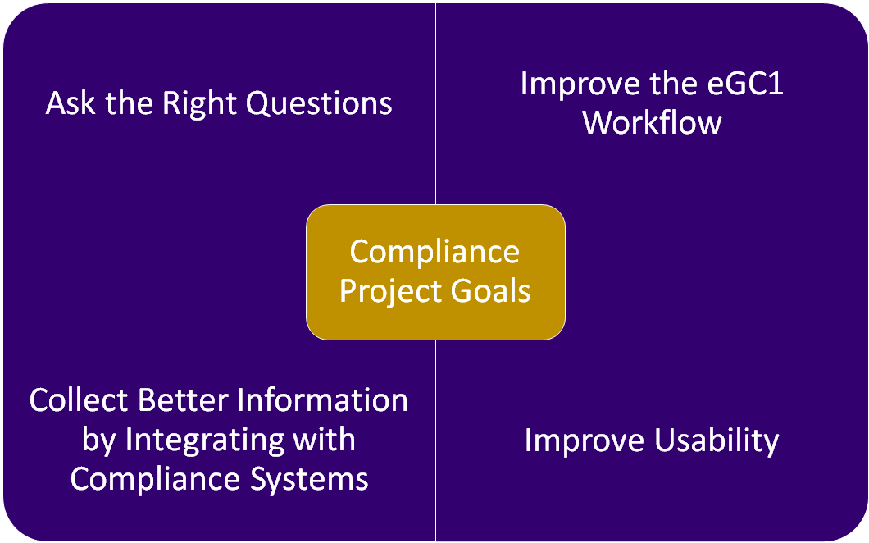
MRAM - Chris Carlson - ORIS

Slide 3
Multi-Phased Feature Delivery
Release 1 (10/17/17) | Release 2 (04/19/18)
Goal: Ask the Right Questions
Eliminate unnecessary questions Reword fiscal and admin questions to better clarify purpose/intent | Revise compliance questions for improved clarity
Goal: Improve Workflow
Move fiscal & administrative questions off Compliance page Add new Activity Locations page | Provide PIs with direct access to Non-Fiscal Compliance page via URL
Goal: Integrate with other Systems
Use GeoSIMS for location lookups | Link Zipline and Hoverboard to Human Subjects and Animal Use sections of eGC1
Goal: Improve Usability
Updated design on Activity Locations | Improved design for Non-Fiscal Compliance page Activity Locations design updated based on subsequent feedback
MRAM - Chris Carlson - ORIS

Slide 4
How We Got Here
Project prioritized due to campus feedback
Stakeholder-driven design
Campus input:
Compliance working group
Research Administration Process Improvement Team (RAPIT)
Sub-group of college/school-level reviewers
OSP partnership
Input from compliance reviewers in HSD, OAW, EH&S, CoMotion, and OR/Export Control
Two rounds of User Acceptance Testing with eGC1 preparers
Sign up to participate in our user research community
MRAM - Chris Carlson - ORIS

Slide 5
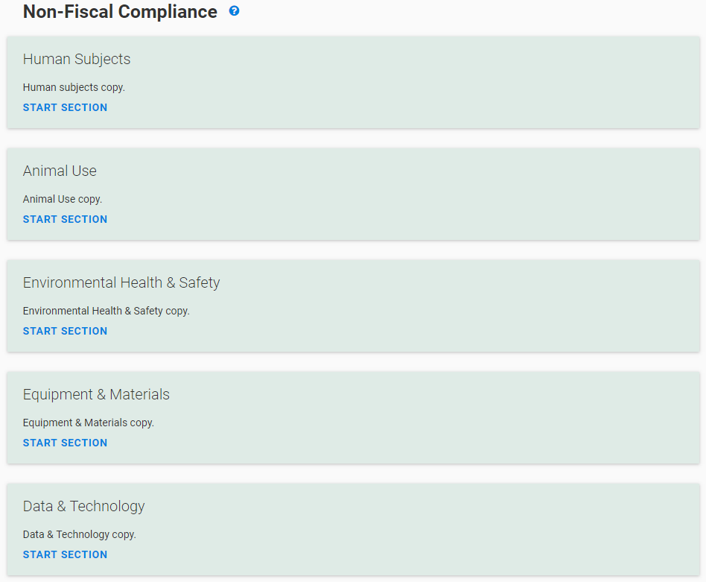
Release 2 Feature Overview
Started fresh, asking:
“What questions need to be asked at time of proposal and why?”
Questions re-worded and re-organized for improved clarity
Obsolete questions removed
Summary page gives transparency to progress, and guidance on how each section is reviewed

Slide 6
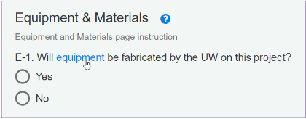
Release 2 Feature Overview
Improved system help documentation
Why asked? What’s it used for?
Links to definitions, guidance

Slide 7
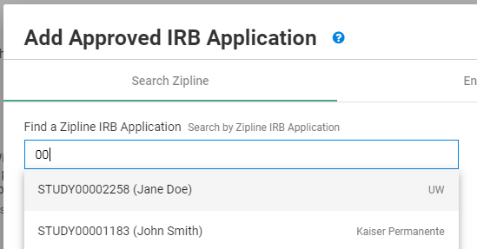
Release 2 Feature Overview
Connect SAGE to Zipline and Hoverboard
Search Zipline and Hoverboard for protocols
Once selected, real-time changes/updates will display in SAGE
(no info from SAGE currently flows to ZL/HB)
MRAM - Chris Carlson - ORIS

Slide 8
Release 2 Feature Overview
Improved collaboration with PI
Send the PI a URL to NFC page for a specific eGC1
The PI can complete the NFC page while you work on other parts of the eGC1
Additional benefits
Direct URLs available to all standard eGC1 pages (not Grant Runner forms)
MRAM - Chris Carlson - ORIS

Slide 9
Summary of Release 2 Benefits
Streamlining:
Removed obsolete questions
Pulls in details from Zipline + Hoverboard
Expedited reviews enabled by more detailed and accurate protocol information
Usability:
Revised, reworded questions for clarity & relevance
Improved design and user experience
Enhanced Collaboration:
Send URL to PIs for direct edit, collaboration
MRAM - Chris Carlson - ORIS

Slide 10
Resources and Feedback
Resources
SNEAK PEEK: View the questions before they go live
eGC1 Compliance Question FAQs (TBD)
SAGE Help Documentation
Non-Fiscal Compliance Guidance
Have questions or suggestions?
Contact sagehelp@uw.edu
MRAM - Chris Carlson - ORIS

