Slide 1
EU General Data Protection Regulation
(EU GDPR)
Office of Research

Slide 2
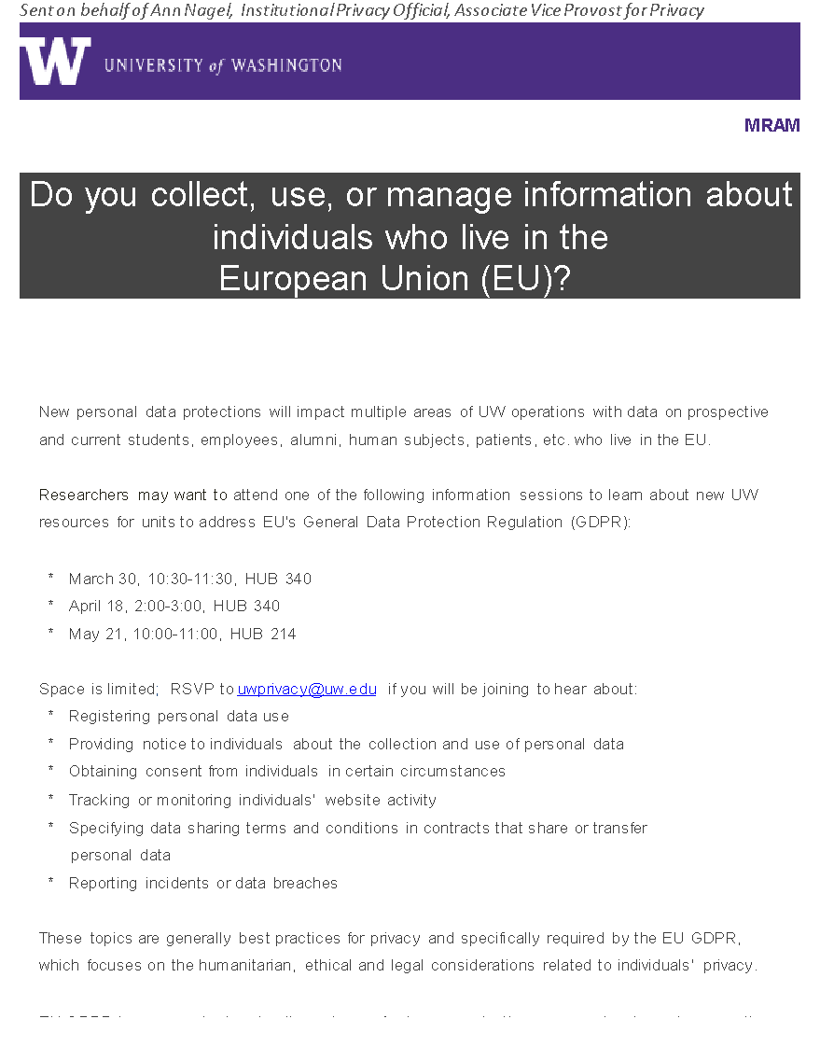
MRAM Message
March 23
Office of Research

Slide 3
EU GDPR Basics
Applies to personal info about EU residents
Notification and sometimes consent required
Breaches must be reported
UW registry
Penalties
Office of Research

Slide 4
UW’s Approach to Compliance
Risk management
Centralized support and coordination
Units are responsible
Integration of Research requirements
Information Resources

Slide 5
Information Sessions
Wednesday, December 13, 2017
Friday, March 30, 2018
Wednesday, April 18 – 2:00-3:00 HUB 304
Monday, May 21 – 10:00 – 11:00 HUB 214

Slide 6
Possible Relief
An exemption, for research?

Slide 7
Questions?
Start with the information sessions
Privacy Office (Privacy Officer Ann Nagel)
https://privacy.uw.edu/
uwprivacy@uw.edu
(206) 616-1238
Office of Research

