Slide 1
WEBSITE REDESIGN
Karen Crow, Outreach & Health Education Analyst
MRAM Meeting
May 10, 2018

Slide 2
BACKGROUND
ABOUT EH&S
60+ safety programs serving multiple client groups
WEBSITE PROJECT GOALS
Replace a static HTML website with CMS website
More professional and consistent with the UW Brand
Easier for content owners to update pages
Easier for users to navigate and locate safety information
DESIRED FEATURES
Training course wizard
Online forms with authentication
Strong search feature
Easy access to popular items and news posts
Notes:
Karen Talking Points:
ABOUT EH&S
--EH&S offers more than 60 programs and services to promote health and safety on the UW campus
--Programs are mainly focused on reducing the risk of job-related accidents and injuries when faculty, staff and students are using hazardous materials or hazardous equipment.
--Many programs have safety training requirements and require users to take online safety training courses.
--Many programs help faculty and staff to comply with state and federal regulations by offering online resources, such as safety manuals, standard operating procedures and safety inspection checklists.

Slide 3
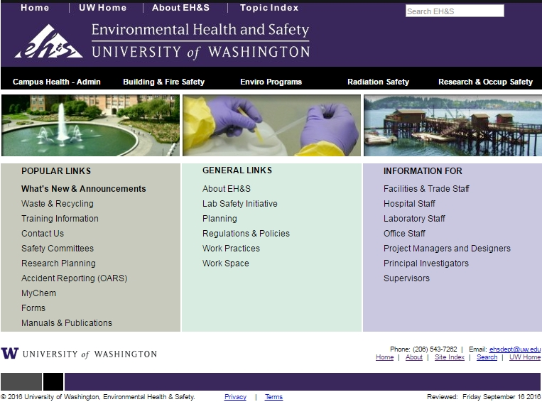
OLD EH&S WEBSITE
Notes:
Karen’s Talking Points
OLD WEBSITE
--Old EH&S logo
--Not UW Brand style
--Home page content static, does not direct users to new content
--Must dig for content, down rabbit holes
--Content organized by department structure, not user-oriented

Slide 4
WEBSITE REDESIGN PROJECT
2 years from contract signing to launch on Feb 2, 2018
From 1,200 HTML pages to about 300 pages
New features:
Organized by topic
Better search functionality
Report a Concern form
Training Course Selection Guides (in progress)
www.ehs.washington.edu (link)
Notes:
Karen’s Talking Points
View redesigned website at www.ehs.washington.edu
Features to highlight:
--Report a Concern form
--Training course guides
--Main Menu options
--Review organization by topic
--Based on user feedback

