Slide 1
MRAM
UW Schedule I Affinity Group
Office of Research

Slide 2
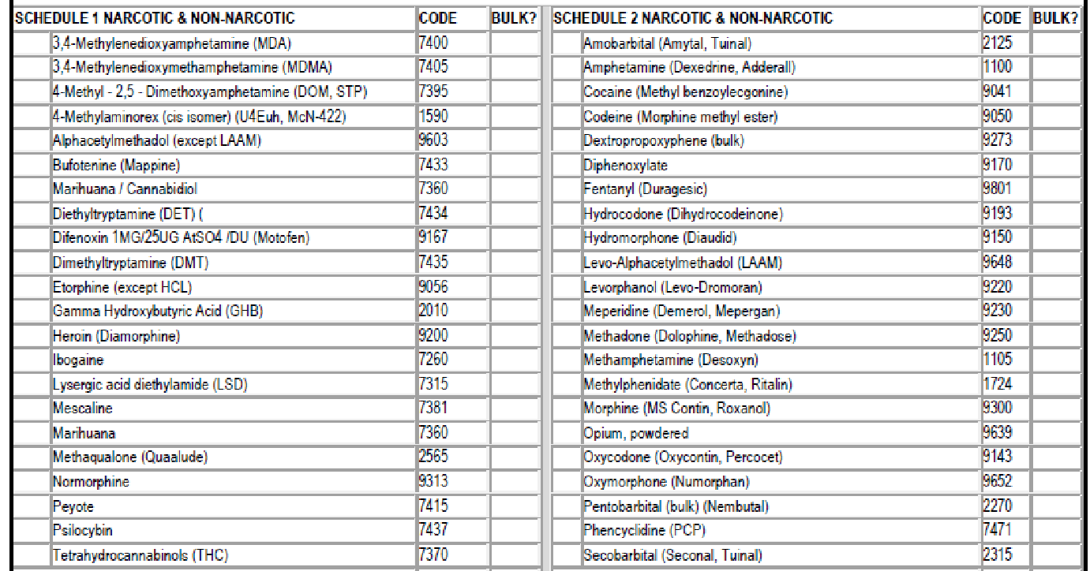
What are Schedule I Substances?
Examples
Cannabis (marijuana)
Lysergic Acid Diethylamide (LSD)
Heroin
Methaqualone (Quaaludes)
3,4-methylenedioxymethamphetamine (Ecstasy)
An updated and complete list of the schedules is published annually at Title 21 Code of Federal Regulations (C.F.R.) §§ 1308.11 through 1308.15.

Slide 3
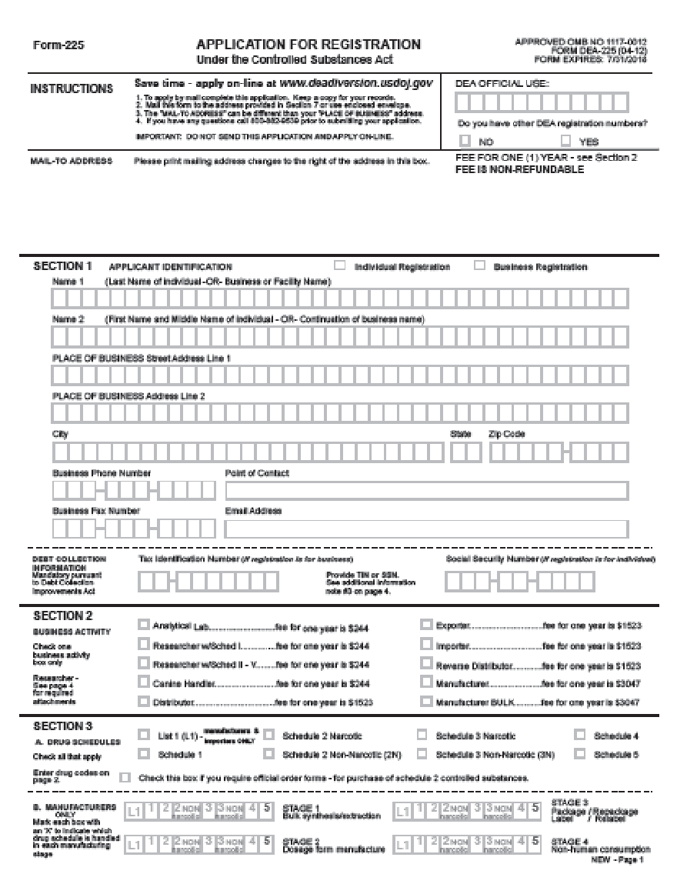
What is the Problem?
Research using Schedule I substances can’t be conducted legally without a federal license

Slide 4
What is the Solution?
(or what is a first step toward a solution?)
UW Schedule I Affinity Group
Facilitator:Nephi Stella, PhD
Professor Department of Pharmacology Director, UW Center for Cannabis Research
Share best practices
Develop information resources

Slide 5
What Can You Do?
Let your research faculty know about the UW Schedule I Affinity Group
Invite them to contact Nephi Stella --
nstella@uw.edu

Slide 6
For more information…
Nephi Stella nstella@uw.edu
Schedule I Registration (license) FAQs https://www.deadiversion.usdoj.gov/drugreg/faq.htm
UW Guidance on Research Involving Marijuana https://www.washington.edu/research/policies/guidance-on-research-involving-marijuana/

