Slide 1
Research Administration Data Consolidation (RADC)
Data Solutions Update - ORIS/DSS
MRAM
Sept 13, 2018
David Smith, DSS/ORIS

Slide 2
Agenda
Intro
Research Data Products Overview
Demos!
Looking Ahead
Training

Slide 3
Intro
ORIS/DSS
ORIS: Office of Research Information Systems
DSS: Decision Support Services
Team
Richard Fenger: Assistant Director, ORIS DSS
Dave Smith (presenter): Data Analyst Lead, ORIS DSS
Grzegorz Grabowski: Data Analyst
Craig Friesen: Data Analyst
“We support data-driven decision making through unlocking, simplifying, and sharing information hidden in Research Administration Data (RAD). We conduct analyses of the RAD to identify inefficiencies and reduce burden to research administrators.”

Slide 4
“Data is an Asset”
Notes:
Our Mantra:
Data is an asset, not just a byproduct of the work we do at the UW.

Slide 5
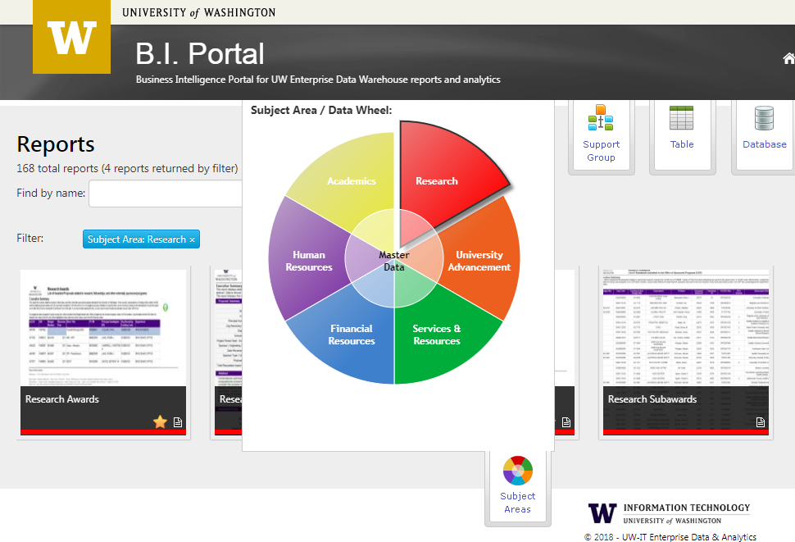
BI Portal: Research Data Tools
Business Intelligence (BI) Portal
The central resource to access institutional data housed in the Enterprise Data Warehouse (EDW)
Categories
Proposals
Awards & Subawards
Expenditures (NEW!)
Sponsored Research Highlights (NEW!)
Tools to access the data
Visualizations
Reports
Research Administration Data Cube
http://www.uw.edu/research/tools/research-administration-data-rad/

Slide 6
BI Portal: Research Data Tools
Visualizations:
High-level, summarized data at-a-glance
Filter the data to capture the information you need and quickly generate a visual report.
Reports:
Detailed Proposal/Award/Expenditures info, including PI information.
Create customized lists for summaries, then download to perform additional analysis.
Research Admin Data Cube:
Deep-dive, drag and drop analysis for more complex questions.
Analyze/explore using Excel or Tableau Desktop

Slide 7
Demo Time!
Notes:
Touch Points:
Bi Portal Overview (very brief)
Visualizations (Live Demo)
Highlights! (hub)
Proposals
Awards
Total Expenditures Summary
Reports (as time allows, show Exps Report)
Mention Cube (not full demo, show info page & screenshot?)

Slide 8
Looking Ahead
Further development of RADC Subject Areas:
Space
Finance
People
Compliance
Master data
Clear the backlog
Analysis and Insights
Know our business
Metrics & KPIs
Forecasting

Slide 9
BI Portal: Training and Outreach
Goals
Provide awareness and education about research funding to enable a range of analytical capabilities using the university’s central source of valid data.
Reduce barriers for departments to use the Enterprise Data Warehouse.
Promote data-driven decision making.
Reduce the amount of systems in use with inaccurate or non-enterprise data. (“Single source of truth”.)

Slide 10
BI Portal: Training and Outreach
Activities
New RAD courses available now! Additional sessions will be added. Refer to CORE schedule for updates. | Throughout 2018 and 2019 Academic Year
ORIS 110: Intro to Research Administration Data | 9/27/18 (Waitlist)
ORIS 210: Research Administration Cube | 10/4/18 (Waitlist)
Departmental engagements - email us to schedule! | Fall 2018 & beyond
Resources
BI Portal | http://itconnect.uw.edu/work/data/use-data/bi-portal/
UW Profiles | https://uwprofiles.uw.edu/
Grantrpt@uw.edu | Ad-hoc requests: analysis, reports, & support
Website | Information and access to tools
Factsheet | Download and share the factsheet with your colleagues

Slide 11
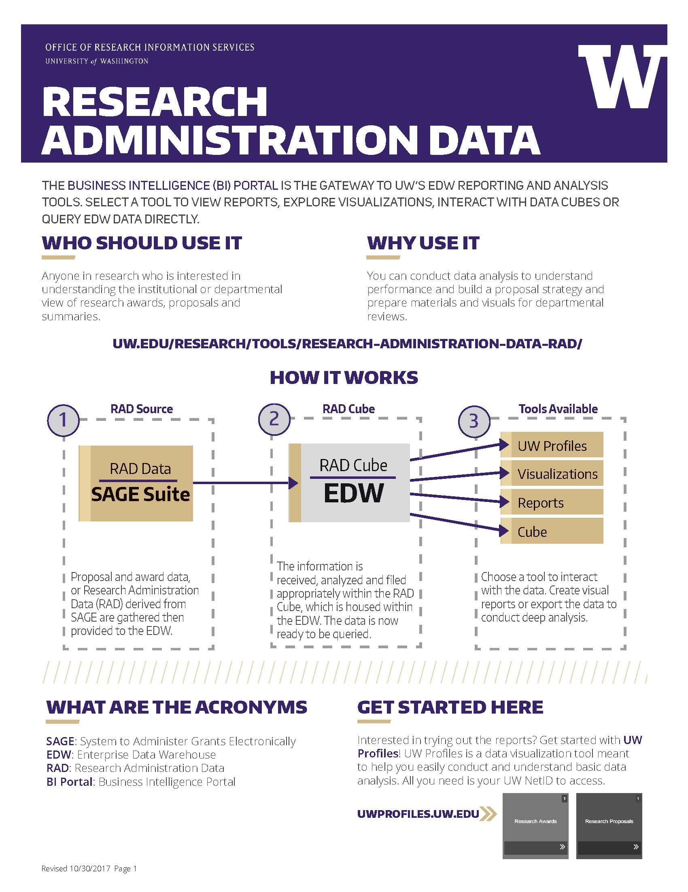
Thank you!
More information/assistance:
email: grantrpt@uw.edu
http://uw.edu/research/tools/research-administration-data-rad/
Materials available to take with you
TIP: Get access to EDW to explore and use BI Portal!
http://itconnect.uw.edu/work/data/use-data/get-access/request-access/
Deans, Chairs and Administrators can all benefit from using the data within BI Portal.

Slide 12
Appendix
Notes:
Data is an asset, not just a byproduct of the work we do at the UW.

Slide 13
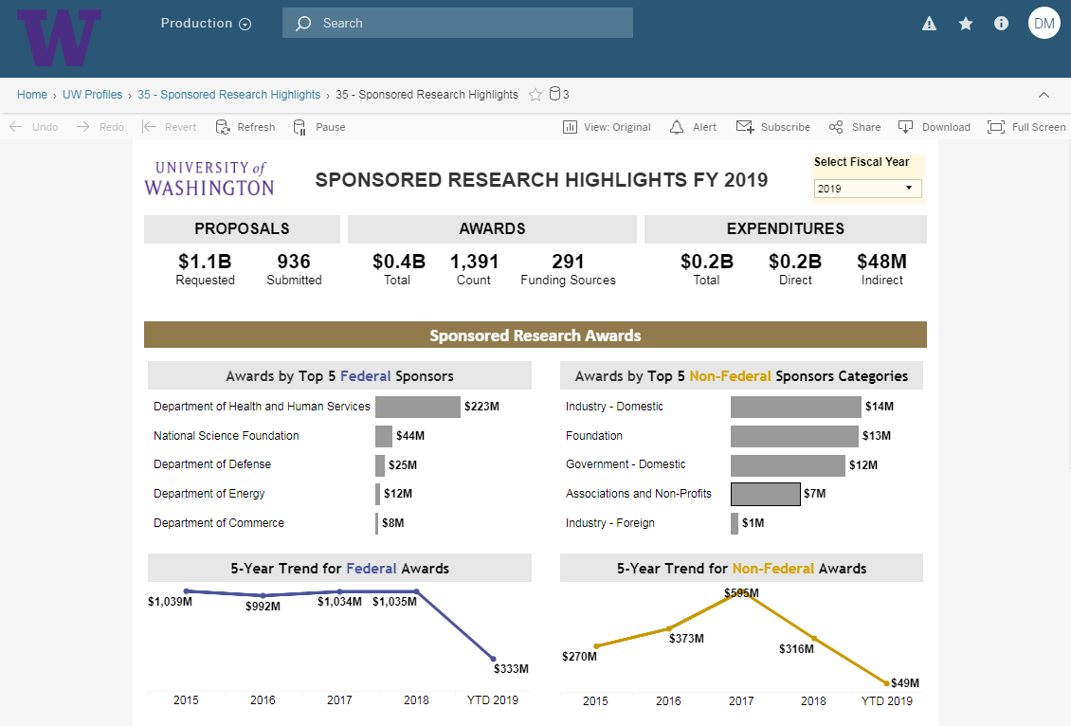
Screenshot: Sponsored Research Highlights

Slide 14
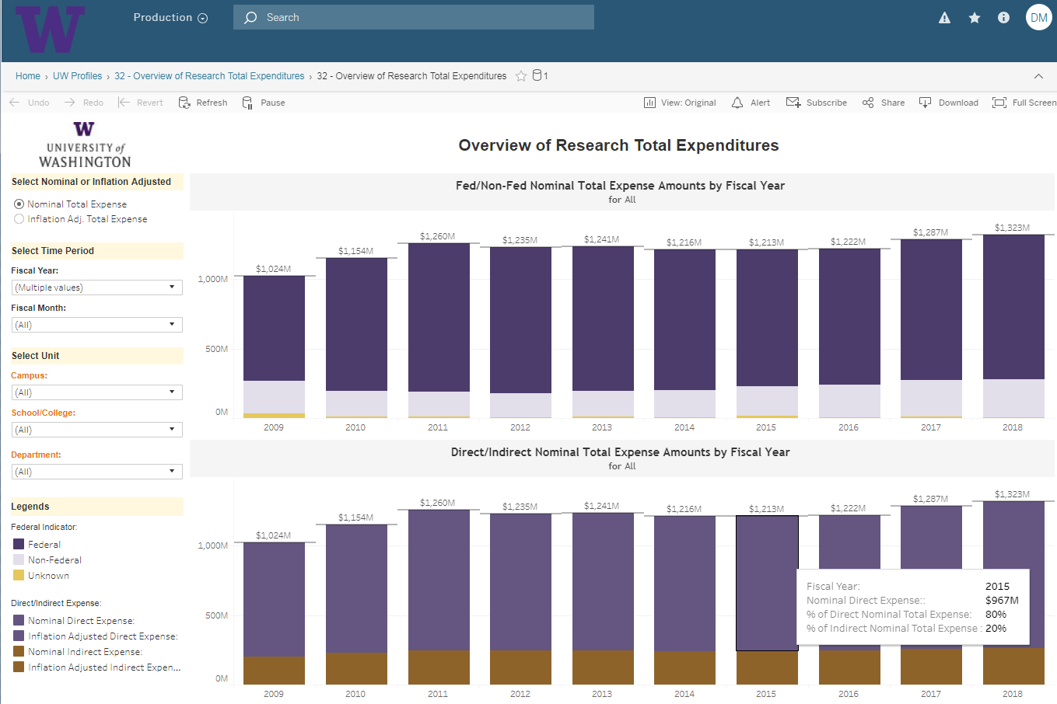
Screenshot: Overview of Research Total Expenditures

Slide 15
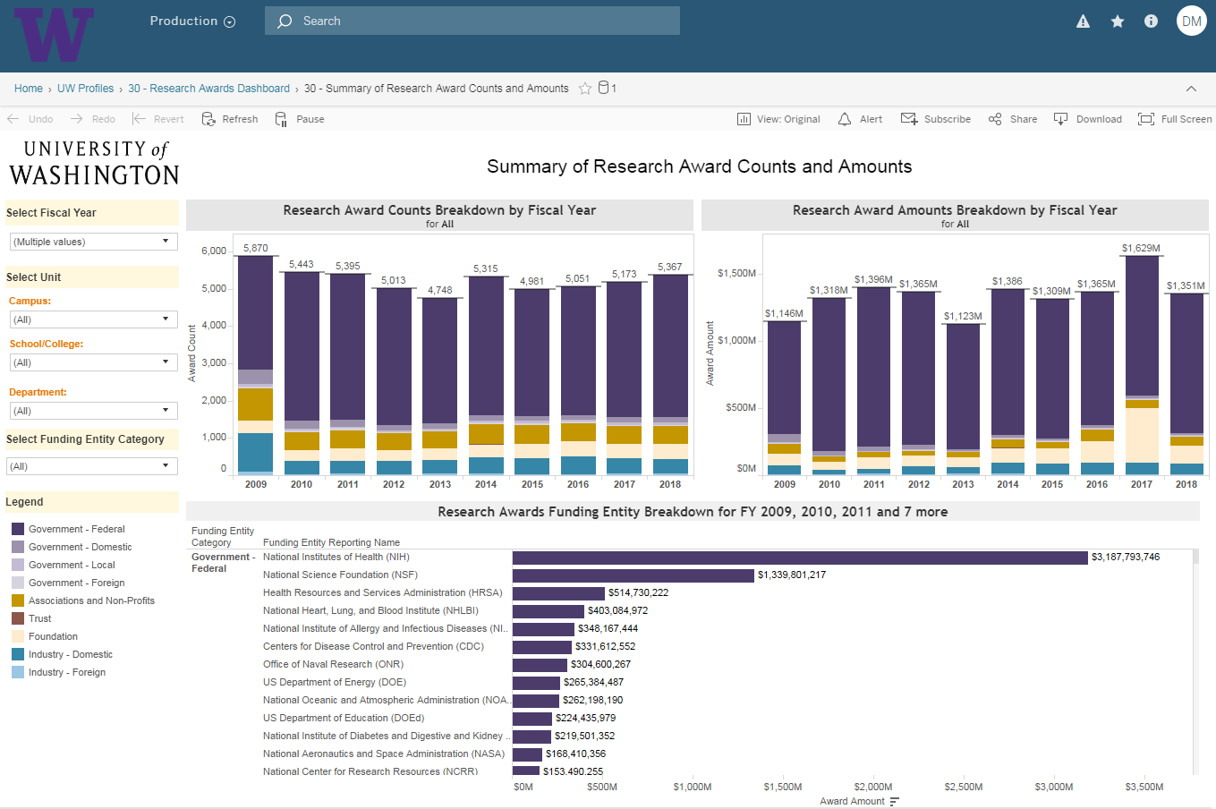
Screenshot: Summary of Research Awards

Slide 16
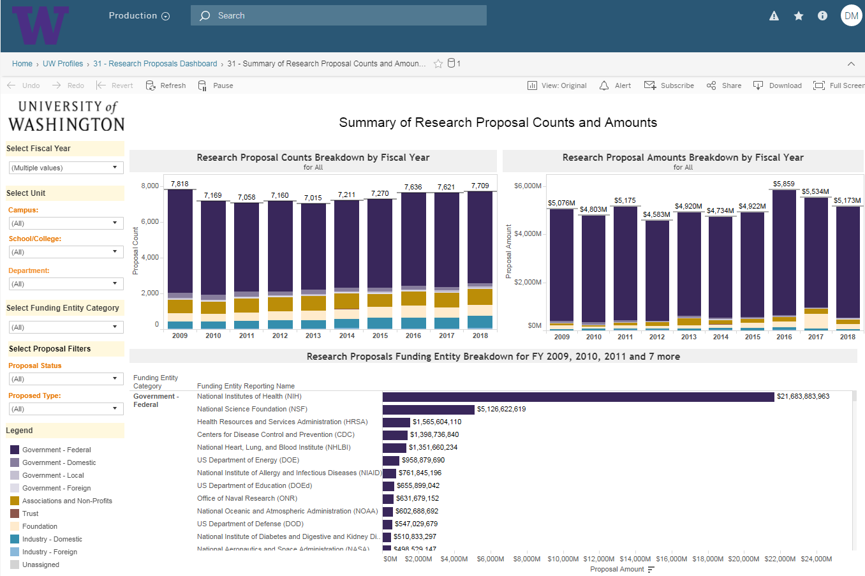
Screenshot: Summary of Research Awards

Slide 17
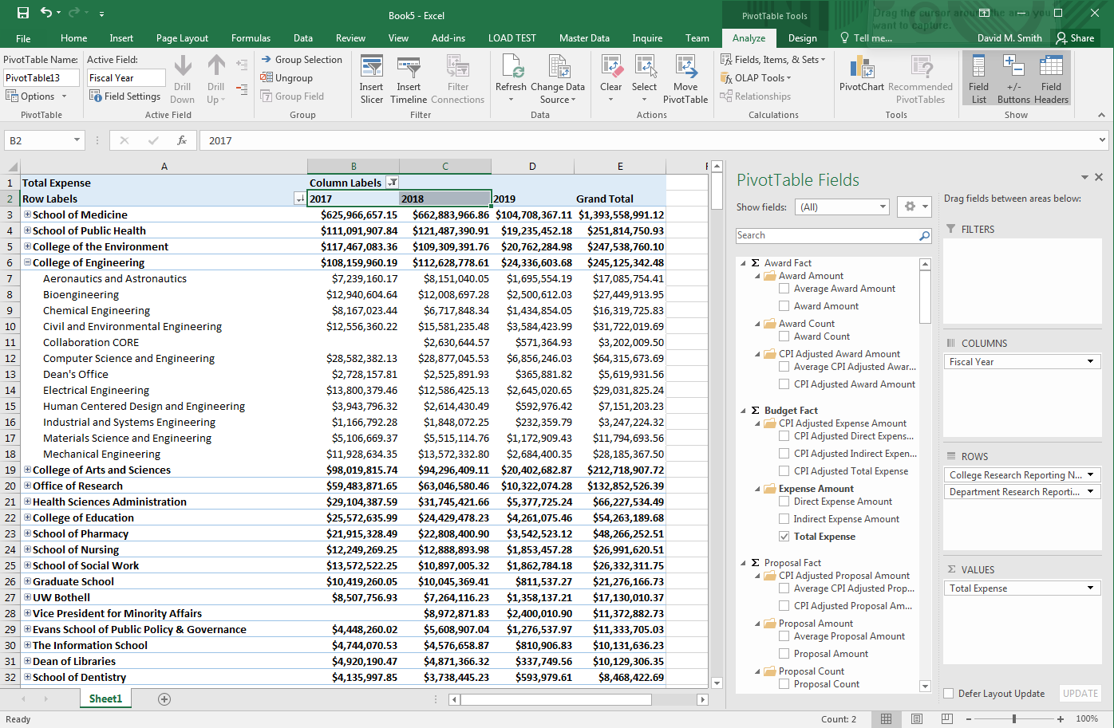
Screenshot: Research Admin Data Cube

