Slide 1
MRAM | Monthly Research Administration Meeting
OCTOBER 11, 2018 9:00 – 10:00 AM UW TOWER AUDITORIUM
TOPIC | PRESENTER | EMAIL | MIN
Welcome | Kirsten DeFries Research Compliance & Operations | kirsten5@uw.edu | 2
OSP Contracts Team | Cathy Cottle Office of Sponsored Programs | cottlec@uw.edu | 5
SNAP Eligible RPPR Delegation Pilot: Report Out | Carol Rhodes Office of Sponsored Programs | carhodes@uw.edu | 10
Financial Interest Reporting | Melissa Petersen Office of Research | petermm@uw.edu | 5
EH&S Changes | Katia Harb Director, Environmental Health & Safety | kharb@uw.edu | 5
National Biosafety Month | Zara Llewellyn Biosafety Manager, EH&S | zaral@uw.edu | 5
New Life Sciences Building | Steve Majeski College of Arts and Sciences | majeski@uw.edu | 10
Compliance Corner | Matt Gardner Post Award Financial Compliance | gcafco@uw.edu | 5
CORE Update | Laurie Stephan Collaborative On Research Education (CORE) | corehelp@uw.ed | 2
NEXT MEETING NOVEMBER 8, 2018 UW TOWER AUDITORIUM

Slide 2
Office of Sponsored Programs: Contracts Team
October 2018 MRAM
Cathy Cottle
Associate Director, Contracts & Grants
Office of Sponsored Programs

Slide 3
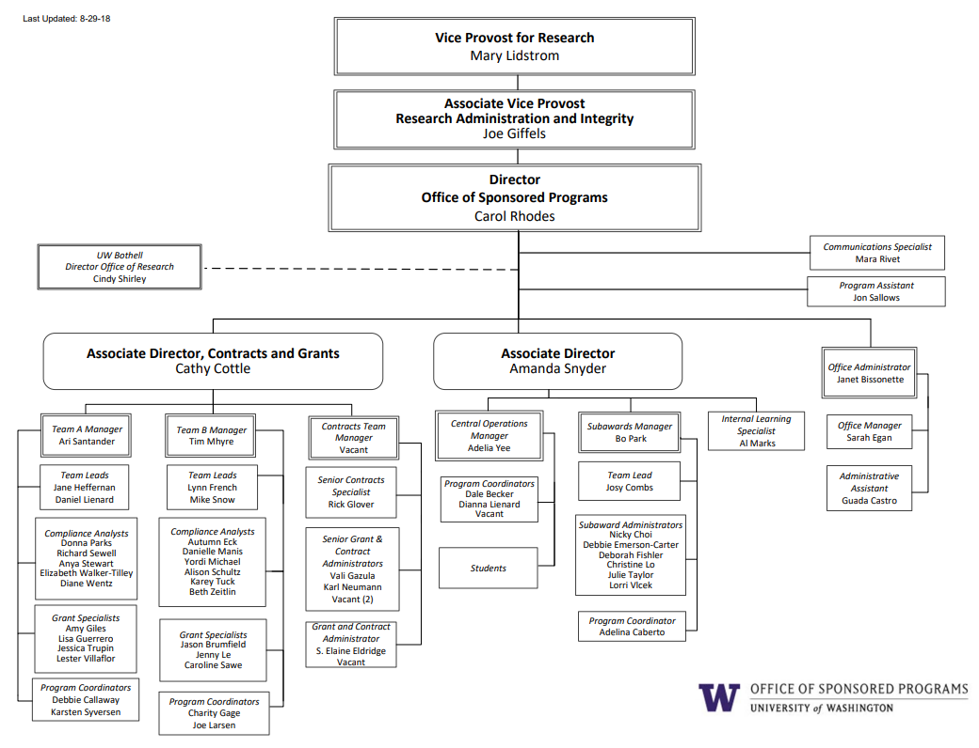

Slide 4
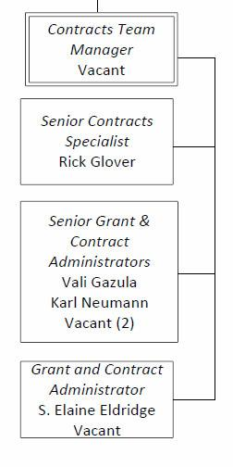
Contracts Team Restructure
Resources reallocated to Contracts Team.

Slide 5
Why?
Proposals ALWAYS take priority for reviewers on Teams A & B.
Allocating resources to the Contracts Team should help Bilateral Awards & Non-Award Agreements get attention they need.
Take advantage of economies of scale.

Slide 6
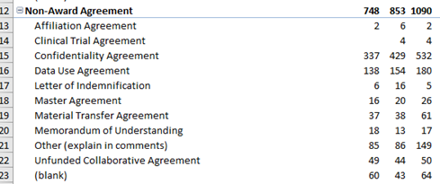
Biggest agreement volume increase area for OSP: Nonaward Agreements
FY16 FY17 FY18

Slide 7
More Complex Bilateral Awards
Example regulatory changes over last year
European Union General Data Protection Regulations (GDPR)
NIH Certificate of Confidentiality and broadened scope of protected identifiable sensitive information
Controlled Unclassified Information and requirements for protection in Nonfederal systems
Changes to Intellectual Property regulations promulgated by the National Institute of Standards and Technology (NIST) under the Patent and Trademark Law Amendments Act (aka: Bayh-Dole Act), 25 U.S.C. 200 and resulting awareness in contract language regarding present assignment of IP

Slide 8
When?
October: Interviews currently being scheduled
November: Hiring should be complete
We’ll be back at an upcoming MRAM with more details.

Slide 9
NIH: SNAP Eligible
RPPR Delegation Pilot -
Report Out
October 2018
Carol Rhodes
Office of Sponsored Programs

Slide 10
NIH RPPR Direct submission Pilot: Scope and Goal
Scope:
Delegated direct submission of NIH SNAP eligible RPPRs to PIs across campus
April - July 2018
Goal:
To assess if delegation would reduce administrative burden.

Slide 11
Pilot Facts
49 PIs participated
Schools: SOM, SPH, A&S, COE, SON, SSW, (and APL)
Feedback/questions during Pilot, catalogued & saved
Post Pilot Survey sent to participating PI and their department administrator:
PI response rate: 42%
Administrator response rate: 40%

Slide 12
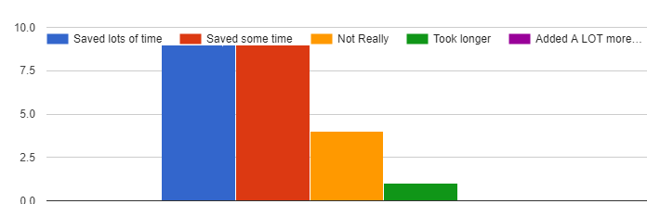
PI Survey Response:
Did submitting report directly save you time?
Saved Time

Slide 13
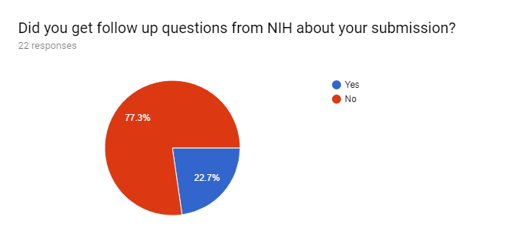
PI Survey Response:
Did you get follow up questions from NIH about your submission?

Slide 14
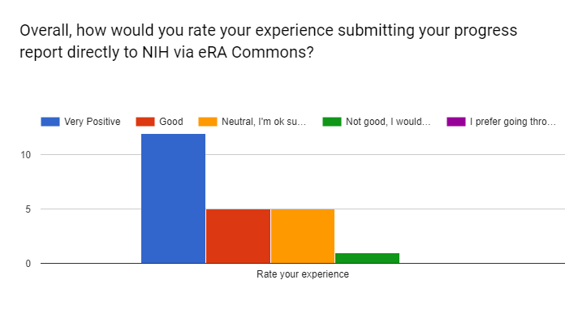
PI Survey Response:
Overall, how would you rate your experience submitting your progress report directly to NIH via eRA Commons?

Slide 15
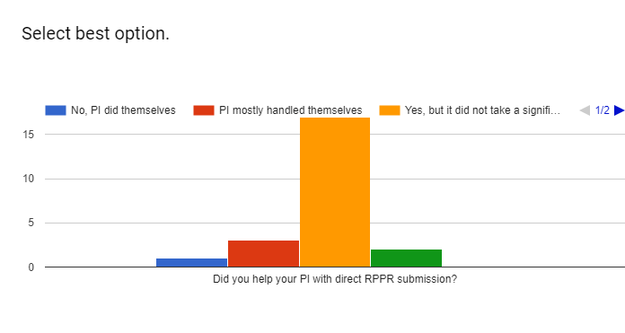
Admins Survey Response:
Did you help your PI with direct submission?

Slide 16
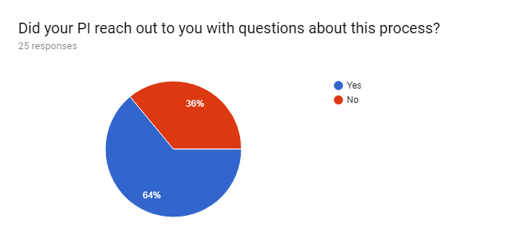
Admins Survey Response:
Did your PI reach out to you with questions about this process?

Slide 17
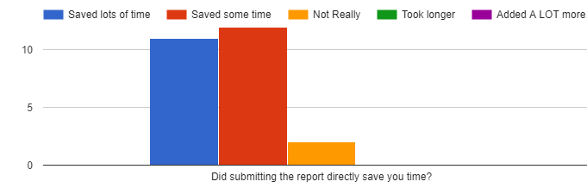
Admins Survey Response:
Did submitting the report directly save you time?

Slide 18
Pilot Summary
eRA system itself: About half of PIs found eRA Commons navigating a bit confusing and needed assistance
Content: PIs did not indicate trouble with the RPPR, but administrators did assist with some of the compliance information (publications, HS information).
NIH follow-up: Did not increase or decrease
Efficiency/time saved: Majority of survey respondents said this saved time

Slide 19
Next Steps:
Delegation & eGC1 Requirements
OSP will delegate submission authority to PIs for SNAP eligible awards.
eGC1s will NO Longer be required for SNAP eligible RPPR Submission
Implementation: November 1st, 2018

Slide 20
Next Steps:
Research Web Updates
Guidance & FAQs will be published and provide:
Information on when an eGC1 is required for progress reports
UW specific information
Steps for completing an RPPR
Highlight ASST role in eRA Commons
Typically dept. admin support for RPPR completion
Information on related processes:
PubMed central process
Uploading human subjects information in HHS system
Annual SFI disclosure in UW FIDS system

Slide 21
Thank you Pilot Participants!

Slide 22
Financial Interest Reporting
MRAM - October 11, 2018
Melissa Petersen
Office of Research
University of Washington
Notes:
Good morning, I am Melissa Petersen from the Office of Research and am here today to talk to you about Financial Interest Reporting.
And with that in mind, let me start with a disclosure of my own: I have a Significant Financial Interest in GIM 10 and Executive Order No 57 in that more compliance with these policies means more work for me, and thus (hopefully) greater job security.

Slide 23
UW Policies & Information
Policies
Financial Conflict of Interest policy (Research & Technology Transfer), Grants Information Memorandum (GIM) 10
Outside Professional Work (Faculty, Librarians, other Academic Personnel), Executive Order No. 57
Outside Consulting Activities and Part-Time Employment by Professional or Classified Staff Employees, Administrative Policy Statement 47.3
UW School of Medicine Policy on Potential Financial Conflicts of Interest for Commercial and Nonprofit Entities
Information
Office of Research – Outside Work
Office of Research – Financial Conflicts of Interest (FCOI)
Notes:
So, policies and information – the two I mentioned GIM 10, the Financial Conflict of Interest policy, and Executive Order No. 57, the Outside Professional Work policy for Faculty, Librarians, and Other Academic Personnel are listed here as well as other related policies such as the Outside Work policy for Staff and the School of Medicine’s policy on Financial Conflicts of Interest.
Also linked here are informational pages provided by the Office of Research covering process and frequently asked questions.

Slide 24
UW Policy & Best Practice
Conflict management plans issued by the UW Office of Research start with:
You are required to make appropriate disclosures of your financial interest(s) in connection with any publication (written, electronic, oral, or otherwise) of the results of the research, as well as to collaborators and trainees (students and postdoctoral fellows) involved in the research.
The American Association for the Advancement of Science (AAAS) says:
“…AAAS has reaffirmed its commitment to robust, independent peer review as well as the sharing of research results through publications and public discourse, in accordance with well-crafted transparency policies and procedures.”
Notes:
This presentation is more than just UW policy, though that is where I’ll start.
Any Investigators on research at the UW who have received a Conflict Management Plan from the Office of Research will be required (it’s the very first condition) to disclose their financial interests in connection with any publications, results, presentations, or collaborators.
Without a conflict management including this condition, we would continue to recommend such disclosure, consistent with the guidance of Triple-A-S, the American Association for the Advancement of Science who says that they are committed to robust, independent peer review as well as the sharing of research results through publications and public disclosure.
So, what happens when researchers do not disclose? This could range from further restrictions or conditions on their UW research activities or external consulting approvals, to, public commenting via media and reporting… such as was the case with…

Slide 25
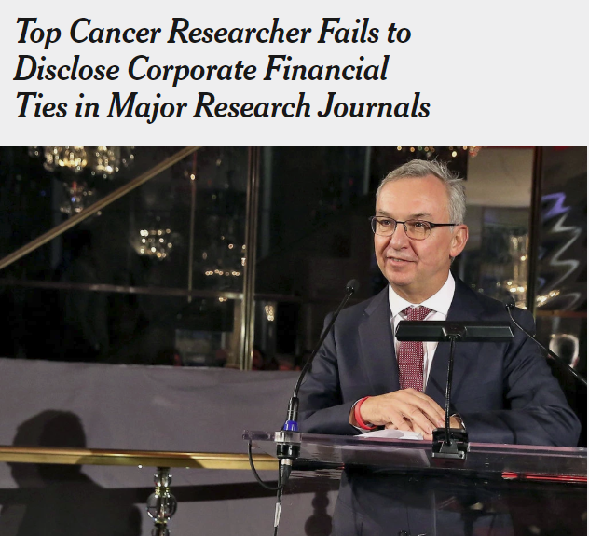
Dr. José Baselga, the chief medical officer at Memorial Sloan Kettering Cancer Center, in 2015.
Cindy Ord Getty Images
By Charles Ornstein and Katie Thomas
Sept. 8, 2018
Notes:
Dr. Jose Baselga – some of you may have seen this article already.
This article only speaks briefly about his institutional compliance where it says Memorial Sloan Kettering was aware of the relationships. This doesn’t necessarily mean he was compliant, however, reporting of financial interests at the UW, for example, doesn’t end with FIDS – especially if there is a conflict management plan, or other conditions, in place for research or outside work.
To continue my shock and awe presentation…

Slide 26
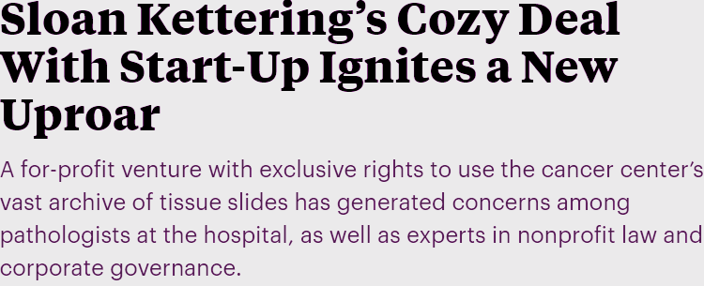
By Charles Ornstein, ProPublica, and Katie Thomas, The New York Times, Sept. 20, 4:10 p.m. EDT
Notes:
Shortly after the previous story, ProPublica and the New York Times worked together to reveal questionable relationships between Sloan Kettering and a Start-Up. At the UW we put restrictions on sharing of intuitional resources (including researchers) in technology transfer management plans that are issued around the time of license execution performed by CoMotion.

Slide 27
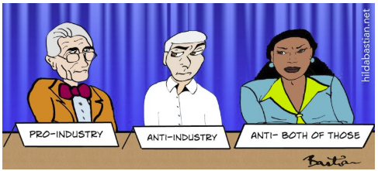
Posted September 24, 2018 by Hilda Bastian in Bias
Notes:
Just one of two more headlines I pulled from recent activity to convey the current level of interest in financial relationships between researchers and industry – these exist by way of consulting and collaboration activities.

Slide 28
Notes:
And the last of my shock and awe headlines, this one was from September 14, 2018. So the theme is: disclose, disclose, disclose – and I don’t intend just to be repetitive – researchers should disclose to their institution, to their study teams, and to their audience.
And “how do I disclose” is not an uncommon question, so we have some sample disclosures available

Slide 29
Simple Disclosures
AUTHOR is employed by COMPANY
AUTHOR is a paid part-time consultant for COMPANY
AUTHOR holds COMPANY stock
One or more embodiments of one or more patents and patent applications filed by the University of Washington and COMPANY may encompass methods, reagents, and the data disclosed in this manuscript. Some work in this study is related to technology described in patent applications.
AUTHOR is a co-founder and equity holder in COMPANY, which has licensed this technology to REACTION via BIOLOGICAL PROCESS in CELL TYPE from the University of Washington
The authors declare the following competing financial interest(s): AUTHOR 1, AND AUTHOR 2 have a financial interest in COMPANY, which has licensed the described technology from the University of Washington
These and additional Sample Disclosures available HERE
Notes:
First, some simple disclosures that should help get any Investigator started, with a link to these and more comprehensive templates.
And if you can't wait until this presentation is posted, don’t hesitate to contact me!

Slide 30
Contact
Contact Information:
research@uw.edu
206.616.0804
Melissa Petersen
petermm@uw.edu
Office of Research, University of Washington
Notes:
My contact information, here.
Questions? Thank you!

Slide 31
EH&S PERSONNEL UPDATES
October 2018
Katia Harb, Interim Director
Environmental Health and Safety Department
kharb@uw.edu, 206-616-4146

Slide 32
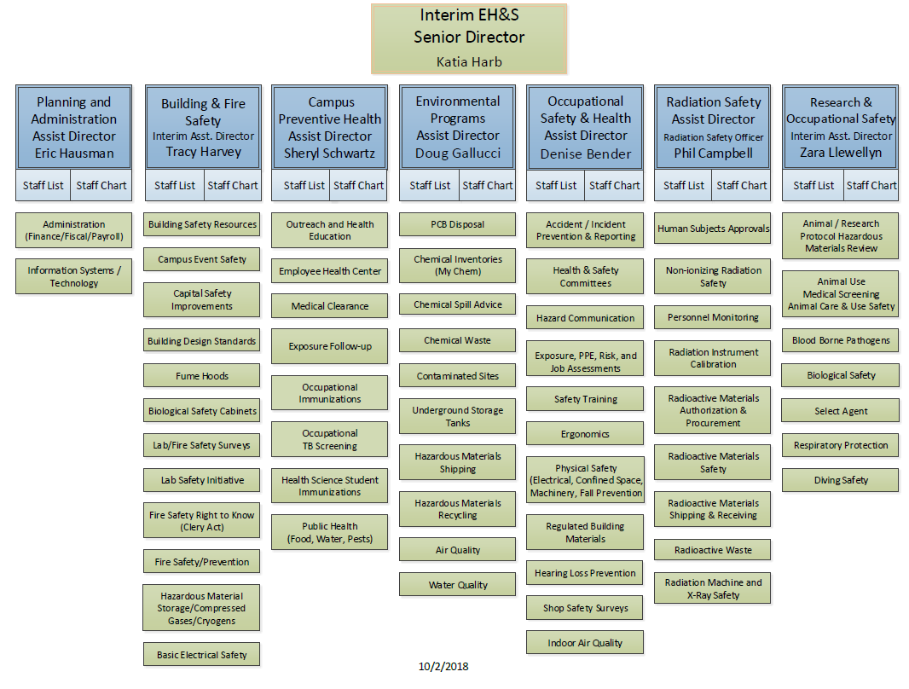

Slide 33
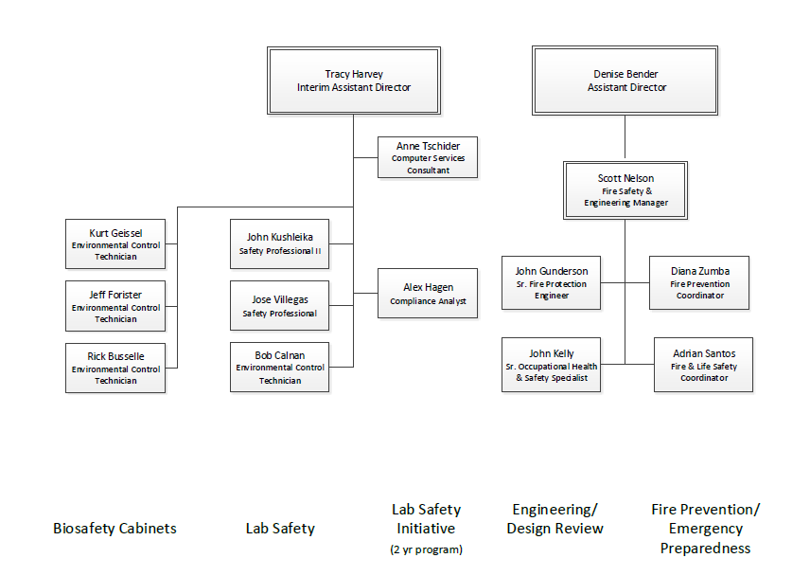
BUILDING AND FIRE SAFETY SECTION

Slide 34
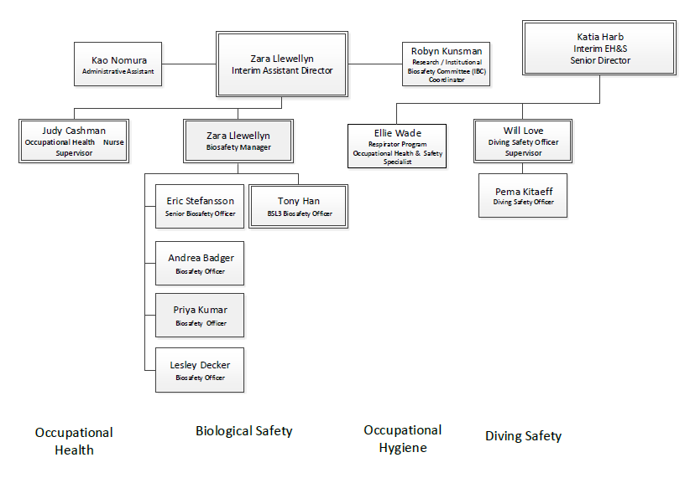
RESEARCH AND OCCUPATIONAL SAFETY

Slide 35
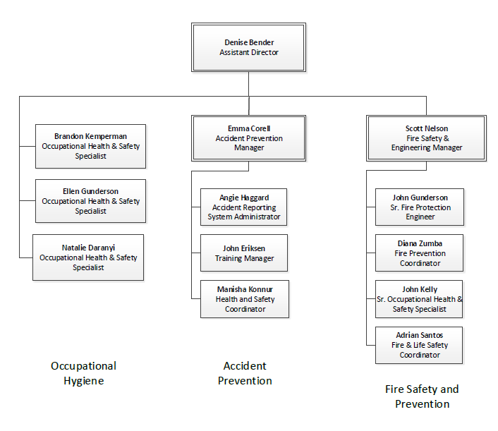
OCCUPATIONAL SAFETY AND HEALTH

Slide 36
EH&S CONTACT INFORMATION
http://www.ehs.washington.edu/
(206) 543-7262
ehsdept@uw.edu

Slide 37
2018 NATIONAL BIOSAFETY MONTH
Zara Llewellyn, PhD, RBP
Biological Safety Manager
Environmental Health and Safety Department
MRAM meeting
October 2018
Notes:
Thank you for inviting me to attend and talk about biosafety month

Slide 38
WHAT IS BIOSAFETY?
The containment of biological hazards
Requires the use of safe practices, training, facilities, and equipment
Provides protection for people, animals, and the environment

Slide 39
BIOLOGICAL RESEARCH AT UW
1,813 of 4,100 total (44%) of lab spaces are biohazard labs
640 projects registered with the Institutional Biosafety Committee (IBC)
368 IBC applications reviewed in 2017
5.6 (FTE) Biological Safety Officers
1.0 (FTE) IBC/Research Coordinator
Notes:
DO you want to show the chart that has projects over time?

Slide 40
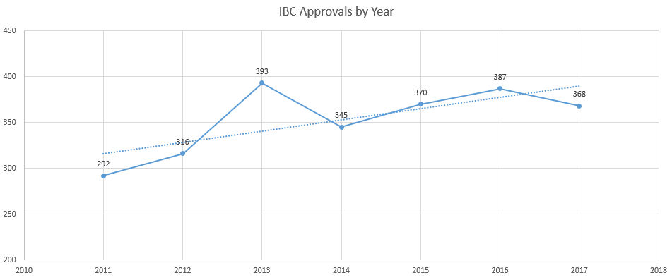
IBC APPROVALS BY YEAR
2011-2017

Slide 41
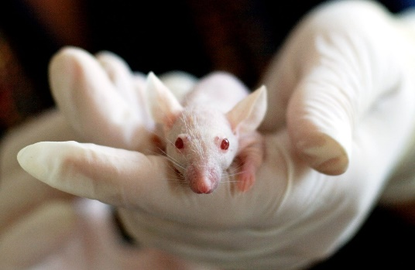
ACTIVE PROJECTS WITH BUAS
610 Currently Approved Projects
37% Involving Viral Vectors (n=222)
37% With Associated Animal Protocol (n=229)
4% Involving Human Subjects (n=24)
15% Involving Recombinant Bacteria or Viruses (n=94)
4% Involving Non-Exempt Transgenic Animals (n=26)
9 plant projects

Slide 42
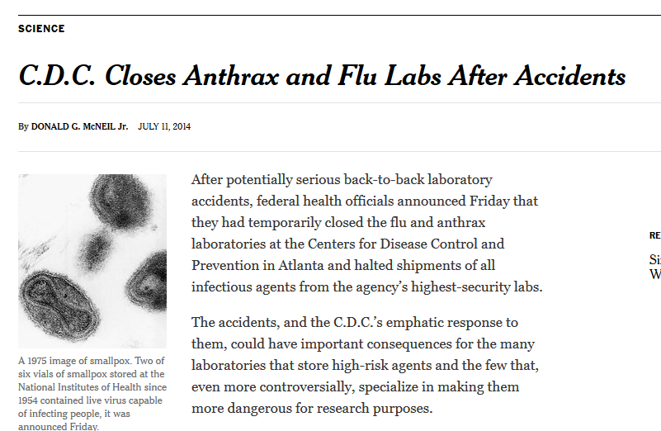
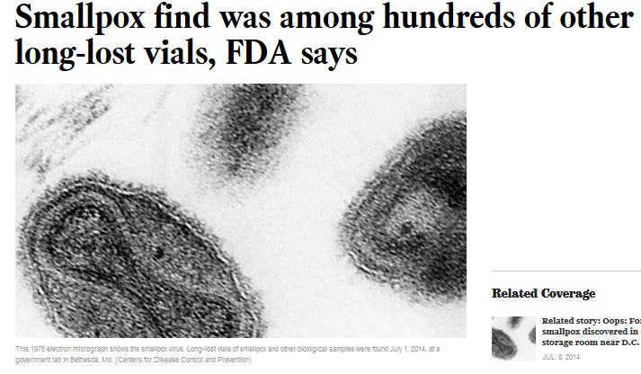
NATIONAL BIOSAFETY MONTH
Started in 2014 by the NIH Office of Science Policy
A time to focus attention to biosafety policies, practices, and procedures

Slide 43
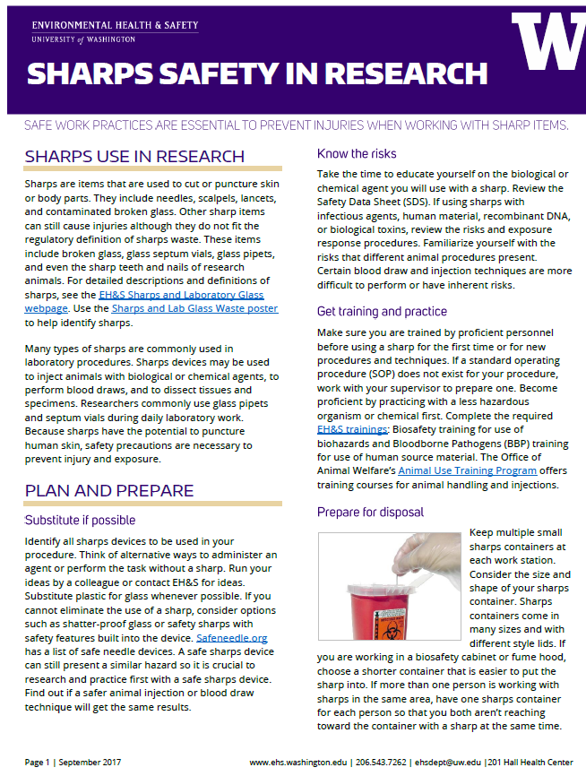
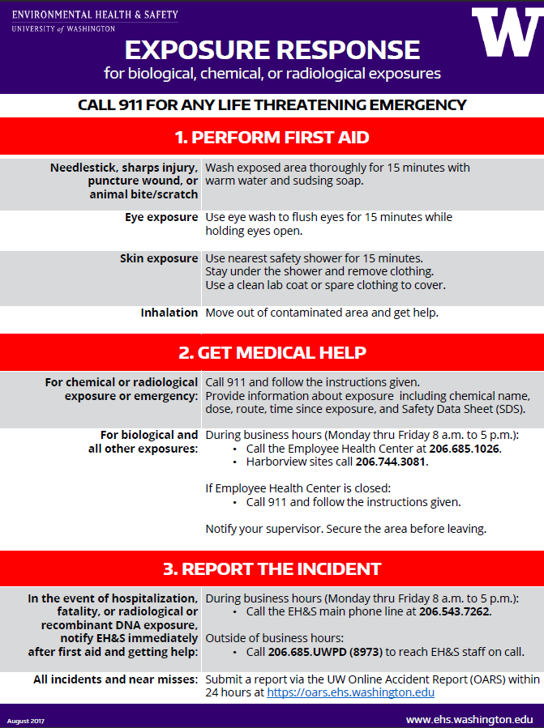
NATIONAL BIOSAFETY MONTH AT UW

Slide 44
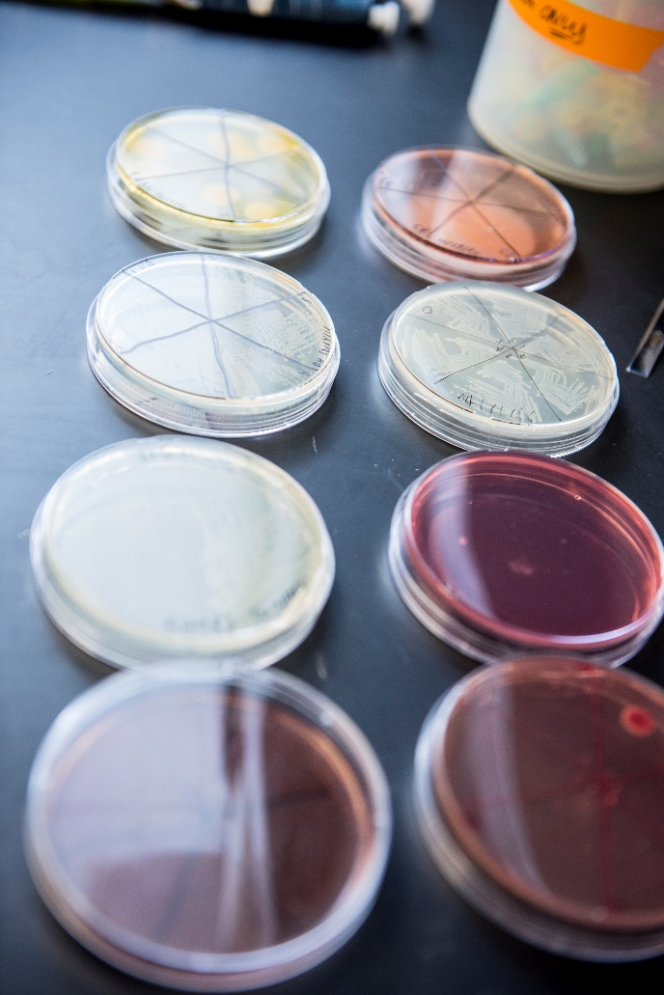
2018 – PROMOTING A CULTURE OF SAFETY
Principal Investigator responsibilities
Culture starts at the top!
Enhance biosafety training and procedures
Lab-specific training
Support researchers and highlight successes
Celebrate positive behaviors
Prevent workplace injuries and illness
Promote reporting of all incidents and near miss events
Discuss root causes and ways to prevent future incidents
Learn from mistakes
Notes:
1. PI’s responsibility to have people trained and safety in the lab. Can you discuss the new PI definition?
2. Each lab should have specific lab training for the types of work they are doing and the types of biohazards they work with.
3. National Biosafety month is a great opportunity in addition to always to provide positive feedback and celebrate positive safety working environment.
3a. Incidents and accidents can occur and it is important that people do report these issues so that we can all learn from mistakes.

Slide 45
ACHIEVING A CULTURE OF SAFETY
“Safety is shared by Everyone”
Increasingly Trustful
5. Safety is inherent
EHS is fully integrated into the business
“I say something when I see unsafe behaviours or conditions”
“I know what to do and have resources to keep myself safe”
4. Safety is a Value
We work proactively on the problems that we still find
“I know what to do to keep safe but do not have resources or safety is the Safety Officer’s job”
Act
3. Safety is a Priority
We have systems in place to manage EHS risks
“I do not know how to keep myself safe at work”
Check
2. Safety is Important
Compliance is important
Programs are Compliant
7 elements
Do
1. No Formal Safety Framework
Safety is not integrated into business
Plan
Increasingly Accountable
Notes:
A culture of safety is achieved through establish an EHS framework and maturing the framework until safety becomes a value and ultimately inherent in the way that we operate. Currently, EH&S is at level 3 – maturing our programs to a compliant state, laying the foundation to shift the culture to value safety

Slide 46
HELP PROMOTE BIOSAFETY MONTH
Email to PIs and lab managers who work with biological agents
Discuss biosafety in your departments and labs
Share article “promote a culture of safety in your lab” on EH&S website
Link to the article on Office of Research
website

Slide 47
2018 EH&S AND IBC BIOSAFETY UPDATES
New EH&S website
Online biological waste training
Sharps safety guidance
New IBC Coordinator and Biosafety Officer

Slide 48
HAPPY BIOSAFETY MONTH!!
Promoting a Culture
of Safety!!
Notes:
All of our responsibility to promote and provide a safety of culture. We are here to help.

Slide 49
RESOURCES
EH&S website: www.ehs.washington.edu
Biological Safety and Biohazardous Waste
Exposure Response Poster
Sharps Safety in Research
IBC webpage
EH&S Guide for Principal Investigators
NIH Office of Science Policy: https://osp.od.nih.gov/
EH&S Biosafety Contacts
ehsbio@uw.edu or 206-221-5524

Slide 50
New Life Sciences Building
MRAM
October, 2018
Steve Majeski
College of Arts and Sciences

Slide 51
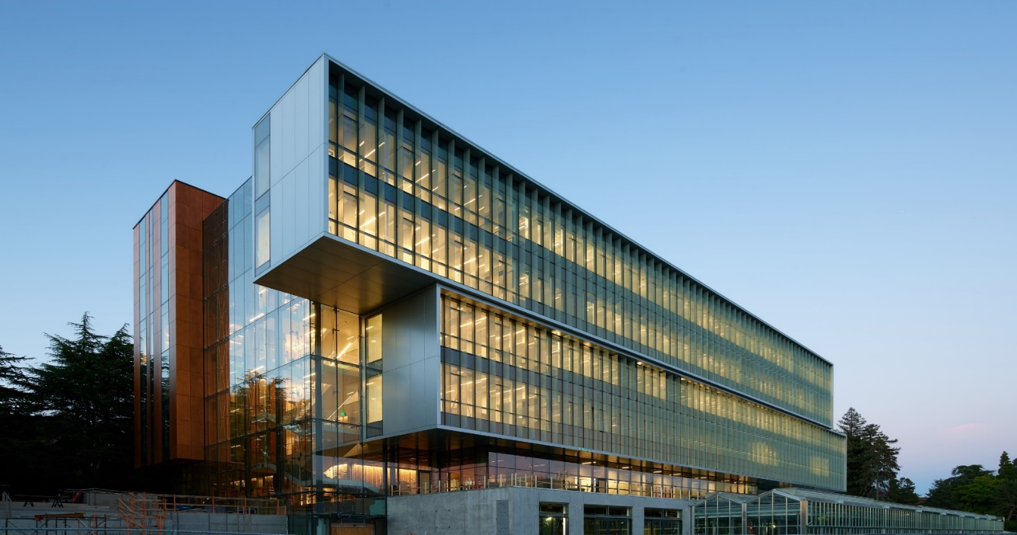
Life Sciences Building Opened 9/26/18

Slide 52
Project Objective
The College of Arts and Sciences Life Sciences Building (LSB) project is a five story above grade building with two stories below grade and mechanical penthouse.
The existing greenhouse and associated buildings were demolished and replaced with approximately 185,700 gross square foot LSB with a 18,000 gross square foot greenhouse.
It is designed to provide new teaching and research facilities for the department of Biology. Biology is the largest STEM degree granting major at the University of Washington and indeed the entire State of Washington

Slide 53
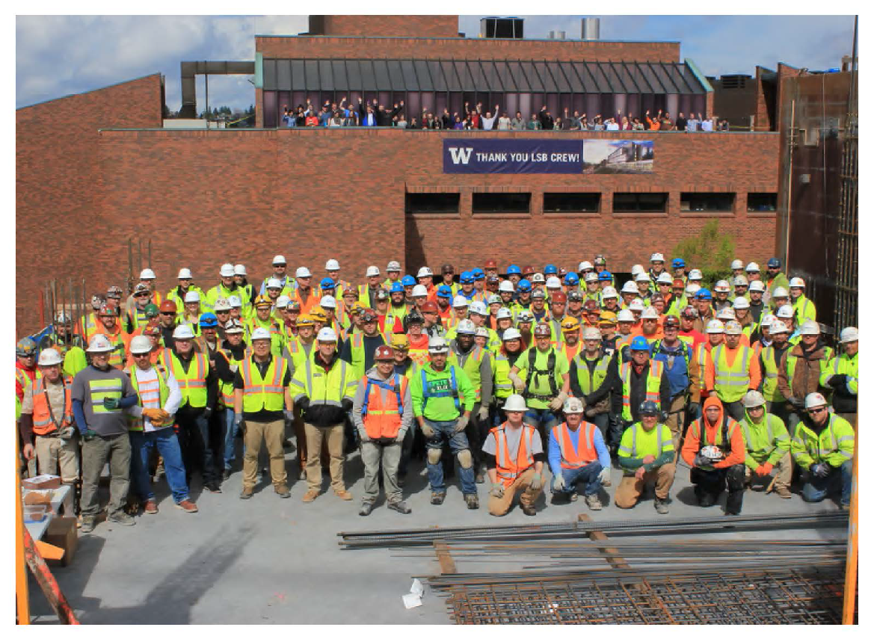
Project Stakeholders
College of Arts and Sciences
Biology
UW Capital Planning and
Development
Skanska Construction
Perkins + Will Architects
McKinstry
VECA Electric
Affiliated Engineers
GGN Landscape Architects

Slide 54
Budget
Current Approved $171,450,000
Forecast Total $169,250,000
Over/Under ($2,200,000)
The Life Science Building Project is funded completely by the College of Arts and Sciences - There is no State funding nor Central Administration funding. Ben and Margaret Hall donated $6.7M to build out the fifth floor of LSB. Amazon donated (valued at $500K) greenhouse space to hold Biology’s plants while the new greenhouse was under construction.

Slide 55
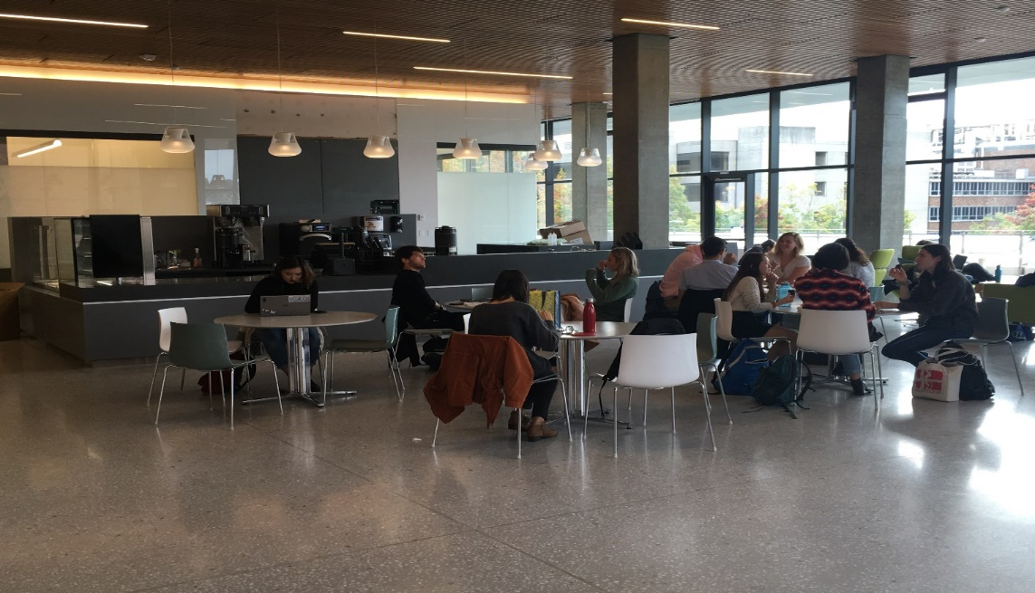
First Floor - Open to the Public
One active learning classroom 60 students
Four authentic research student teaching labs 25 students each
Student lounge
Café “Evolutionary Grounds”
Two student conference rooms

Slide 56
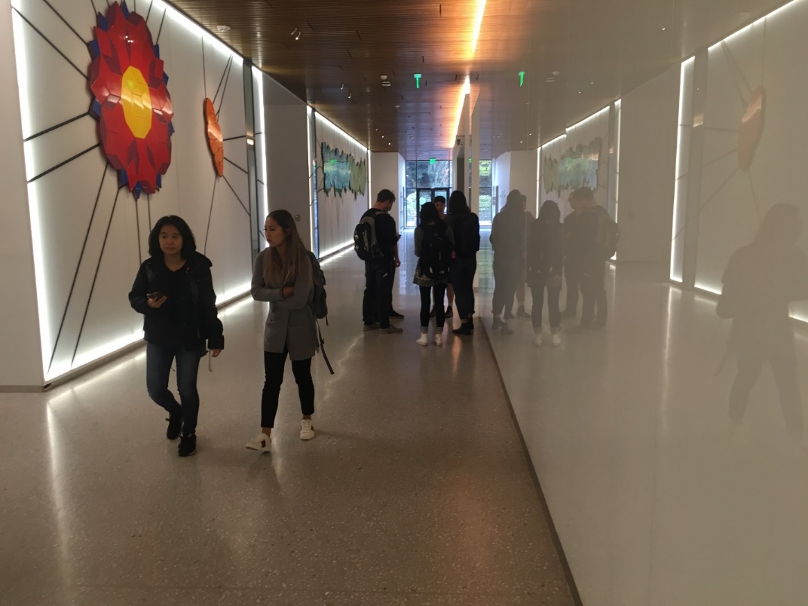
First Floor

Slide 57
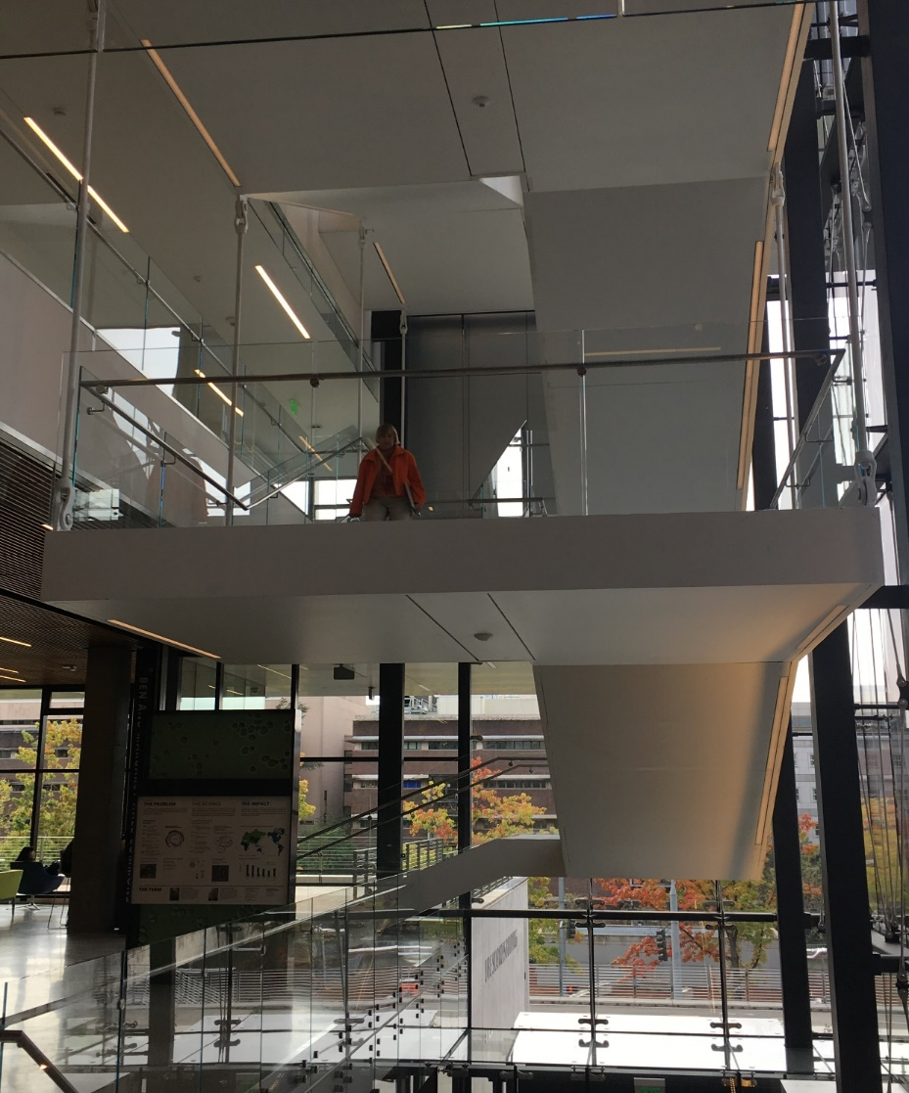
First Floor Active Learning Classroom

Slide 58
First Floor – Authentic Research Student Teaching Lab – Biomechanics lab class

Slide 59
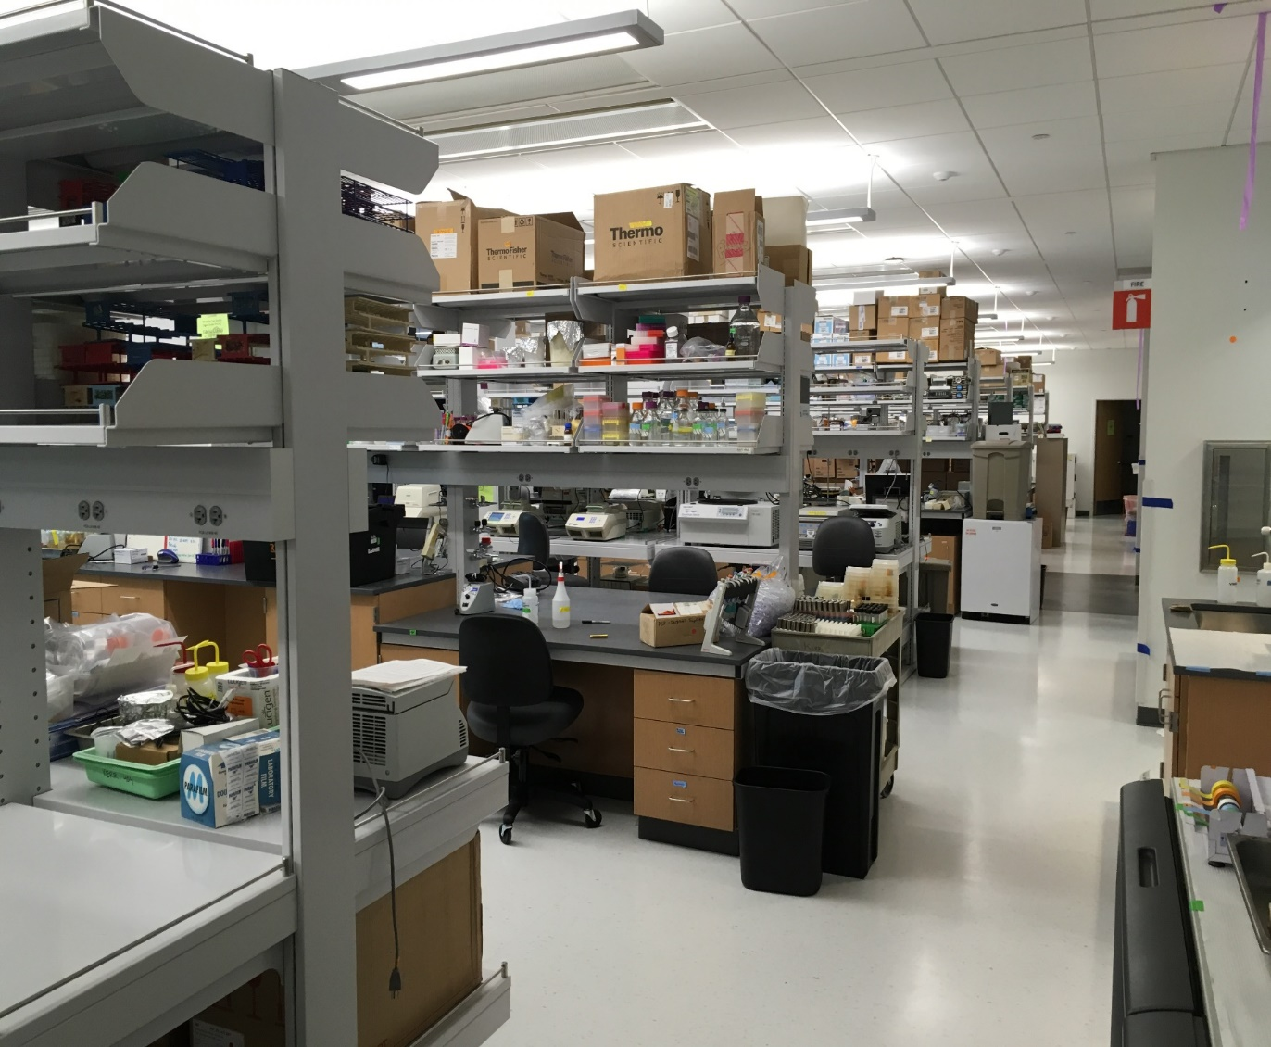
Research Lab Floors
Floors 2-5
Each floor 20,000 sq. ft.
Ten PIs per floor
Each Floor houses 100 faculty,
postdocs, graduate students,
and undergraduate
researchers
The design promotes
collaboration, interaction, and
interdisciplinary research

Slide 61
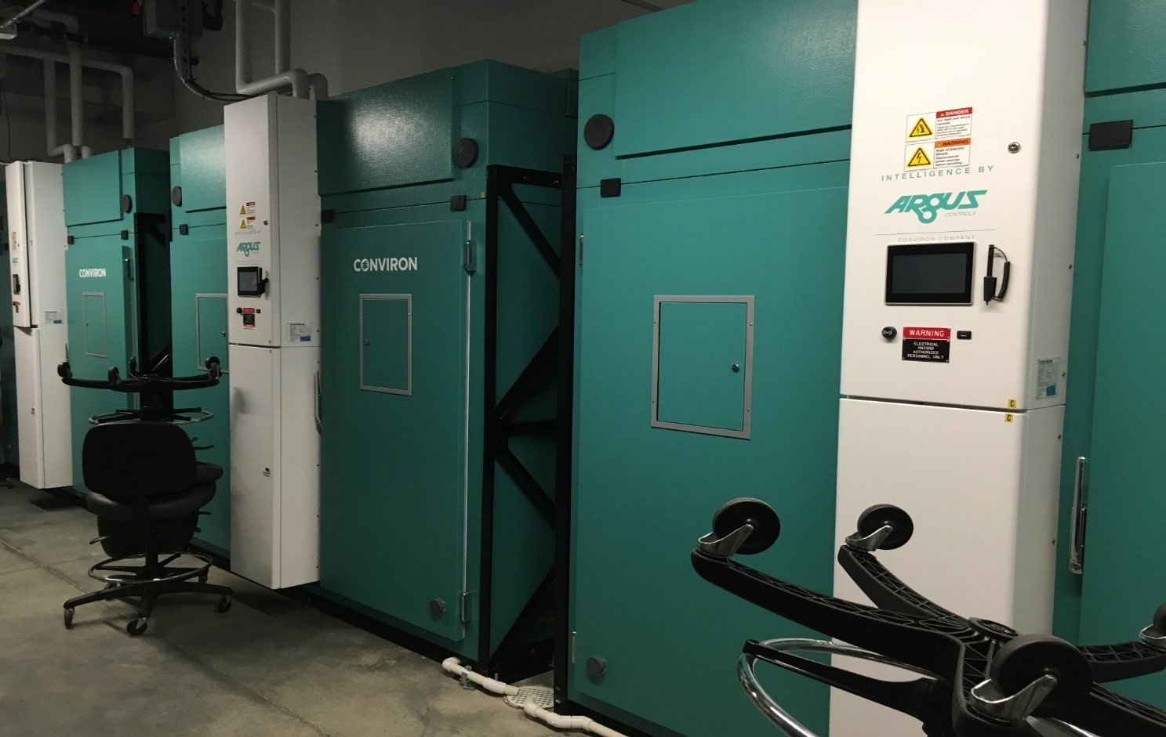
Basement Floors
Animal Care B1
Growth Chambers B2

Slide 62
Sustainability – Key Features
LEED Gold
Vertical Photovoltaic Glass Fins –
Generates enough power to lights all offices for the entire year
Shade the building at the hottest times of the year
First installation of its kind in the WORLD
Chilled Beams
Chilled Waves
Radiant Floors
Reverse Osmosis reject water (from labs) stored and used to irrigate the greenhouse
Rooftop solar panels (funded by donors and will be installed soon)
Operable windows for passive cooling

Slide 63
Photovoltaic Glass fins

Slide 65
COMPLIANCE CORNER
MRAM
October, 2018
Matt Gardner
Post Award Fiscal Compliance

Slide 66
NEW CLASS! Managing NRSA Training Grants & Fellowships at the UW
When?
December 4th, 2018
9:30 am to Noon
Instructors:
Matt Gardner, Post Award Fiscal Compliance
Vince Gonzalez, Grant & Contract Accounting
Focus of the class is Post Award
Designed for staff with beginning to intermediate knowledge and experience, but all levels are welcome
Sign up at CORE!
MRAM – Matt Gardner – Post Award Fiscal Compliance
Notes:
This class won’t discuss Data Tables or the training grant application process

Slide 67
NEW CLASS! Managing NRSA Training Grants & Fellowships at the UW
Selected Topics:
Managing Trainee Appointments
Allowable and unallowable costs
Rebudgeting restrictions and why it matters
Understanding Unliquidated Obligations
How to calculate and the impact on the budget
Carryovers and Deficits
Common pitfalls to avoid
GCA’s Reconciliation Process
What are the Department’s responsibilities?
MRAM – Matt Gardner – Post Award Fiscal Compliance

Slide 68
Research Terms & Conditions:
Prior Approval Matrix
Six agencies have adopted the Research Terms & Conditions
NSF, NIH, Dept. of Energy, USDA/NIFA, Dept. of Commerce (NOAA), NASA
The Prior Approval Matrix outlines actions which do or do not require prior written approval
A copy of the matrix can be found on PAFC’s website:
https://finance.uw.edu/pafc/sites/default/files/RTC_Prior_Approval_10_9_2017.pdf
MRAM – Matt Gardner – Post Award Fiscal Compliance

Slide 69
Questions?
gcafco@uw.edu
https://finance.uw.edu/pafc/
Matt Gardner
mgard4@uw.edu
206-543-2610
Andra Sawyer - Currently on vacation!
andra2@uw.edu
206-685-8902
MRAM – Matt Gardner – Post Award Fiscal Compliance

Slide 70
UPCOMING COURSES IN
RESEARCH ADMINISTRATION
 | Oct 24 | MAA 100 | Introduction to Grant and Contract Certification (GCCR)
 | Nov 6 | RAA 100 | Grant and Contract Fiscal Administration: Compliance
 | Nov 6 | ORIS 103 | SAGE Budget
 | Nov 7 | RAA 205 | Introduction to Cost Share at the UW: When is it really Cost Share?
 | Dec 4 | RAA 210 | Managing NRSA Training Grants and Fellowships at the UW
 | Coming Soon | Budget Foundations (ONLINE)
 | Coming Soon | Introduction to Compliance for Research Administrators at the UW
To see a full list of courses and to register, visit: https://uwresearch.gosignmeup.com/public/course/browse
For information on CORE, visit our homepage:
https://www.washington.edu/research/training/core//

