Slide 1
Office of Sponsored Programs: Contracts Team
October 2018 MRAM
Cathy Cottle
Associate Director, Contracts & Grants
Office of Sponsored Programs

Slide 2
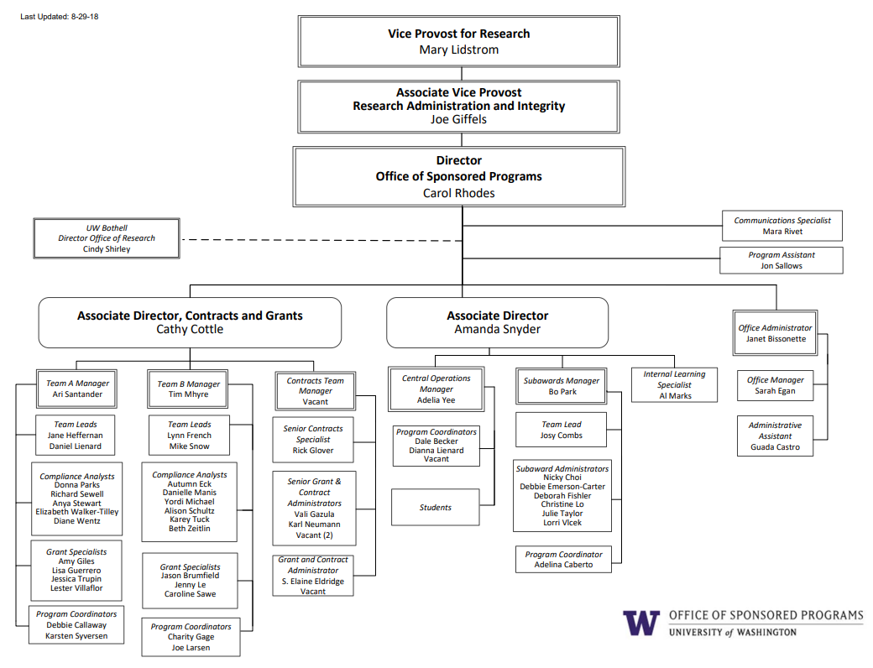

Slide 3
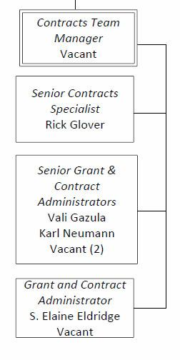
Contracts Team Restructure
Resources reallocated to Contracts Team.

Slide 4
Why?
Proposals ALWAYS take priority for reviewers on Teams A & B.
Allocating resources to the Contracts Team should help Bilateral Awards & Non-Award Agreements get attention they need.
Take advantage of economies of scale.

Slide 5
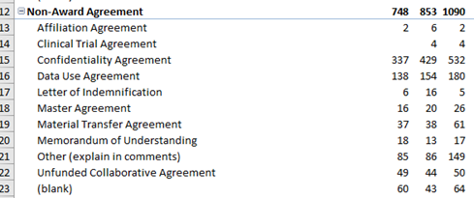
Biggest agreement volume increase area for OSP: Nonaward Agreements
FY16 FY17 FY18

Slide 6
More Complex Bilateral Awards
Example regulatory changes over last year
European Union General Data Protection Regulations (GDPR)
NIH Certificate of Confidentiality and broadened scope of protected identifiable sensitive information
Controlled Unclassified Information and requirements for protection in Nonfederal systems
Changes to Intellectual Property regulations promulgated by the National Institute of Standards and Technology (NIST) under the Patent and Trademark Law Amendments Act (aka: Bayh-Dole Act), 25 U.S.C. 200 and resulting awareness in contract language regarding present assignment of IP

Slide 7
When?
October: Interviews currently being scheduled
November: Hiring should be complete
We’ll be back at an upcoming MRAM with more details.

