Slide 1
EH&S PERSONNEL UPDATES
October 2018
Katia Harb, Interim Director
Environmental Health and Safety Department
kharb@uw.edu, 206-616-4146

Slide 2
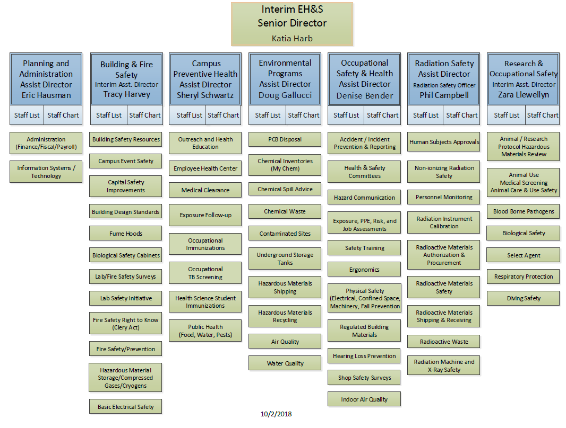

Slide 3
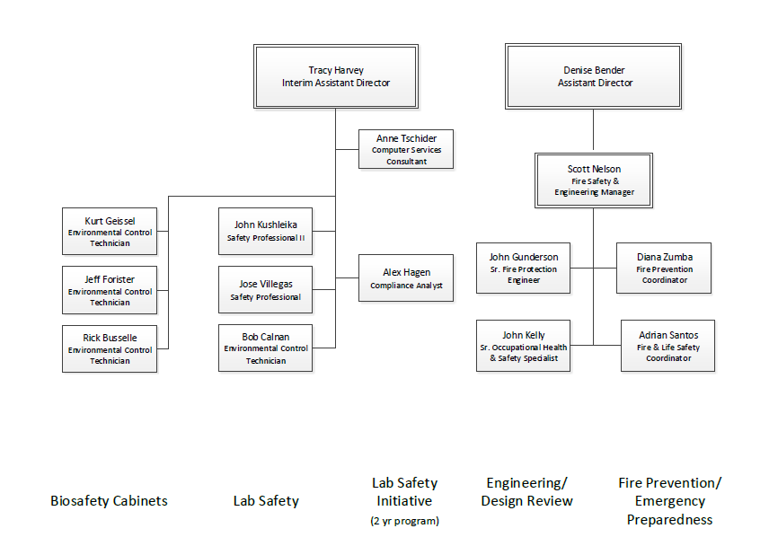
BUILDING AND FIRE SAFETY SECTION

Slide 4
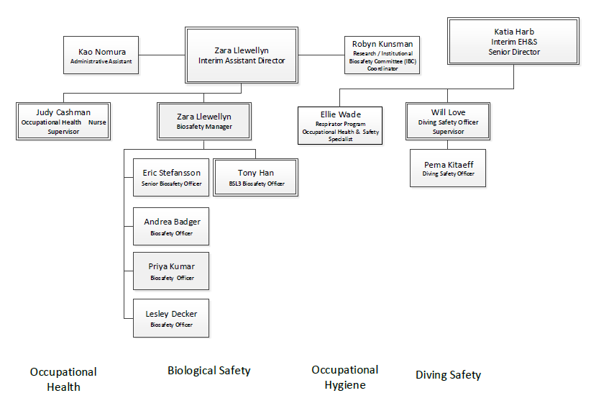
RESEARCH AND OCCUPATIONAL SAFETY

Slide 5
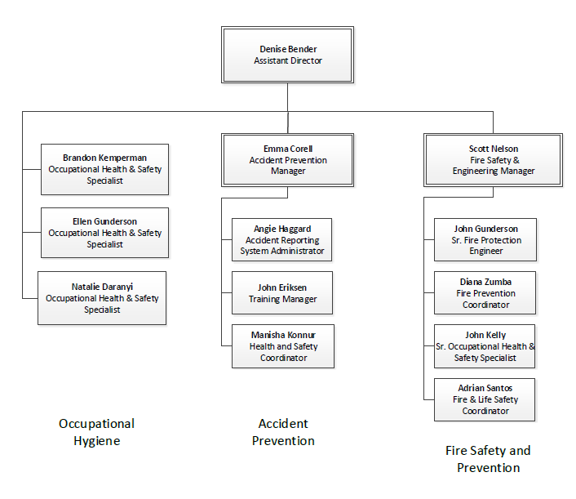
OCCUPATIONAL SAFETY AND HEALTH

Slide 6
EH&S CONTACT INFORMATION
http://www.ehs.washington.edu/
(206) 543-7262
ehsdept@uw.edu

