Slide 1
New Life Sciences Building
MRAM
October, 2018
Steve Majeski
College of Arts and Sciences

Slide 2
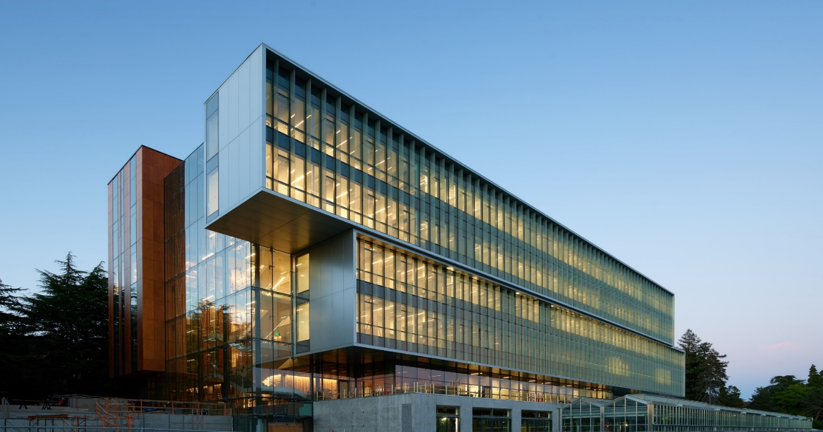
Life Sciences Building Opened 9/26/18

Slide 3
Project Objective
The College of Arts and Sciences Life Sciences Building (LSB) project is a five story above grade building with two stories below grade and mechanical penthouse.
The existing greenhouse and associated buildings were demolished and replaced with approximately 185,700 gross square foot LSB with a 18,000 gross square foot greenhouse.
It is designed to provide new teaching and research facilities for the department of Biology. Biology is the largest STEM degree granting major at the University of Washington and indeed the entire State of Washington

Slide 4
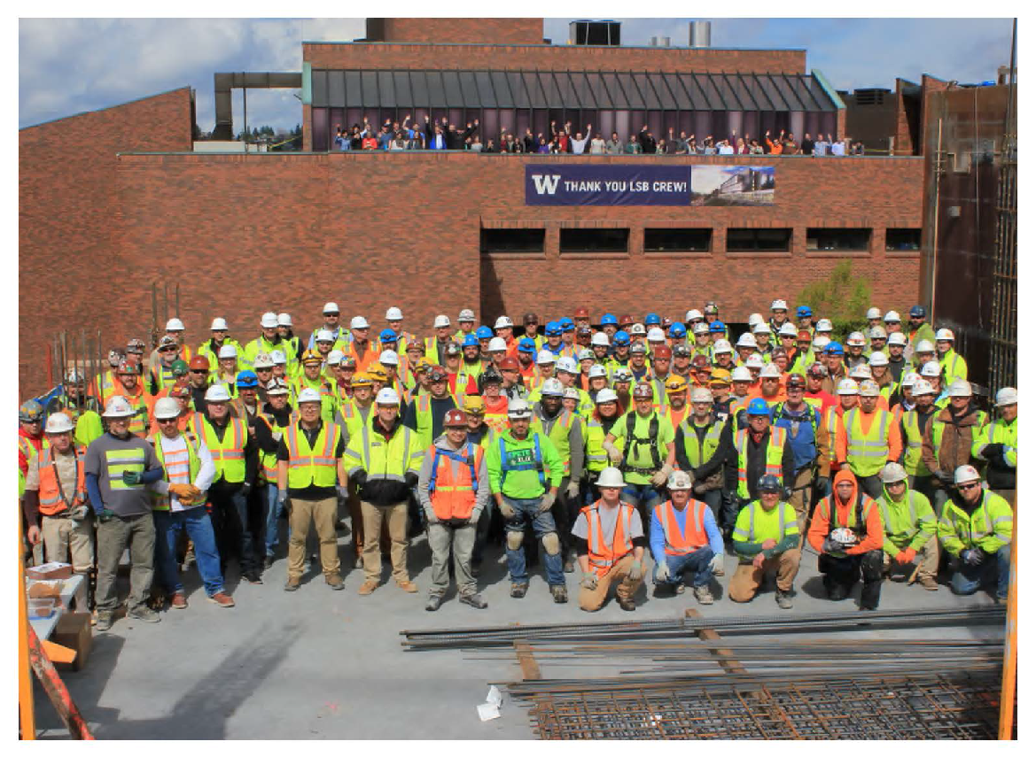
Project Stakeholders
College of Arts and Sciences
Biology
UW Capital Planning and
Development
Skanska Construction
Perkins + Will Architects
McKinstry
VECA Electric
Affiliated Engineers
GGN Landscape Architects

Slide 5
Budget
Current Approved $171,450,000
Forecast Total $169,250,000
Over/Under ($2,200,000)
The Life Science Building Project is funded completely by the College of Arts and Sciences - There is no State funding nor Central Administration funding. Ben and Margaret Hall donated $6.7M to build out the fifth floor of LSB. Amazon donated (valued at $500K) greenhouse space to hold Biology’s plants while the new greenhouse was under construction.

Slide 6
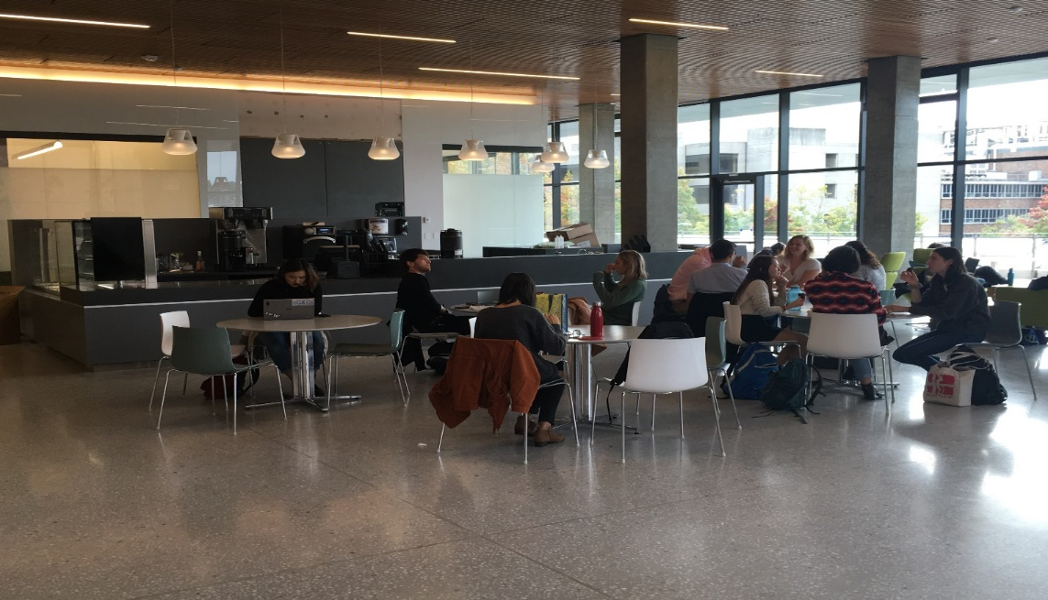
First Floor - Open to the Public
One active learning classroom 60 students
Four authentic research student teaching labs 25 students each
Student lounge
Café “Evolutionary Grounds”
Two student conference rooms

Slide 7
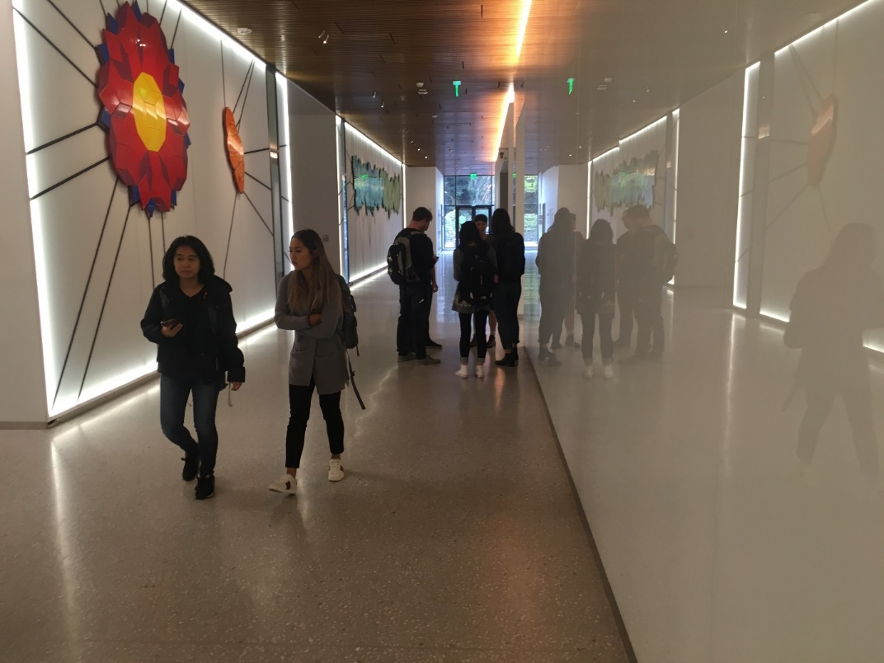
First Floor

Slide 8
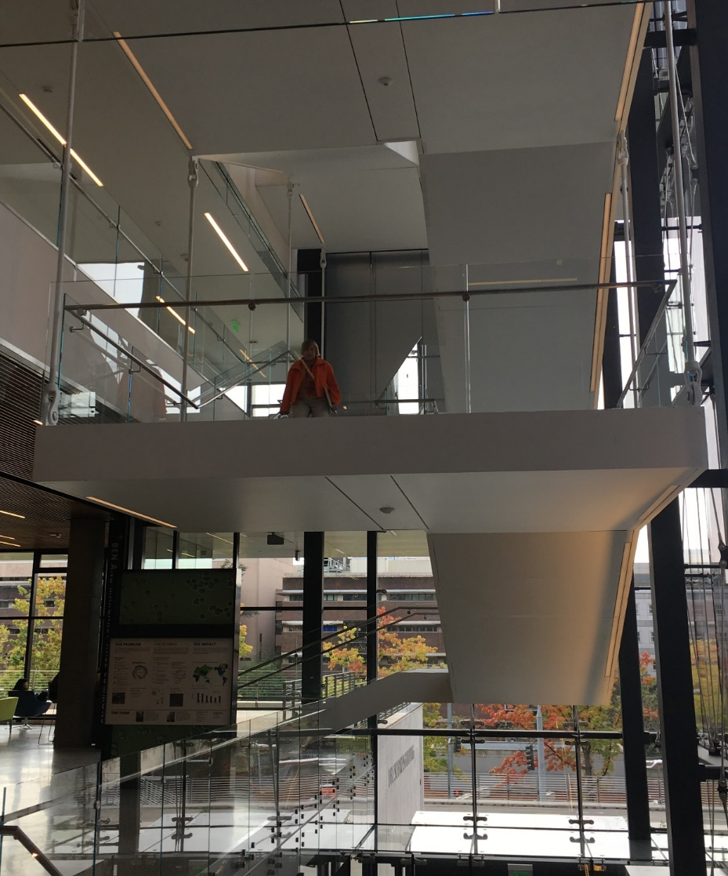
First Floor Active Learning Classroom

Slide 9
First Floor – Authentic Research Student Teaching Lab – Biomechanics lab class

Slide 10
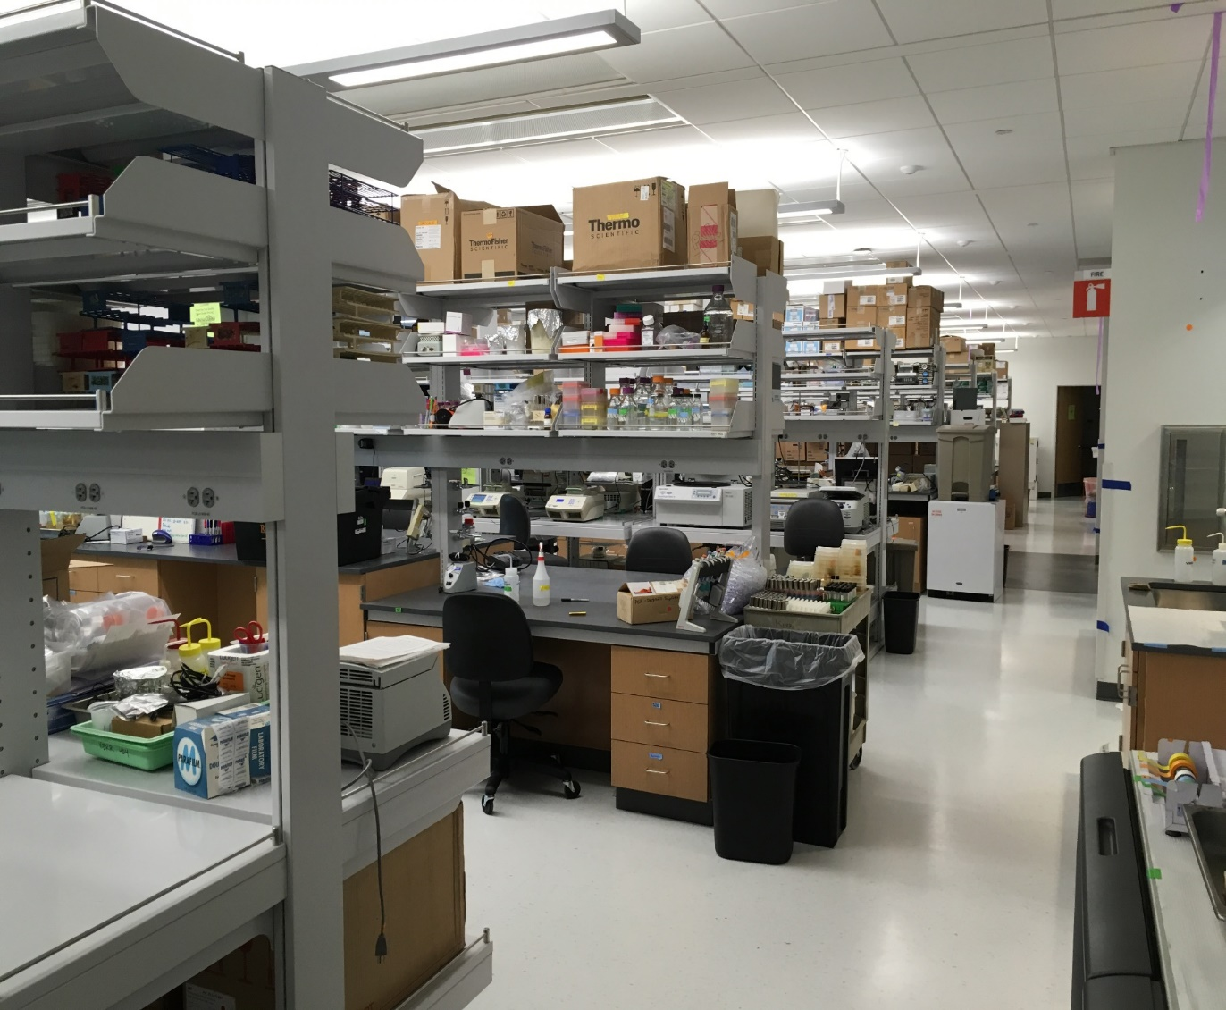
Research Lab Floors
Floors 2-5
Each floor 20,000 sq. ft.
Ten PIs per floor
Each Floor houses 100 faculty,
postdocs, graduate students,
and undergraduate
researchers
The design promotes
collaboration, interaction, and
interdisciplinary research

Slide 12
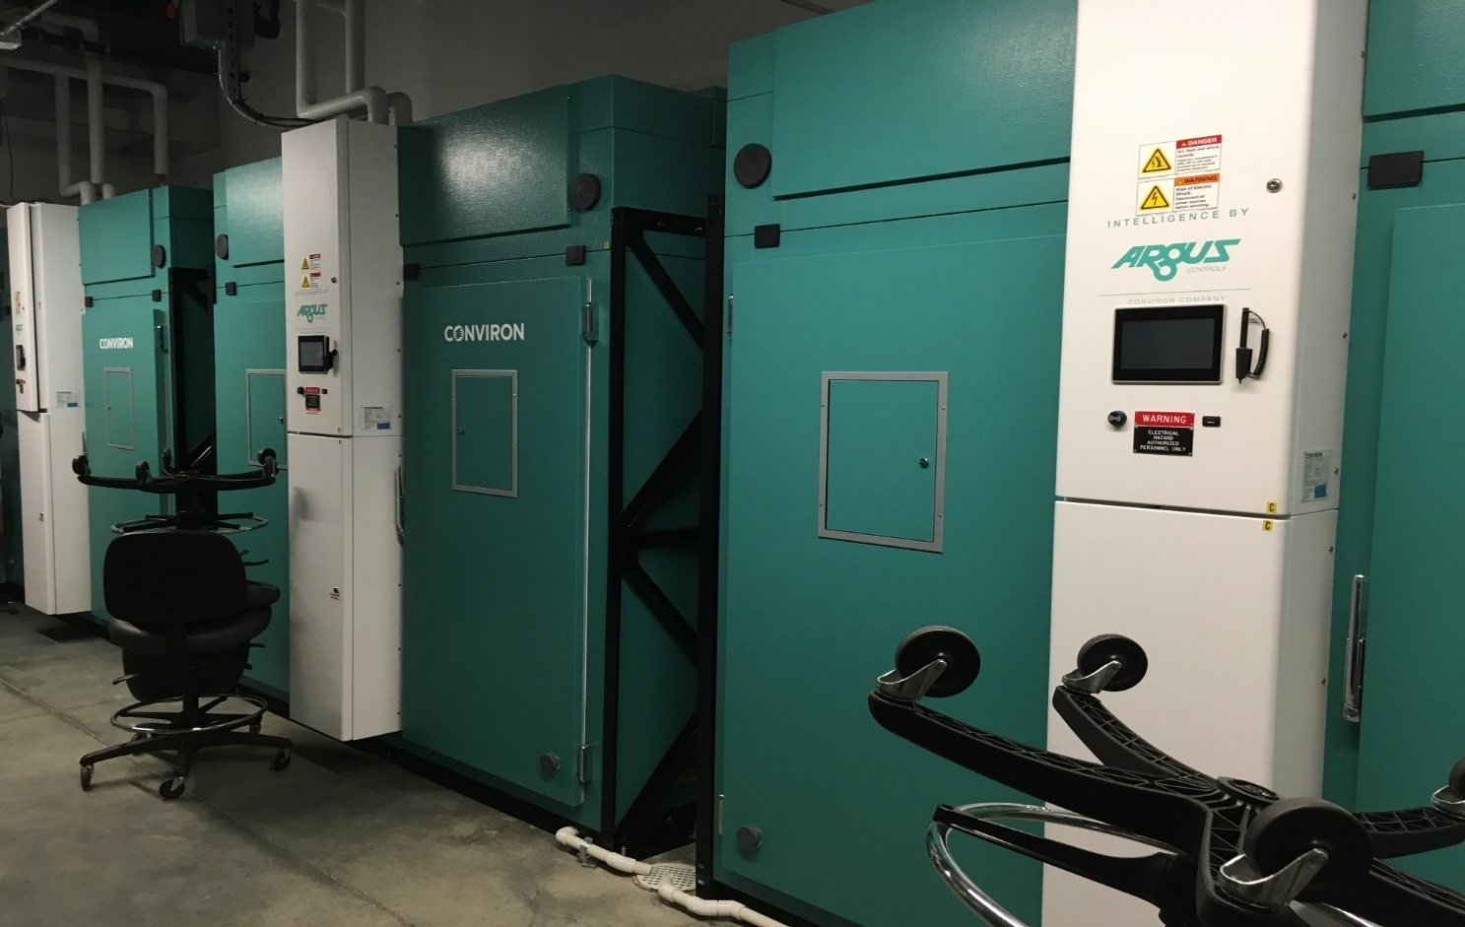
Basement Floors
Animal Care B1
Growth Chambers B2

Slide 13
Sustainability – Key Features
LEED Gold
Vertical Photovoltaic Glass Fins –
Generates enough power to lights all offices for the entire year
Shade the building at the hottest times of the year
First installation of its kind in the WORLD
Chilled Beams
Chilled Waves
Radiant Floors
Reverse Osmosis reject water (from labs) stored and used to irrigate the greenhouse
Rooftop solar panels (funded by donors and will be installed soon)
Operable windows for passive cooling

Slide 14
Photovoltaic Glass fins

