Slide 1
REPORTING IN WORKDAY
Presenters:
Stepanka Sirotek, Business Systems Analyst, UWFT
Jesse Rice, Business Systems Analyst, UWFT

Slide 2
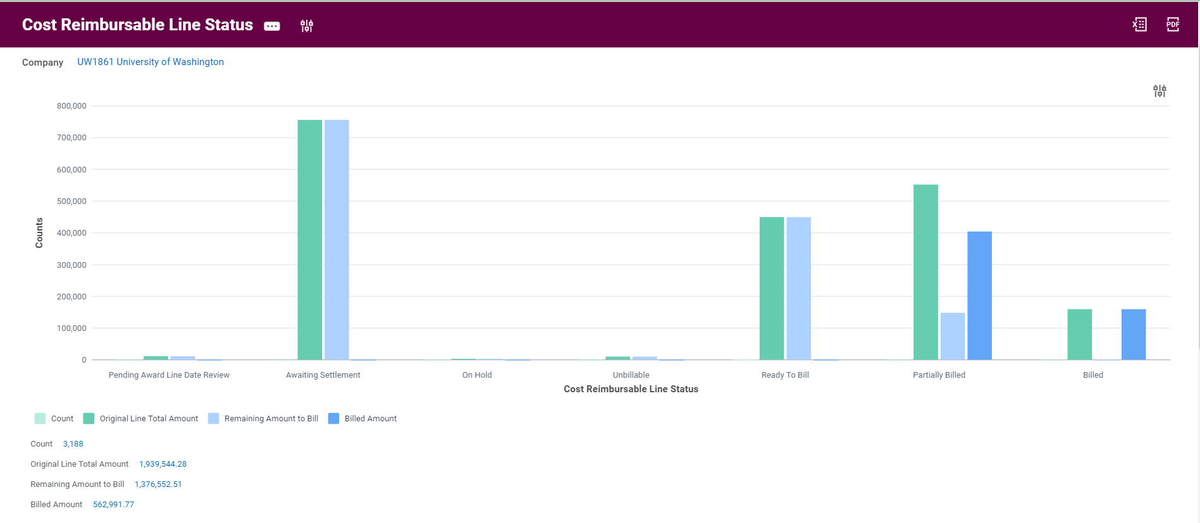
Cost Reimbursable Line Status Sample

Slide 3
Cost Reimbursable Line Status definitions
Pending Award Line Date Review:
Transactions with Budget dates outside award dates – cannot be pulled into a Sponsor Invoice unless the budget date is reviewed and corrected
Awaiting Settlement:
Transactions not yet paid by UW to Suppliers – cannot be pulled into a Sponsor Invoice until paid
On Hold:
Transactions manually placed on hold - cannot be pulled into a Sponsor Invoice until hold is removed
Unbillable:
Contains spend over prepaid installment when set to not bill over prepaid amount; retention; transactions not associated with an approved billing schedule (advance spend)

Slide 4
Cost Reimbursable Line Status Definitions continued
Ready To Bill:
Transactions which can be pulled into a Sponsor Invoice
Partially Billed:
Split transactions due to billing limits or exceeding Authorized Amount (deficit spend)
Billed:
Transactions already billed to Sponsor

Slide 5
Reporting Demo

Slide 6
Q&A

