Slide 1
BONUS UWFT SESSION Monthly Research Administration Meeting - MRAM
June 16, 2023, 9:00 AM – 10:30 AM Click “CC” to Show Captions in your Zoom Controls
TOPIC | PRESENTER | EMAIL | MIN
Welcome |  |  | 2
Dashboard Reports in Workday Finance | Don Wilcox UWFT Finance Transformation | uwftask@uw.edu | 10
Legacy Reports | Nicole Flagg UWFT Finance Transformation | uwftask@uw.edu | 5
Closer look at Future State: When do I need an eGC1 vs. Modifications in SAGE | Carol Rhodes Office of Sponsored Programs | carhodes@uw.edu | 15
Where are Awards & Modifications During OSP Cutover and what happens to These at Go-Live? | Carol Rhodes Office of Sponsored Programs | carhodes@uw.edu | 10
Subaward Follow Up | Amanda Snyder Office of Sponsored Programs | acs229@uw.edu | 5
SNAP Award Setup | Vincent Gonzalez Grant & Contract Accounting | vinceg@uw.edu | 10
Hypercare & the Customer Support Model | Sarah Thomas Finance Readiness Program | saraht93@uw.edu | 10
Salary Over the Cap in Workday Finance | Stepanka Sirotek UW Finance Transformation | sr8@uw.edu | 15
Training Resources | Kim Halstead Office of Research Information Services | khalstea@uw.edu | 2
NEXT MRAM July 13, 2023, 9:00 AM - 10:00 AM

Slide 2
WORKDAY GRANT DASHBOARDS
Don Wilcox
UW Finance Transformation
June 16, 2023 MRAM

Slide 3
Workday Dashboards
Grant Manager Dashboard
Principal Investigator Dashboard
Financial Desktop Dashboard

Slide 4
LEGACY REPORTS
Nicole Flagg
UW Finance Transformation
June 16, 2023 MRAM

Slide 5
Closer look at Future State:
When do I need an eGC1?
& Modifications
June 16, 2023 MRAM
Carol Rhodes
Office of Sponsored Programs

Slide 6
Award Modification Handling - what we used to do
Award Changes without funding were handled as Post-Award Changes (PACs).
Examples:
Change in budget (no additional funding)
Extensions
When the Award Change involved funding:
If funding above the current eGC1 amount, you’d route an eGC1 for the additional amount.
OSP would create a funding action under that eGC1.
Examples:
Supplemental funding
Amount of award exceeded the original proposed amount by 25% or more

Slide 7
Future State Award Modification Handling
After Award is established, all changes are processed via a Modification (MOD).
Some features:
You can decide to route to OSP or to GCA only
Ability to choose categories
Submission button with assurance language
Ability to add ad-hoc approvers
and more to come…
This means adjusting eGC1 Requirements.
Notes:
Post-Award Changes (PACs) or Funding Actions (FAs) will no longer be used to reflect changes.

Slide 8
Future State eGC1 Requirements
Keeping eGC1 requirement for:
Pre-applications, Pre-proposals, Letters of Intent / Interest requiring authorized official (AO) submission/sign-off or that contain budget details.
Proposals: competing & application stage supplemental
Revised applications
Resubmission
Transfer from Another Institution
After-the-Fact awards
Non-award agreements (NAAs) and NAA continuations
OSP will determine if unique situations not described require an eGC1.

Slide 9
Updates to eGC1 Requirements
These will no longer require an eGC1:
Change in scope of work (change in direction, aims, objectives, purpose)
Additional compliance requirements not in an earlier eGC1, such as animal or human subjects or cost share
When award exceeds 25% or more of original eGC1 amount
Non-SNAP RPPRs

Slide 10
Examples to consider in our future state
Modification to change Key Personnel (MOD)
Modification awarding additional funding, even when additional funding exceeds amount on original eGC1 (MOD)
Your PI is applying for additional funding for year 3 (eGC1)
Your PI is applying for an administrative supplement (eGC1)
Your PI needs additional time added to end of project (MOD)

Slide 11
Modifications Guidance
What you need to include on MODs will be listed in Award Changes guidance (coming soon!)
Modifications will be requested according to Categories.
We are keeping forms we require, and recommended concurrence letter form:
Change of PI form
Extension form
End of Award Request form
F&A Waiver form
Concurrence letter
What about changes you used to process via TRANSPASU?
Those will be handled as MODs as well! They will go straight to GCA and bypass OSP.

Slide 12
We will have smooth sailing soon!

Slide 13
How to Create an Award Modification
Create an Award Modification
Help icon links to guidance on selecting the correct modification type

Slide 14
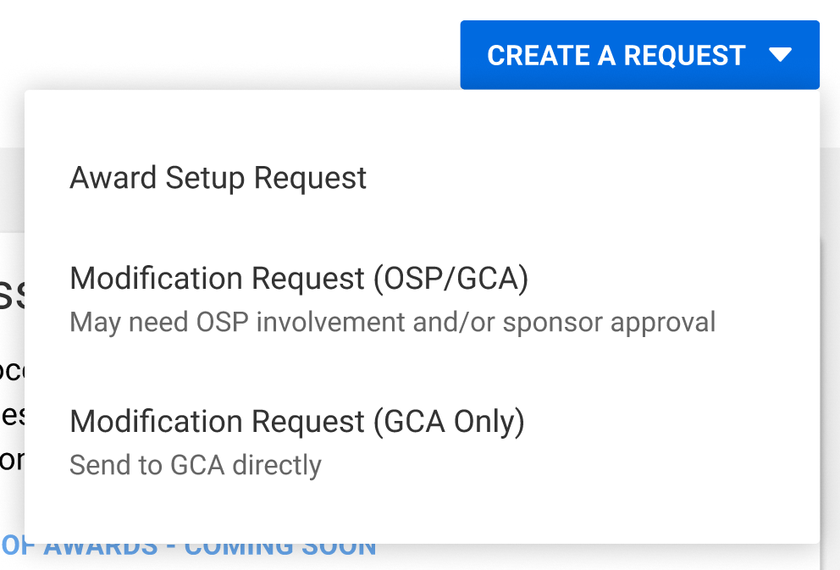
How to Create an Award Modification:
Select Modification Request & offices involved
Select Modification Request and offices that need to be involved
Notes:
if Campus selects the one Mod Request (i.e. they choose it to be only reviewed by GCA, when it has to be reviewed by both teams) then GCA will send it back to Campus and they'll need to delete this Mod request and start over.

Slide 15
How to Create an Award Modification:
Search for award
Search for award that requires modification
Notes:
Searching by Award ID is confirmed for R1. The team is unsure if they'll be able to get searching by PI or Short Title in by R1.

Slide 16
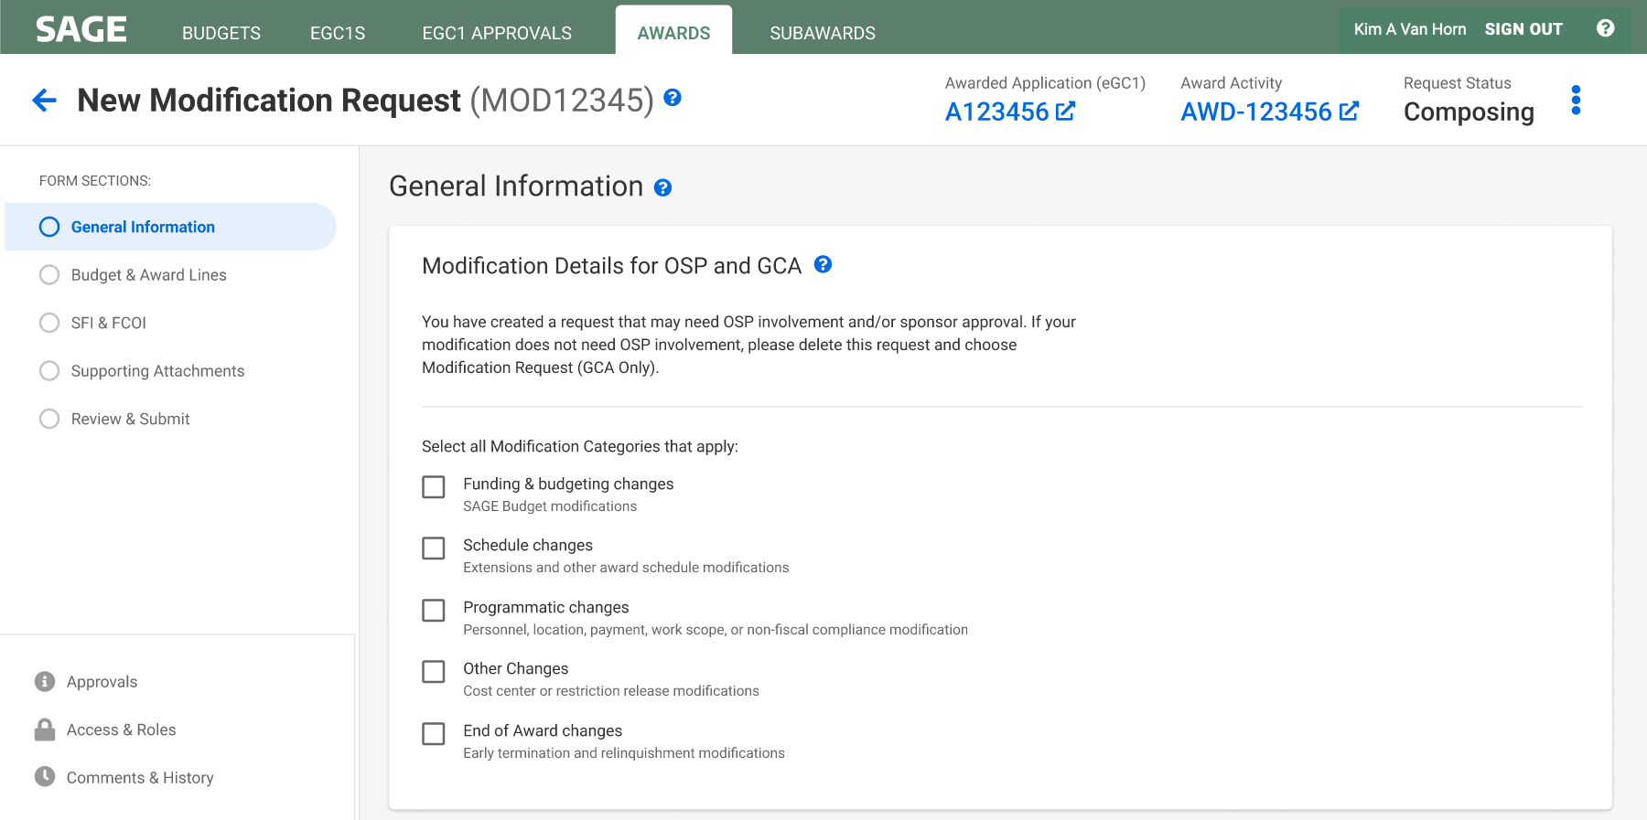
How to Create an Award Modification:
Select categories
Select all modification categories that apply

Slide 17
How to Create an Award Modification:
Review request summary
Review your Modification request summary
Screenshot 1 of 2. Image continues on next slide.

Slide 18
How to Create an Award Modification:
Review authority & approval statement
Review the authority & approval statement
Screenshot 2 of 2.

Slide 19
Resources
When will I need to route an eGC1 vs. create a Modification Request?
More details and instructions will be published as we get closer to launch in early July on our Award Changes web page - Stay tuned!

Slide 20
Questions?

Slide 21
Where are Awards & Modification requests during OSP’s cutover?
What happens at Go-Live?
June 16, 2023 MRAM
Carol Rhodes
Office of Sponsored Programs

Slide 22
Cutover: June 12-July 6
OSP is not processing awards or fiscal-related award modifications during cutover.
All items received during this time (from sponsors) will be collected for conversion at Go-live.

Slide 23
Collection process
Unilateral awards & modifications e.g. no negotiation of terms and conditions needed
Assigned to “MAILOUT” as a temporary holding spot
No processing unless an item requires submission in a sponsor system by a deadline during cutover
Bilateral awards & modifications e.g. may require negotiation:
Assigned to reviewers

Slide 24
Conversion beginning 7/07
All existing budget numbers went through automatic conversion during cutover.
All OSP collected items must be converted manually
Priority items first - goal is to convert during month of July
All the rest will be converted soon after
Converted means:
All new awards matched with their eGC1, basic information entered, then sent to PI/campus for SAGE Budget worksheet and additional fields completed
All fiscal-related modifications matched with their award, basic information entered, sent to PI/campus for additional information needed.
What does this mean for tracking?
Please visit the special session MRAM in July
Notes:
April MRAM - UWFT Transitions: https://finance.uw.edu/gca/sites/default/files/mram/2023.04/04%20UWFT%20Sponsored%20Program%20Transitions%20Round%20Two.MRAM_.4.13.23.pptx

Slide 25
Prepare for Go-Live During Cutover
Have a changes to an award you used to send on eGC1?
Do not route an eGC1 for award changes that will no longer be processed on an eGC1.
Supplements
RPPRs (unless they are due before 7/07)
Scope changes
Hold off on submitting award modification requests, e.g. extensions, unless an emergency needs submission to a sponsor during cutover.
If you have an award to send to OSP:
Route an ATF eGC1 for an award received that does not have an eGC1 in place. An approved eGC1 is needed to process an Award Set-up Request at Go-Live!
If you have an approved eGC1 already: Hold off on sending in awards to osp@uw.edu

Slide 26
Items you have “Collected” - as of July 7th
Award Changes: Use an Award Modification in SAGE
New Awards: Use an Award Set-Up Request in SAGE

Slide 27
Questions

Slide 28
Subaward Updates
June 16, 2023 MRAM
Amanda Snyder
Office of Sponsored Programs

Slide 29
BPO transition to Workday
FT Program has been working on solutions to convert existing, open subaward BPOs from Ariba to Workday
During conversion, effort will be made to load subaward BPOs
Expect a portion of BPOs will be converted
Expect errors to block other BPOs from converting
Those that do not convert will need to be entered manually

Slide 30
Questions

Slide 31
NIH SNAP Award Setup:
Current vs Future State
Bonus UWFT MRAM
June 16th, 2023
Vince Gonzalez, Associate Director
Grant & Contract Accounting

Slide 32
NIH SNAP Awards
The National Institutes of Health (NIH) have provisions that modify an award to streamline submission of information. These provisions are referred to as Streamlined Noncompeting Award Process (SNAP).
These SNAP provisions are outlined in an award document in Section III – Standard Terms and Conditions.
Special UWFT MRAM - Vince Gonzalez - Grant & Contract Accounting

Slide 33
SNAP Award Setup - Current State
Upon receipt of the year 1 (or 1st year of the competitive segment) of funding, GCA processes a New Funding Action and setup a budget number with a current period equal to the Project Period (or planned competitive segment).
Future years of funding (years 2 – 5), would be processed as Supplement Funding Actions
Special UWFT MRAM - Vince Gonzalez - Grant & Contract Accounting

Slide 34
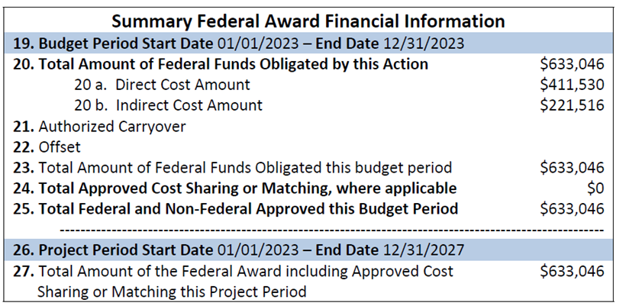
SNAP Setup - Current State (Continued)
GCA Sets Up Budget with Current Period of 1/1/2023 to 12/31/2027
Special UWFT MRAM - Vince Gonzalez - Grant & Contract Accounting

Slide 35
SNAP Award Setup - Future State
Upon receipt of year 1 (or 1st year of the competitive segment) of funding, GCA will process the Award Setup Request (ASR) and setup an Award Line for the period being funded, aka the Budget Period.
Future Periods of funding received (years 2 – 5) would be processed as Supplement & Extension Modifications (MODs).
Special UWFT MRAM - Vince Gonzalez - Grant & Contract Accounting

Slide 36
SNAP Setup - Future State (Continued)
GCA Will Set Up Award Line with dates of 1/1/2023 to 12/31/2023
Special UWFT MRAM - Vince Gonzalez - Grant & Contract Accounting

Slide 37
Impact on Award Management
Departments would need to wait for non-competing continuation years of funding to supplement and extend existing award line(s).
If there are delays in funding for non-competing years, a department may need to request a Temporary Budget Extension MOD to extend the award line and ensure award expenditures can continue to post.
Special UWFT MRAM - Vince Gonzalez - Grant & Contract Accounting

Slide 38
Similar Impact to Other Awards
This setup change will also impact awards setup similar to NIH SNAP, including but not limited to awards from:
National Science Foundation
U.S. Department of Energy
U.S. Department of Education
U.S. Geological Survey
National Oceanic & Atmospheric Administration
Special UWFT MRAM - Vince Gonzalez - Grant & Contract Accounting

Slide 39
Questions?
If you have additional questions, please feel free to reach out to me via email at vinceg@uw.edu
Special UWFT MRAM - Vince Gonzalez - Grant & Contract Accounting

Slide 40
HYPERCARE & THE CUSTOMER SUPPORT MODEL FOR WORKDAY FINANCE
June 2023 MRAM
Sarah Thomas
UWFT Operating Model

Slide 41
WHAT IS HYPERCARE?
Dedicated support period immediately after go-live that includes:
Additional layers of support for our customer support teams
Special escalation paths and teams to troubleshoot and resolve issues
UWFT program team there to support stabilization and minimize business disruption
Notes:
Amanda

Slide 42
WHAT IS THE CUSTOMER SUPPORT MODEL?
Customer support refers to the infrastructure and tools to support Workday Finance end users including where and how to get help.
UW Connect Finance (UW-branded ServiceNow) will be the common tool for submitting help requests to central offices.
Shared Environments are the first point of support for Workday Finance within each unit/department.
We will be here to help!
Notes:
Amanda

Slide 43
WHERE TO GET HELP
Workday Finance: Reach out to your unit's Shared Environment via UW Connect or their defined methods
Security Role Questions: Contact the Integrated Service Center (ISC)
SAGE: Contact sagehelp@uw.edu
OSP: Contact osp@uw.edu
GCA & Award Portal: Contact gcahelp@uw.edu
ECC: Contact ECCHelp@uw.edu

Slide 44
WHAT IS UW CONNECT?
UW Connect (the UW-branded ServiceNow) is a customer support platform, already used across the University.
A new module, UW Connect Finance, will be the primary support system used for Workday finance and procurement.
UW Connect Finance includes a self-help portal with knowledge articles and training links and will allow campus users to submit help tickets.
You can find more information here: UW Connect Finance Overview (sharepoint.com)

Slide 45
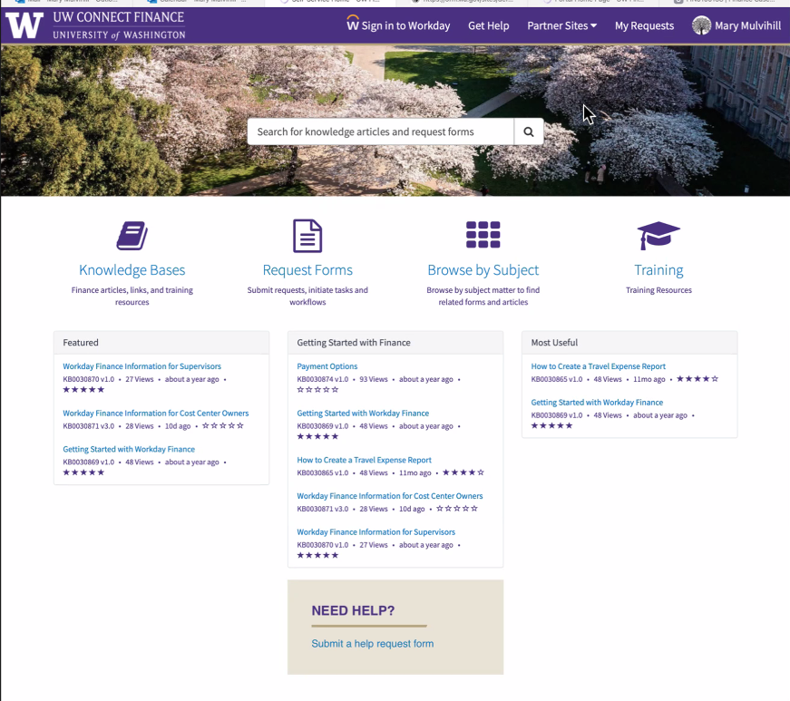
UW CONNECT FINANCE PORTAL

Slide 46
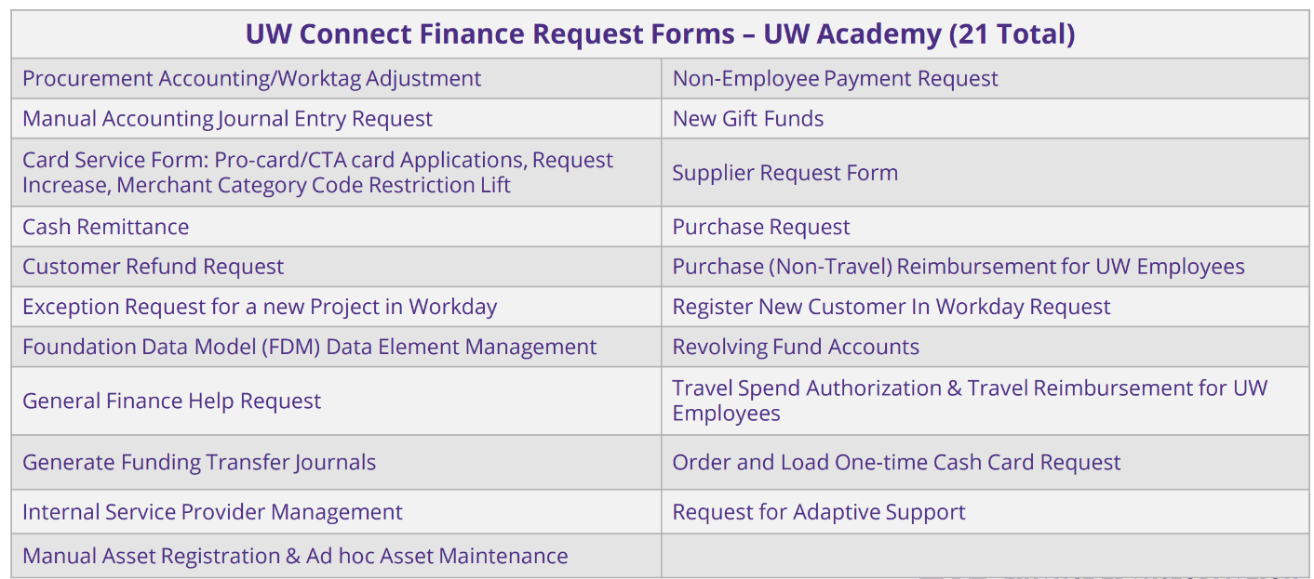
WHEN TO SUBMIT A UW CONNECT TICKET
More details here: UWFT Change Network - UWCF Request Forms

Slide 47
WHERE TO GET HELP – SHARED ENVIRONMENTS
A Shared Environment is a pooled group of staff, conducting finance and procurement activities on behalf of one or more local units.
Shared Environments enhance efficiency and compliance by pooling specific transactions that had previously been performed separately by local entities. By serving one or more units, Shared Environment specialists with Workday expertise will ensure standardization and ease the administrative burden of local staff who were previously tasked with transactional work that was not core to their job functions.
Shared Environments are specific to UW Academy and live at the Dean or VP-equivalent level office of each unit.
Shared Environments complete tasks within four defined business process areas:
Shared Environments are the first point of contact for units for all
support questions.
Misc. Accounts Receivables | Procurement
General Accounting | Post-Award Research Administration

Slide 48
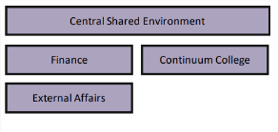
SHARED ENVIRONMENTS
34 Shared Environments, including the Central Shared Environment
Located in Dean, or VP-equivalent level, office of each unit
Some smaller units are serviced by the Shared Environment in a larger unit
UW Connect help tickets will auto-route to submitter's assigned Shared Environment

Slide 49
COSTING ALLOCATIONS: SALARY OVER THE CAP AND EFFORT COST SHARE
Stepanka Sirotek
Business Analyst, UW Finance Transformation
June 16, 2023 MRAM

Slide 50
Salary Cap – Current State Example
Faculty – 12.6% effort on grant 61-0000
Total Base Pay: $21,825/monthly
Salary cap = $17,325/monthly
Department will enter costing allocations into WD:
10% to the grant
2.6% to a non-grant salary source

Slide 51
FUTURE STATE

Slide 52
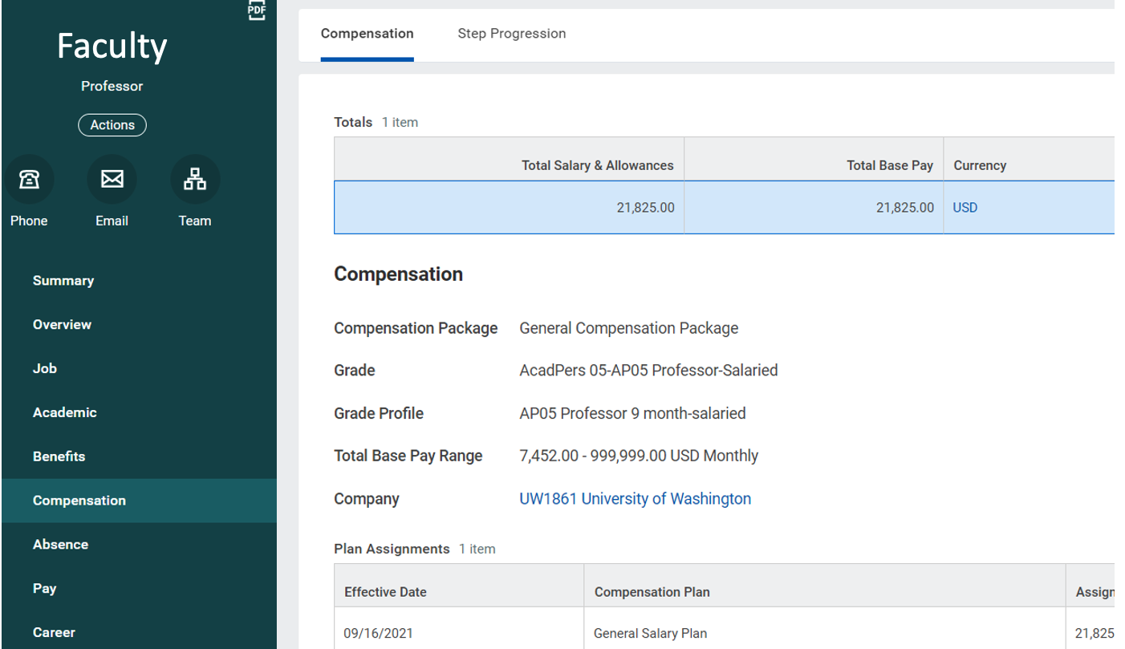
WORKDAY
Notes:
do you need this slide?

Slide 53
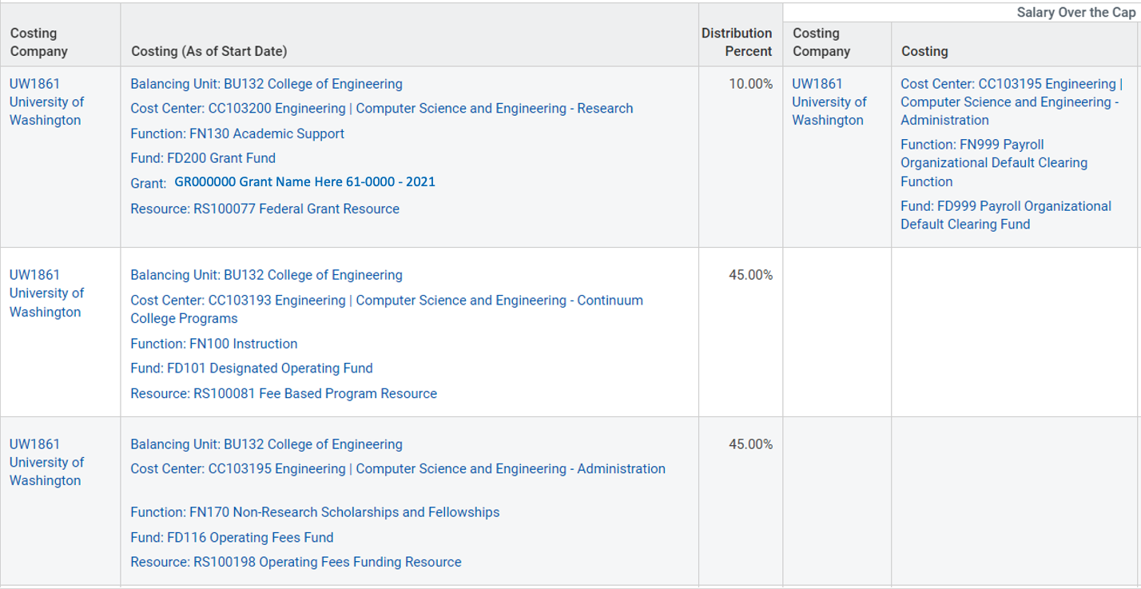
WORKDAY Costing Allocations – Future State

Slide 54
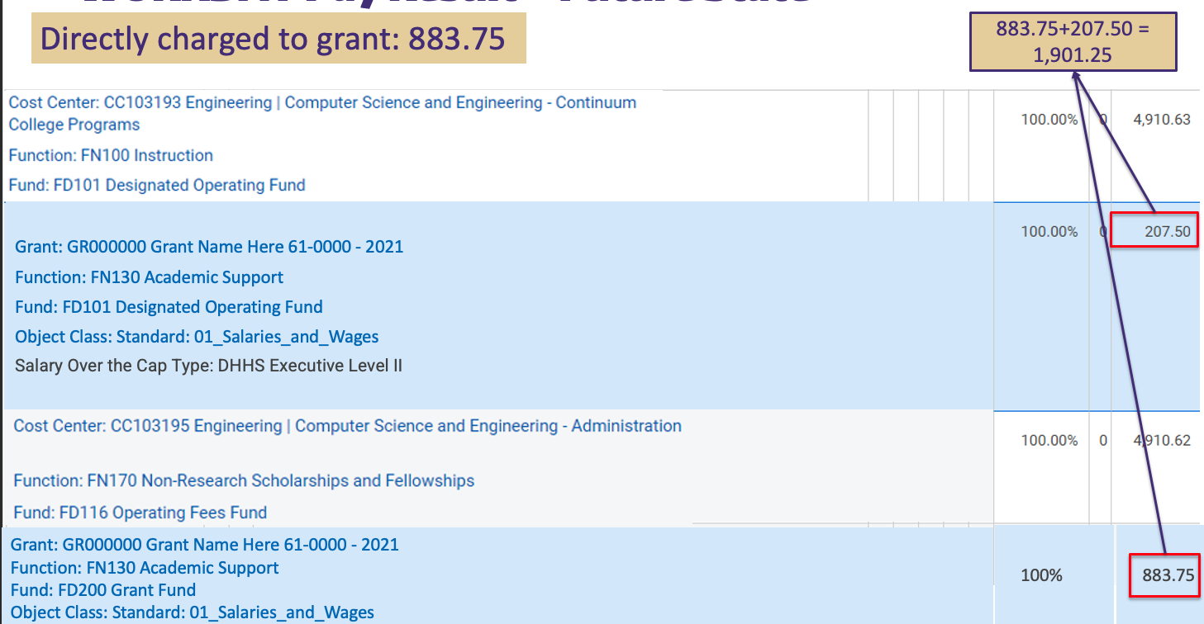
WORKDAY Pay Result – Future State

Slide 55
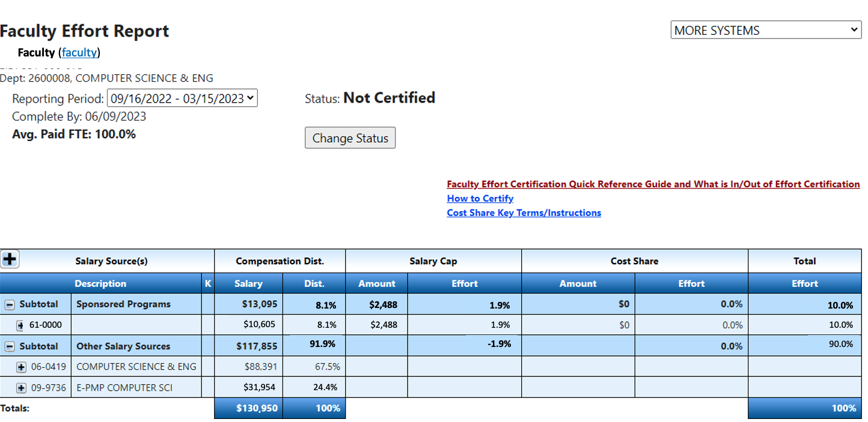
Effort Report - Future state

Slide 56
COMMITTED COST SHARE

Slide 57
Cost Share – Current State Example
Faculty – 100% effort on grant 62-0000
90% is directly charged to the grant
10% is cost shared, paid from 06-1030
Costing allocation current state:
90% costed to 62-0000
10% costed to 06-1030
Cost Share is recorded outside of WD, in the eFECS Cost Share Summary application and eFECS Effort Reporting application

Slide 58
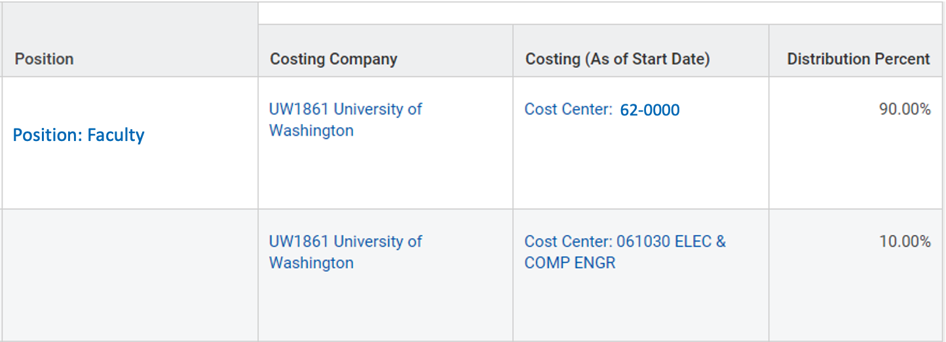
WORKDAY Costing Allocations – Current State

Slide 59
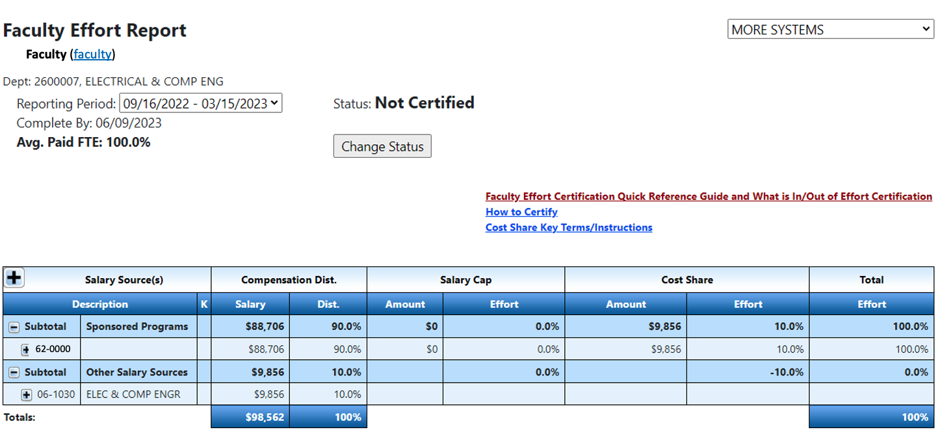
Effort Report - Current State

Slide 60
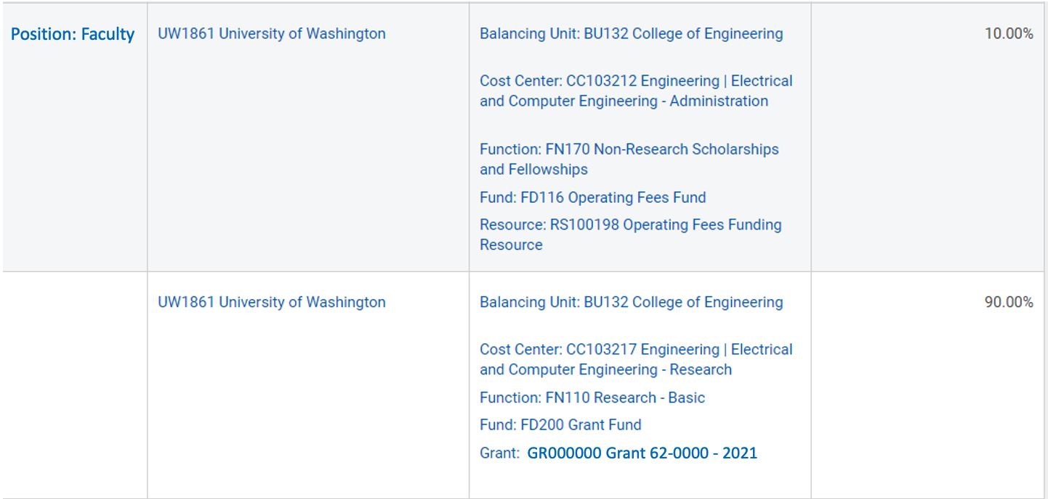
WORKDAY Costing Allocations – Future State (now)
Non-sponsored funding resource
The grant

Slide 61
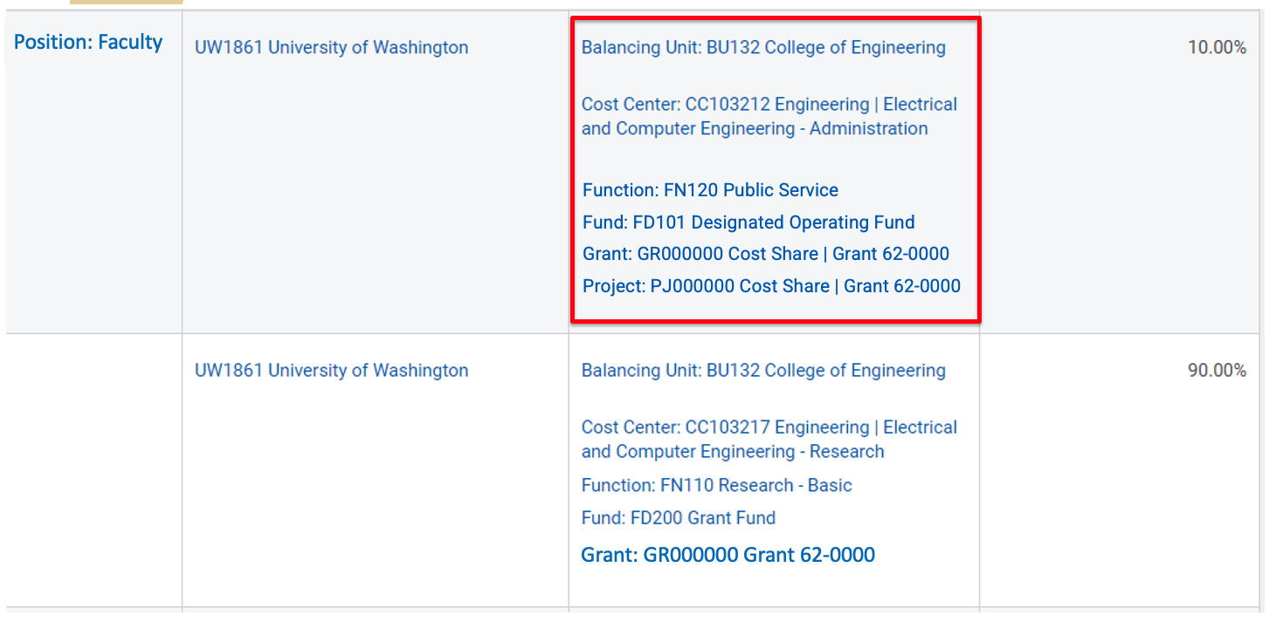
WORKDAY Costing Allocations – Future State (desired)
Non-sponsored funding resource
The grant

Slide 62
RETROACTIVE ADJUSTMENTS
Retro adjustments will not calculate SOC accurately and will require additional corrections
PAAs will not calculate the SOC
Corrections will require supplemental documentation (inclusion of a salary cap calculator)

Slide 63
HANDLING SPECIAL CASES
X/Y Salary Components
Continue to adjust manually at time of entry
SOC will be handled by ECC
ECC will calculate and display how much over the cap has not been covered yet
Allocations on awards with salary limitations
Continue to adjust manually at time of entry
“Co-funding” of effort (e.g., use of non-federal grant to offset salary limitations of K award) will require a salary allocation in the Workday payroll module and manual adjustments in ECC

Slide 64
THINGS TO KEEP IN MIND
Don’t prorate costing allocations in Workday Finance
Create costing allocations for committed cost share
SOC designated cost centers will need to be proactively added or the charges will end up on the individual’s default cost center
An updated costing allocation user guide is being developed to address new process requirements
Accrued charges can be reviewed after each pay period in the Employee Compensation Compliance (ECC) system
Watch out for outreach from UWFT HRP Remediation Team

Slide 65
Questions
Please email Stepanka Sirotek with questions at sr8@uw.edu

Slide 66
ADDENDUM:
SALARY CAP - CURRENT STATE

Slide 67
Salary Cap – Current State
Capped award is set up by GCA with grant flag 08
Department calculates cap using the Salary Cap Calculators
Department enters costing allocation into WD (adjusted for the cap)
Over the cap amount goes to a non-grant salary source
No need to specify salary source for over the cap
Need to have enough Other Salary Sources to cover all salary over the cap obligations

Slide 68
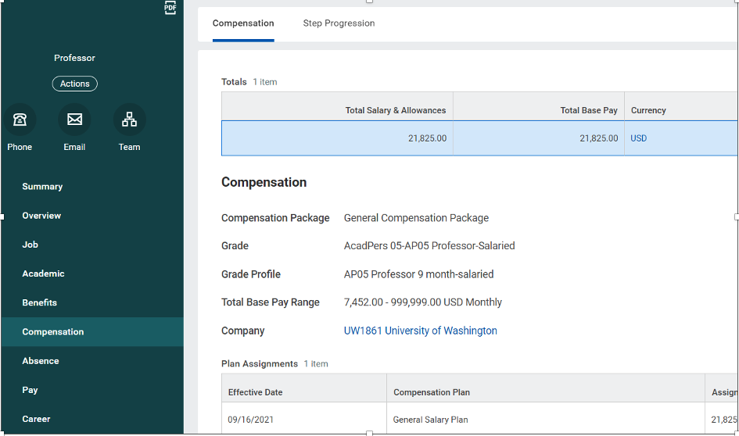
WORKDAY
Notes:
do you need this slide?

Slide 69
WORKDAY Costing Allocations – Current State

Slide 70
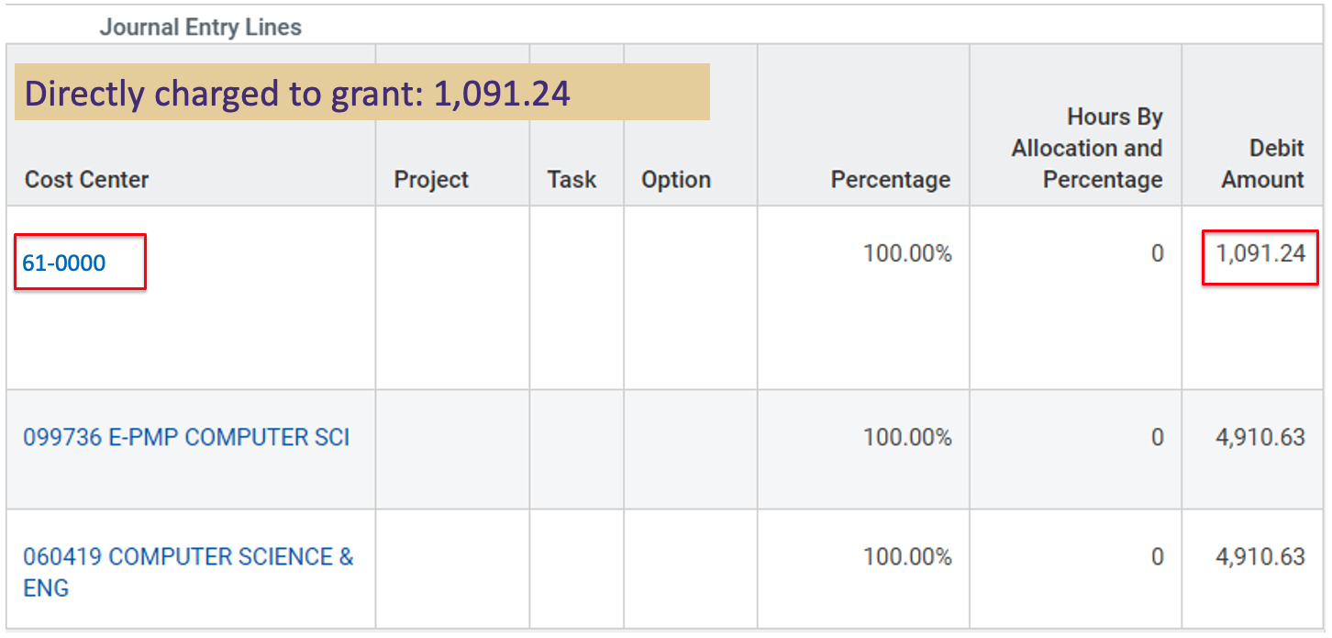
WORKDAY Pay Result – Current State

Slide 71
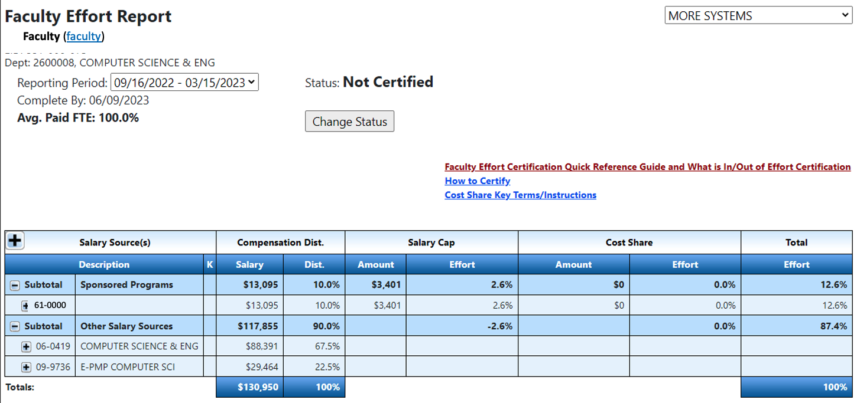
Effort Report - Current State

Slide 72
TRAINING RESOURCES
June 16, 2023
Kim Halstead & Breona Gutschmidt
Office of Research Information Services

Slide 73
SAGE TRAINING RESOURCES
UWFT for the Research Community webpage
A frequently updated hub for research resources related to the Workday Finance transformation.
All SAGE-related resources are linked.
For PIs: UWFT for Principal Investigators
SAGE Awards Training
Award Setup & Tracking in SAGE eLearning (40 mins)
SAGE Award Setup Workflow Video (8 mins)
What’s Changing in SAGE? Video (9 mins)
SAGE Awards user guides are in development and will be available after SAGE release.
Notes:
We are continuing to make updates to training.

Slide 74
SAGE TRAINING RESOURCES
SAGE Budget
SAGE Budget Instructor-led Class
July 20, 1 - 3 p.m.
August 31, 1 - 3 p.m.
SAGE Budget eLearning (60 mins)
SAGE Budget Job Aid and User Guides
SAGE Office Hours: SAGE Office Hours are scheduled twice monthly throughout 2023 to assist with questions on SAGE Budget, SAGE Awards, and general SAGE assistance.
Thursday, June 29, 1 - 2 p.m.
Thursday, July 13, 11 a.m. - noon
Notes:
SAGE Office Hours are available for your SAGE questions – questions on Awards, SAGE budget, and other SAGE functionality are welcome.

Slide 75
ADDITIONAL UWFT TRAINING RESOURCES
Workday Finance
Access Bridge LMS for training for your Workday security role.
Information on optional foundational Workday training, PI Workday training, and Grant Manager training available on the PI Training Resources page.
Award Portal
Award Portal training will available at Award Portal go-live on July 11.
ECC
ECC training will consist of instructor-led training with supplemental video training.
Training will begin in August, with first sessions focusing on Project Statements.
More instructions for course sign-up to come.

Slide 76
UWFT TRAINING PRIORITIES
Live trainings
Courses in high-frequency process areas
eLearning
Recorded Demo courses
Nano-Learning courses
Work with your peers to develop unit-specific recommendations to prioritize Finance Transformation trainings.
Notes:
Additional message to admins with guidance on high-priority training going out soon.

