Slide 1
Tips for Success
Award Setup and Modification Requests in SAGE
September 14, 2023 MRAM
Ari Santander & Juan Lepez
Office of Sponsored Programs and Grant & Contract Accounting

Slide 2
Award Setup Requests
Attach:
Award documentation and any sponsor correspondence that accompany award document
Documentation when there is a sponsor deadline for accepting an award
Compliance documentation (IRB/IACUC)
Include sponsor contact information
Use the comments to provide more information or to provide an explanation
Setup Financials - Research web guidance on Award Setup Requests
Grant & Contract Accounting Award Setup Request process
Notes:
Speaker: Ari
include explanations in comments that may help reviewers understand what you are trying to do

Slide 3
SAGE Budget Worksheets
Enter a named Principal Investigator for each SAGE Budget worksheet, even if they are not supported by the award.
This populates the Workday Principal Investigator (Grant) field.
SAGE Budget Job Aid & Updated SAGE Budget eLearning
Notes:
Speaker: Juan

Slide 4
SAGE Budget Worksheets
Cost Center Receiving Funding: Enter the Cost Center Receiving Funding on the Award Setup Request and all worksheets.
Worksheet Security Grant Hierarchy: Enter the security hierarchy into the Worksheet Security Grant Hierarchy field for all budget worksheets.
Sponsored Program Activity (SPA) Type: Ensure the SPA type on budget worksheets matches the Award Setup Request SPA type, unless there’s a legitimate reason for them to be different (e.g. sponsored program award includes multiple SPA types).
3
1
CC103048
2
SPH | Epi Grants B (GRH 04)
Notes:
Speaker: Juan

Slide 5
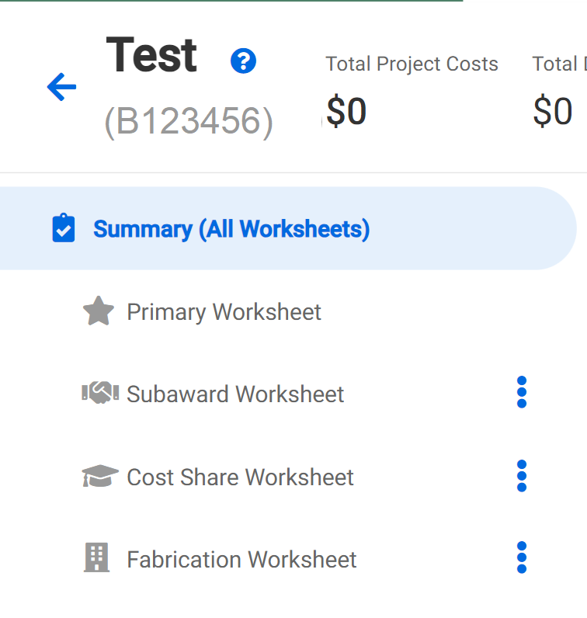
SAGE Budget Worksheets
SAGE Budget worksheet periods should match, or be within, the Award Setup Request Current Period Start Date and the Current Period End Date.
Create and include separate worksheets for anything that needs to be on a separate award line in Workday, including subawards, equipment fabrication, multiple F&A rates.
GCA Award Line Types, SAGE Budget Job Aid , Updated SAGE Budget eLearning
Notes:
Speaker: Juan

Slide 6
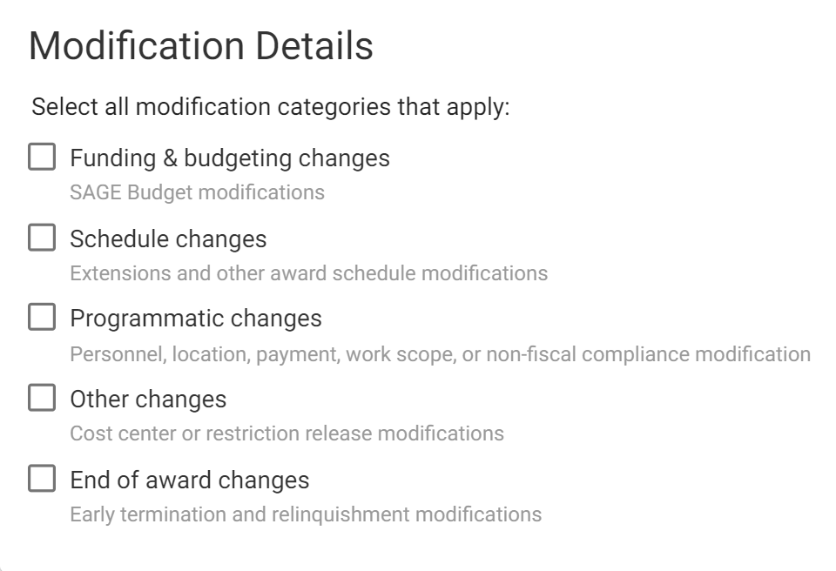
Award Modification Requests
Select at least one MOD category, and all that apply
e.g. Funding & Budgeting Changes, Schedule Changes, Other Changes, etc.
Manage Award Changes - Research web guidance
Grant & Contract Accounting - Modifications
Notes:
Speaker: Ari

Slide 7
Award Modification Requests
Use the Comments & History section to provide details and explanations for your request.
e.g. Make sure to provide sponsor contact information when request needs to be sent to sponsor by AOR (OSP).
Manage Award Changes - Research web guidance
Grant & Contract Accounting - Modifications
Notes:
Speaker: Ari

Slide 8
Award Modification Requests
Confirm you have updated any relevant fields and attachments needed to complete your request.
Complete and attach relevant forms, such as the Extension or Change of PI forms.
Manage Award Changes - Research web guidance
Grant & Contract Accounting - Modifications
Notes:
Speaker: Ari

Slide 9
Returned Items
Review the Comments & History section for information about why the request was returned.
Address reasons an item was returned before sending it back to OSP or GCA.
Notes:
Speaker: Ari

Slide 10
Questions
Notes:
Speaker: Ari

