Slide 1
MRAM | Monthly Research Administration Meeting
October 12, 2023, 9:00 AM – 10:00 AM Join Webinar: https://washington.zoom.us/j/346891888 Click “CC” to Show Captions in your Zoom Controls
TOPIC | PRESENTER | EMAIL | MIN
Welcome | Kirsten DeFries Research Compliance & Operations | kirsten5@uw.edu | 2
National Biosafety Month | Lesley Decker, Haris Malik Environmental Health & Safety | lldecker@uw.edu hmalik54@uw.edu | 10
PAFC Hot Topic: eFECs Closeout & NIH Childcare Allowance | Matt Gardner Post Award Fiscal Compliance | gcafco@uw.edu | 10
Agreement Templates | Carol Rhodes Office of Sponsored Programs | carhodes@uw.edu | 5
Research Security: Agency Updates & Looking Ahead | Carol Rhodes Office of Sponsored Programs | carhodes@uw.edu | 15
ORCID Overview | Aron Knapp & Kim Halstead Office of Research Information Services | orishelp@uw.edu | 5
GCA Update | Juan Lepez Grant & Contract Accounting | kabah12@uw.edu | 10
CORE Update & SAGE Resources | Laurie Stephan Collaborative On Research Education (CORE) | corehelp@uw.edu | 2
NEXT MEETING November 9, 2023 9:00 AM - 10:00 AM Questions about MRAM? email mramques@uw.edu

Slide 2
NATIONAL BIOSAFETY
MONTH 2023
The Value of Written Procedures
Lesley Decker, Biosafety manager
Haris Malik, Biosafety officer
October 2023
Notes:
Welcome to biosafety month everyone!
Each year for biosafety month we highlight our role in the university and a topic in biosafety.
Presentation by Lesley Decker and Haris Malik

Slide 3
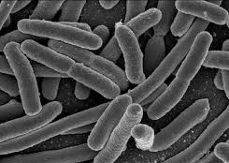
WHAT IS BIOSAFETY?
Framework for containment of biohazards
Includes safe practices, safety equipment, facilities and training
Protects the worker, community and environment
Protects the research product
Notes:
Biosafety is the safe handling of biohazards. Quickly define biohazard.
The purpose of biosafety is to protect the worker community and environment, by extension the safe work practices protect the product and improve research quality.

Slide 4
ABOUT EH&S BIOSAFETY (FY23)
371 Biological Use Authorizations (BUAs)
20 clinical trial BUAs (rDNA into humans)
392 biosafety lab inspections (598 rooms)
Online trainings completed:
Biosafety: 2,694
Bloodborne pathogens (BBP): 3,783
Shipping regulated medical waste: 237
Notes:
Here are some of our prominent metrics to summarize our 2023 fiscal year.
We have processed 371 biological use authorizations including 20 clinical trial BUAs involving recombinant DNA in humans.
Our team has conducted almost 400 inspections for almost 600 rooms.
Additionally, we have tracked the number of users completing our trainings each year. Over 2.5 thousand biosafety trainings, nearly 4 thousand bloodborne pathogen. And over 200 shipping medical waste trainings.

Slide 5
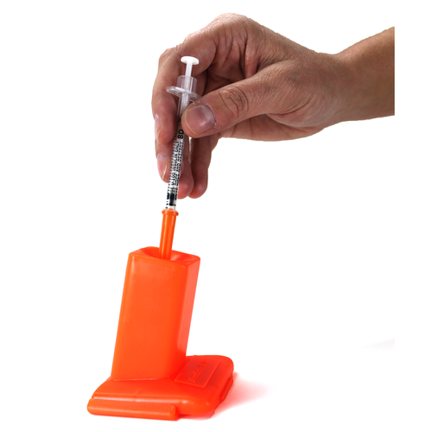
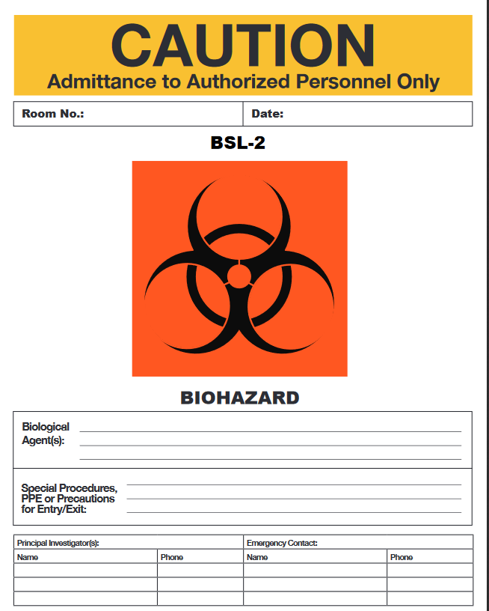
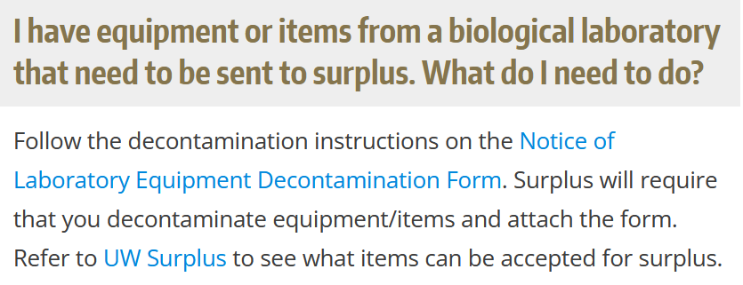
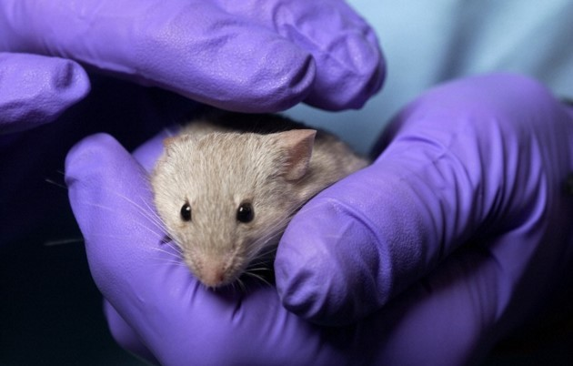
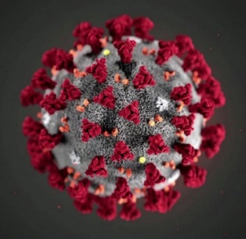
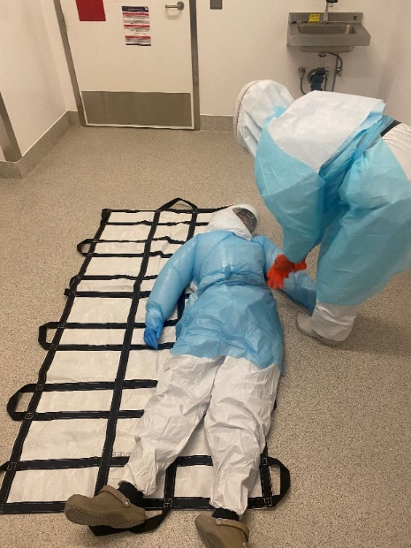
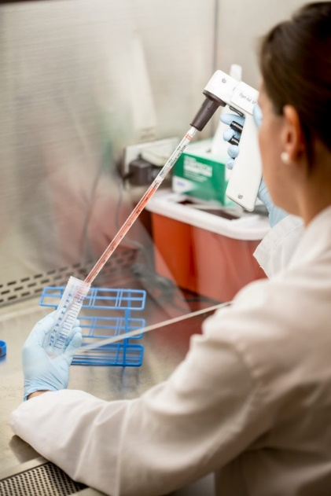
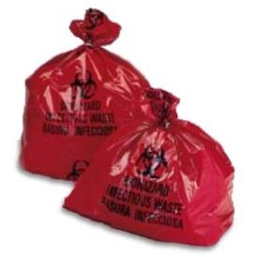
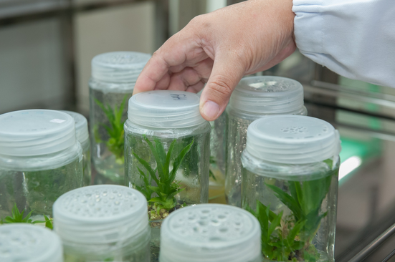
ABOUT EH&S BIOSAFETY
Notes:
The UW EH&S biosafety day to day and specialized work across all UW locations where biohazards are used:
Review and approve research with IBC
Train labs on proper use of PPE and decontamination
How to handle and treat biohazardous waste
Sharps safety
How to work safely inside a biosafety cabinets
Transgenic plants and animals, different types of facilities
Incident response
And BSL-3 and select agent programs

Slide 6
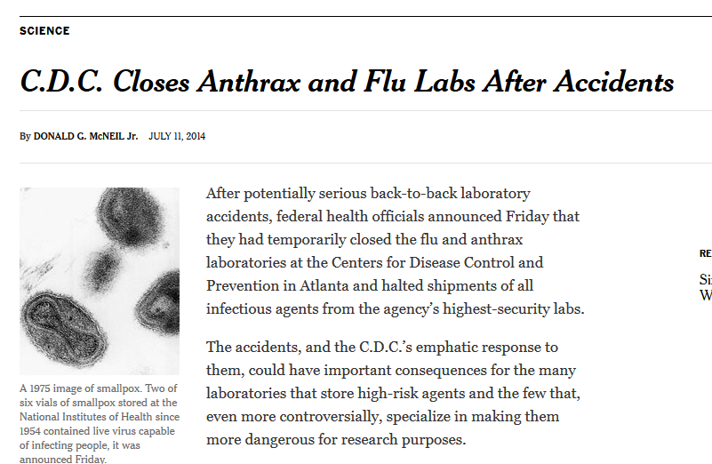
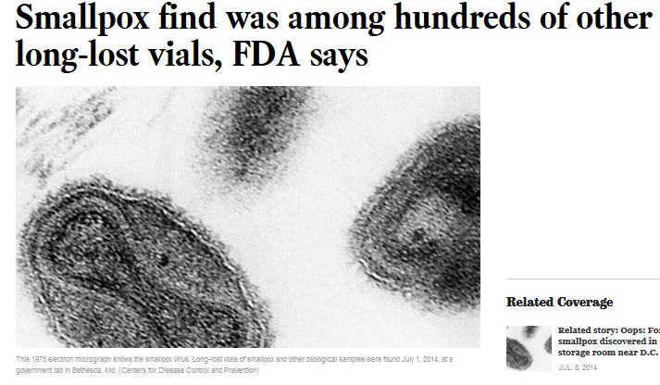
NATIONAL BIOSAFETY MONTH
Started in 2014 by the NIH Office of Science Policy
Time to focus attention to biosafety practices, policies, procedures and inventory
Notes:
About a decade ago there were several incidents in the news that highlighted gaps in biosafety programs. The FDA found smallpox vials in a cold room that were unaccounted for.
The CDC failed to inactivate anthrax samples that were sent out to labs that did not have the ability to handle them appropriately.
In response the white house ordered all federally funded labs to stop work and review inventories and procedures. From these incidents biosafety month was born.

Slide 7
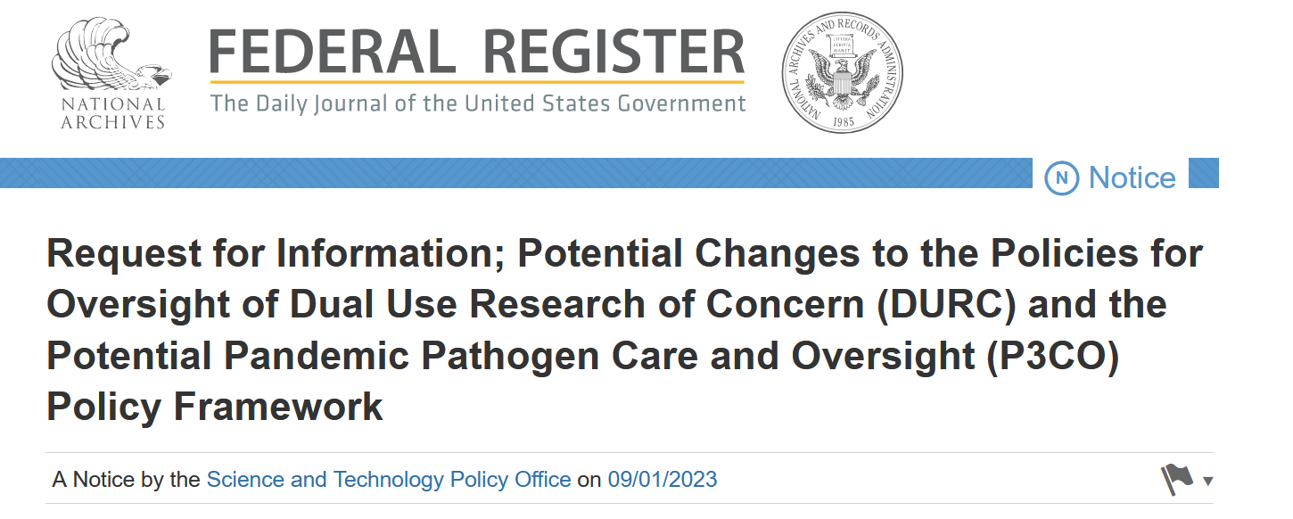
BIOSAFETY AND BIOSECURITY IN 2023
Notes:
Still prominently in the news with emerging diseases and potential threats.
COVID-19 put a spotlight on biosafety and biosecurity. Did the virus emanate from a lab or not? Either way funding has been impacted.
Efforts throughout government to potentially regulate biological research involving potential pathogens.
Two Federal Register publications with proposed changes to research regulations.

Slide 8
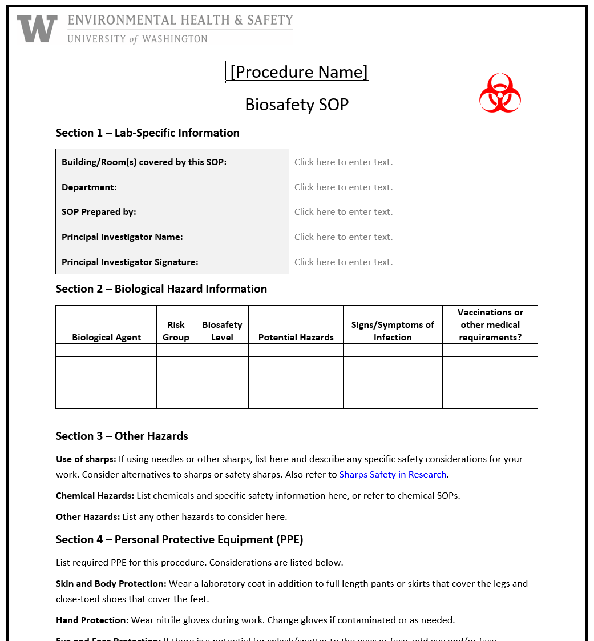
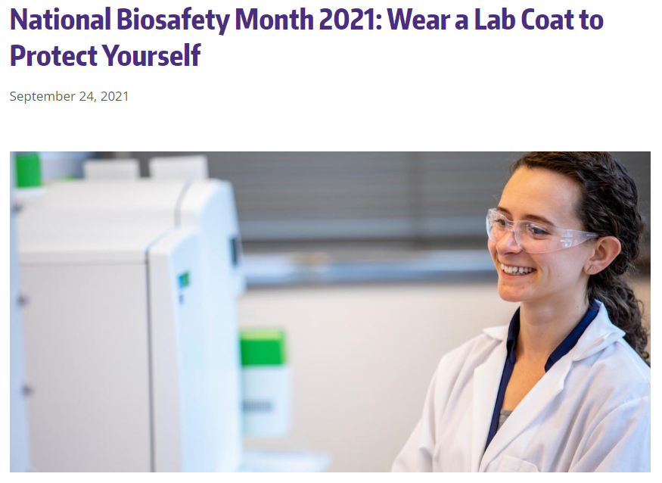
NATIONAL BIOSAFETY MONTH AT UW
Notes:
We have had numerous topics featured in our biosafety month from its start in 2014 including substituting hazards with safer alternatives, biological inventories, sharps safety, exposure response, and wearing appropriate PPE. This year we are putting the emphasis on SOPs, when do you need them and how to make them effective.

Slide 9
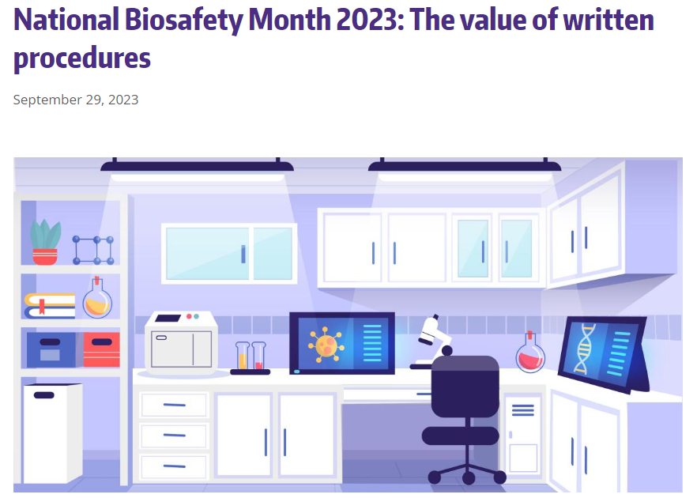
2023 BIOSAFETY MONTH AT UW: THE VALUE OF WRITTEN PROCEDURES
SOPs are step-by-step written instructions for how to perform a procedure.
Include information about potential hazards involved and ways to mitigate the hazards.
Can help improve consistency and quality across work.
https://www.ehs.washington.edu/about/latest-news/national-biosafety-month-2023-value-written-procedures
Notes:
SOPs are written instructions on how to do a procedure involving hazards from start to finish and should include all information regarding hazard mitigation including tips and tricks that are picked up along the way.
Include hazard mitigation and decontamination information
Help improve

Slide 10
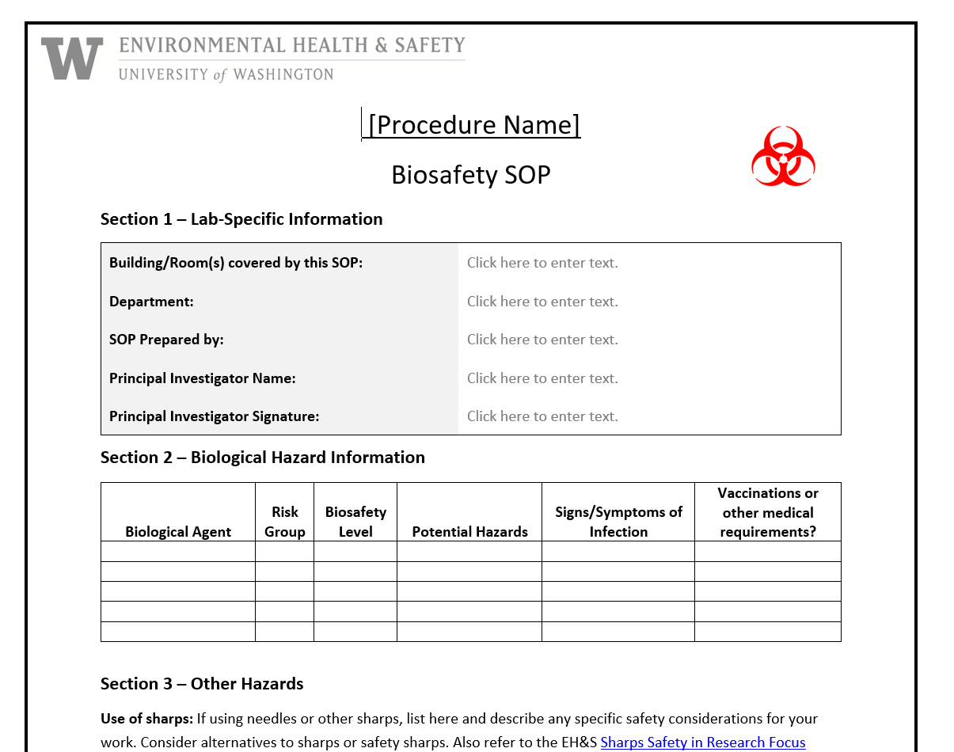
2023 BIOSAFETY MONTH AT UW: THE VALUE OF WRITTEN PROCEDURES
Use SOPs as training tools for new personnel, and document training.
Learn from the past. Share lessons learned, effective techniques, and avoid repeating mistakes.
Sometimes SOPs are a regulatory requirement (e.g., bloodborne pathogens).
Template biosafety SOP available on EH&S website.

Slide 11
CURATED TIPS TO IMPROVE SOPS
Treat your SOPs as a living document of accumulated knowledge and review regularly.
Avoid the “we’ve always done it this way” mindset. Solicit feedback from others who may view through a unique lens.
Use clear, concise, plain language to ensure content is accessible and steps are easy to follow.
Notes:
Labs are dynamic not static

Slide 12
BIOSAFETY MONTH OUTREACH
Email to principal investigators and lab managers with BUAs
A news post featured on the EH&S website and in EH&S newsletter
Featured on the Office of Research webpage
Present to U-WIDE Health and Safety Committee, MRAM (research administrators) and the IBC

Slide 13
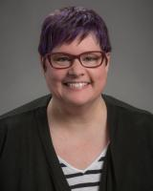
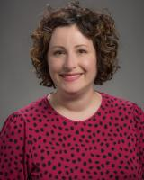
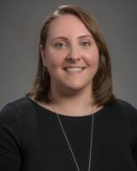
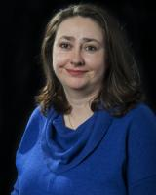
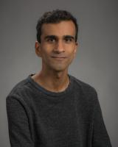
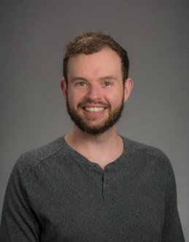
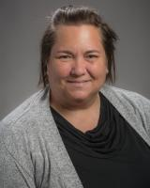
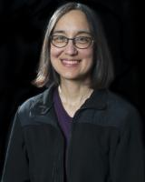
HAPPY BIOSAFETY MONTH!
Questions? ehsbio@uw.edu
Thanks to the biosafety team:
Lesley Decker
Zara Llewellyn
Kristi Kilgore
Esther Pellham
Haris Malik
Devon McMenimen
Jennifer Cabarrus
And our occupational health nurse:
Judy Cashman

Slide 14
COMPLIANCE HOT TOPICS:
EFECS CLOSEOUT &
NIH CHILDCARE UPDATES
MRAM
October 2023
Matt Gardner
Post Award Fiscal Compliance

Slide 15
eFECS CLOSEOUT
The eFECS Effort Reporting system and eFECS Cost Share Module are now frozen in preparation for retirement.
No changes can be made in either system going forward and the databases will be archived in accordance with UW record retention policies.
eFECS retirement impacts to effort reporting and documenting cost share…
MRAM – Matt Gardner - PAFC

Slide 16
UNCERTIFIED FACULTY EFFORT CERTIFICATIONS
Any uncertified FECs for any reporting period ending before 7/1/2023 will require a manual “paper” process for certification.
Contact efecs@uw.edu to initiate the manual certification process.
The PAFC Effort Team will prepare the manual FECs and work with campus units through the certification process.
MRAM – Matt Gardner - PAFC

Slide 17
FECs ON-HOLD DUE TO PENDING PRE-7/1 SALARY TRANSFERS
If you have an FEC that requires a pre-7/1 salary transfer, please email the Effort Team at efecs@uw.edu. Please provide:
Name of the faculty
Impacted FEC cycle
Once the Workday reclass journal process is ready, and transfers are occurring, the Effort Team will begin working through the list of FECs which require manual certification.
We anticipate it will take multiple weeks, at a minimum, to work through the backlog of manual FECs.
MRAM – Matt Gardner - PAFC

Slide 18
COST SHARE CONTRIBUTIONS
With eFECS retirement, all cost share commitments and contributions are now tracked and managed within Workday.
Any pre-7/1 cost share contributions (salary or expenditures) that were not documented in eFECS must be documented in Workday via the forthcoming pre-7/1 reclass journal process.
MRAM – Matt Gardner - PAFC

Slide 19
ECC UPDATE
Coordinator training is underway for the new effort reporting system – ECC.
“Office Hours” will begin on October 13th and will occur every Friday from 10:00 am to 11:00 am.
You can access links for the Coordinator Trainings or Office Hours via the webpage below: https://finance.uw.edu/maa/ecc_training_timeline
MRAM – Matt Gardner - PAFC

Slide 20
NIH CHILDCARE ALLOWANCE UPDATES
New Workday Spend Category to use for Childcare Allowance reimbursements on NRSA fellowships or training grants:
National Research Service Award (NRSA) Childcare Costs (SC2742)
Workday link to spend category – https://wd5.myworkday.com/uw/d/inst/1$806/806$1540.htmld
MRAM – Matt Gardner - PAFC

Slide 21
NIH CHILDCARE ALLOWANCE UPDATES
Hierarchy for new NRSA Spend Category:
Ledger: 62690 Other Purchased and Contract Services
Object Class: 05_Other Contractual Services
Spend Category: National Research Service Award (NRSA) Childcare Costs (SC2742)
MRAM – Matt Gardner - PAFC

Slide 22
NIH CHILDCARE ALLOWANCE UPDATES
Updated website content to reflect process in Workday
PAFC: https://finance.uw.edu/pafc/nih-childcare-allowance
GCA: https://finance.uw.edu/gca/award-lifecycle/sponsor-specific-information/nih-childcare-allowance
MRAM – Matt Gardner - PAFC

Slide 23
Questions
Post Award Fiscal Compliance (PAFC)
gcafco@uw.edu
efecs@uw.edu (FEC/eFECS related questions
effortreporting@uw.edu (ECC-related questions)
https://finance.uw.edu/pafc/
Matt Gardner
mgard4@uw.edu
206-543-2610
MRAM – Matt Gardner – PAFC

Slide 24
Agreement Templates
October 12, 2023 MRAM
Carol Rhodes
Office of Sponsored Programs

Slide 25
Guidance Updates
Agreement Considerations
UW’s Agreement Considerations based on Sponsored Research Agreement template
Provides basic information on standard terms the UW considers in sponsored research agreements.
Webpage can be shared with potential sponsors
Notes:
You may find the agreement considerations most useful to share with start-ups or other sponsors who may not already have their own research agreement templates.

Slide 26
Sponsored Research Agreement (SRA) Template
NEW Sponsored Research Agreement Template & instructions for requesting
Using an approved UW agreement template may speed up the review process
Inform us via SAGE when there is request to use the UW’s SRA template
Comments inthe After-the-Fact eGC1or the Award Setup Request
Notes:
You may find the agreement considerations useful to share with start-ups or other sponsors who may not already have their own research agreement templates.
https://www.washington.edu/research/forms-and-templates/sponsored-research-agreement-sra-template/

Slide 27
Resources
Agreement Considerations
Sponsored Research Agreement Template Instructions to request
Sharing Information and Data
Mutual Non-Disclosure Agreement
Data Use & Transfer Agreement (FDP)
Agreement Types
Tool: Agreement Decision Tree
Notes:
https://www.washington.edu/research/myresearch-lifecycle/setup/sponsor-requirements/agreement-considerations/

Slide 28
Questions

Slide 29
Research Security
October 12, 2023 MRAM
Carol Rhodes
Office of Sponsored Programs

Slide 30
What is Research Security?
Standardized policies and practices among researchers and research organizations applying for Federal Research and Development (R&D) awards, in the interest of strengthening protections of US Government supported R&D against foreign government interference and exploitation.
White House (Presidential Memorandum on USG- Supported R&D National Security Policy)

Slide 31
Elements of a Research Security Program
National Security Presidential Memorandum 33 (NSPM-33)
Issued January 2022
Main areas:
Disclosure Requirements and Standardization
Digital Persistent Identifiers
Consequences for Violation of Disclosure Requirements Information Sharing
Cybersecurity
Foreign travel security
Research security training
Export control training
Whitehouse: NSPM-33 Implementation Guidance

Slide 32
Sponsored Programs:
What do we consider?
Required Disclosures to sponsors
What kind of information or materials will be accessed/shared?
Controlled Unclassified Information (CUI)
Dual Use/Agents
Are Cybersecurity requirements met?
Export Control review, e.g.
Foreign national participation and licensing
Shipping export controlled items
Restrictions on participation/Faculty Council on Research review
Prohibitions on products, technologies
Bytedance
Huawei

Slide 33
Examples of Research Security Steps and Guidance in Place
Foreign Interests in Sponsored Programs
Current & Pending, or Other Support
Foreign Talent Recruitment Disclosure form
Export Control Guidance, Review and ECMPs or Technology Control Plans
No TikTok / Bytedance on devices used with Federal Contracts
EH&S - DURC Training
Procurement Services: Foreign Supplier Guidance and Exceptions

Slide 34
NIH - Subaward/Consortium Written Agreements
“Subaward agreements must stipulate that foreign subrecipients will provide access to copies of all lab notebooks, all data, and all documentation that supports the research outcomes as described in the progress report, to the primary recipient with a frequency of no less than once per year, in alignment with the timing requirements for Research Performance Progress Report submission.”
Effective date Jan. 2024, compliance required by March 2, 2024
Note: Similar to retaining your RPPRs, campus units should retain relevant supporting documentation.
NOT-OD-23-133
Open Mike

Slide 35
Research Security Training Requirements Coming
Training modules in development
NSF issued solicitation in 2022 to develop research security training for recipients of federal research funding.
“This training is an essential step toward mitigating foreign government risks and threats to U.S. government-funded research and may be used to fulfill the research security program requirement in NSPM-33.”
NSF: Research Security

Slide 36
What is Controlled Unclassified
Information (CUI)?
Information the Government creates or possesses, or that an entity creates or possesses for or on behalf of the Government, that a law, regulation, or Government-wide policy requires or permits an agency to handle using safeguarding or dissemination controls.
Controlled Unclassified Information (CUI) Registry

Slide 37
What is the Cybersecurity Maturity Model Certification (CMMC)?
A three-tier model designed to protect Controlled Unclassified Information (CUI) that is shared with contractors (like UW) through acquisition programs (federal contracts).
Requires cybersecurity requirements align with National Institute of Standards and Technology (NIST SP 800-171).
DoD is going through CMMC 2.0 rulemaking to develop new DFARs.
How do I know which standards apply?
Once CMMC 2.0 is implemented, DoD will specify the required CMMC level in the solicitation and in any Requests for Information (RFIs) and DFARs will be in impacted contracts.

Slide 38
Research Security Memo
When sponsors (such as DoD) include specific research security requirements, e.g. around Controlled Unclassified Information (CUI):
OSP reviewers will provide a Research Security Memo to PI to acknowledge.
Memo will indicate requirements imposed by sponsor and ask for confirmation that security requirements are in place
PI acknowledgement and IT administrator or Chair concurrence required

Slide 39
Some Current Sponsor Guidance
DOD Countering Unwanted Foreign Influence in Department-Funded Research
NIH: Foreign Interference
NSF Research Security
Guidance on Disclosures & Foreign Talent Program Participation: NIH, NSF, and DOE
Related agency disclosure requirements such as :
DOE interim COI policy requirements
NASA COI policy

Slide 40
What’s Coming Up
Final NSTC Common disclosure forms
Final Research Security Program standards
NSF research security training modules
NSF Research Security and Integrity Information Sharing Analysis Organization (RSI-ISAO)
Final NSF 2024 Proposals and Awards Policies & Procedures Guide (PAPPG):
Reporting of foreign gifts & contacts to NSF, 2024 PAPPG, Chapt. II.B.2
Certification to NSF of non-participation in malign foreign talents programs, 2024 PAPPG, Chapt. II.D.1.d. & e
COGR: Quick Reference Table of Current & Upcoming Federal Research Security Requirements

Slide 41
Questions

Slide 42
ORCID OVERVIEW
October 12, 2023
Aron Knapp & Kim Halstead
Office of Research Information Services

Slide 43
WHAT IS ORCID?
ORCID: Open Researcher and Contributor iD
An ORCID iD is a unique digital identifier that helps link researchers to their grants, publications, and other research-related work, through time.
ORCID profile data helps research institutions, funders, publishers, and other organizations better track and support research work.

Slide 44
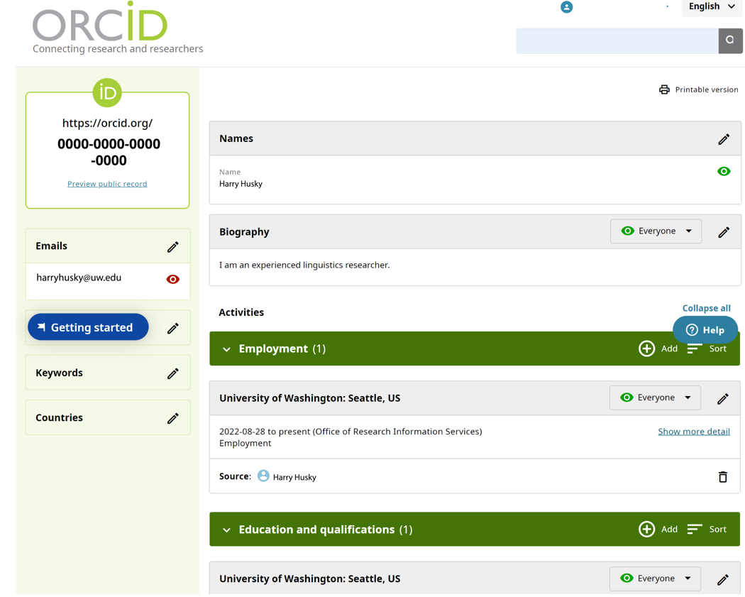
WHAT IS ORCID?

Slide 45
WHAT ARE THE BENEFITS OF ORCID?
Reduces Administration Time: ORCID profile data can be re-used for a number of reporting requirements:
Enables auto-population of biosketches and other documents required by some agencies (e.g., NIH and NSF)
Increasingly, publications, sponsors, and institutions such as the NIH are requiring ORCID iDs for certain applications
Ensure Compliance: Sponsors and publishers are increasingly requiring ORCID iDs.
Consistency: Researchers can use the same iD throughout their career, bringing record of their contributions with them.
Easier Publication Maintenance: The iD can link to all their research publications and other research-related material in a single place.
Enables Integrations: The ORCID API enables integrations with funders, publishers, repositories, UW’s SAGE and MyResearch applications, faculty profiles, and more.
Notes:
Consistency: Their unique iD persists throughout researchers’ lives, through name changes, institution changes, or if you change field of study. - The summary of publication history is helpful when connecting with publishers and prospective sponsors.

Slide 46
WHAT ARE THE BENEFITS OF ORCID?
ORCID enables the exchange of information between systems, reducing administrative burden.
Grants
Repositories
Researcher Information Systems
Publishers
Society Membership
Other Identifiers

Slide 47
WHAT COMMUNICATION ABOUT ORCID IS PLANNED?
The UW is strongly encouraging adoption of ORCID iDs and consistent profile maintenance.
Thursday, 10/5: Email sent from Mari Ostendorf to all active faculty and non-faculty researchers introducing ORCID and its benefits
Webpage published: ORCID iD Overview
Friday, 10/13: Email will be sent from ORIS to active faculty and non-faculty researchers who do not yet have an ORCID iD encouraging registration

Slide 48
WHAT COMMUNICATION ABOUT ORCID IS PLANNED?
Coming Soon: Email from ORIS to ORCID iD users who need to update their affiliation to the University of Washington
Correct Affiliation
Incorrect Affiliation

Slide 49
WHAT COMMUNICATION ABOUT ORCID IS PLANNED?
Email recipients will be asked to grant the University of Washington permission to update their affiliation.
Clicking allows the UW to update ORCID affiliation

Slide 50
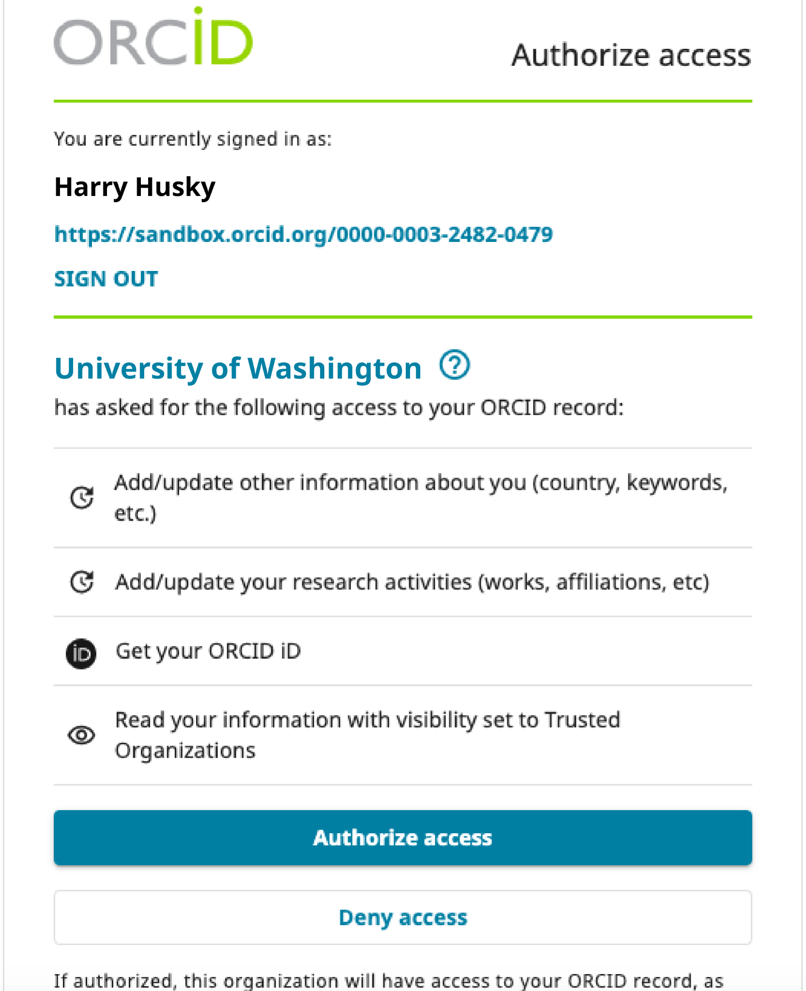
WHAT COMMUNICATION ABOUT ORCID IS PLANNED?
Recipients will be asked to grant permission to the UW to update their ORCID profile affiliation.

Slide 51
GCA UPDATE
Juan Lepez
Director, Grant & Contract Accounting
October 12, 2023 MRAM

Slide 52
TOPICS
GCA status update
Award tasks for campus
Submitting urgent requests

Slide 53
STATUS UPDATE
As of Monday, October 9:
Award Setup: 1467 unprocessed items
Invoicing: Working on metrics
Reporting: 282 backlog reports
Closing: Working on metrics
Customer Service: 5 day response time
Notes:
Speaker note: We are behind where we thought we would be at the end of September. We are dealing with the same struggles as everybody else and still defining processes as we come across new things. Average productivity: 50 Award Setup items per day, including returning 20-30 items. Customer service: Receiving 200+ items per day, average productivity: 200+ items per day.

Slide 54
AWARD TASKS FOR CAMPUS
Based on our current progress, we will continue to focus on creating and maintaining GCA award tasks
Revisit in early 2024
Notes:
Speaker Note: Taken to PTT in June 2023; Gave an update at August 2023 MRAM and said we would revisit in October 2023.

Slide 55
DEFINING URGENT REQUESTS
GCA is receiving a high volume of urgent requests daily. To help triage these requests, “urgent” means:
Possible non-payment
Loss of funding
Inability to post expenditures because of GCA’s backlogs
Examples include No-Cost Extensions, Temporary Internal Extensions, ASRs with upcoming start dates
GCA teams are prioritizing items based on award end date

Slide 56
SENDING URGENT REQUESTS TO GCA
If your situation falls into those categories, send an email to gcahelp@uw.edu and:
Put “Urgent” in the subject line
Include why the request is urgent
Attach sponsor communication (if app.)
Turnaround for urgent items: 3-5 business days
Notes:
GCA is relying on campus to be honest when they mark something “urgent”

Slide 57
WHERE’S MY STUFF, GCA?
If your situation doesn’t fall into an “urgent” category:
Send an Award Portal Ticket
We will try to provide an estimate for when item will be completed

Slide 58
RESOURCES
Award Setup volumes week-over-week is available on GCA homepage
Urgent requests webpage

Slide 59
QUESTIONS
Contact GCA for assistance by creating a ticket in
Award Portal or email gcahelp@uw.edu
Notes:
Add Vince’s example here.

Slide 60
Updates
FT and CORE coursework
Fall quarter schedule published.
Learners must restart on-demand coursework not completed prior to July 6, 2023.
Curriculum Guide contains up-to-date information about course status.
CORE Registration
https://uwresearch.gosignmeup.com/public/course/browse
CORE Home https://www.washington.edu/research/training/core/
Notes:
Fall schedule is published. Almost all of our instructor-led courses are available.
Where we have information available we have made updates to the eLearning and live courses. Some updates are taking longer to make due to evolving systems.
Check the Curriculum Guide for updates to course statuses. Updates will also be sent to the MRAM email list.

Slide 61
Updates
New Courses
November 1 9:30 am – 12:00 pm | Compliance Case Studies: Humans, Animals and Substances
November 15 1:00 – 3:00 pm | SAGE Awards
November 19 10:00 – 11:30 am | Reading Your Notice of Award
Notes:
Fall schedule is published. Almost all of our instructor-led courses are available.
Where we have information available we have made updates to the eLearning and live courses. Some updates are taking longer to make due to evolving systems.
Check the Curriculum Guide for updates to course statuses. Updates will also be sent to the MRAM email list.

Slide 62
SAGE TRAINING RESOURCES
Office of Research Information Services

Slide 63
VIRTUAL INSTRUCTOR-LED
CORE TRAINING
Thursday, 10/19: Understanding Your New Award
Tuesday, 10/24: Reading the Notice of Award
New! Wednesday, 11/15: SAGE Awards
Notes:
The SAGE Awards course provides an overview of the award and modification process in SAGE. Prior knowledge in creating SAGE eGC1s, sponsored project proposal budgets, and SAGE Budgets is recommended for this course

Slide 64
HELPFUL WEBPAGES
Award Setup Requests
OSP Setup Financials
GCA Award Setup
Tips for Success - Award Setup & Modification Requests
SAGE Awards: Setup. Tracking & Modifications eLearning
Job Aids: Many job aids are available on the UWFT for the Research Community page.

Slide 65
HELPFUL WEBPAGES
Modification Requests
OSP Award Changes
GCA Modifications
Tips for Success - Award Setup and Modification Requests
Job Aids: Many job aids are available on the UWFT for the Research Community page.

Slide 66
SAGE OFFICE HOURS
SAGE Office Hours Schedule
Thursday, October 19, 1 - 2 p.m.
Wednesday, October 25, 11 a.m. - noon
Thursday, November 2, 11 a.m.-noon
Wednesday, November 8, 11 a.m.-noon

