Slide 1
SAGE SEARCH TIPS &
UPCOMING RELEASE
Judy Chung & Mia Alberro
Office of Research Information Services (ORIS)
December 14, 2023

Slide 2
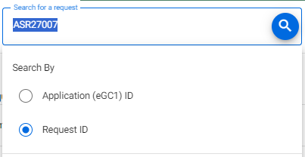
Award Search Tips
Search returns direct matches only.
Include prefixes (ASR, MOD, ADV, A)!
Remove trailing or leading spaces from copy/pasting
Search by Application ID (eGC1) will search for the eGC1 listed on the request.
Most MODs will not have an eGC1, so search by RequestID instead

Slide 3
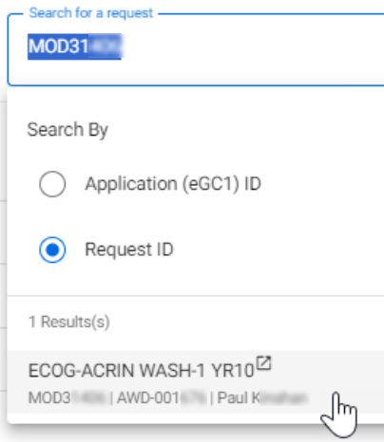
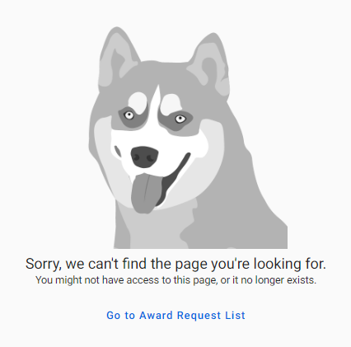
How Permissions Impact Search
Search will show all results regardless of permissions.
If you do not have permissions to access a request, attempting to open it will result in an error.
Error displayed if no permissions to view item
Notes:
Will fine tune the error msg for more clarity in a future release

Slide 4
What’s Next | Award Requests List
Release Date: December 20, 2023
Award Request List: More Data Available!
Short title, eGC1 ID for MODs, Cost Center, PI, Workday Award ID, Sponsor Name, Prime/Originating Sponsor Name

Slide 5
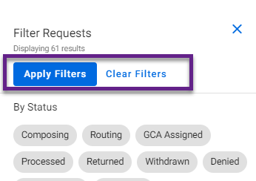
What’s Next | Filtering
New “Apply Filters” Button: Improves SAGE performance!
Select 1 or more filters
Click “Apply Filters” button
Click “Clear Filters” as needed

Slide 6
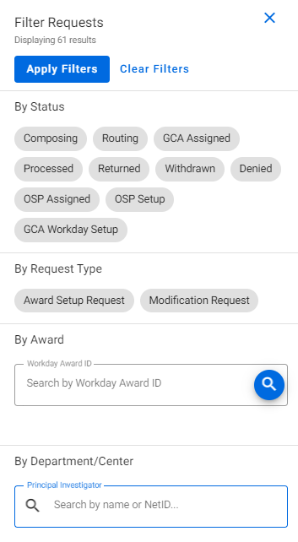
What’s Next | New Filters
New Filters Coming!
By Workday Award ID
By Principal Investigator
Tips
Use full Workday format for searching by award: AWD-005841
Helpful for seeing if OSP has already started an ASR or MOD
Open item in a new tab to retain prior filter (right-click)
Notes:
When OSP initiates an item, it will be in OSP Setup status. Once they return it to campus for completion, it will be in Composing status.

Slide 7
What’s Next | Budget Export &
Performance Improvements
Budget Export Updates (for MOD use)
The following data will be visible on worksheet exports:
Cost Center
Security Grant Hierarchy
Worksheet PI
Additional Performance Improvements
Quicker Award Search & Filters performance
Protects overall system stability

Slide 8
SAGE Notification Survey
We want your feedback!
Goal: Improve SAGE system notifications for award-related activity
Audience: SAGE users who set up or monitor ASRs and/or MODs
How to Participate
Use Microsoft Forms: SAGE Notifications
Open today, 12/14, through Wednesday, 12/20
The survey will take 10-15 minutes to complete

Slide 9
SAGE Resources
Award Setup & Modification Requests
Tips for Success for ASRs & Mods
Virtual Instructor-Led Classes
SAGE Awards
Wednesday, 2/7, 1 - 3 p.m.
Thursday, 2/15, 1 - 3 p.m.
SAGE Budget
Thursday, 1/25, 1 - 3
Office Hours
Today, December 14, 1-2 p.m.
Notes:
SAGE Office Hours will continue through at least the first quarter of 2024.

Slide 10
Questions?

