Slide 1
Disclaimer
The GCA Forum will be recorded and retained for the legally approved retention period under Washington State Policy
It is subject to release under the Washington State Public Records Act or Federal Freedom of Information Act (FOIA)
It will be posted publicly on our GCA YouTube channel
Slide decks and recordings for this and past Forums are linked on our GCA Forum web page: https://finance.uw.edu/gca/resources/gca-forum

Slide 2
GCA Summer Forum
August 25, 2022

Slide 3
Welcome
Please make sure you are muted in order to reduce background noise during the presentation.
Please ask us questions using the Chat feature in Zoom. We will pause after each segment to answer them.
We want you to be engaged. This meeting is for you!

Slide 4
Agenda
Guest Speaker Matt Gardner - Audits
GCA Announcements – Training Grants & Researchers
Letter of Credit: An Overview
Carryover
Tips & Tricks
  Requesting multiple org code changes
  Requesting sub budgets (online vs Excel form)
  Updating Campus Contacts in GT
Department Submitted Invoices
Encumbrances and Open Balances

Slide 5
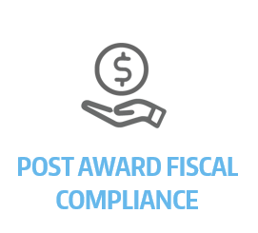
ALL ABOUT AUDITS
Matt Gardner
Assistant Director, Post Award Fiscal Compliance
mgard4@uw.edu
gcafco@uw.edu
https://finance.uw.edu/pafc/

Slide 6
Audit Types
Award Specific
Sponsor/Agency Specific (NSF, NIH, ONR, DOD, etc.)
Federal Government (“Single Audit”)
State of Washington
University of Washington (“Internal Audit”)
Keep in mind there are many different types of audits
More to consider than simply the Award-specific sponsor

Slide 7
What do audits examine?
Award expenditure compliance with the Cost Principles:
  Allowable, Allocable, Reasonable, Consistently Treated
Compliance with Award terms and conditions
Compliance with University policies
  Equipment inventory
  Faculty effort certification and GCCRs
  Budget reconciliations
  Approvals and delegations
Internal Controls

Slide 8
Audits & Internal Controls
Some audits lead to findings on a “lack of internal controls”
Auditors will recommend steps that should be taken to strengthen internal controls and will follow-up to ensure the issues are resolved
Translation: “you squeaked by this time but…”

Slide 9
What do Auditors focus on?
High-Risk Expenditures:
Travel
Food
Equipment purchases in the last 90 days of the Award
Cost Transfers onto the Award
Cost Transfers off the Award
Cost Transfers which occur more than 120 days from posting

Slide 10
Sponsor Audits
Sponsors may, at their discretion, audit:
  Any single Award;
  A group of Awards (ex., all Awards issued with specific funding); or
  All funding from the Sponsor for a specified time frame
Some sponsors regularly audit all of their Awards (NSF)
Some sponsors target specific aspects of their Awards (ONR Equipment Audits)

Slide 11
UW Internal Audit
Serves multiple functions, including:
  Acting as a liaison between external audits and UW units
  Providing focused internal audits and investigations
Audits from IA are a good thing – you’d rather have IA discover an issue so it can be corrected than the sponsor.

Slide 12
Federal Single Audit
The UW is part of Washington state
Federal government requires an annual audit (“Single Audit”) for any entity that receives more than $750k in federal funding in the entity’s fiscal year
WA state is audited so the UW is part of that audit
Single Audit requirements specified in the Code of Federal Regulations (200 CFR Subpart F)
Audit report is publically available
If the UW is a subrecipient, we are required to provide a copy of the Single Audit report to our Sponsors
https://finance.uw.edu/pafc/audit-information#Single_Audit

Slide 13
Why should we care?
Possible consequences of adverse audit findings:
Cost Disallowance: Departments are responsible for covering disallowed costs
Reputation: UW, P.I., School/College, Department…
Sponsor Restrictions: Sponsors may limit or restrict current or future funding
Audit findings lead to more audits.

Slide 14
Questions?
PAFC Resources
Spending: https://finance.uw.edu/pafc/spending
Specific Cost Items: https://finance.uw.edu/pafc/specific-cost-items
Audit Information Page: http://finance.uw.edu/pafc/audit-information
CORE Class - Preparing for Audit: Preparing for an Audit - UW Research (washington.edu)
Internal Audit: http://fa.uw.edu/audit/audit-process

Slide 15
GCA Announcements
Azalea Vasquez

Slide 16
Training Grants
After GCA reconciles your Training Grant you may receive a communication from us via GrantTracker about the following
  Discrepancies discovered during the reconciliation process that require resolution
  Reviewing the draft Outstanding Trainee Obligations (OTO) we created
  Balance of Funds available for tuition obligation
  The deficit balance and transfer options

Slide 17
Training Grants
Please help us submit your report on time
  Make any stipend corrections as necessary
  Remove any unallowable expenditures
  Review the OTO’s
    Obligate tuition for the continuation year
    Submit completed OTO form to GCA via Grant Tracker
  Provide a budget number for a deficit transfer

Slide 18
Researchers Wanted
GCA would like to invite a PI to give a 30-to-45-minute Zoom presentation to our staff!
These presentations connect us to the fantastic work done at the UW.
Please email gcahelp@uw.edu with your suggestions!

Slide 19
Letter of Credit: An Overview
Azalea Vasquez

Slide 20
Letter of Credit: Definition
Most federal agencies authorize Letter of Credit (LOC) as the mechanism for providing cash disbursements to award recipients. For these awards, payment is requested and received on a cost reimbursable basis. The Research & Cash Accounting Team is responsible for preparing and performing the LOC draws across the over twenty federal agencies that utilize an LOC. The drawdowns are processed through each agency’s respective online payment request system.

Slide 21
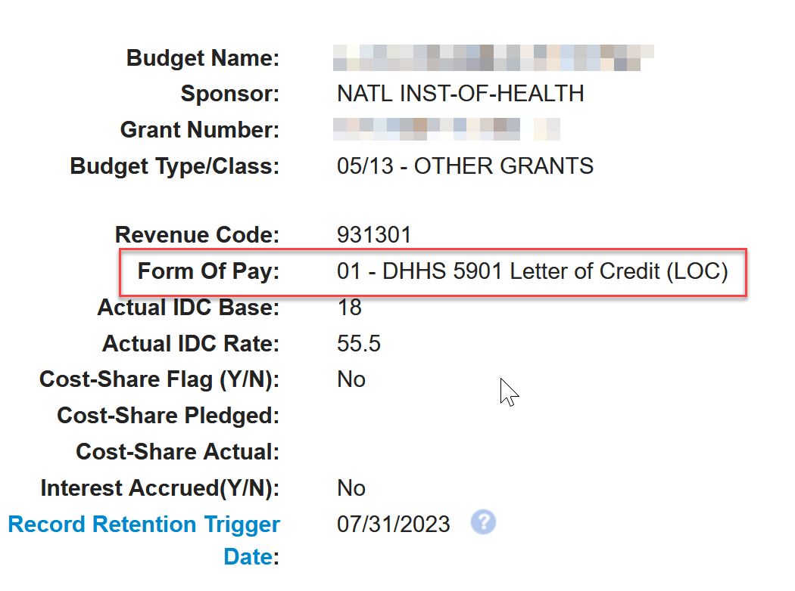
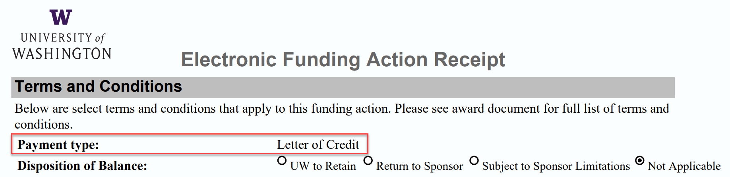
Is my award Letter of Credit?
Check your Funding Action Notification or Grant Tracker for the Form of Payment

Slide 22
Drawdown Systems
Drawdown System | Federal Agency
G5 | Department of Education
Research.gov/ACMS | National Science Foundation
Payment Management System (PMS) | Department of Health & Human Services, Department of Homeland Security, National Aeronautics and Space Administration (NASA), United States Department of Agriculture (USDA)
ASAP | United States Department of Agriculture (USDA), Department of Justice, Department of Energy (DOE), Department of Interior (DOI), United States Environmental Protection Agency (EPA)

Slide 23
Drawdowns and Frequency
Our Letter of Credit (LOC) specialist, who is part of the Research & Cash Accounting Team, is the person who processes the drawdowns for your award.
Draws occur after every payroll period and other times as needed.

Slide 24
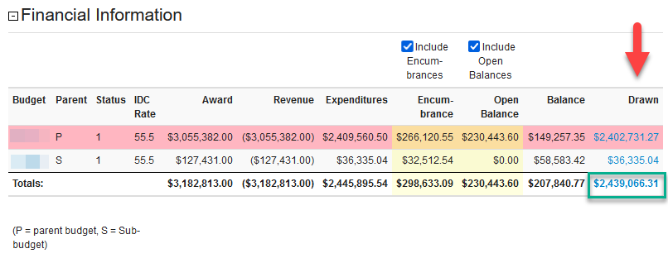
Drawdown Information
Drawdowns are available in Grant Tracker

Slide 25
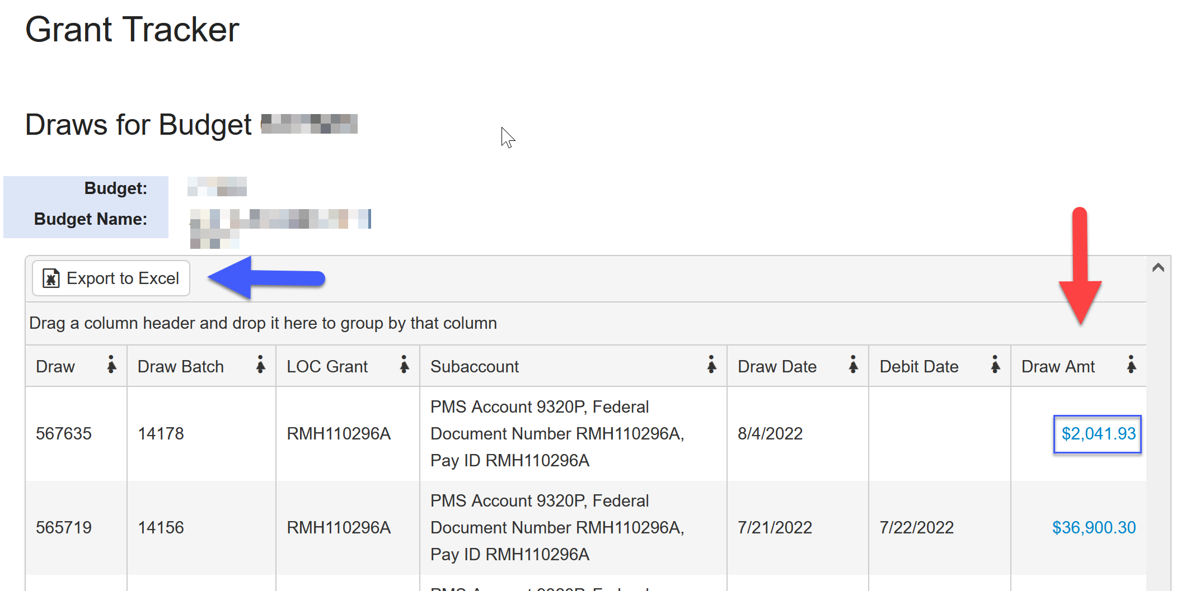
Drawdown Information

Slide 26
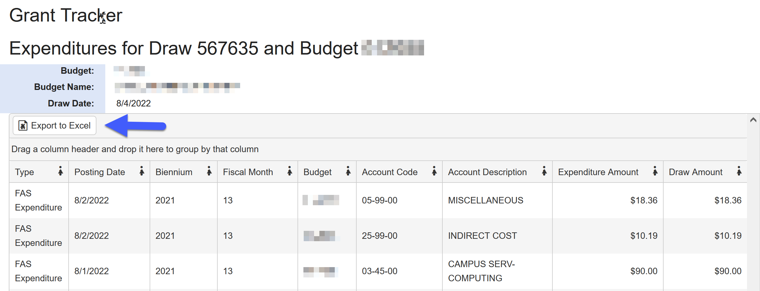
Drawdown Information

Slide 27
Closeout & Drawdown Cutoff
Most federal agencies allow draws up to 90 days after the award expiration date.
NIH and NSF allow draws up to 120 days after the award expiration date.
LOC draws completed after the 90/120 day deadlines will be rejected by the sponsor.

Slide 28
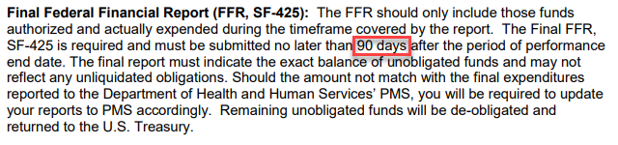
Closeout & Drawdown Cutoff

Slide 29
Document Numbers
In July 2013 NIH announced that they were moving away from Payment Management System (PMS) pooled accounts to PMS Subaccounts.
This would allow NIH to monitor draws by award, and to enforce close-out deadlines (i.e. – restricting draws after 90 or 120 days.
By September 2016, all NIH LOC awards were assigned document numbers corresponding to a PMS Subaccount.

Slide 30
Document Numbers
Most awards have one federal document number assigned to it, but there are times when a federal sponsor will assign more than one document number.
If your award has more than one document number, it may be due to restricted funds or a different source of funds (supplement).

Slide 31
Document Numbers
In order to successfully draw down the funds by different document number, GCA must create sub budgets.
Each budget can only have one federal document number, but multiple budgets can be associated with one document number.

Slide 32
Federal Cash Transaction Report
The Federal Financial Report (FFR) consists of both the Federal Cash Transaction Report (FCTR) and the Financial Status Report (FSR).
All PMS agencies except DHHS still require FCTRs
FCTRs are completed by the Letter of Credit specialist.
FSRs are completed by the GCA Reporting Team.

Slide 33
Federal Cash Transaction Report
The FFR Federal Cash Transaction Report must be filed within 30 days at the end of each of the following quarter end dates:
December 31 (1st Quarter of fiscal year)
March 31 (2nd Quarter of fiscal year)
June 30 (3rd Quarter of fiscal year)
September 30 (4th Quarter of fiscal year)
* Exception is NOAA – they are due semi-annually (6 months)

Slide 34

Questions

Slide 35
Carryover: What and How?
Michelle Davis

Slide 36

What is carryover?
Carryover is when the balance of unexpended funds at the end of a budget period is transferred to the continuation period
Some sponsors allow automatic carryover, while others require prior approval

Slide 37
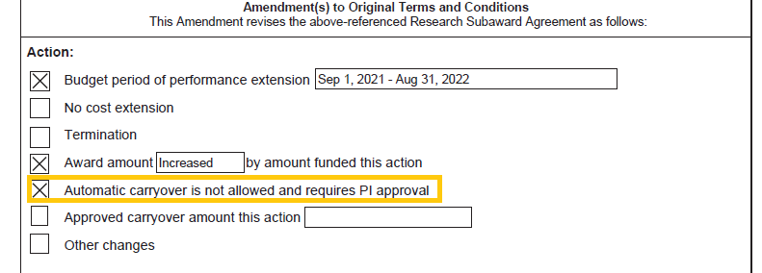

What are my award’s carryover terms?
Some sponsors will clearly outline their carryover terms on the award or terms & conditions:

Slide 38
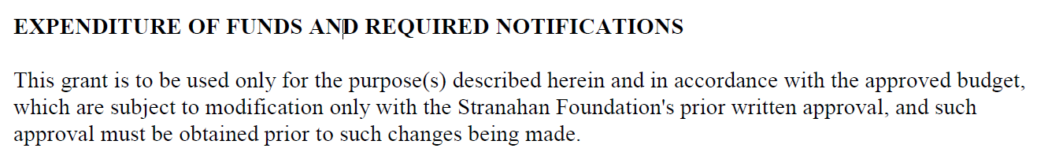

What are my award’s carryover terms? (cont’d)
While others aren’t as clear:
When in doubt, check with the sponsor

Slide 39
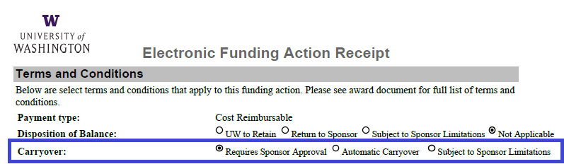

Funding Action!
You can also refer to the Funding Action – on page 2, we specify the carryover terms

Slide 40

I have automatic carryover – now what?
For awards with automatic carryover, we generally use the same budget number for the entire project period, unless the award requires separate year billing/reporting, in which case we’ll set up a continuation budget
  We will transfer the unexpended funds to the continuation budget when the current budget is closed to status 4
  The funds will be allocated to 38 and 25-99 (if your award has F&A) – the funds can be rebudgeted into other categories via a Grant Tracker request

Slide 41


I don’t have automatic carryover…now what?
Carryover requests need to go through OSP:
  Submit a concurrence letter along with:
    Requested carryover total
    Explanation of unobligated balance
    Detail budget of carryover
    Scientific justification
If the sponsor approves the request, OSP will issue a carryover PAC
  When GCA processes the PAC, the funds will become available on the continuation budget

Slide 42

Additional Resources!
GCA Training Video on Carryover
MyResearch Project Lifecycle – Award Changes
GIM 2 - Acceptance of Sponsored Program Awards and Fiscal Compliance on Sponsored Program Accounts (Carryover)

Slide 43
Questions

Slide 44
Tips and Tricks
Susan Wilbanks

Slide 45

Bulk Org Code Updates
If you need to update the org code for one budget, just send GCA a Grant Tracker! Nice and simple.
But what if you need to update 10, 20, or 200 budgets? Do you have to send a separate Grant Tracker for each one?

Slide 46
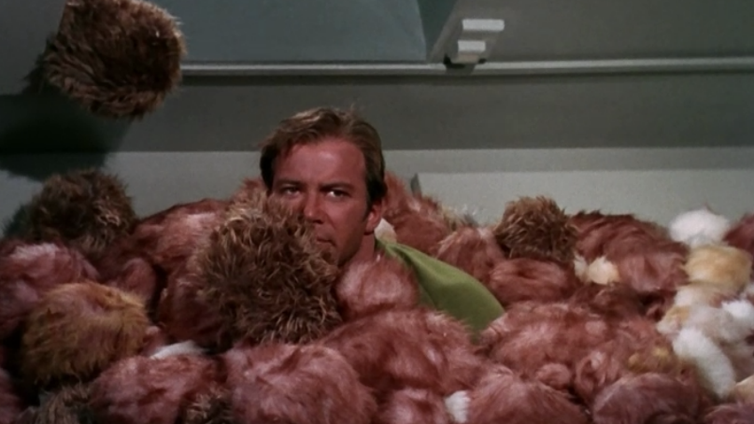
Too many GTs!
Sending dozens or hundreds of individual Grant Trackers overwhelms everyone involved

Slide 47

Keep it simple for everyone!
If you are requesting org code changes for more than five budgets simultaneously, please download and complete a Bulk Org Code Update form and email it to gcahelp@uw.edu.

Slide 48

Sub budget requests – online Transpasu vs. Excel form?
So you’re setting up a new sub budget or requesting updates to an existing one. Do you use the Grant Tracker tool or the Excel form?

Slide 49
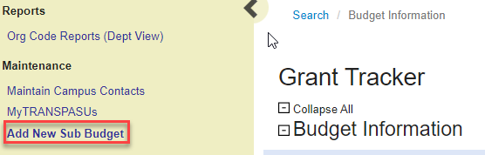
Grant Tracker tool
This tool can ONLY be used when setting up a NEW sub budget under a grant or contract parent budget.

Slide 50
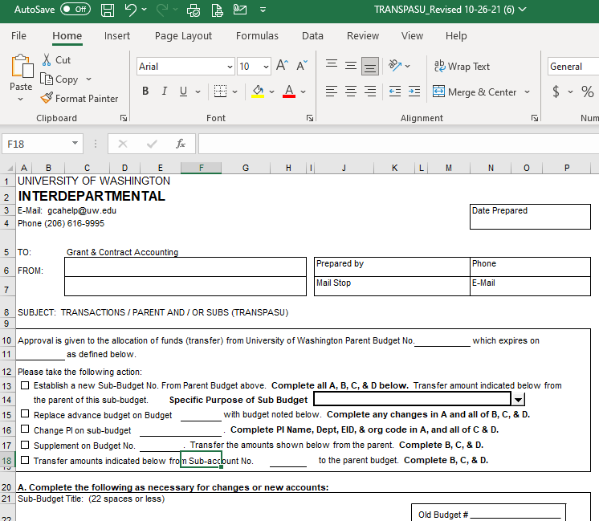
Excel form
Everything else!
New sub budgets for gift or endowment parents
Adding additional funds to an existing sub budget
Changing a sub budget PI
Transferring funds from a sub budget back to the parent
Download a copy of the form here: https://finance.uw.edu/gca/sites/default/files/TRANSPASU_Revised%2010-26-21.xlsx

Slide 51
Sub Budget Resources
Sub Budget Setup and Changes
Parent/Sub Budget Policy

Slide 52
Updating Campus Contacts in Grant Tracker
Providing current contacts in the Grant Tracker system helps GCA reach out to the right people when we need to provide (or request!) important information related to your budgets.
Keep these contacts up-to-date so the right information will get to the right people in a timely manner!

Slide 53
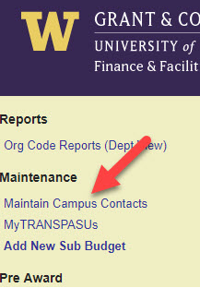
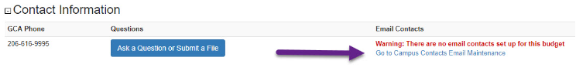
Accessing the Maintenance Page
Sidebar
Budget Information Page

Slide 54
Making updates
You can update an individual budget or make a bulk update for an org code or PI
Detailed instructions are found here: https://finance.uw.edu/gca/training-outreach/updating-contacts-grant-tracker

Slide 55
Questions

Slide 56
Department-Submitted Invoices: Best Practices
Jonathan Nagle

Slide 57
Know Your Requirements
Read your award document! Check for requirements such as:
    Receipt copies
    Timesheets
    Expenditure breakdowns by task
    PI signature
    PI Progress reports
    Anything else the sponsor wants!
Check your Funding Action (FA)!
Ask GCA!

Slide 58
Know How To Meet Your Requirements
Make sure you know the details of how your sponsor wants their requirements met – e.g., formats, submission methods, etc.
NOTE - GCA may be able to help resolve ambiguity in these situations, but the sponsor is the final arbiter of what meets their requirements and what does not. As such, it may be helpful to reach out to the sponsor with these sorts of questions.

Slide 59
Update Your Contact Information
All invoice communication from GCA will come via Grant Tracker. As such, it is vital that departments keep their campus contacts updated.
You can update your Grant Tracker campus contacts here: https://gcaserver.finance.washington.edu/gca/DVK/Email

Slide 60
Review/Act On Grant Tracker Messages Promptly
Review Grant Tracker messages promptly.
Take appropriate action as possible.
  Automatic notices
    Review your invoices and tell GCA if there are any problems with submission!
  Invoices with Special Handling Instructions
    Respond to Grant Tracker messages requesting backup documentation or task breakdown in a timely fashion so that invoices can be submitted on time.

Slide 61
Ask GCA!
We are happy to answer any questions about this process and direct you to appropriate resources. We’re also happy to investigate if you have concerns about how your award’s invoicing was set up.
Feel free to contact us!
  Grant Tracker: https://www.washington.edu/research/gca/budget/Grant Tracker.html
  Email: gcahelp@uw.edu
  Phone: 206-616-9995

Slide 62
Questions

Slide 63
Encumbrances & Open Balances
Patrick Carney

Slide 64
What are they?
Encumbrance: An outstanding commitment on a budget for transactions processed through the Financial Accounting System (FAS). Commonly applied to salaries, indirect costs, or restricted funds
Open Balance: An outstanding commitment on a budget for orders or contracts placed through the Ariba procurement system.

Slide 65
What are the differences
Encumbrances are housed in FAS and managed by GCA or the Integrated Service Center (ISC) for salaries and benefits, Open Balances are housed in ARIBA and can not be cleared by GCA.
Both should be cleared to close a budget to status 4, but a budget can be closed if an open balance remains but NOT if an encumbrance remains.

Slide 66
How can I close them?
Encumbrances will be cleared before the budget closes. To close encumbrances in salaries or benefits please work with ISC. Other encumbrances will be cleared by GCA while the budget is in status 3.
Open balances can be closed in ARIBA when an order is completed or cancelled.

Slide 67
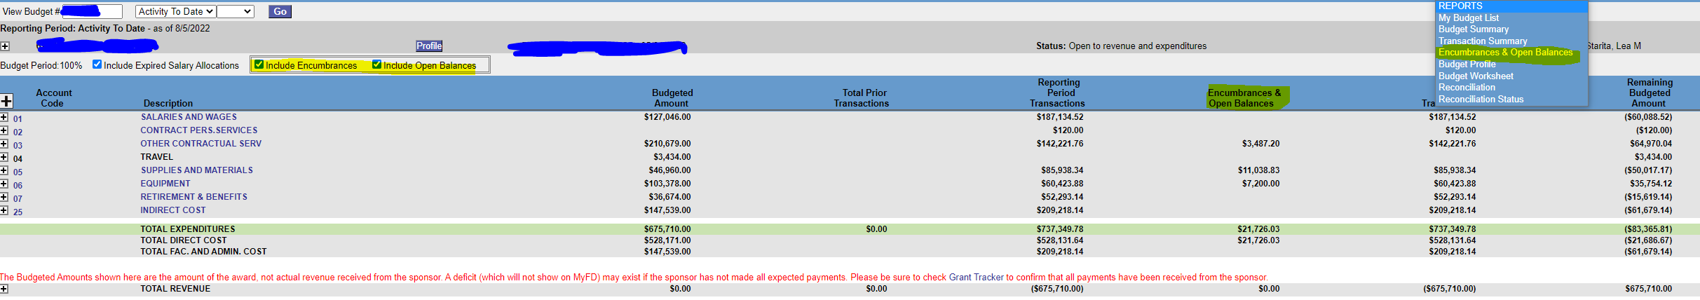
Where can I view them?
Grant Tracker
MyFD

Slide 68
Questions

Slide 69
Future Forum
November
2022
VIA ZOOM
https://finance.uw.edu/gca/training-outreach/gca-forum
Survey about today’s forum will be sent out soon!

Slide 70
Thank you
Email
gcahelp@uw.edu
GCA Help Hotline
206-616-9995 (9:00 am to 12:00 pm and 1:00 pm to 4:00 pm)
Grant Tracker
https://www.washington.edu/research/gca/budget/granttracker.html

