Slide 1
WORKDAY SALARY ALLOCATIONS – SALARY CAP, ADS/ENS
ECC Focused Topic Office Hours
February 2024
Matt Gardner & David Parks
Post Award Fiscal Compliance

Slide 2
Effort Reporting & IBS
Effort Reports (and FECs) display effort based on IBS, not just REG pay (they will not show TPS and excess comp)
When faculty propose a level of effort on a sponsored award, that level is based on the IBS (GIM 35)
If a faculty has an Administrative Supplement (“ADS”) or Endowed Supplement (“ENS”), those are both included in the IBS
Salary Cap compliance is calculated on the full IBS, not just REG pay

Slide 3
Salary Cap Calculator
Calculator is needed for individuals with Clinical pay and/or an ADS/ENS
Calculator determines the adjustment needed to the payroll costing allocation in Workday, taking into account the salary components you enter, to arrive at the proposed level of effort
Assumption is that an ADS/ENS is not being used to cover effort on a sponsored award
https://finance.uw.edu/pafc/calculatorstools
Calculator is not needed for individuals that only have REG pay. The allocation in these situations should just be the full committed percentage to each grant.

Slide 4
Some Situations Break the Calculator…

Slide 5
Example #1 – The Calculator Works!
Faculty A’s monthly IBS:
REG 80%
ADS 20%
Faculty A proposes the following levels of effort on Awards where the salary cap applies:
Grant A: 25%
Grant B: 15%
Grant C: 10%
Total Sponsored Award proposed effort: 50%
Effort Statement will display effort based on IBS (REG and ADS), not just REG pay
In this scenario, a payroll allocation of 20% of REG pay to Grant A will NOT result in 20% effort to Grant A on the Effort Statement

Slide 6
Example #2 – Where things can become challenging…
Faculty A’s monthly IBS:
REG 80%
ADS 20%
Faculty A proposes the following levels of effort on Awards where salary cap applies:
Grant A: 25%
Grant B: 40%
Grant C: 30%
Total Sponsored Award proposed effort: 95%

Slide 7
In the old effort system…

Slide 8
In Workday…
Salary Cap coverage must be tied to specific funding sources
Workday calculates the cap on the full IBS, not just REG pay
When a faculty has a high percentage of effort on sponsored awards which require salary cap coverage, and a large ADS, the calculator will break
In these situations, it is not possible to allocate REG in a manner that will charge salary to the grant at the desired level

Slide 9
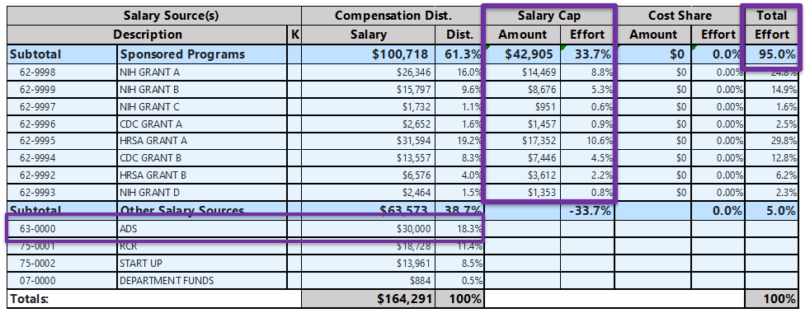
What you can’t do in Workday…
The Pre-Workday/FEC process whereby the ADS can exclusively cover over-the-cap portion isn’t possible.
There are a couple of options to handle these situations…

Slide 10
Salary Cap and ADS – Option #1
If the ADS is NOT to be used towards any sponsored award effort, then the faculty must reduce the amount of effort devoted to sponsored awards
Example: If Faculty A’s IBS is 80% REG and 20% ADS, and the ADS is not to be used towards any sponsored award effort, then… The maximum amount of IBS that may be committed to sponsored award is 80%

Slide 11
Salary Cap and ADS – Option #2
Allocate REG and ADS (separate allocations) to sponsored awards in proportion to the proposed effort on the award*
Faculty A’s monthly IBS:
REG 80%
ADS 20%
Faculty A proposes the following levels of effort on Awards where salary cap applies:
Grant A: 25%
Grant B: 40%
Grant C: 30%
Total Sponsored Award proposed effort: 95%
*Because an ADS/ENS is part of the UW’s Institutional Base Salary, it is permissible to charge the pay to sponsored award in proportion to the devoted effort

Slide 12
Salary Cap and ADS – Option #2 continued…
REG Payroll Allocation:
Grant A: 25%
Grant B: 40%
Grant C: 30%
ADS allocation:
Grant A: 25%
Grant B: 40%
Grant C: 30%
Workday will perform the Salary Cap calculation on the REG and ADS pay

