Slide 1
UW Tips on Student Loan Repayment

Slide 2
Presented by
(Department Name Here)

Slide 3
Agenda
Loan Life Cycle
Loan History and Repayment
Understanding your Income
Understanding Your Credit Report
Questions

Slide 4
Loan Life Cycle
The School Financial Aid Office
Student completes entrance form and signs promissory note.
Loan Disbursement
Exit Counseling Sessions
Graduation or Withdrawal
(Separation Date)
Deferment
Forbearance
Cancellation
Grace Period
6 Months – Direct Loans
9 Months – Perkins
Varies – Health Prof
Varies – Private/Institutional
Billing Cycle
Monthly – Federal Direct, Perkins, and Health Professions Loans
Monthly – UW Loans
Varies – Privatel
First Bill Due
Notes:
Promissory note: The binding legal document that you must sign when you get a federal student loan. It lists the terms and conditions under which you agree to repay the loan and explains your rights and responsibilities as a borrower.
Exit Counseling: Depending on the types of loans you have, you may need to complete multiple exit counseling sessions. Direct loan exit counseling is completed on studentloans.gov, Perkins and Health professions counseling is at wwwhttps://heartland.ecsi.net/
Grace Period: A period of time where the student is not required to make payments on certain federal student loans. Some federal student loans accrue interest during the grace period, and if the interest is unpaid, it will be added to the principal balance of the loan when the repayment period begins.

Slide 5
Loan Repayment Basics
Education loans must be repaid
Loans can be prepaid
Repayment begins following the grace period
Keep your loan servicers informed of any pertinent changes
Communicate with your loan servicer if payment problems arise
Communicate with your loan servicer if payment problems arse
Notes:
Pertinent changes include change of name, address, phone, or school registration status.

Slide 6
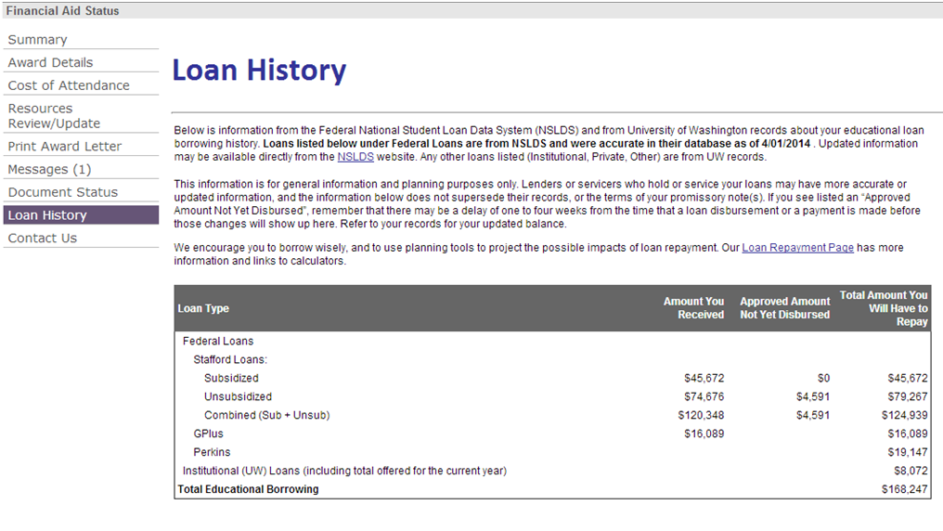
UW Loan History
Notes:
On MyUW – you an view a snapshot of loans taken while a student at UW.
This is an estimate intended as a guideline and may not include all disbursements for the current year.

Slide 7
Loan Information
Your loan servicer website
Direct Loan Program - Department of Education
studentloans.gov
studentaid.ed.gov
nslds.ed.gov
Perkins, Health Profession & Institutional Loans Heartland ECSI
https://heartland.ecsi.net/
Private Loans - Varies
Notes:
Studentloans.gov is where you signed your master promissory note for Direct Loans and completed entrance and exit counseling. There is also an optional Financial Awareness Counseling tool. The site links to additional information regarding your loans including repayment calculators and Direct Consolidation Loan applications.
Studentaid.ed.gov is a user friendly Federal Student Aid website that provides searchable information on financial aid, loan repayment options and calculators, cancellation, and contact information for additional questions. You can log in to this site with your FAFSA PIN to view your loan information.
NSLDS.ed.gov is the National Student Loan Data System for all Title IV funding including Federal Direct Loans, Perkins Loans, and Pell Grants. This site also provides the name of company servicing your loan servicer in the event that you need to confirm this information.
Campus Partners is the University’s loan servicer. You can access their website for loan repayment, and for the forms required for cancellation, forbearance, and deferment of your institutional, Health Professions, and Perkins loans.

Slide 8
Work with your loan servicer to choose a repayment plan https://studentaid.ed.gov/repay-loans/understand/plans
Standard Plan
Extended Plan
Graduated Plan
Income-Based Plan
Income-Contingent Plan
Income-Sensitive Plan
Pay As You Earn Plan
Notes:
Several repayment plans are available for Federal Direct Loans including Subsidized, Unsubsidized, Grad Plus, and Consolidation loans. Review the information on studentaid.ed.gov and contact your loan servicer with any additional questions.

Slide 9
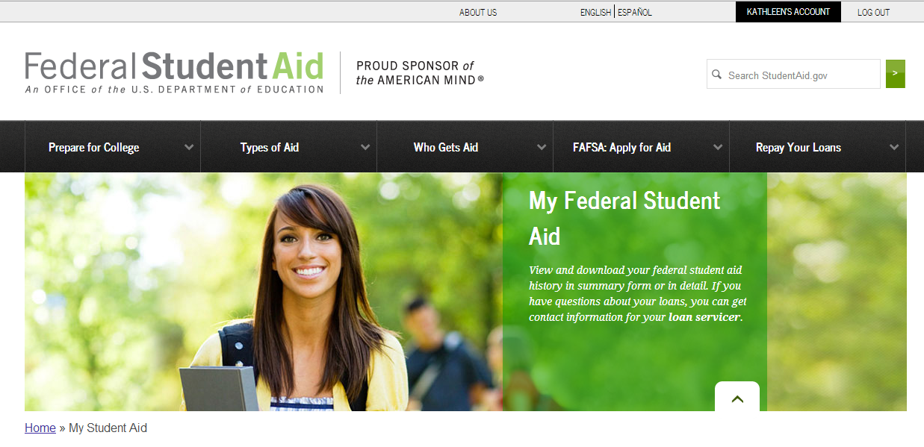
My Federal Student Aid
https://studentaid.ed.gov/my-student-aid
Notes:
My Federal Student Aid shows your student loan data.

Slide 10
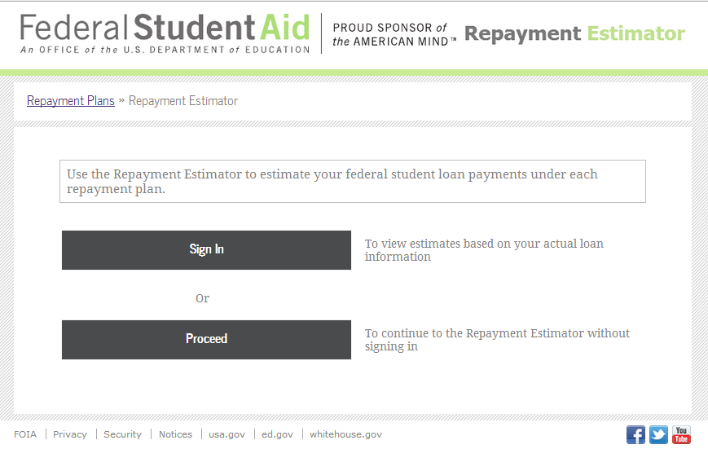
Student Loan Repayment Estimator
studentloans.gov/myDirectLoan/mobile/repayment/repaymentEstimator.action
Notes:
The repayment estimator is a tool for reviewing repayment options based on your student loan indebtedness and income. You can sign in to use your Title IV information, input specific information or you can use use average loan balances.

Slide 11
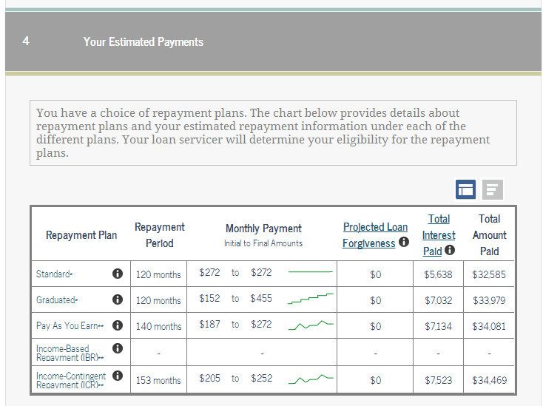
Student Loan Repayment Estimator
studentloans.gov/myDirectLoan/mobile/repayment/repaymentEstimator.action
Notes:
The results here are based on loan debt of $26,947 for a single individual living in Washington state and earning $40,000 per year.

Slide 12
Loan Consolidation
Combines eligible federal education loans into a single consolidation loan – weigh the pros and cons to determine if a consolidation loan is right for you
One lender/one monthly payment
Flexible repayment options
Reduced monthly payments
Fixed interest rate
May increase total interest paid
Borrower benefits may be lost
Notes:
Subsidized, unsubsidized, PLUS loans for graduate or professional students, Perkins Loans, and certain health profession loans made by the U.S. Department of Health and Human Services are eligible for consolidation.
For additional consolidation information or to apply for a consolidation loan go to: studentloans.gov (log in with your FAFSA PIN) > Manage My Direct Loan > Direct Consolidation Loan Applications.
Note: Private loans are ineligible for federal loan consolidation but can be used to establish the repayment period on consolidation loans.

Slide 13
Consolidation Repayment Period
Based on total educational indebtedness
This includes:
Federal student loans that you consolidate
Federal student loans that you do not consolidate
Private student loans (that you cannot consolidate)
Private student loan debt considered toward repayment period cannot be more than amount of the consolidation loan
If your total education loan indebtedness is… |  | …your repayment period will be…
At least | Less than
- | $7,500 | 10 years
$7,500 | $10,000 | 12 years
$10,000 | $20,000 | 15 years
$20,000 | $40,000 | 20 years
$40,000 | $60,000 | 25 years
$60,000 | - | 30 years
To count private student loans toward repayment period, list them on consolidation application under the “Loans You Do Not Want to Consolidate” section.
Notes:
For additional consolidation information or to apply for a consolidation loan go to: studentloans.gov (log in with your FAFSA PIN) > Manage My Direct Loan > Direct Consolidation Loan Applications.

Slide 14
Deferment and Forbearance
A deferment or forbearance allows you to temporarily postpone making student loan payments or to temporarily reduce the amount you pay. The following list includes some of the events that may qualify you for deferment or forbearance.
Return to school | Medical
Rehabilitation training program | Military
Economic hardship | Unemployment
Graduate fellowship | Americorps
Student loan debt burden | Medical/Dental residency
Notes:
Your promissory note will explain deferment and/or forbearance options. Your best resource for additional information is your loan servicer.
Deferment is a postponement of payment on a loan that is allowed under certain conditions and during which interest does not accrue on Direct Subsidized Loans, Subsidized Federal Stafford Loans, and Federal Perkins Loans. All other federal student loans that are deferred will continue to accrue interest. Any unpaid interest that accrued during the deferment period may be added to the principal balance (capitalized) of the loan(s).
Forbearance is a period during which your loan payments are temporarily suspended or reduced. Your lender may grant you a forbearance if you are willing but unable to make loan payments due to certain types of financial hardships. During forbearance, principal payments are postponed but interest continues to accrue. Unpaid interest that accrues during the forbearance will be added to the principal balance (capitalized) of your loan(s), increasing the total amount you owe. For some loans, interest may be due in a lump sum at the end of the forbearance or billed monthly. Check with your loan servicer for details.

Slide 15
Discharge, Forgiveness, Cancellation
Death (DL, FFEL, Perkins)
Disability (DL, FFEL, Perkins)
Public Service (DL)
Teaching (DL, FFEL, Perkins)
Notes:
For additional cancellation information visit studentaid.ed.gov or contact your loan servicer.

Slide 16
Delinquency and Default
Account is delinquent the day after the due date if full payment is not made
Continue to make payments to save time and interest payments in the long run
Servicers can advise on deferment and forbearance options if needed
Default occurs after 270 days of delinquency
Contact your loan servicer – they are your best resource to avoid default!
Notes:
Consequences of default:
Reported to credit bureaus
Lose eligibility for additional financial aid
Loan is immediately due and payable in full
May lose eligibility for repayment plans and deferment of forbearance options
Account may be sent to collection agency
Wage garnishment
Tax refund garnishment

Slide 17
Understand Your Income
Understand the difference between gross and net pay
Gross pay – your income before deductions such as tax, insurance, or optional deductions
Net pay – the amount you receive after deductions “take home pay”
Review your paychecks when you receive them to become familiar with your deductions
Notes:
Remember – when you are offered a job the amount offered is not the actual amount you will receive.
Optional deductions may include a bus pass, 401k, charitable donations, or healthcare. These options will decrease your take home pay.

Slide 18
What is a Credit Report?
A report containing detailed information on a person’s credit history including:
Identifying information
Credit card and loan accounts
Bankruptcies
Late payments
Recent inquiries
Can be obtained by prospective lenders, employers, and other parties with your permission
Notes:
There are three major credit reporting agencies:
Equifax www.equifax.com
Trans Union www.transunion.com
Experian www.experian.com
You have a credit report if you have applied for a credit card, a student, auto, or home loan.
Potential creditors will review your credit report to determine your eligibility for a loan. Landlords, potential and current employers, government licensing agencies, and insurance underwriters also may view your credit report.
Credit bureaus report answers to the following questions:
How promptly are your bills paid?
How many credit cards do you hold?
What is the total amount of credit that is extended?
How much is owed on all of your outstanding accounts?
Negative information (late payments, bankruptcies, too much debt) found on your credit report can have a serious impact on your ability to:
borrow loans,
seek employment in certain occupations,
receive a promotion, or
purchase or rent a home.
A credit report typically includes the following:
Personal identifying information — Name, Social Security number, date of birth, current and previous addresses, and employers
Credit account information — date opened, credit limit, balance, monthly payment, and payment history
Public record information — bankruptcy, tax and other liens, judgments, and, in some states, overdue child support
Inquiries — names of companies that requested your credit report
You should review your credit reports at least once per year, verifying that all of the information is accurate. To request your free credit report, go to www.annualcreditreport.com. Do not pay a fee to view your credit report. You can request your credit report annually free of charge.
If credit is denied at any time, the lender must provide a letter explaining the reason and indicate which credit agency report was reviewed. You may request a free report from that agency within 60 days of receiving the letter.
Report all inaccuracies on your credit report to the agency immediately. Be certain to notify both the credit bureau and the information provider, in writing, of the discrepancy. Include the following in the notification:
Name
Complete address
A summary of the information that you are disputing and why
A copy of the credit report with the information highlighted
Copies of any supporting documents
When the dispute is received, the credit agencies have 30 days to investigate and respond to you in writing. In most instances, if the information is incorrect on one credit report, it will be incorrect on all three. Review and contact all three credit agencies when disputing information.
For more information on your rights and responsibilities regarding your credit report, review the Fair Credit Reporting Act (www.ftc.gov/os/statutes/031224fcra.pdf).

Slide 19
Influencing Your Credit Score
Pay your bills on time
Keep credit card balances low
Apply for and open new credit accounts only as needed
Use credit cards responsibly to create a positive credit history
A secure credit card is a good option to build credit history for individuals who have no credit history
It is important to review your credit report on a regular basis to verify its accuracy
Notes:
Your free credit report will not contain your credit score.
When you apply for a loan or an apartment lease you are often charged for a credit check. Ask for a copy or a statement containing your credit score.

Slide 20
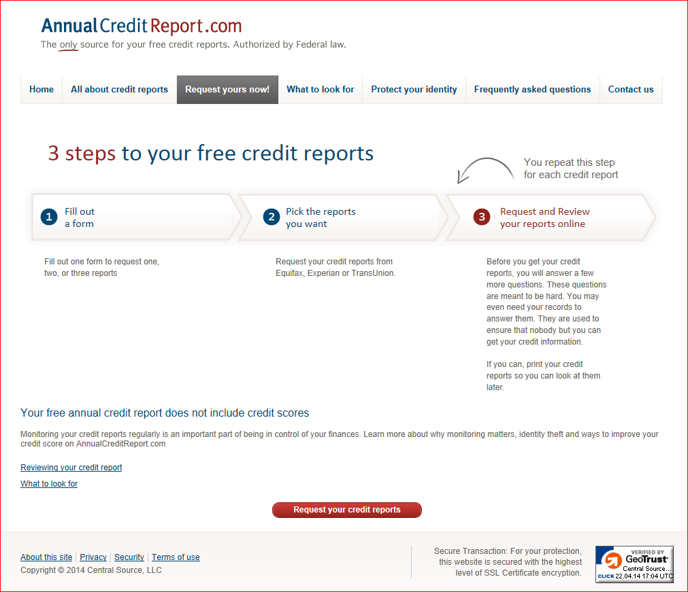
For Your FREE Credit Report
annualcreditreport.com
Notes:
Once per year you can view a credit report on line from AnnualCreditReport.com free of charge. This site is sponsored by the three main credit reporting companies; Equifax, Experian and Trans Union.
If something is incorrect or questionable you can dispute the item using the instructions on the credit bureau website. The creditor is required to respond validity of the consumer’s dispute within thirty days.

Slide 21
Questions?
Student Fiscal Services
129 Schmitz Hall
206–543–4694
sfshelp@uw.edu
www.f2.washington.edu/fm/sfs/

Slide 22
Links to further information
Direct Loan Program
http://www.direct.ed.gov/student.html
Perkins and Institutional Loans: (Heartland ECSI)
https://heartland.ecsi.net/
National Student Loan Data System
http://www.nslds.ed.gov/nslds_SA/
My Federal Student Aid
https://studentaid.ed.gov/my-student-aid
Loan Consolidation
https://studentaid.ed.gov/repay-loans/consolidation
Postponing Repayment
http://studentaid.ed.gov/repay-loans/understand#what-should-i-do
Federal Loan Discharge or Cancellation
http://studentaid.ed.gov/repay-loans/forgiveness-cancellation
Student Loan Repayment Calculator
https://studentloans.gov/myDirectLoan/mobile/repayment/repaymentEstimator.action
Annual Credit Report
https://www.annualcreditreport.com/index.action

