Slide 1

Loan Repayment and Forgiveness
Presented by:
Robin Elliott
March 11, 2011

Slide 2

Loan Life Cycle
The School Financial Aid Office
Student completes entrance form and signs promissory note.
Separation Date
Student Leaves School
New Loan/
Advance
Exit Interview
Student completes exit form and signs
Grace Period
6 or 9 months
90 Day Grace Statement
150 Day Grace Statement
(9 mo. Only)
150 Day (6 mo.) or 240 (9 mo.) Early Notices
First Bill Due
Deferment
Forbearance
Cancellation
Billing Cycle
Q = 3 months

Slide 3
Deferment and Forbearance Options
Deferment: A period during which payments are postponed and interest does not accrue.
Deferments are available for:
    Students enrolled at least ½ time
    Studying in an approved graduate fellowship or rehabilitation program for the disabled
    Qualifying employment 12 months prior to a cancellation
    Unemployment (max 36 months)
    Economic hardship (max 36 months)
    Active duty military service in an area of hostilities
Forbearance: A period during which payments are postponed, but interest continues to accumulate.
Forbearance is available at the borrower’s request during times of hardship when criteria for deferment is not met.
    Borrower is responsible for paying interest that accrues during a period of forbearance

Slide 4
Cancellation Criteria
Law Enforcement Up to 100%
    Full time employment
    Employed full-time in local, State or Federal law enforcement agency that is publicly funded.
    Responsibility is to enforce, reduce or control criminal law.
    Sworn law enforcement/corrections officer or position unique to the criminal justice system.
Peace Corp Up to 70%
    Full time service in the Peace Corp for 12 consecutive months.
Military Up to 100%
    Full time service in the Army, Navy, Air Force, Marines or Coast Guard.
    Who served in an area of hostilities.
Teacher Low Income Up to 100%
    Full time teacher in elementary or secondary school or educational service agency.
    School serves a population of more than 30% of low-income students.
    Provide classroom teaching or classroom like teaching in a non-classroom setting or educational services to students related to classroom teaching.

Slide 5
Cancellation Criteria
Special Education Up to 100%
    Full-time teacher in elementary or secondary school.
    Teacher of infants, toddlers, children or youth with disabilities.
    Ages of children birth to 21 years.
Teacher Shortage Up to 100%
    Full-time teacher in an elementary or secondary school.
    Teaches math, science, foreign language or bilingual studies 100% of time.
    Teaches subject the state education agency determines to be a shortage area teacher.
Head Start 15% per year

Slide 6
Cancellation Criteria
Early Intervention Up to 100%
    Full-time employee for 12 consecutive months.
    Providing developmental services to an infant or toddler with a disability under the age of three.
    Developmental needs in; physical, cognitive, language and speech, psycho-social development, or self help skills.
Nurse/Med Tech. Up to 100%
    Full-time nurse or medical technician.
    Licensed or certified by the State.
    A Medical Technician is someone who assists, facilitates or complements the work of a physician or health care specialist.
At-Risk Child Service Up to 100%
    Full-time employed at a child family service agency that is public or non-profit.
    Servicing high risk children from low-income communities.
    High risk children are under the age of 21 who are low income, or have been or are at risk of being abused or neglected, have serious emotional, mental or behavioral disturbances, or reside in placements outside of the home, or are involved in the juvenile justice system.

Slide 7
Cancellation Criteria
Pre-K or child care program 15% per year
    Full Time Staff Member
    In a pre-kindergarten or child care program
    Licensed or regulated by the state
Educational Services Agency Up to 100%
    Full time teachers (including special ed)
    Working in an Educational Agency
    Serving low-income community
Librarians in Low Income Up to 100%
    Full time librarian with Masters Degree in library science
    Employed in an elementary or secondary school that qualifies for Title I funding or public library servicing a geographic area that includes one or more Title I schools.
Speech/Lang Pathologist Up to 100%
    Full time employment
    Borrower has a master’s degree
    Working exclusively with Title I eligible schools

Slide 8
Cancellation Criteria
Public Defenders* Up to 100%
    This section has been expanded to include cancellation for a full-time attorney employed in a Federal public defender organization or community defender organization.
Faculty Member Tribal College Up to 100%
    Full time faculty member
    Tribally controlled College or University
Firefighter Up to 100%
    Employed by a federal, state or local firefighting agency to extinguish destructive fires; or provide firefighting related services such as
      Providing community disaster support and, as a first responder, providing emergency medical services
      Conducting search and rescue
      Providing hazardous materials mitigation (HAZMAT)

Slide 9
Prior Service
Schools cannot cancel any portion of the loan for service performed before the date the loan was disbursed or during the same period that he/she received the loan.

Slide 10
Defaulted Loans
Schools may cancel a defaulted loan if the reason for the default was the borrower’s failure to file a cancellation.

Slide 11
No Double Dipping!
Schools may not grant cancellation of a Perkins loan to a borrower who has received an education benefit under the Subtitle D of Title I of the National Community Service Act of 1990 (Americorps).

Slide 12
Payment Refund
Schools may not refund payments made during a period for which the borrower qualified for a cancellation , unless the borrower made the payment because of the school’s error.

Slide 13

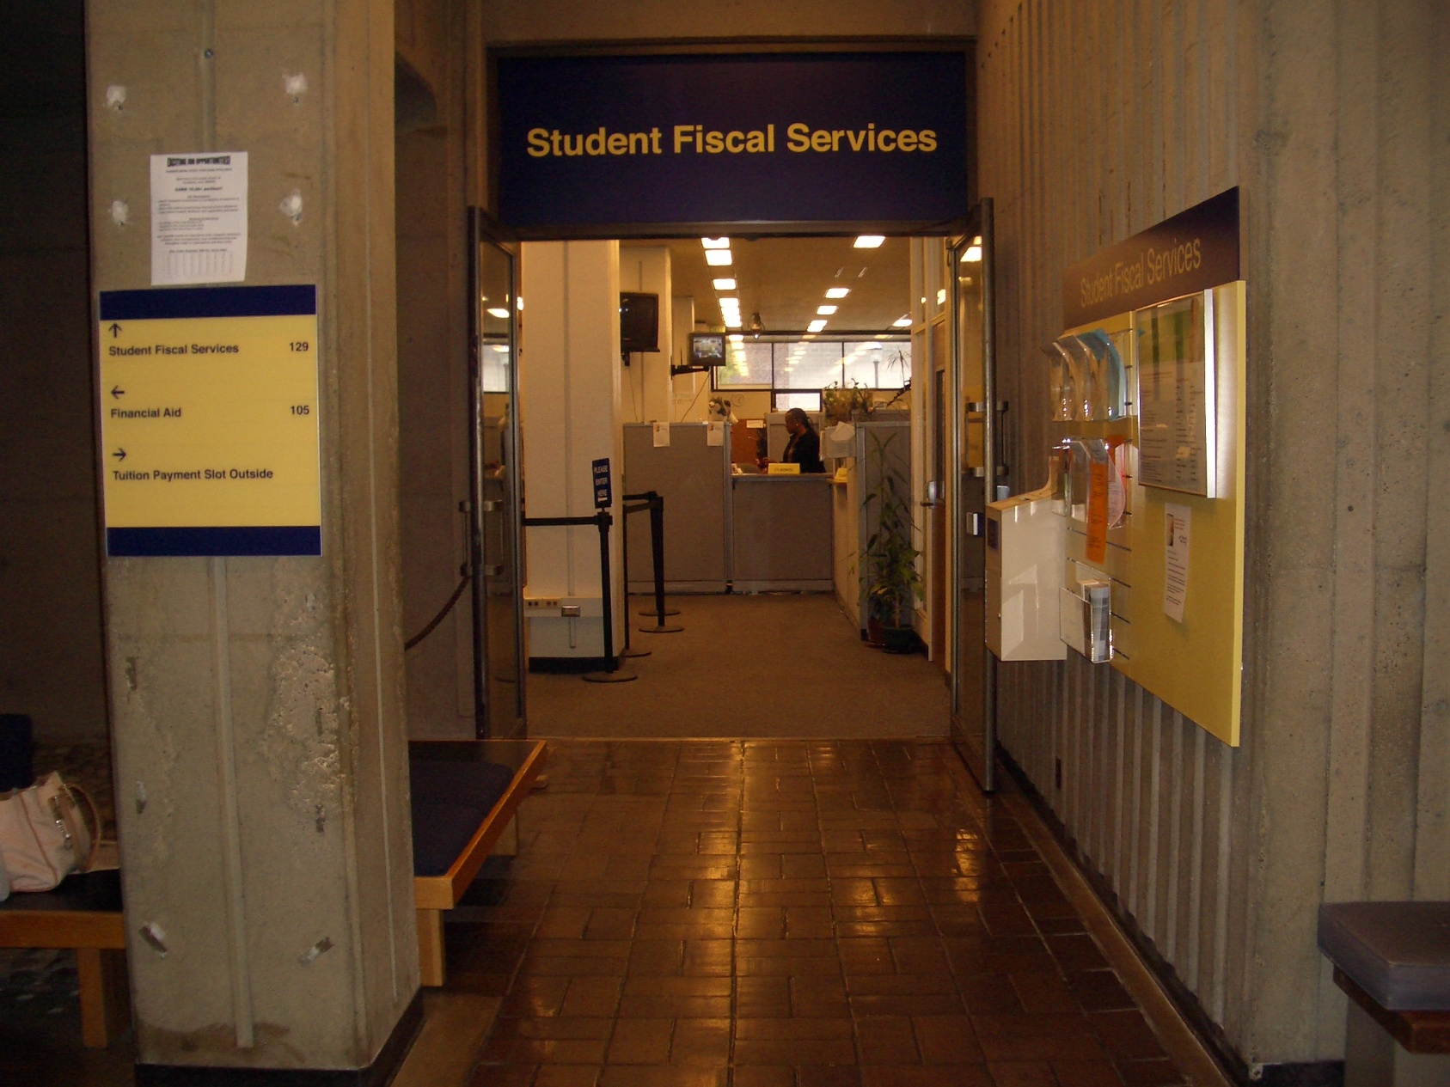
Questions
129 Schmitz Hall
Box 355870
(206) 543 – 4694
FAX: (206)685-2942
sfshelp@u.washington.edu
www.washington.edu/students/sfs
Items on The Tuition Statement
Payment of Tuition and Fees
Outside Sponsor Payments
Aid Disbursement - After It Is Awarded
Money Management

