Slide 1
Parent Orientation
Tuition Bill and How Best to Pay
Things to be Aware of
Questions

Slide 2
Tuition Bill
Tuition is Due by the
3rd Friday of the Quarter
Online Tuition Statement
Found in MyUW
Payment Options: http://f2.washington.edu/fm/sfs/tuition/payment/
Separate University Housing Bill
Webcheck is free, fast, and safe
Payment shows immediately
No chance that check is lost in the mail or stolen
Other options: check, credit card with a 2.24% fee, or in person

Slide 3
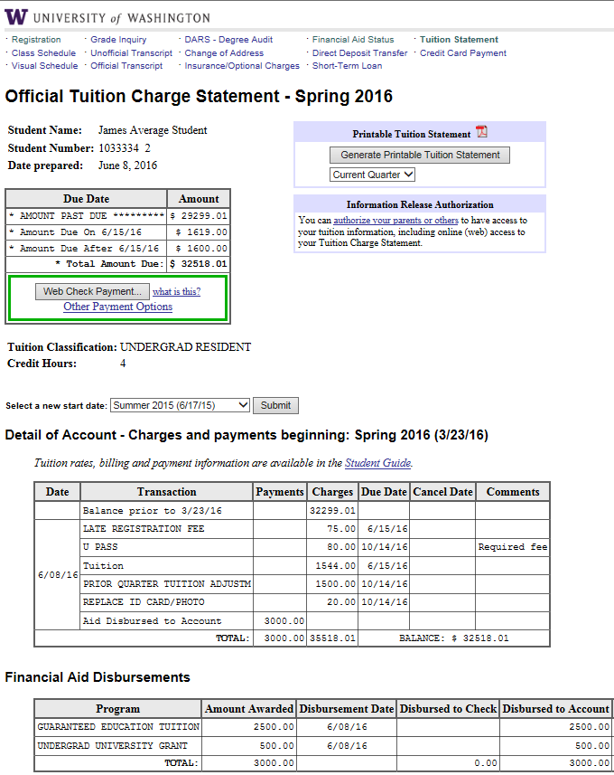

Slide 4
Tuition Bill
Student Gives YOU Access to the Bill

Slide 5
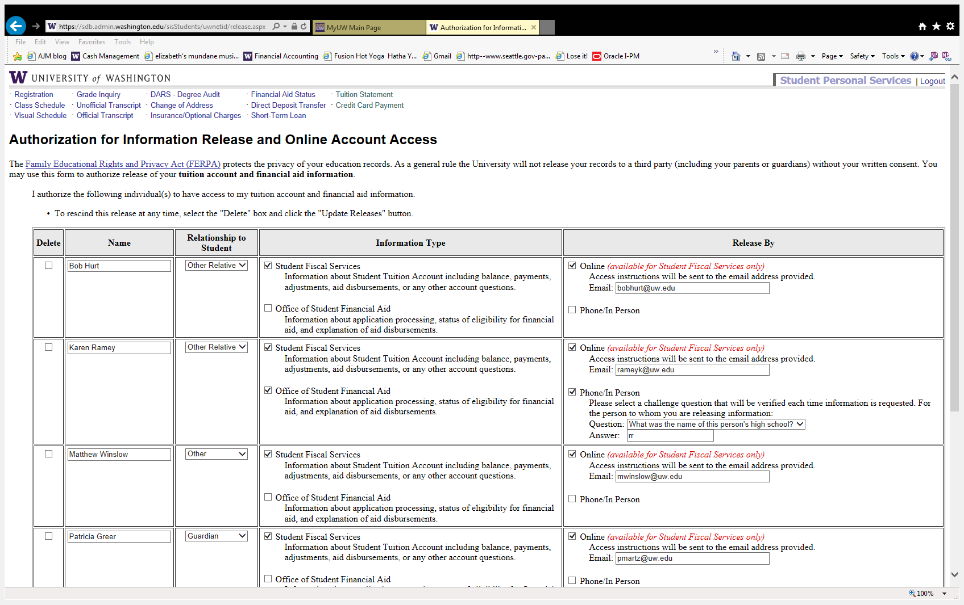
Student gives you access to their bill

Slide 6
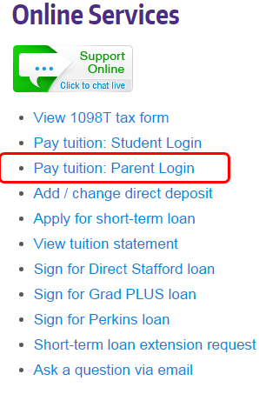
Paying Tuition Bill
Student Gives YOU Access to the Bill
You will receive an email with instructions once your student authorizes you
You will need the following information
Your student’s UW number
The answer to the challenge question your student provided.
You will see the image below to log in
To log in at any time, go to https://f2.washington.edu/fm/sfs/parents or view the quick link from our SFS webpage to pay tuition →

Slide 7
Important Information
Aid: Generally, tuition and fees are paid first from any scholarships, grants, or loans received
Additional fees: Fees can be charged throughout the quarter- check the bill periodically (Late changes or fees, lost U Pass, class fees etc.)
Important Dates: Make sure your student is aware of deadlines for class or credit changes without a penalty
Taxes: Opt out of the paper form-> your student can print the 1098-T online to get it earlier and more efficiently
Contact the IRS at https://www.irs.gov/
to ask about tax credits

Slide 8
Student Financial Aid
FAFSA must be completed by February 28 –(contact Financial Aid if this was not done)
Once an offer is made by the Financial Aid Office, student must accept aid and sign the appropriate promissory notes
Parent signs the Plus Loan Master Promissory Note and completes request process online: www.StudentLoans.gov
Always have student confirm that their tuition and fees are paid prior to using any funds sent to them via check or Direct Deposit

Slide 9
Fees You May See in Detail:
Late Fees
$50 to $249.99 → $50
$250 and over → $120
Course/Lab fees
Tuition Forfeiture
Add/Drop Fee
Insurance
Short Term Loan
$2500 available
UW Housing
Study Abroad
Other

Slide 10
Non-UW Scholarships
Students need to report all scholarships to the Office of Student Financial Aid (OSFA), if they were not already reported on their award notice. Forgetting to report all scholarships can cause problems with their financial aid award and in some cases may require them to return some of their financial aid money.
Scholarships will reduce a student’s unmet need first, and then loans and/or work study before any grants or UW scholarships are reduced.
Scholarships checks are sent to:
University of Washington, Scholarships
Box 24967
Seattle, WA 98124-1967

Slide 11
Parents - Go to www.get.wa.gov
You can request in Fall for all three quarters or
You can request each quarter separately
Questions about how much or how many units - contact the GET office
UW housing charges can be paid with GET, please contact HFS to coordinate this payment with our office
UW Process
UW receives GET funds three times a week during the first three weeks of the quarter
We will post your payment as soon as it is received
The GET program can take up to 2 weeks to process payment requests – take action early!!

Slide 12
Veterans
VA
Student applies for the benefit in the UW VA office – call 206-543-6122
VA office certifies the account and requests the money for the student
SFS pays tuition for the student after we receive the funds
VA funds usually come in the 4th or 5th week of the quarter- we waive late fee
ROTC
Contact the ROTC unit on campus for your scholarship questions.
Army: 206-543-9010
Navy: 206-543-0170
Air Force: 206-543-2360

Slide 13
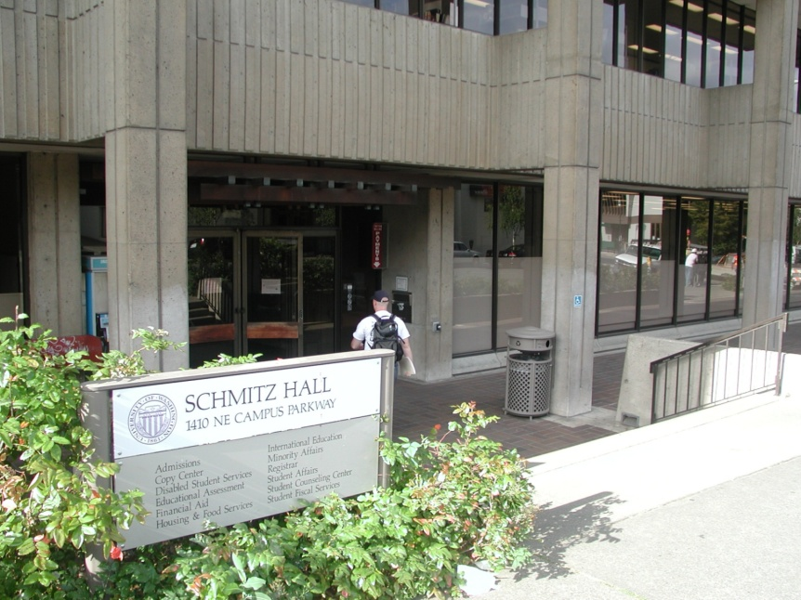
Which Office?
Student Fiscal Services for:
Items on The Tuition Statement
Payment of Tuition and Fees
Outside Sponsor Payments
Disbursement of Awarded Aid
129 Schmitz Hall
Financial Aid:
Handles Applications
Determines Eligibility
Monitors Eligibility
Helps Finalize Award
Revises Eligibility
105 Schmitz Hall

