Slide 1


Husky Ready
Ensuring the UW of Tomorrow by Preparing for Today

Slide 2
BARC
Business
Academic
B
A
R
C
Research
Continuity

Slide 3

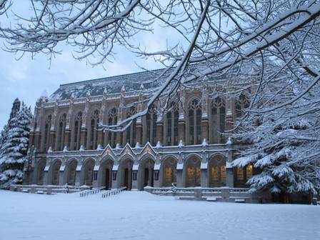


THE NEED

Slide 4




INCIDENT MANAGEMENT CHALLENGES
Fog of Disaster-
Tyranny of Time-
Communication Difficulties-
Logistics Challenges-

Slide 5
DISASTER CURVE
REACTIVE
RESPONSE
PROACTIVE
RESPONSE
RESOURCES
ADEQUATE
RESOURCE
GAP
RESOURCES
RELEASED
RESPONSE
BEGINS
INCIDENT OCCURS
INCIDENT
RESOLVED

Slide 6

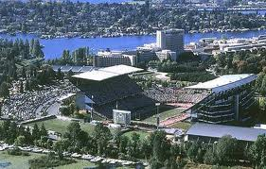


THE BENEFIT
Resilience
Recovery
Reputation

Slide 7
THE EFFORT
All-Hazards
Emergency Management Plan
(University Wide)
Unit Response Center Plan (URC)
(division)
Emergency Evacuation & Operations Plan (EEOP)
(building)
Business Continuity
(unit/department)
Personal Preparedness Plan
(individuals/employees)

Slide 8


BEST PRACTICE CONCEPTS
DONT’s
The Great Big Book of Everything.
The Scenario Labyrinth.
Bottle-Rocket Planning.
Black-hole Budget Myth.
Plans over Planning.
The Ostrich Defense
The Possum Principle

Slide 9
BEST PRACTICE CONCEPTS
DO’s
Resource-oriented planning
Incident Management by Objective
Planning for People first
Understand Interdependencies
Planning is better than plans

Slide 10
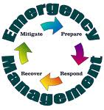
With A Little Luck….
"Luck is what happens when preparation meets opportunity”
Seneca, Roman philosopher, mid-1st century AD

Slide 11
APS 13.2
To be compliant departments must have the following:
Prioritized recovery checklist of critical resources (Personnel, Facilities, Information and Equipment) necessary for core business, academic or research processes.
Alternative staffing plan for a minimum of 72 hours.
Alternative facility planning for continuity of workspace.

Slide 12

HUSKY READY

Slide 13
THE GOAL
We want to be able to do tomorrow
what we were doing yesterday
(no matter what happens today).
Paul Dimond, Kuali Ready Council Chair

Slide 14
By Higher Ed for Higher Ed
Developed by the Kuali foundation
Web-based continuity software planning
Budget-friendly cost model
Easy to use, intuitive interface
Self-paced planning
Easy to update plans
UW standard across all UW-properties, domestic and international.
Hosted at and supported by UC Berkley, under contract with Kuali

Slide 15
BARC PROGRAM MANAGEMENT
BARC is PROGRAM, not a single project.
Each department will identify a BARC program manager.
Recommend units within the departments also have BARC coordinators.
During initial program phase, meet bi-weekly with UWEM.
Attend monthly BARC workgroup meetings as a continuity effort.
Annual review and update.
Bi-annual exercise of plans.

Slide 16
TIMELINE
May 2011 | June 2011 | July 2011 | Aug 2011
2-May | 20-Jun | 5-Jul | 1-Aug
Husky Ready Kick-Off | Husky Ready Progress Meeting | Husky Ready Progress Meeting | AAR report released
16-May |  | 18-Jul | 15-Aug
Husky Ready Progress Meeting |  | Pilot AAR Meeting | U-Wide Husky Ready Release
31-May |  |  | 29-Aug
Husky Ready Progress Meeting |  |  | Husky Ready Workgroup Meeting

Slide 17


SUPPORT
Scott Preston
CEM, ABCP, EMT
UW Emergency Management
scottpre@uw.edu
206-897-1882

