Slide 1
UW Internal Audit in Southern Africa February 2011

Slide 2
Global Operations at UW
Operates in over 100 countries
Research, Education, Partnerships
3,700 international students in 2010
Over 2,000 undergrads study abroad annually
50 foreign languages taught
1,700 international scholars in residence
Over 80 University wide exchange programs

Slide 3
Global Support Project
Established in 2006 with objective of providing solutions to basic challenges in operating overseas:
Transfer money overseas, payroll, benefits
Legal status, tax
Acquiring space, property, employing staff
Ensure safety, provide insurance
Human subjects, purchasing, visas

Slide 4
UWorld
WA nonprofit corporation set up by UW to facilitate our overseas activities. UW fully controls UWorld and UWorld can only do what UW is legally permitted to do.
UWorld is used when there is a requirement to:
Open a foreign bank account
Hire local citizens
Open a foreign office

Slide 5
I-TECH
International Training & Education center on Health
Formed in 2002 to share lessons learned from US domestic Aids programs
Currently gets $65m in annual federal funding
650 employees in 12 countries; HQ in Seattle
Mostly sub-Saharan Africa, but also Caribbean, India, SE Asia

Slide 6
“Fraud Plagues Global Fund to Fight AIDs” The Seattle Times 1/23/11
“as much as two thirds of some grants eaten by corruption”
“much of the money accounted for with forged documents and improper bookkeeping”
“in Zambia, the (Global) Fund is trying to recover $7 million in "unsupported and ineligible costs" from the ministry.”

Slide 7
“Fraud Plagues Global Fund to Fight AIDs”
"We would contend that we do not have any corruption problems that are significantly different in scale or nature to any other international financing institution."
“Fund officials blame the misspending on the lack of financial controls among the grants' recipients, many of which are African health ministries whose budgets are heavily supported by the fund.”

Slide 8
“UW international AIDS nonprofit hit by financial questions in Mozambique” The Seattle Times 2/1/2011
“Lost out on $100 million in funding it expected last year”
“Cut its Seattle staff in half and its Africa staff to one-tenth its former size”.
“An internal audit found financial problems that its director says possibly point to fraud by subcontractors”.

Slide 9
I-Tech Audit Plan
Year One: - Better understand overall I-Tech
Completed Internal Audit of the HQ Operations (based in Seattle) - Field Advances, Recharge Centers
Campus concerns regarding local operations
Year Two – Visit Locations
Risk assess in-country operations
Determine where to audit

Slide 10
Where did we go?
Goal to visit minimum of three locations.
Pretoria, South Africa
Gaborone, Botswana
Windhoek, Namibia
Three days in each location

Slide 11
Goals
Give opinion on the adequacy of internal financial controls
Develop an audit program for I-TECH staff to use in performing similar audits in the future
Open up direct lines of communication between local offices and UW internal audit
Meet with local external auditor, KPMG

Slide 12
Areas Tested
Payroll
Banking
Purchasing
Travel
Petty Cash
Equipment Inventory
Accounts Payable
Accounts Receivable
Management Reporting
IT Security

Slide 13
Audit Objectives
Budgetary responsibilities, including initiating expenditures and authorizing payments, are clearly defined, communicated and delegated.
Transactions are authorized, valid, adequately supported and accurately processed.
Assets are protected.
Sufficient, reliable and timely financial information provided to stakeholders.

Slide 14
Conclusions
No critical findings; however, ID’d areas for improvement;
Committed staff; eager to learn; want to get it right;
Come a long way in a short time period;
Detailed policies and procedures; communicated and understood. The key now is to make sure they are complied with;
Need for greater attention to detail and more forward planning.

Slide 15
Specific Findings
PURCHASING: Lack of/late UW approval; sole source with no/poor justification; no bid analysis; missing quotes, invoices; no confirmation of receipt of goods; need to develop vendor contracts
PAYROLL: Poor separation of duties over payroll authorization; lack of documentation to support payments to payroll vendor.

Slide 16
Specific Findings
MANAGEMENT REPORTING: Need to develop local reporting.
BANKING: Late bank reconciliations; incomplete resolution of non balancing items; transactions recorded late into QuickBooks
ASSET REGISTERS: Incomplete local asset registers; differences to UW asset register; confusion over coding and treatment of equipment.

Slide 17
Specific Findings
PETTY CASH: Mixing of personal and I-TECH cash; improvements to security of cash and associated documents
IT SECURITY: Location and access to server
ACCOUNTS RECEIVABLE: Not being reconciled monthly

Slide 18
Lessons Learned
Audit program was too ambitious. We did not achieve all we set out to do, but pushed ourselves!
Better up front planning – choose and communicate samples earlier.
Our visit as a big event for the local offices – allocate more time for meeting and greeting, office tours etc.
Utilizing a UW based I-Tech employee on audit as resource was a significant help!!!
Work back in Seattle didn’t go away.
Don’t underestimate jet lag – or fly business class!
DON’T work the weekend, when working overseas!

Slide 19
Madikwe Game Reserve

Slide 22
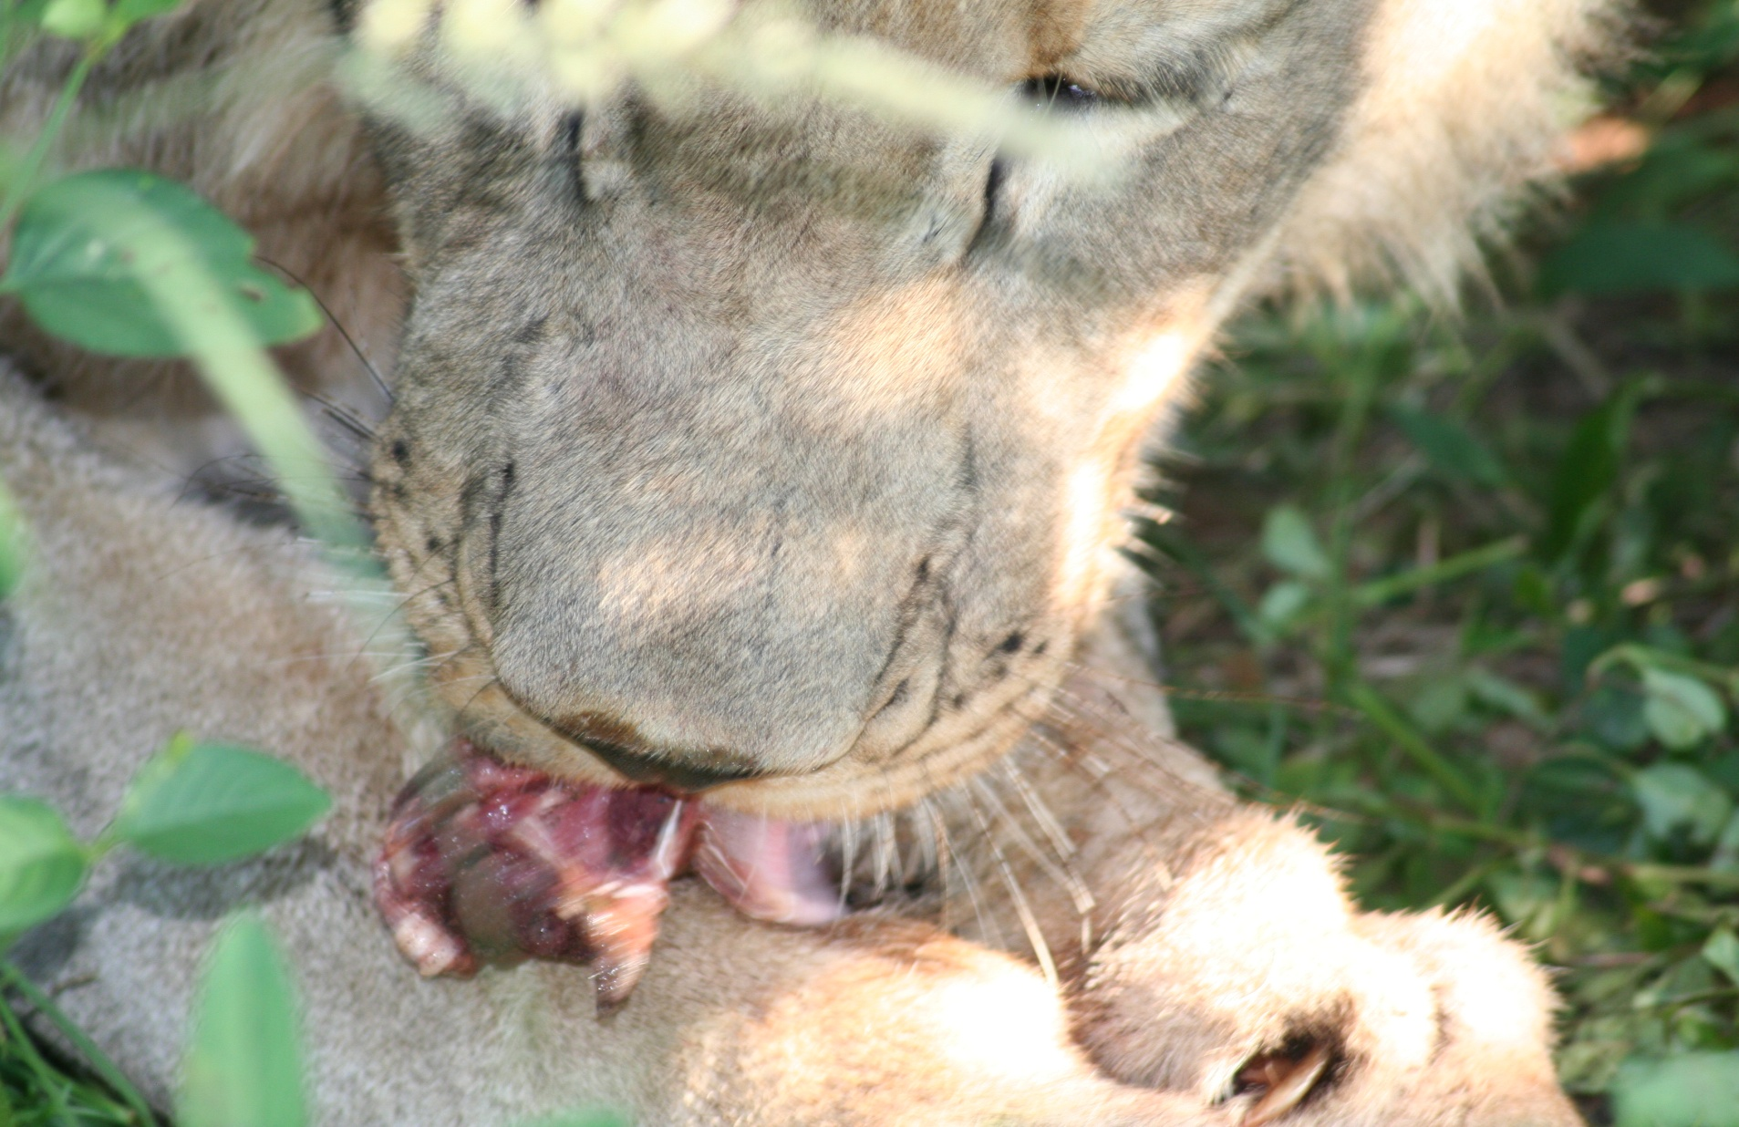

Slide 23
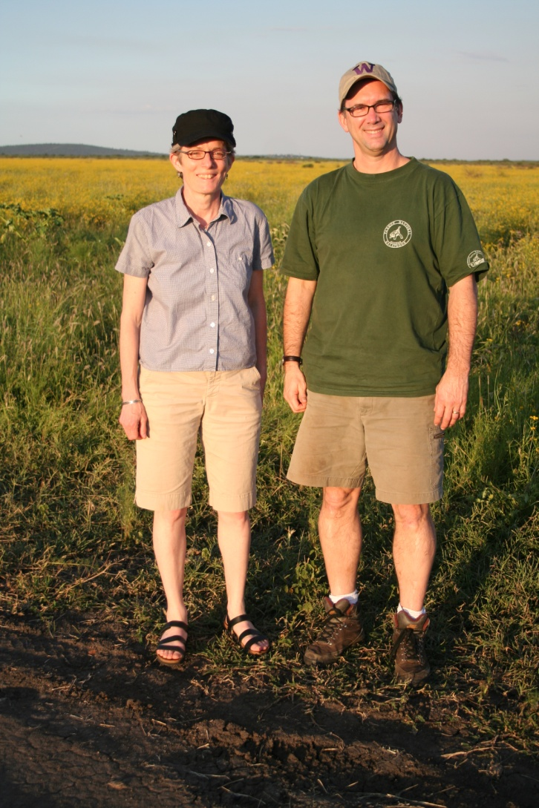
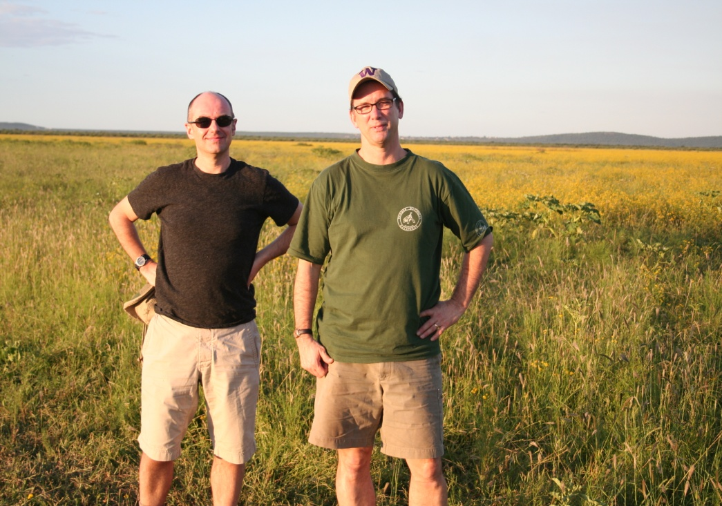

Slide 26
