Slide 1



2011 Annual Risk Assessment
Oregon University System
Presented by: Patricia “Patti” Snopkowski
Chief Auditor, OUS Internal Audit Division

Slide 2

Objective and Goal of a Risk Assessment
  Identify audits that will add value to the organization.
    Reduce the risk of losses related to internal control structure breakdowns
    Identify opportunities for increased efficiencies
    Reinforce existing control strengths

Slide 3
IIA Risk Assessment Standards
2010 – Planning
The chief audit executive must establish risk-based plans to determine the priorities of the internal audit activity, consistent with the organization's goals.

Slide 4
IIA Risk Assessment Standards
2010.A1
The internal audit activity’s plan of engagements must be based on a documented risk assessment, undertaken at least annually. The input of senior management and the board must be considered in this process.
2010.A2
The chief audit executive must identify and consider the expectations of senior management, the board, and other stakeholders for internal audit opinions and other conclusions.

Slide 5
IIA Risk Assessment Standards
2010.C1
The chief audit executive should consider accepting consulting engagements based on the engagement’s potential to improve management of risks, add value, and improve the organization’s operations. Accepted engagements must be included in the plan.

Slide 6
IIA Risk Assessment Standards
2020 – Communication and Approval
The chief audit executive must communicate the internal audit activity’s plans and resource requirements, including significant interim changes, to senior management and the board for review and approval. The chief audit executive must also communicate the impact of resource limitations.

Slide 7
IIA Risk Assessment Standards
2030 – Resource Management
The chief audit executive must ensure that internal audit resources are appropriate, sufficient, and effectively deployed to achieve the approved plan.

Slide 8

Elements of a Risk Assessment
Audit universe
Risk analysis
Management input
Judgment
Mechanics (i.e. number crunching)
Review and Approval

Slide 9
Step 1- OUS Audit Universe
Governance and Leadership
Academic Units
Research and Development
Student Services
Auxiliary Services
Information Technology
Human Resources
Financial Asset Management
Plant/Facility Operations

Slide 10
Step 2- Risk Analysis
    Sources of information
    Fiscal analysis
    Org change analysis
    Industry trends
    Past experience
    Management input

Slide 11
Step 2- Risk Analysis
  Industry trends
    Chronicle of Higher Education
    University Administrator Associations
    Association of College and University Auditors
  Past experiences
    GAO and Inspector General Offices
    State Auditors and Controllers Offices
    Risk management and crime reports
    Key Performance Measure Reports
    Board minutes and campus news summaries

Slide 12
Step 3-Management Input
Top Challenges/Risks Noted in survey
  Budget constraints
  Growth
  Policy and compliance
  Liability increases with tort limitations
  IT – operational and strategic limitations
  Staff development and morale
  Implementation of new initiatives/reorganizations

Slide 13
Step 4- Judgment
  For each unit under various functional areas mark :
      Impact of inherent risk (HML)
      Likelihood of risk (HML)

Slide 14
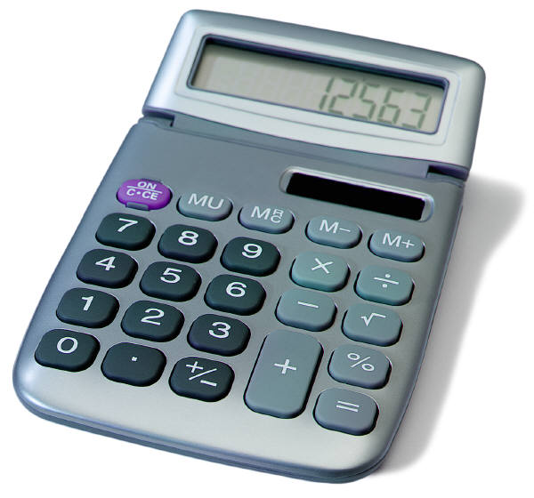
Step 5- Mechanics
Determine available hours
  2080 hours per year
Hour allocation methodology
  Direct hours to areas with available resources. Devoted to High/High areas.
  Indirect hours (25-30%)
Allocate contingency hours (misc mgmt requests and frauds)

Slide 15

Step 6- Review and Approval
Final review and formal approval
  Provide feedback on how their input was considered.
  Outline limitation of resources and level of audit universe coverage.
  Seek formal approval
  http://www.ous.edu/state_board/meeting/dockets (February 2011)

Slide 16
2011 Internal Audit Plan
Governance/Leadership- Consultation on policy and control implications
Instruction and Academic Support- International programs and extended studies
Research and Development- Selected grant compliance
Student Services- Health center operations
Human Resources Management- Business center processing
Fiscal/Asset Management- Treasury management/internal bank and Vendor and refund payment controls
Plant Operations- Facilities operations
Auxiliaries and Services- Museum collection inventory and NCAA football attendance certifications
Information Technology- Selected application controls

Slide 17
2011 Internal Audit Plan
  External Audit Liaison
  A-133 and Financial Statement Audits
  NCAA Agreed Upon Procedures
  Secretary of State Audits Division
  Other assistance as needed

Slide 18
Questions ?
Oregon University System

