Slide 1



Payment Card Industry-
Data Security Standards
Oregon University System
Jessica Johnson, CIA, CISA, Audit Supervisor
Dan Temmesfeld, CPA, Audit Supervisor

Slide 2
Agenda
PCI DSS Overview
PCI DSS Trends in Compliance
2011 Data on Data Breaches
Internal Audits’ Role
Common Risks and Internal Controls
State of Oregon Approach

Slide 3
PCI DSS Overview
PCI DSS: Payment Card Industry Data Security Standard
  2.0: sets out requirements to help those accepting card payments to protect cardholder information:
    Assess
    Remediate
    Report
  Compliance is mandatory if you store, process or handle credit or debit card information.

Slide 4
PCI DSS Overview
Compliance is self-monitored within the industry
  Must validate compliance by providing info to bank:
    Self-Assessment Questionnaire (SAQ), or
    Report on Compliance (ROC), generally for larger organizations
  Quarterly network scans showing no breaches
  Failure to comply could lead to PCI brands/banks removing your right to accept cards as methods of payment

Slide 5
PCI DSS Overview
Who does PCI DSS affect?
  Business Affairs Office
  Bursar/Cashier
  Campus Bookstore (if owned/operated by the university)
  Any network segment that has a system that stores, processes or transmits confidential PCI data
    Point of Sale retailers on campus?
    Decentralized department that sells tickets to events?
    Selling of other materials outside of normal BAO/Cashier collections?

Slide 6
PCI DSS Overview
The Scope of PCI DSS
  Workstations
  Servers
  Wireless and wired networks
  Mobile payment processing
    including remote POS devices and smartphones
    “Cloud computing”
  A big “no no”… hardcopy files or storing full credit card #s in Excel

Slide 7
PCI DSS Overview
Why is PCI DSS important?
  Helps set the bar for compliance and controls that could save organization from a critical data breach!
  A few Horror Stories!!
  Heartland Payment Systems – 100 million accounts
  TJ Maxx – 94 million customer records
  Sony Playstation – 77 million names, addresses, C/C
  Morgan Stanley – 34k investment clients on CDRom
  IBM – employee data “fell off a truck”
  Current cost estimates… $100 to $300/record
  Source: various financial news sources and the 2011 Ponemon Institute Report

Slide 8
PCI DSS Trends in Compliance
Compliant vs. non-compliant (2009-2010)
  Approx 64% of compliant organizations reported suffering no data breaches involving credit card data over the past two years.
  Only 38% of organizations which were not compliant reported no breaches during 2009 & 2010
  Cyber-criminals target smaller organizations, less likely to have implemented basic security measures, or to have done so incorrectly.
  Source: 2011 Verizon DBI Report, 2011 Ponemon Institute Report

Slide 9
PCI DSS Trends in Compliance
Compliant organizations suffer fewer data breaches
  Duh!
  64% compliant vs. 38% non-compliant organizations
  26% of non-compliant organizations suffered more than five breaches over two years
  This seems obvious, but…
  Source: 2011 Ponemon Institute Report
Notes:
What are other ways that PCI DSS is a tool for us?

Slide 10
PCI DSS Trends in Compliance
Perception of compliance is cynical
  670 U.S. & multinational IT security practitioners
    While the majority of compliant organizations suffer fewer or no breaches, most practitioners still do not perceive PCI-DSS compliance to have a positive impact on data security
  88% didn’t agree that PCI regulations had an impact
  Only 39% considered improved security as one of the benefits
  Source: 2011 Ponemon Institute Report
Notes:
What are other ways that PCI DSS is a tool for us?

Slide 11
PCI DSS Trends in Compliance
Despite the cynicism of CIOs & IT practitioners, compliance is increasing:
  2009 Ponemon Institute Report:
    1/2 had some compliance
    1/4 hadn’t achieved any compliance
  2011 Ponemon Institute Report:
    2/3 had some compliance
    Only 16% hadn’t achieved any compliance
Notes:
What are other ways that PCI DSS is a tool for us?

Slide 12
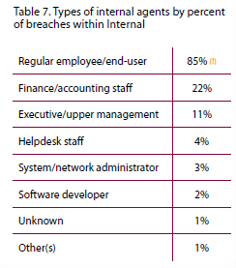
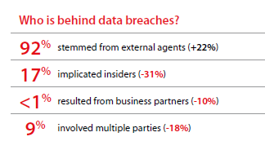
2011 Data on Data Breaches
  Analysis of 7 years, 1700+ breaches, and over 900 million compromised records
Source: 2011 Verizon Data Breach Investigations Report

Slide 13
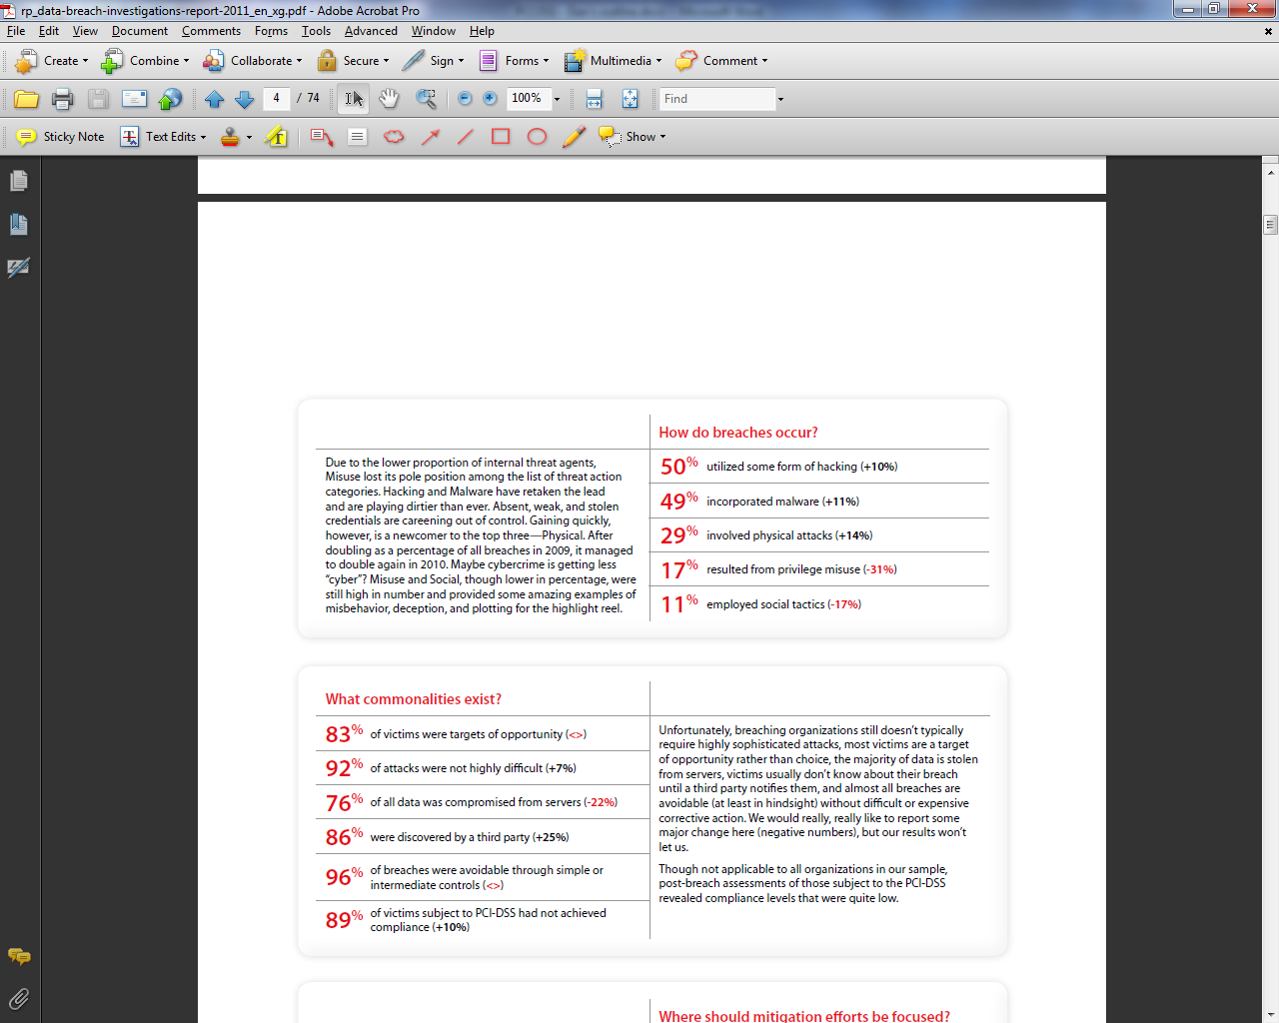
2011 Data on Data Breaches
Source: 2011 Verizon Data Breach Investigations Report

Slide 14
Internal Audits’ Role
PCI DSS: A Tool for Internal Auditors
      Framework to measure effectiveness of which customer information is secured
      Regulatory argument for mitigating risks

Slide 15
Internal Audits’ Role
PCI DSS: A Job for Internal Auditors
  Identify gaps in compliance
  Support creation and implementation of a security program to fill gaps
  Help management prioritize corrective action
  Offer advice and support
      Outstanding gaps
      Issues with requirement interpretation

Slide 16
Internal Audits’ Role
Steps for Internal Audit Department
  Evaluate During Annual Risk Assessment
    Relation to IT Security and Compliance
  Determine Appropriate Approach and Incorporate into Annual Audit Plan
    Formal Audit vs. Consulting Engagement
    In-house vs. External Consultant
      Competency Considerations
    Opportunities for Collaboration
      State Treasury Department

Slide 17
Internal Audits’ Role
Audit Analysis
  Data Flow
    Input, Processing, Output, and Storage
  Business Requirements
    Compliance Feasibility
  Gaps
    Prioritization by Impact
  Solutions
    Collaboration with Management & External Partners

Slide 18
Common Risks & Internal Controls
The overall risk is DATA BREACH
  Reputation
  Legal issues
  Lost revenues, increased costs, administrative headaches… $$$$$$$
  estimated $100 to $300/record breached

Slide 19
Common Risks & Internal Controls
Overall risk is data breach, brought on by:
  Open-ended access (physical & logical)
  Vulnerability
    decentralization
    hardware or software
    poor policies and procedures
  Insufficient monitoring & training

Slide 20
Common Risks & Internal Controls
Implement strong access controls
  Risk: Open-ended access / inadequate access controls leaves PCI data wide-open
  Restrict access to those who need it as part of their job, specific User IDs per user (not just generic or shared “AR Clerk”)
  Logical: robust, mandatory change passwords
  Physical: locked servers, keycard entry, limit access to those that need to as part of job

Slide 21
Common Risks & Internal Controls
Build and maintain a secure network
  Risk: Vulnerability with decentralized operations or unknown interaction
  Network logical access controls
    firewall
    robust passwords
  Network Segregation
    PCI computers vs. non-PCI
  Establish policies for non-Business Affairs PCI collections (mandatory adherence)

Slide 22
Common Risks & Internal Controls
Protect cardholder data
  Risks:
    Outdated or incomplete policies and procedures
    Old, vulnerable hardware
    Manual forms
  Establish & carryout policy to protect & encrypt when transmitting data
  Keep up-to-date on hardware maintenance
  Do away with manual record storage

Slide 23
Common Risks & Internal Controls
Vulnerability management
  Risk: Old, vulnerable software
  Keep up-to-date on virus protection software
  Establish periodic software maintenance plan

Slide 24
Common Risks & Internal Controls
Monitor, monitor, monitor
  Risk: Insufficient monitoring and lack of proper training
  Maintain an IT security policy
  IT function, test physical & logical access, maintenance of anti-virus & patches
  Great controls don’t matter if they aren’t implemented as designed.
  Monitoring needs to be a key function of management.

Slide 25
State of Oregon Approach
Oregon State Government merchant card usage (total merchant card revenue)
  2000 - $125,000,000
  2010 - $572,000,000

Slide 26
State of Oregon Approach
State Agencies’ Responsibility for Securing Sensitive Banking Information
  PCI DSS
  National Automated Clearinghouse Association (NACHA) Rules

Slide 27
State of Oregon Approach
Oregon State Treasury’s (OST) Role
  Ensure state agencies can demonstrate their diligence in protecting the merchant card information entrusted to them.
  Three OST staff are assigned to provide assistance with securing sensitive banking information.

Slide 28
State of Oregon Approach
OST Compliance Program: 2008-2009
  Discovery/Education
  PCI/ACH Surveys (Excel)
    Based on Self Assessment Questionnaires (SAQs) published by the PCI
    Modified PCI Standards for ACH transactions.
  Results Verbally Communicated

Slide 29
State of Oregon Approach
OST Compliance Program: 2010-2011
  New Technology/Education
  Rapid SAQ
    Web-based
    Requirement Specificity
    Information Library
    Evidence Storage
  Results Summarized at a State-wide Level
  Full Compliance Expected, Not Enforced

Slide 30
State of Oregon Approach
OST Compliance Program: 2012
  Continue educating and assisting
  Focus on compliance gaps already identified
  Increased enforcement
    In depth review of supporting documentation
    Non-compliant agencies need to show corrective action plan
    Revocation of merchant ID needed to process transactions – only for extreme non-compliance

Slide 31
State of Oregon Approach
OUS IAD Collaboration
  Consulting Role
    Direct institutions to OST when setting up new credit card functions
    Available to help with policy development
    Resource for questions

Slide 32
State of Oregon Approach
OST Recommendations
  Strong Tone From the Top
  Use Cross Functional Teams
  Simplify Security Requirements
    Similar Control Structure for Data with Similar Risks and Values
  Focus on Improving Key Compliance Gaps Already Identified

Slide 33
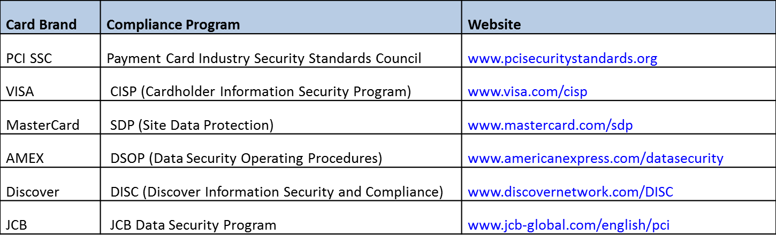
Useful Resources

Slide 34
Questions ?
Oregon University System

