Slide 1
Billing Interface Data Review
Using ACL
PNW Higher Ed Internal Audit Conference
August 11, 2011

Slide 2
Agenda
Background - (deleted – specific audit info)
Objectives – (deleted)
Approach
Challenges/Solutions
Lessons Learned
Results – (deleted)
Questions?

Slide 3
Approach
Standard ACL data analysis cycle:
  Planning
  Data access
  Data integrity verification **
  Data analysis
  Reporting results

Slide 4
Challenges/Solutions
EVN | P03 | 201101272315
PID | 1 | U7777777 | LNAMEX^FNAMEX^
PV1 | 1 | E | 333333^Drlastr^DrFirst^Mi
FT1 | 1 | VL232435 | 201101272315
PR1 | 1 | VL232435 | F
FT1 | 2 | SL193119 | 201101272315
PR1 | 2 | SL193119 | F
Data – obscure formats, i.e. HL7
  Example: (deleted)

Slide 5
Challenges/Solutions, cont’d
  Solution: Requested client convert data files to 1 record per line. Note: ACL AuditExchange has capability to convert HL7.
Excel formatting issues:
  Certain “text” fields populated by Import Wizard as date fields upon loading into ACL. Unable to be modified. Example: “20707” became "07/26/2007“.

Slide 6
Challenges/Solutions, cont’d
  Solution 1: ACL Help Desk suggested loading via ODBC. This partially helped – although more complicated.
  Solution 2: Get text file from client if possible
  Solution 3: “My” fix where Excel was the only option – create “dummy” line at beginning of Excel input file specifying correct format (i.e. xxxxx)

Slide 7
Challenges/Solutions, cont’d
Date/time fields
  ACL does not have date/time data type
  Solution: Import date as date, create separate fields for hours/min/seconds as numeric or text.
Differing field lengths for key fields to be joined
  Example: Cost center sometimes abbreviated to 3 digits (405) from 5 digits (10405)
  Solution: Used “Insert” function, i.e. INSERT (ccenter , "10" , 1 )

Slide 8
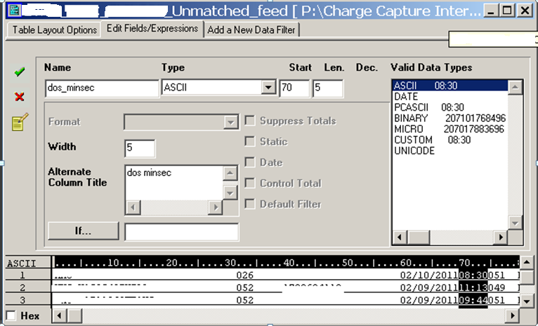
Challenges/Solutions, cont’d

Slide 9
Challenges/Solutions, cont’d
Differing table schemas/layouts
  To ensure successful joins, needed to do “side by side” comparison of layouts for key tables
  Solution: Used “Print Project Contents” feature (under File) to select which tables to print out. Was able to do quick comparison.

Slide 10
Lessons Learned
Data validation is critical at all steps in process!!
  Perform initial review of data after importing to ACL
    Correct data types - Issues with Excel conversion as noted above.
    Extraneous records at beginning, and less obvious, at end of file. Even “blank” lines in Excel can be loaded as a record in ACL if the field had been previously used. Need to delete the line.
    Duplicates – found one file that had been sent to me twice.

Slide 11
Lessons Learned, cont’d
  Validate again after redefining table layouts.
    Example: if you change the start position of a quantity field and are one digit off, this creates a big problem! Need to recheck control totals.
  If you have no control totals to check data, need to be creative – verify with numbers from another source and/or review for reasonableness.
    Example: Discovered a SQL error in data provided by the client when compared data to another report.

Slide 12
Lessons Learned, cont’d
    Example: Ran analysis of the “calculated” charges from one module to determine reasonableness. Analyzed for lines with no charges calculated. Found many lines with zero charges due to the system having no rate tied to a classification issue . This analysis led to the biggest issue discovered during the course of the audit.

Slide 13
Lessons Learned, cont’d
Sometimes the best discoveries are not from the “planned” tests
If something doesn’t make sense, keep asking!
Input and assistance from project sponsors/clients is important
Without data dictionary, specifications, etc. triple the budget!

Slide 14
Questions?

