Slide 1

FY 2012 Audit Risk Assessment
Heather Lopez, Director Internal Audit
August 2011

Slide 2
WSU Stats
  Land grant, public research institution
  Flagship campus – Pullman
  Regional campuses: Vancouver, TriCities, Spokane
  26,300 students
  6,000 employees
  Operating budget:
    $1.6B (biennium)
    $387M from state appropriations
  Endowment: $640M ($1B campaign – 55%)

Slide 3
More WSU Stats
12 Colleges
Distance Education (global)
Vet Hospital, Global Animal Health
WSU Spokane – Health Sciences, future medical
SBDC
39 Extension Offices
7 Ag Research Stations

Slide 4
Impacts
Budget Cuts:
  In four years – 52% state reduction, $231m
  Newest cut: $40m 2011-13
  500 employees cut since 2007
  Tuition increase each yr (14% FY 12)
Initiatives
  Global Animal Health
  Increased international presence
  Everett regional

Slide 5
More Impacts
Risk Survey:
  Low confidence in leadership, ethics, culture
SAO Changes:
  Budget cut – potential zero Accountability hrs (down from 960 FY 10, 1300 FY 09)
  Past plans relied on external audit for broad coverage
Reduction in IA staff

Slide 6
WSU Office of Internal Audit
Director
Audit Manager
Auditor 3
Auditor 2
Two interns (up to 22 hrs/week total)
No IT support/staff
Very limited budget for training, travel, other support

Slide 7
Risk Assessment
Identify Audit Universe (areas, significant units/functions, campuses, projects)
Table areas identified – send survey to management of each area/unit, to include all:
  President, provost
  Chancellors
  Deans, Vice Presidents
  Associate/Assistant Deans, VPs, Chairs, Directors, Finance/Administrative Managers

Slide 8
Survey
Broad, high level
12 questions
  Identify position
  10 questions to identify areas where audit would provide value
  Selections offered, but also, ‘none’, ‘other’ (open-ended) and ‘additional’ choice
Sent Survey Monkey – 270 people
Response rate 42%, 120

Slide 9
Audit Functions/Categories
Governance and Leadership
Instruction/Academic Support
Research and Development
Student Support Services
Human Resource Management
Fiscal/Asset Management
Information Technology
Plant Operations
Auxiliary

Slide 10
Example Question
Information Technology: Select the area or function you feel would most benefit from an internal audit, if any:
  Managing system access
  Network security
  Data security
  Network infrastructure
  User support
  Disaster recovery
  No known significant concerns
  ‘other’ please specify

Slide 11
Survey Responses to Risk Pool
Tabled and Analyzed based on identification (area) of respondent
Categorized and % tables
Responses with over 15% in each category (usually top 3) pulled into pool
Interviews with mgmt (38) included in survey responses
Auditor input included in survey response – audit history, industry concerns, etc

Slide 12
Risk Pool
Pool highlighted 53 top risk/concern areas
Sent to sr. management and Audit Steering Committee for feedback and ranking
  Rank top 5
  Identify for top 5 impact/likelihood

Slide 13
Final Risk Ranking
Weighted responses by rank and occurrence (‘5’ highest)
Weighted impact and likelihood by incremental values and tallied (1-low, 2-medium, 3-high)
Summed all to identify top 15
  Identify resources needed
  Judgmental ID of auditable concerns**
For remaining 15, applied heat mapping
**some issues not easily auditable, but communicated to management as risks/concerns

Slide 14
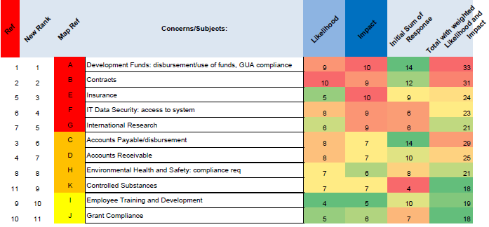
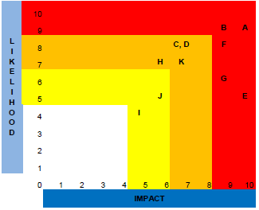
Top 11

Slide 15
Final Plan
7 Assurance Audits
Special Projects
Development Fund
Contracts
Employee Training/Development*
IT Data: Access
Int’l Research
Accounts Payable
Accounts Receivable
IA approach to continued audits
  Pcards
  Time reporting
  Cash receipting
  IT Security: password, retention
Policy/process review: research conflict of interest
Plus, 25% contingency for investigation, consulting, facilitation, liaison

Slide 16
* Change from Ranking
Insurance ranked # 3. Currently being reviewed by Business and AAG – will hold off to determine risk and approach.
Replaced #3 with #10 Training to ensure HRS audit activity – one of three categories with highest number of specific concerns listed, and least number of respondents indicating ‘no known concern’ (other two: IT, Governance)

Slide 17
Next Steps
Define budget within preliminary scope, objective
Audit Plan forwarded to Audit Steering Committee for comment, review
Audit Plan to President and Finance Audit Committee for approval

Slide 18
Last Notes
Supplemental memo submitted to Sr. Leadership as attachment to audit plan noting areas of concern expressed overall as related to culture, environment.
University wide memo sent twice, plus in daily announcements regarding the audit areas to be included in continued audit approach: a ‘heads up’ and be ready
Again identify resources
Schedule staff and timelines
Get auditing!

