Slide 1
FY2021 Annual Review
Process Overview and Updates
Fall 2019

Slide 2
Agenda
Purpose
Goals and Requirements for FY2021 Annual Review Process
Incremental Improvements – Fiscal Vitality (i.e. financial projection) Worksheets
Incremental Improvements – Narrative Response Collection
How to Upload & Submit
FY21 Annual Review Materials website: https://www.washington.edu/opb/uw-budget/annual-budgets/
fy21-annual-review-materials/

Slide 3
Annual Review Cycle Overview
July - October
Template Development
Inform Community
Campus Unit Template Population
OPB 1st Pass Review
OPB Peer Review
Unit Calls w/OPB
OPB 2nd Pass Review
Unit Meetings w/Executive Office
Development of Operating Budget
Final Operating Budget Presentation to Regents
Process Improvement
Plan
April - June
Develop
Analyze
November - March

Slide 4
Purpose
Collect the following from academic units, administrative units and campuses to inform budget discussions with the Executive Office:
Consolidated unit-level financial forecasts (3-digit org) for FY20-23, by fund type grouping
Commitments and intended uses of carryover
Academic/programmatic “vitality”
Fiscal “vitality”
Staff, Faculty/Librarian and Student anticipated growth/contraction/retention information
Tuition rate proposals (graduate/professional) programs

Slide 5
FY21 Annual Review Process Goals
Once again, focus on incremental improvements, such as the addition of formulas, new reference tools, locking cells for data consistency, etc.
Capture unit level forecasts, by fund, from FY20-FY23
Employ a timeline that is similar to last year
Collect supplementary detail regarding unit level commitments of carryover (GOF/DOF)
Collect additional information in the following areas:
  Undergraduate enrollment capacity planning
  Fiscal exigency planning
  Status of business, academic and research continuity plans (BARC)

Slide 6
Undergraduate Enrollment Capacity Planning Questions
  Purpose: Gather general information from academic units to inform institutional undergraduate enrollment capacity planning efforts. Three questions – program capacity, teaching load policy and strategic enrollment plans.
  Program Capacity (i.e. as measured by major enrollments and/or degree production)
  Word Limit: 250
    What programs are at or close to capacity without additional space or supplemental resources?
    What programs are at or close to capacity based on demand and program quality (i.e., we don’t see enough demand to increase or an increase in the size would negatively impact quality)?
    Do you have programs with declining enrollments or declining demand that you feel will continue in the next 3-5 years (2021-2025)?
    If yes, which ones and at what rate (i.e. “our Mechanical Engineering program has seen a 10% decline in enrollments (or activity) over the past three years”)?

Slide 7
Undergraduate Enrollment Capacity Planning Questions
  Faculty Teaching Load:
  Word Limit: 250
    Does your unit have a faculty workload policy or practice for its tenured/tenure track faculty and multi-year appointment lecturers that includes expectations for course load?
    If so, please provide details (e.g., the number of course sections taught).
  Strategic Enrollment Plans: Please share your optimal 3-5 year strategic enrollment plan for your undergraduate programs. Specifically address the following:
  Word Limit: 500
    Areas for growth
    Areas for contraction
    Opportunities for Interdisciplinary programs or collaboration within or across schools/colleges
    Space and Resource Considerations

Slide 8
Business Continuity and Fiscal Exigency Planning Questions
  Purpose: Gather a high level overview of unit level business/academic planning for a disruption in the UW’s ability to conduct “business as usual” or experience a sudden, material, decline in its revenue base.
  How would your unit respond to a 5% decrease in overall budget authority (GOF/DOF) and revenue (all other funds)?
  Word Limit: 500
  Please describe the status of your unit/campus’s business, academic, and research continuity (BARC) plan, as loaded into the Husky Ready system.
  Word Limit: 250

Slide 9
Fiscal Vitality Template Revisions
Incremental Changes
GOF and Special State Appropriations Tabs
  Added a calculated “Foregone Proviso Funds” line to reflect the impact of unused proviso funds remaining at the end of BI17-19
Grants & Contracts – Other Tab
  Allows for entry of revenues falling short of, or exceeding, expenditures for the population of grants and contracts covered within this section that are not cost reimbursable
Carryover Uses and Commitments Tab
  Reconfigured display to allow for the detailing of carryover commitments, by type and fiscal year
  Formulas pull in beginning GOF/DOF balances, by fiscal year, driven off of unit data inputs to the GOF & DOF tabs
  Responsive to the Provost’s desire to better understand how carryover
  is committed

Slide 10
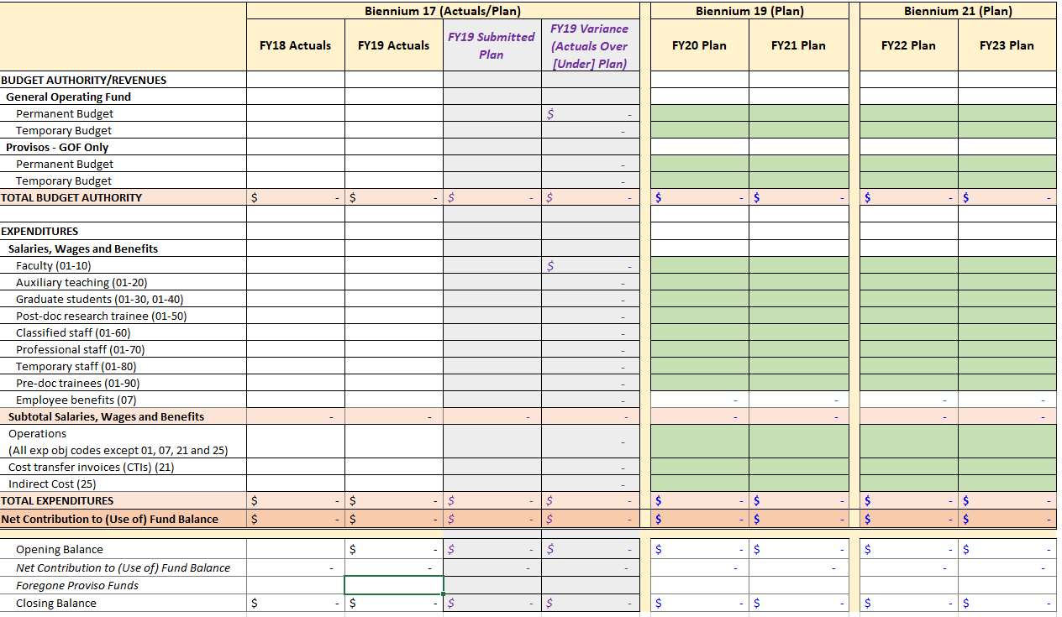
Fiscal Vitality Template Revisions
General Operating Fund
10

Slide 11
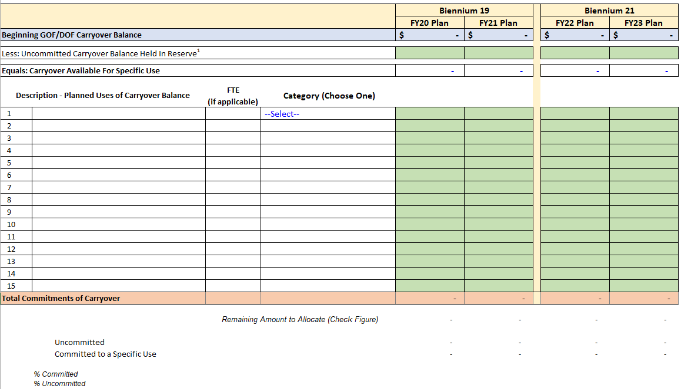
Fiscal Vitality Template Revisions
Carryover Uses and Commitments

Slide 12
Annual Review Narrative Response
Incremental Changes
Moved text heavy questions out of the “online survey” and into a Word template
  Intended to eliminate the extensive “copy/paste” exercise that occurred last year
Many “core” questions are the same as last year, with the option to respond “no changes” if last year’s response is still accurate and applicable.
Quantitative, non-financial, data points will be collected within the online submission portal

Slide 13
Annual Review Narrative Response
Collection Methodology Update
Collected via Word Template* | Collected Online**
Programmatic & Academic Vitality Narratives | Staff FTE Growth or Contraction (yes/no)
Fiscal Vitality Narratives | Net Faculty/Librarian FTE Growth or Contraction, by Fiscal Year (numeric)
Tuition Rate Recommendation Narratives | Brief comment on Faculty/Librarian Net Growth or Contraction, by Fiscal Year (short text)
Staff recruitment/retention challenges & mitigation efforts/plans | Grad. Student FTE Growth or Contraction, by tuition group & fiscal year (numeric)
Faculty recruitment/retention challenges & mitigation efforts/plans | New Tuition Category Requests (short text)
Confirmation of Communication with Stakeholders | Existing Tuition Category Rate Change Recommendations (checkbox)
 | Modifications to Central Planning Assumptions (checkbox & short text)
* Completed in Word Template & Uploaded to Online Submission Portal
** Completed as part of your Annual Review Online Submission
Required for Academic Units, or, where applicable, Administrative Units with Faculty or Librarians Only

Slide 14
Annual Review Submission Requirements
Submission Requirements
What to Submit | Format | Required For | When To Submit | How to Submit
Completed Fiscal Vitality Reports | Excel Template | All Units | Monday, February 3, 2020 | Upload to the “Annual Review Submission Portal” available on OPB’s website Completion of several yes/no, check box or short answer fields within the submission portal is required.
Completed Annual Review Narrative Responses | Word Template | All Units
Tuition Based Program Rate Recommendations | Excel Template | Units with Tuition Based Programs

Slide 15
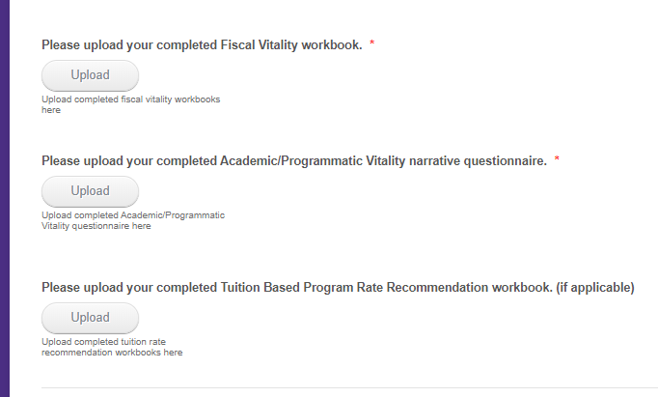
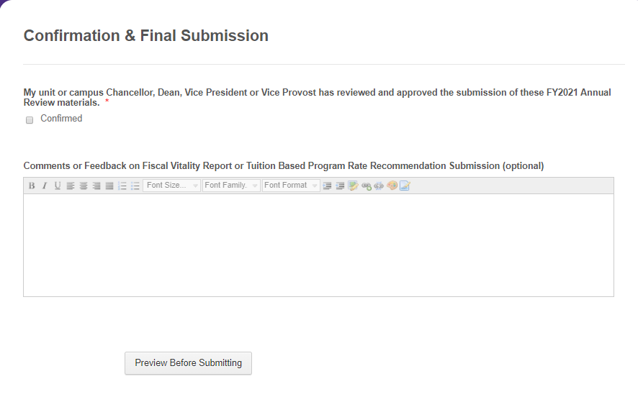
How to Upload and Submit

Slide 16
Questions?

