Slide 1
Adaptive
Office Hours
January 22, 2026

Slide 2
Agenda
Update 80010 ILP and 80500 Debt Principal Payments
Depreciation
Capital Outlays – Trackable vs non Trackable
Questions?

Slide 3
Debt
Conducted some research over the week
80500 and 80010 budgeted in Sheet 6 should be removed once they are loaded to prevent doubling
To simplify and make more accurate, BPO will load Treasury provided principal and interest in the next week.
Treasury numbers will show in reports
80500 will offset to 0 at the CC level but remain visible by CC and RS reflecting Actuals
80010 will continue to appear reflecting Actuals

Slide 4
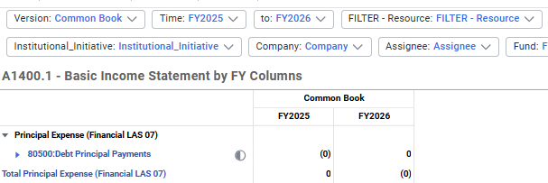
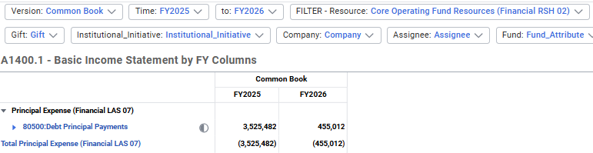
Debt

Slide 5
Depreciation
63015/63020 – Depreciation (unit entered and centrally provided) now shows in reports at the Enterprise level (EFO)
Does not show at the Unit level reflecting actuals
Question – do planners know when capital outlays are trackable vs non trackable?
Do you use the $ amount, or some other criteria combined with $?

Slide 6
Questions?

