Slide 1
Adaptive
Office Hours
January 29, 2026

Slide 2
Agenda
Union Increases
Data Quality Review
Questions?

Slide 3
Union Increases
Working with HR Compensation
BPO has never had good visibility over Bargaining Unit Agreements
Goal is a report that we can load into Adaptive

Slide 4

Data Quality
Data Validations
UW Connect Data Validations for Adaptive
Ledgers align with Resource

Slide 5
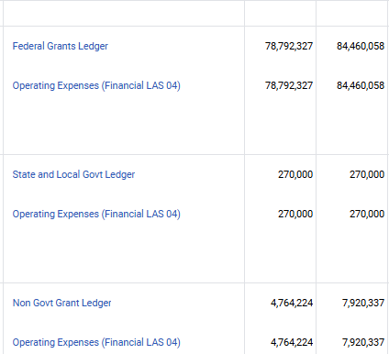
Data Quality
Grant Revenue = Grant Expense

Slide 6
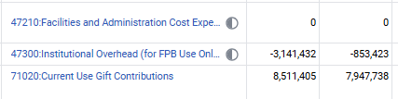
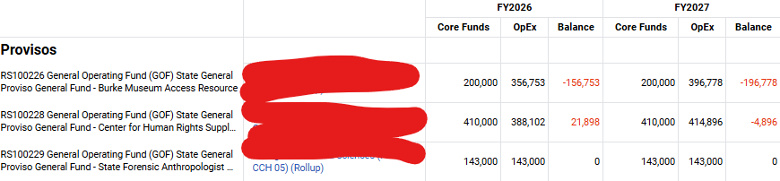
Data Quality
F&A, IOH and Gift Assessment entered
Annual provisos net to zero

Slide 7
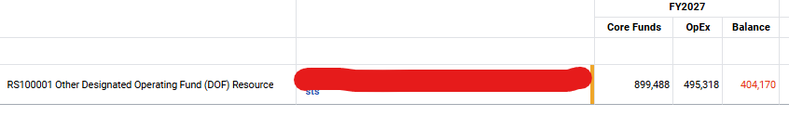
Data Quality
Fixed Cost Expenses = Fixed Cost Revenues
Did unit use wrong ledgers? (e.g., Budget no actuals, actuals no budget, 87000 vs 73070)
Executive Dashboard
UWA Core Fund Distributions Dashboard

Slide 8
Questions?

