Slide 1
Adaptive
Office Hours
February 5, 2026

Slide 2
Agenda
HCM Personnel Updates
Offer to pre-review budgets
Use of Dashboards
Questions?

Slide 3
HCM Personnel Updates
Today will be last update for this budget cycle
Next update would be on the 19th but this is too close to budget close

Slide 4
Budget Pre-review
If your unit is interested in a data quality review prior to Feb 23
Email fpb-bpo@uw.edu

Slide 5
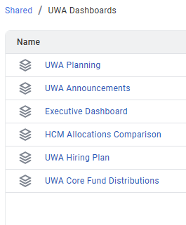
Dashboards
Quick Reminder to use Dashboards for checking results

Slide 6
Questions?

